Slide 1


xAI-Drop: Don’t Use What You Cannot Explain
Vincenzo Marco De Luca[1], Antonio Longa[1], Pietro Liò[2], Andrea Passerini[1]
[1] University of Trento, [2] University of Cambridge

Slide 2


Who I am
Vincenzo Marco De Luca, 1st year PhD student
University of Trento
Involved in Tango Horizon EU and FAIR project
Graph Neural Networks for Human-Centric AI
Automated Team Analysis

Slide 3
Index
Motivation
2. Dropping in GNNs
3. xAI-Drop
4. Results
5. Further considerations

Slide 4
Motivation
Why do we need to Drop?
Reduce generalization error
2. Attenuate oversmoothing
3. Ensemble effect
4. Augment data

Slide 5
Dropping in Graph Neural Networks
Random strategies
Fang, Taoran, et al. "Dropmessage: Unifying random dropping for graph neural networks." Proceedings of the AAAI Conference on Artificial Intelligence. Vol. 37. No. 4. 2023.

Slide 6
Dropping in Graph Neural Networks
Random strategies
Pros
Cons
Efficient
Reduce generalization error
Mitigates oversmoothing
No guidance

Slide 7
Dropping in Graph Neural Networks
Parametric strategies

Slide 8
Dropping in Graph Neural Networks
Parametric strategies
Pros
Cons
Reduces Generalization error
Mitigates Oversmoothing
Time consuming
Many parameters to learn

Slide 9
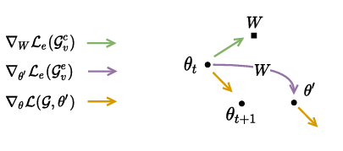
Dropping in Graph Neural Networks
xAI-Guided strategies
EXPASS
MATE
ENGAGE

Slide 10
Dropping in Graph Neural Networks
xAI-Guided strategies
EXPASS
MATE
ENGAGE
Pros
Cons
Reduces Generalization error
EXPASS mitigates oversmoothing
MATE enhances explanation quality
All of them are time consuming
ENGAGE requires a lot of parameters

Slide 11
Dropping in Graph Neural Networks
What to discard?
Can we define a principled manner to decide which information should be
discarded during training?

Slide 12
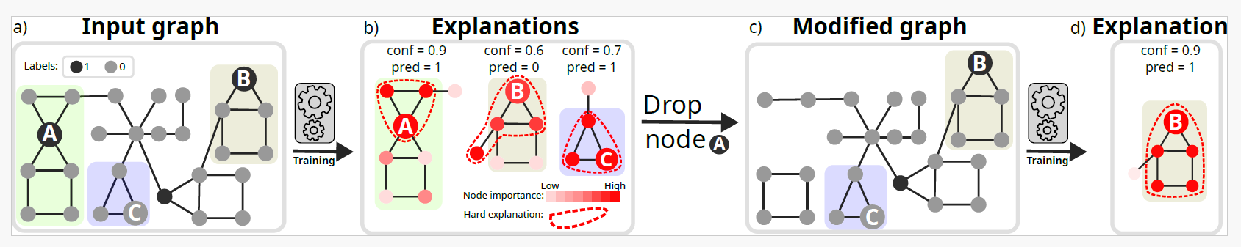
xAI-Drop
Intuition
Given a transductive binary node classification task

Slide 13
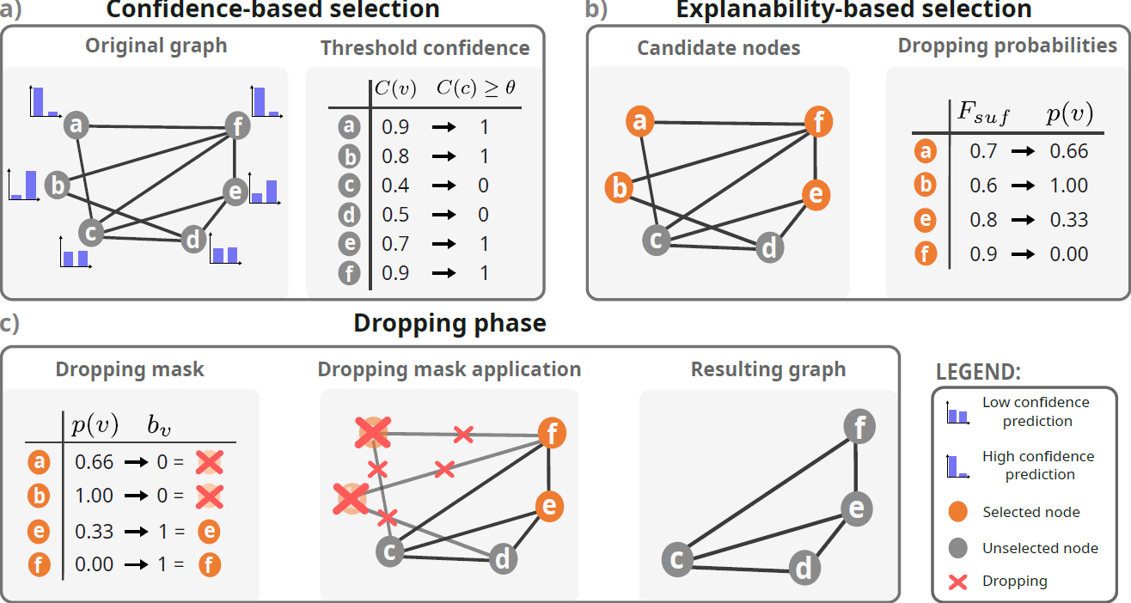
xAI-Drop
High-Level view

Slide 14
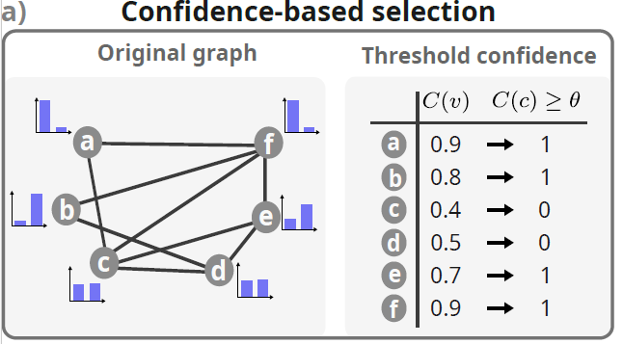
xAI-Drop
Step 1 - Subsampling over-confident nodes
1 - Assess confidence of all the nodes (transductive setting)

Slide 15
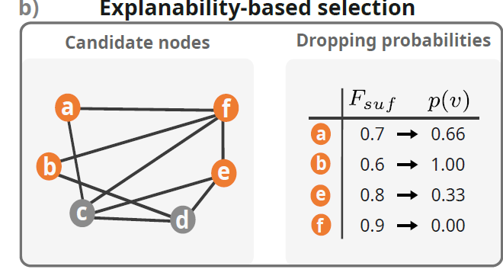

xAI-Drop
Step 2 - From xAI-scores to Dropping probabilities
2.1- Generate explanation for the over-confident nodes

Slide 16

xAI-Drop
Step 2 - From xAI-scores to Dropping probabilities
2.2 - Assess explanation via KL-Sufficiency

Slide 17

xAI-Drop
Step 2 - From xAI-scores to Dropping probabilities
2.3- Cast explanation scores into probabilities (e.g. Box-Cox transformation)
Please refer to Appendix L (Table 9) in the paper for additional ablations about hyperparameters

Slide 18
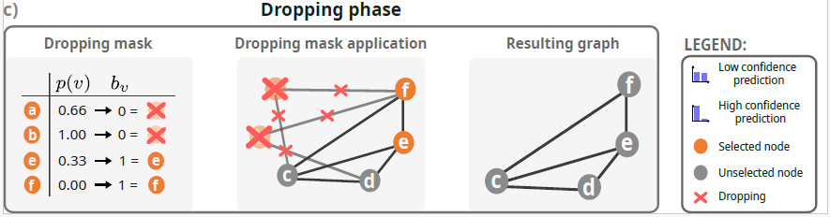

xAI-Drop
Step 3 - Dropping
3- Bias dropping probability of over-confident nodes
while leaving unaltered the dropping probability of the other nodes

Slide 19
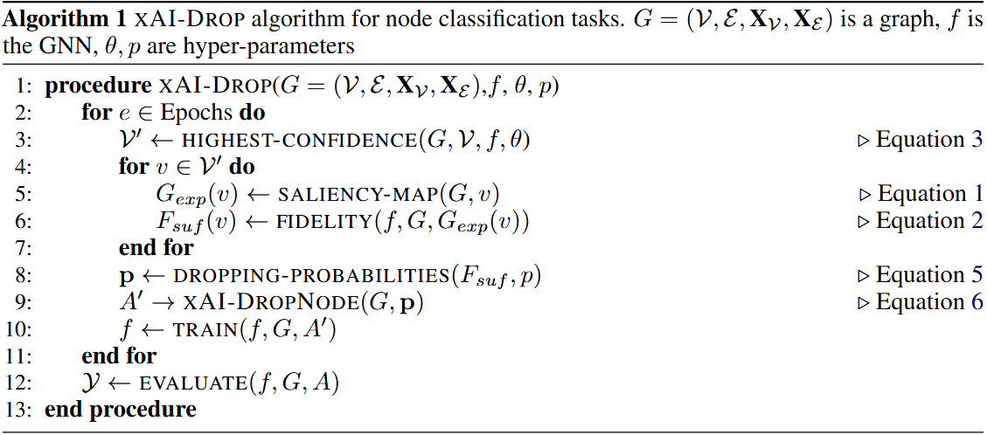

xAI-Drop
The Algorithm
Please refer to Appendix F (Figure 6 and Figure 7) in the paper for detailed discussion about hyperparameters

Slide 20
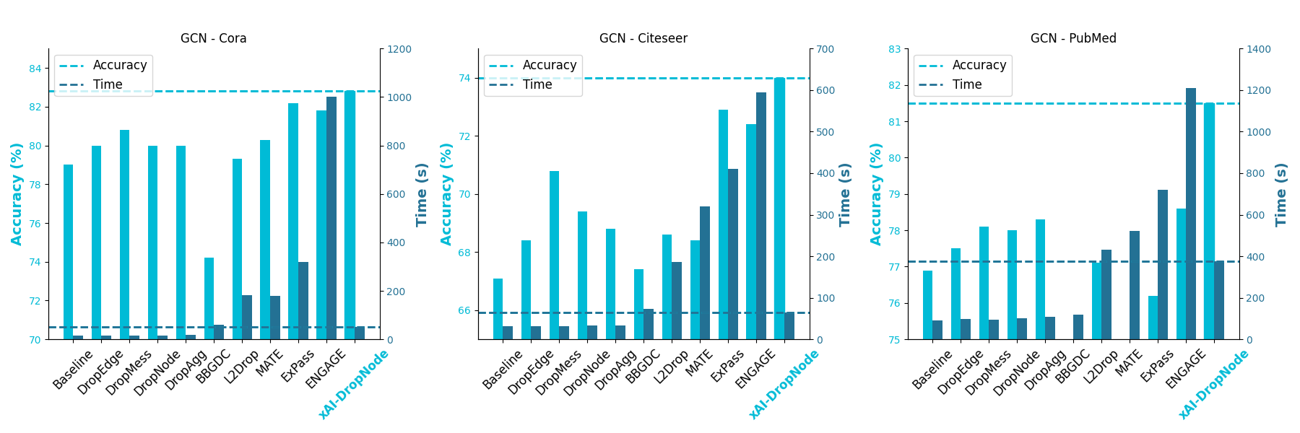
Results
Accuracy and Time complexity
Please refer to Table 1,4,5, and 8 in the paper for additional architectures, complexity analyses and datasets

Slide 21
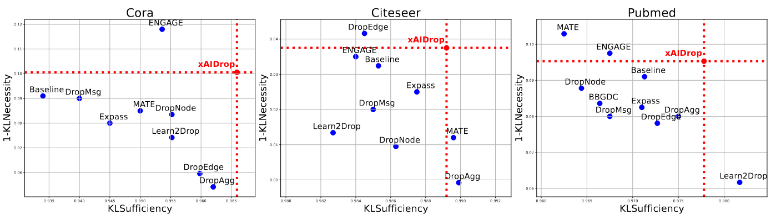

Results
Explanation quality
KL-sufficiency
KL-necessity
Please refer to Table 2 in the paper for additional metrics, architectures, and datasets

Slide 22
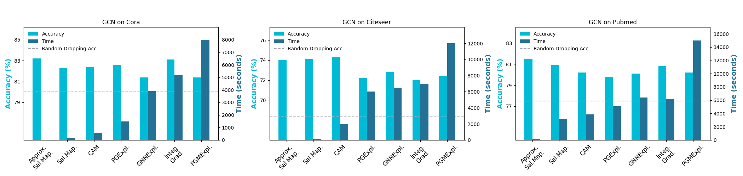
Results
xAI-Drop as a general framework: Across Explainers
Please refer to Appendix C in the paper for additional details about Saliency Map

Slide 23
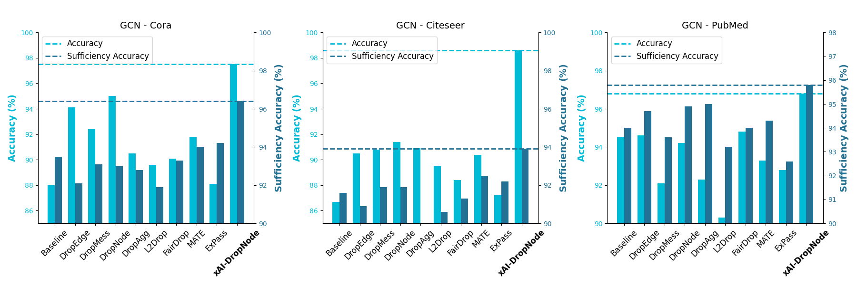

Results
xAI-Drop as a general framework: Across Tasks
Sufficiency Accuracy
Please refer to Table 3, and 4 in the paper for additional datasets, and architectures

Slide 24
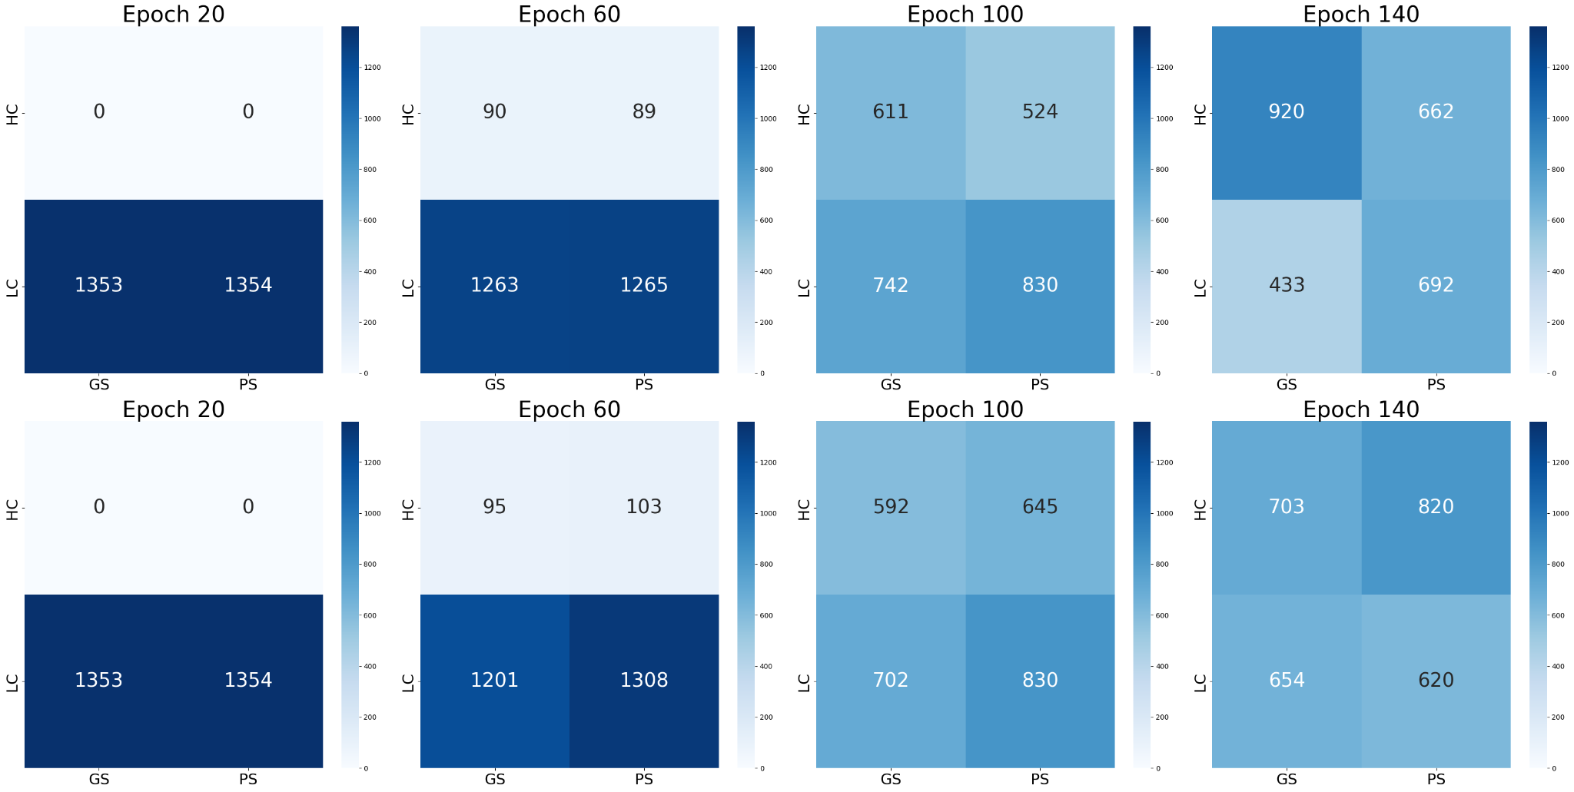
Further consideration
Why does xAI-Drop outperform competitors?
xAI-Drop
DropNode
Please refer to Appendix F (Figure 7 and 8) in the paper for additional ablations about hyperparameters

Slide 25
Further consideration
Is xAI-Drop just a starting point?
Can the combination of confidence and explainability
have additional applications?

Slide 26
Thank you for the attention

