Slide 1
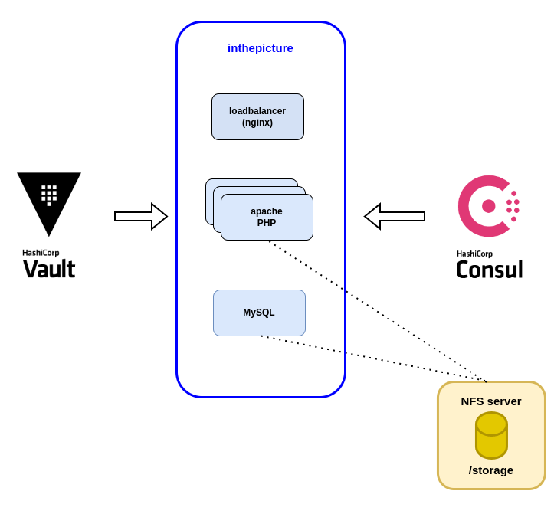
InthePicture
Requirements:
  Scalable
  High available
  Stateful

Slide 2
Nomad - Storage
In the past
  Nomad ephemeral_disks
  Nomad host_volume
  Docker volumes
Storage plugins
  Managed dynamically (Third party plugins → CSI specification)
  Created dynamically like Nomad jobs
  Nomad scheduler is aware of volumes created by plugins
  Requires privileged containers
  Types
    Controller plugins → create volume
    Node plugins → create bind mount on each client node

Slide 3
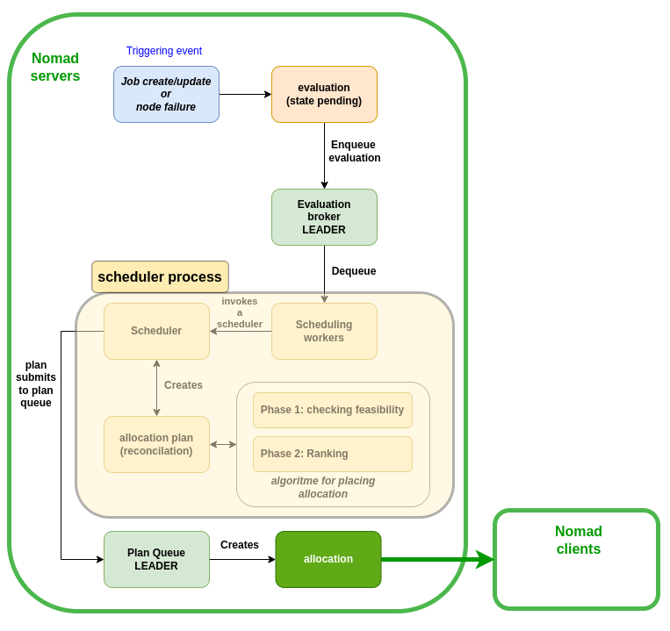
Nomad - Scheduling
Core function of Nomad
  Assigning tasks from jobs to clients
Types of schedulers
  Batch
  Service
  System
  System batch

Slide 4
Nomad – Terminology (1)
Job
  Declared workload
Task group
  Part of a job
  Contains a set of tasks
Task
  Smallest unit of work
  Scheduled by Nomad server
  Scheduled on and executed by a Nomad client
Driver
  Execute tasks and provides resource allocation

Slide 5
Nomad – Terminology (2)
Allocation
  Mapping between task group and client node
  managed by Nomad server
Evaluation
  Created when desired state or actual state changes
  Managed by Nomad server
Deployment
  Triggered by job creation or update
  Useful when working with update strategies
    Canary (temporarily mix of new and old versions)
    blue/green (temporarily run same environment twice.
one with old version and another with the new version).

