Slide 1
Bluestock
Fintech
CAPSTONE PROJECT · JUNE 2026
MUTUAL FUND / FINTECH · DATA ENGINEERING
Mutual Fund Analytics Platform
An end-to-end pipeline that turns raw AMFI market data into a structured database, exploratory insight, and advanced risk analytics.
Vindhya D
40
10
87K+
4.5 yr
Data Analyst Intern · Bluestock Fintech
SCHEMES
DATASETS
ROWS
NAV HISTORY

Slide 2
01
PROJECT OVERVIEW
An analytics platform built from raw market data to investor insight
The project ingests public mutual-fund data and carries it through a complete analytics lifecycle — cleaning, modelling, exploration, and advanced quant analysis — for 40 schemes across Equity, Debt and Hybrid categories.
01
02
03
04
Engineer
Explore
Measure
Advise
A repeatable ETL pipeline cleans 10 raw datasets and loads them into a structured database.
EDA notebooks surface market trends, AUM concentration, SIP growth and correlations.
Risk-adjusted performance metrics rank every fund on a composite scorecard.
Advanced analytics add Value-at-Risk, cohort retention and a fund recommender.
Bluestock MF Analytics
github.com/Vindhya1110/mutual-fund-dashboard

Slide 3
02
THE DATASET
Real, public market data — 40 schemes over four-plus years
10
87K+
46K
6
SOURCE DATASETS
TRANSACTION & NAV ROWS
DAILY NAV RECORDS
LIVE API SCHEMES
CORE TABLES
SOURCES
01 fund_master
02 nav_history
03 aum_by_fund_house
AMFI India — official scheme & NAV master data
04 monthly_sip_inflows
05 category_inflows
06 industry_folio_count
mfapi.in REST API — live historical NAV for 6 large-cap schemes
07 scheme_performance
08 investor_transactions
09 portfolio_holdings
NSE / BSE — NIFTY 50/100/500 & CRISIL benchmark indices
10 benchmark_indices
Public data, educational use only — investments are subject to market risk.
Bluestock MF Analytics
Data: AMFI · mfapi.in · NSE / BSE

Slide 4
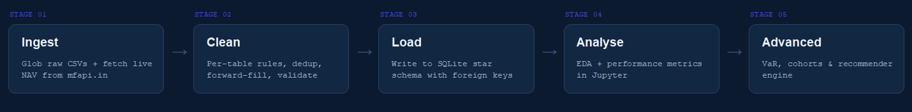
03
SYSTEM ARCHITECTURE
One pipeline, five stages, end to end
A single entry point — python scripts/etl_pipeline.py — chains ingest → clean → load in one command.
etl_pipeline.py · pathlib · logging

Slide 5
04
D1 · ETL PIPELINE
Ingest, clean and load — isolated and repeatable
KEY DESIGN DECISIONS
No hard-coded paths — pathlib.Path throughout; repo root auto-detected.
# scripts/etl_pipeline.py def ingest_raw(raw_dir): # glob + normalise cols def basic_clean(tables): # trim, drop empties def load_sqlite(processed): # write fact/dim tables def main(): # detect root, run all $ python scripts/etl_pipeline.py
Weekend NAV handling — resample('D').ffill() fills holiday gaps after dedup.
Error isolation — per-file try / except so one bad CSV never aborts the run.
Full logging — every file load and write recorded at INFO level.
Bluestock MF Analytics
data_ingestion.py · data_cleaning.py · etl_pipeline.py

Slide 6
05
D2 · DATABASE
A SQLite star schema — two dimensions, four facts
SCHEMA
10 ANALYTICAL QUERIES
Top 5 fund houses by total AUM
DIMENSION
DIMENSION
dim_fund
dim_date
SIP year-on-year growth (LAG window fn)
Fund master — 14 columns, amfi_code primary key
Calendar — day, month, quarter, year, weekend flag
Transaction volume & amount by state
Top 5 funds by 1-year return
FACT
FACT
Redemption-vs-SIP ratio & KYC breakdown
fact_nav
fact_transactions
Daily NAV · CHECK(nav > 0)
SIP / Lumpsum / Redemption by state
FACT
FACT
fact_performance
fact_aum
Returns, Sharpe, alpha, beta, drawdown
AUM by fund house, units in column names
Every fact table carries a foreign key to dim_fund.amfi_code — referential integrity enforced in the schema.
Bluestock MF Analytics
schema.sql · load_db.py · queries.sql

Slide 7
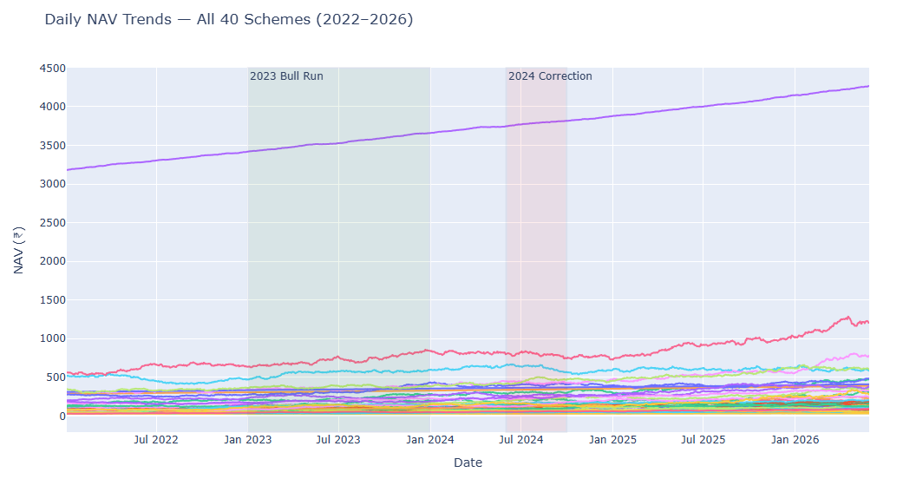
06
D3 · EXPLORATORY DATA ANALYSIS
Eleven charts, one market story
HEADLINE FINDINGS
SBI manages ₹12.5L Cr+ AUM — nearly 2× the next AMC; top-5 hold ~65% of industry assets.
SIP inflows crossed ₹20,000 Cr in 2024; active accounts grew 4.9 → 7.4 Cr in three years.
Large-caps move together (r > 0.85); small-cap–debt correlation near zero confirms diversification.
Financials 24%, IT 18% dominate equity holdings; industry folios near 20 Cr.
chart_placeholder · 01_nav_trends.html — drop notebook screenshot
Bluestock MF Analytics
EDA_Analysis.ipynb · 11 charts (Plotly + Matplotlib)

Slide 8
07
D4 · PERFORMANCE ANALYSIS
Risk-adjusted metrics from daily NAV returns
Seven metrics computed for all 40 funds — risk-free proxy 6.5% p.a. (RBI repo), benchmark NIFTY 100, annualised over 252 trading days.
CAGR
Sharpe
Sortino
Trading-day compounded annual growth — (252 / n)^ exponent.
Excess return per unit of total volatility, ×√252.
Like Sharpe, but penalises downside deviation only.
Alpha & Beta
Max Drawdown
Tracking Error
OLS regression of fund vs NIFTY 100 returns.
Largest peak-to-trough fall in NAV.
Std of fund-minus-benchmark return, annualised.
Bluestock MF Analytics
Performance_Analysis.ipynb → fund_scorecard · alpha_beta · tracking_error

Slide 9
08
FUND SCORECARD
Top performers by composite score
Composite weighting — Sharpe 40% · CAGR 25% · Alpha 20% · Drawdown 10% · Expense 5%.
#
SCHEME
CAGR 3Y
SHARPE
MAX DD
SCORE
1
Mirae Asset Large Cap — Regular
34.00%
1.45
−11.3%
88.9
2
ICICI Pru Bluechip — Direct
32.49%
1.03
−12.6%
82.0
3
ICICI Pru Midcap — Regular
31.78%
1.18
−18.2%
80.5
4
Kotak Flexicap — Regular
29.58%
1.31
−13.0%
79.2
5
HDFC Mid-Cap Opportunities — Regular
32.44%
1.09
−16.2%
78.1
Bluestock MF Analytics
fund_scorecard.csv

Slide 10
09
RISK ANALYSIS
Value-at-Risk — where the tail risk lives
Historical-simulation VaR & Conditional VaR at 95% / 99% confidence. VaR 99% = −3.5% means a 1% chance of losing more than 3.5% on any trading day.
HIGHEST RISK — SMALL-CAP EQUITY
LOWEST RISK — LIQUID DEBT
SCHEME
VAR 95
VAR 99
CVAR 99
SCHEME
VAR 95
VAR 99
CVAR 99
ABSL Small Cap
−2.60%
−3.71%
−4.21%
ABSL Liquid
−0.03%
−0.05%
−0.06%
DSP Small Cap
−2.35%
−3.68%
−4.08%
ICICI Pru Liquid
−0.02%
−0.05%
−0.06%
SBI Small Cap
−2.69%
−3.61%
−4.00%
Kotak Liquid
−0.03%
−0.05%
−0.06%
Bluestock MF Analytics
var_analysis.csv · historical simulation

Slide 11
10
D6 · ADVANCED ANALYTICS
Three quant modules beyond the basics
01
02
03
Value at Risk
Cohort Retention
Fund Recommender
Historical VaR & Expected Shortfall at 95% / 99% for all 40 funds — small-caps −3.7%, liquid debt −0.05%.
5,000 investors, 17 monthly cohorts. ~25% month-1 retention reveals high early churn; Jan-2024 cohort holds 34–36%.
Rule-based scorer ranks funds on Sharpe, CAGR, drawdown & expense across three investor risk profiles.
Bluestock MF Analytics
05_advanced_analytics.ipynb

Slide 12
11
FUND RECOMMENDER
Tailored picks for every risk appetite
A rule-based scorer ranks every fund on Sharpe, CAGR, drawdown and expense — then re-weights the blend for each investor risk profile.
CONSERVATIVE · WEIGHTED TOWARD STABILITY
AGGRESSIVE · WEIGHTED TOWARD GROWTH
#
SCHEME
CAGR
SHARPE
SCORE
#
SCHEME
CAGR
SHARPE
SCORE
1
Mirae Asset Large Cap
34.0%
1.45
0.931
1
Mirae Asset Large Cap
34.0%
1.45
0.964
2
Kotak Flexicap
29.6%
1.31
0.872
2
Axis Midcap
35.1%
1.00
0.901
3
SBI Bluechip
30.5%
1.21
0.842
3
HDFC Mid-Cap Opportunities
32.4%
1.09
0.888
Bluestock MF Analytics
Three risk profiles: Low · Medium · High

Slide 13
12
TECH STACK & ENGINEERING
Built with a production engineering mindset
TOOLCHAIN
Python 3.11+
pandas · numpy
scipy
matplotlib · seaborn · plotly
SQLite 3
JupyterLab
mfapi.in REST
Reproducible
Resilient
Validated
Documented
pathlib paths, no hard-coded locations, single-command run.
Per-file error isolation and INFO-level logging throughout.
Range checks, anomaly flags and CHECK / FK constraints in SQL.
Data dictionary, quality summary and a full project report.
Bluestock MF Analytics
requirements.txt · pip

Slide 14
13
STATUS & ROADMAP
Delivered, and what comes next
✓ COMPLETED
→ NEXT UP
D1 — ETL pipeline (ingest → clean → load)
D5 — Power BI dashboard, 4 pages with slicers
D2 — SQLite star schema + 10 queries
D7 — Final PDF report & presentation
D3 — Exploratory analysis, 11 charts
Bonus — scheduled cron ETL & Streamlit app
D4 — Performance scorecard & metrics
Bonus — Monte Carlo & Markowitz frontier
D6 — VaR, cohorts & recommender
Bluestock MF Analytics
Known issues & pending work tracked in docs

Slide 15
Bluestock
Fintech
CAPSTONE PROJECT · 2026
FROM RAW DATA TO INVESTOR INSIGHT
Thank you.
A complete, reproducible analytics platform — engineered, explored, measured and ready to advise.
Vindhya D
github.com/Vindhya1110/mutual-fund-dashboard
Data Analyst Intern · Bluestock Fintech
Python · SQL · Jupyter · Power BI

