Slide 1
The Impact of National Science Foundation (NSF) Funding on Academic Output of Scholars
Scrapers
Team Members:
Guankun Li : guankun@uchicago.edu
Jiazheng Li : jiazheng123@uchicago.edu
Tianyue Cong : tianyuec@uchicago.edu
Weiwu Yan : weiwuyan@uchicago.edu
GitHub: https://github.com/macs30122-winter24/final-project-scrapers.git
MACS 30122

Slide 2
Background
MACS 30122

Slide 3
Research Question
MACS 30122

Slide 4
Hypothesis
MACS 30122

Slide 5
Data
MACS 30122

Slide 6
Data
Table 1: Summary Statistics
VarName | Obs | Mean | SD | Min | Median | Max
year | 20640 | 2015.5 | 2.872 | 2011 | 2015 | 2020
award_amount | 20640 | 1.30e+05 | 2.70e+05 | 0 | 0 | 3.24e+06
laward | 20640 | 5.280 | 5.974 | 0 | 0 | 14.990
award_dummy | 20640 | 0.444 | 0.497 | 0 | 0 | 1
total_citations | 20640 | 8797.634 | 17447.221 | 1 | 3902.5 | 3.62e+05
h_index | 20640 | 33.613 | 22.731 | 1 | 29 | 192
citation | 20113 | 476.106 | 965.345 | 1 | 210 | 24631
pub_num | 20640 | 5.472 | 10.209 | 0 | 4 | 1129
top_cited | 20004 | 84.654 | 305.650 | 0 | 33 | 22244
MACS 30122

Slide 7
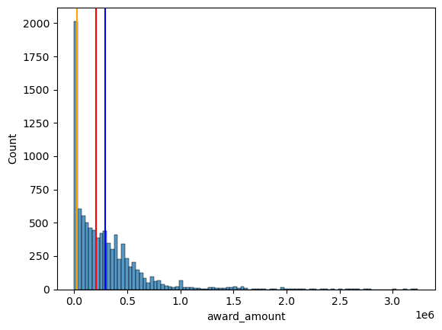
Data
MACS 30122

Slide 8
Methodology
MACS 30122

Slide 9
Result
Table 2: Baseline Regression
 | (1) | (2) | (3) | (4)
 | pub_num | top_cited | pub_num | top_cited
laward | 0.0909*** | -1.689***
 | (0.00997) | (0.413)
h_index | 0.143*** | 0.258 | 0.144*** | 0.252
 | (0.00565) | (1.106) | (0.00564) | (1.106)
citation | 0.000522*** | 0.104** | 0.000522*** | 0.104**
 | (0.000185) | (0.0405) | (0.000184) | (0.0405)
award_dummy |  |  | 1.086*** | -20.18***
 |  |  | (0.149) | (4.646)
_cons | -0.0455 | 36.09* | -0.0590 | 36.33*
 | (0.136) | (20.87) | (0.125) | (20.90)
N | 20113 | 19511 | 20113 | 19511
R² | 0.129 | 0.118 | 0.129 | 0.118
adj. R² | 0.128 | 0.118 | 0.128 | 0.118
Standard errors in parentheses * p < 0.1, ** p < 0.05, *** p < 0.01
MACS 30122

Slide 10
Result
Table 3: Regression Panel Data
 | (1) | (2) | (3) | (4)
 | pub_num | top_cited | pub_num | top_cited
laward | 0.0961*** | -0.0108
 | (0.0126) | (0.377)
h_index | 0.142*** | -0.0970 | 0.142*** | -0.0951
 | (0.00599) | (1.129) | (0.00599) | (1.129)
citation | 0.000558*** | 0.114*** | 0.000555*** | 0.114***
 | (0.000187) | (0.0410) | (0.000187) | (0.0410)
award_dummy |  |  | 1.135*** | -1.280
 |  |  | (0.183) | (4.143)
year | controlled | controlled | controlled | controlled
_cons | -0.113 | 83.94*** | -0.134 | 84.00***
 | (0.183) | (27.70) | (0.181) | (27.70)
N | 20113 | 19511 | 20113 | 19511
R² | 0.130 | 0.132 | 0.129 | 0.132
adj. R² | 0.129 | 0.131 | 0.129 | 0.131
Standard errors in parentheses * p < 0.1, ** p < 0.05, *** p < 0.01
MACS 30122

Slide 11
Result
Table 4: Panel with Subfield_1 Controlled
 | (1) | (2) | (3) | (4)
 | pub_num | top_cited | pub_num | top_cited
laward | 0.102*** | 0.176
 | (0.0135) | (0.379)
h_index | 0.146*** | 1.388*** | 0.146*** | 1.390***
 | (0.00733) | (0.459) | (0.00737) | (0.458)
citation | 0.000170 | 0.0576*** | 0.000172 | 0.0576***
 | (0.000222) | (0.0191) | (0.000223) | (0.0191)
award_dummy |  |  | 1.206*** | 0.755
 |  |  | (0.196) | (4.084)
year | controlled | controlled | controlled | controlled
subfield_1 | controlled | controlled | controlled | controlled
_cons | -0.451** | 39.85*** | -0.483** | 39.90***
 | (0.194) | (11.42) | (0.192) | (11.38)
N | 18972 | 18405 | 18972 | 18405
R² | 0.118 | 0.088 | 0.118 | 0.088
adj. R² | 0.117 | 0.087 | 0.117 | 0.087
Standard errors in parentheses * p < 0.1, ** p < 0.05, *** p < 0.01
MACS 30122

Slide 12
Result
Table 5: Panel with Subfield_2 Controlled
 | (1) | (2) | (3) | (4)
 | pub_num | top_cited | pub_num | top_cited
laward | 0.104*** | 0.112
 | (0.0131) | (0.381)
h_index | 0.153*** | 1.337*** | 0.153*** | 1.339***
 | (0.00625) | (0.495) | (0.00627) | (0.493)
citation | 0.0000459 | 0.0581*** | 0.0000439 | 0.0581***
 | (0.000218) | (0.0196) | (0.000218) | (0.0196)
award_dummy |  |  | 1.212*** | 0.404
 |  |  | (0.187) | (4.155)
year | controlled | controlled | controlled | controlled
subfield_1 | controlled | controlled | controlled | controlled
_cons | 0.0777 | 36.48*** | 0.0416 | 36.49***
 | (0.423) | (12.54) | (0.417) | (12.48)
N | 18972 | 18405 | 18972 | 18405
R² | 0.117 | 0.087 | 0.117 | 0.087
adj. R² | 0.117 | 0.087 | 0.116 | 0.087
Standard errors in parentheses * p < 0.1, ** p < 0.05, *** p < 0.01
MACS 30122

