Slide 1

IVF Cycle Outcomes Analysis
Comparing Success Rates Across Treatment Cycles
Data Briefing for NICE Guidelines Review
HFEA Anonymised Register 2017-2018 • 169,616 treatment cycles

Slide 2

Executive Summary - Three Key Findings
This analysis of 169,616 IVF cycles from 2017-2018 reveals three critical patterns that inform NICE funding policy:
1
2
3
Success Rates Across Cycles Show Complex Pattern
Multiple Confounding Factors Complicate Direct Comparison
Current 3-Cycle Policy Appears Evidence-Based
•
Our 2017-2018 data shows success peaking at 2nd cycle (27.2%)
•
Patient age increases 11% (32.5→36.1 years)
•
85% of patients exit by end of 3rd cycle
•
Success rates remain reasonable through 3rd cycle, decline after
•
Differs from published literature showing 1st cycle peaks (29.5%, Smith et al. JAMA 2015)
•
Donor egg usage triples (3.6%→10.1%)
•
Treatment shifts dramatically from fresh to frozen cycles (85%→51%)
•
Safety concerns: multiple births double (6.7%→13.4%), eSET usage drops (35.8%→26.1%)
•
Discrepancy requires investigation but does not change policy implications
•
Later cycles serve fundamentally different population

Slide 3

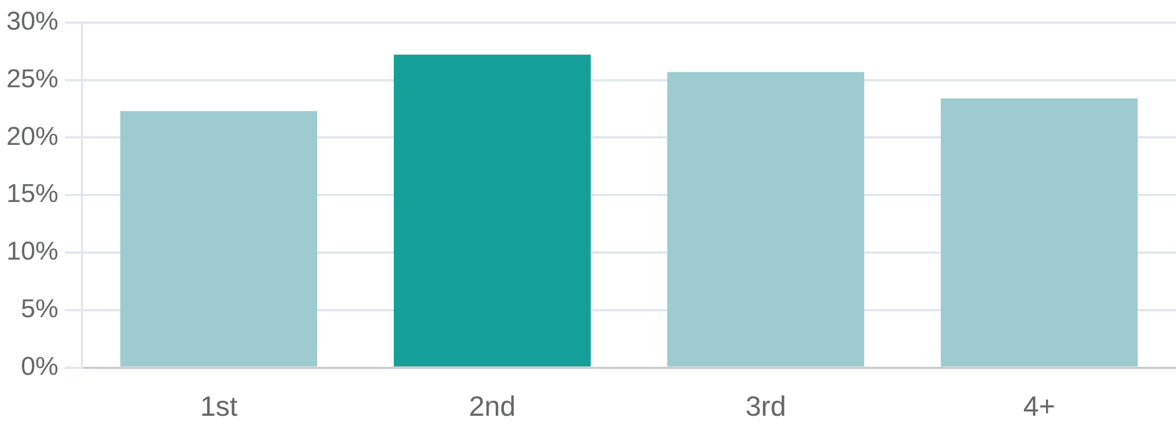
Per-Cycle Success Rates - Data vs Literature
Research Question: How do IVF live-birth rates compare across 1st, 2nd, 3rd, and 4+ treatment cycles?
Our 2017-2018 Data (169,616 cycles)
Published Literature Comparison
Cycle Number
Success Rate
Sample Size
Study
1st Cycle Rate
Pattern
1st cycle
22.3%
72,758
2nd cycle
27.2%
40,631
Smith et al. JAMA 2015
29.5%
Highest at 1st, gradual decline
3rd cycle
25.7%
24,011
(UK, n=156,947)
HFEA 2023
29-32%
Highest at 1st, age-dependent decline
4+ cycles
23.4%
32,216
National Data
Our 2017-2018
22.3%
Peak at 2nd cycle
Data
Critical Note:
Our finding of 2nd cycle peak contradicts established literature. Possible
explanations:
Different outcome measures (clinical pregnancy vs live birth)
Cohort-specific characteristics
Data quality issues
This discrepancy warrants further investigation but does not alter policy
conclusions.

Slide 4

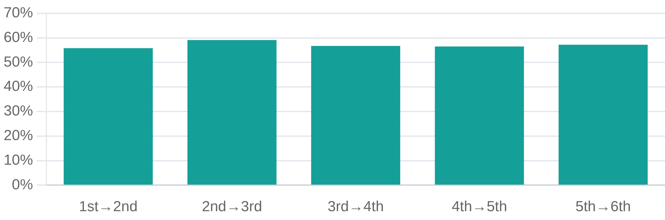
Cumulative Success - The Policy-Relevant Metric
Key Insight: Per-cycle rates tell only part of the story. Cumulative success rates demonstrate IVF is a course of treatment, not a single event.
Published Cumulative Live-Birth Rates (Literature)
Our Continuation Data (2017-2018)
Number of Cycles
Women <35
Women 40+
•
Average continuation rate:
57.1%
across all cycle transitions
1 cycle
~32%
~12%
•
Consistent 56-59% continuation regardless of previous outcome
3 cycles
~61%
~20%
6 cycles
68-86%
23-42%
Source: Malizia et al. NEJM 2009; Smith et al. JAMA 2015
Context for Policy
With 61% cumulative success after 3 cycles for women under 35, the NICE recommendation of 3 funded cycles captures majority of potential successes while managing resource allocation. Our data showing 85% of patients exit by end of 3rd cycle supports this threshold.

Slide 5

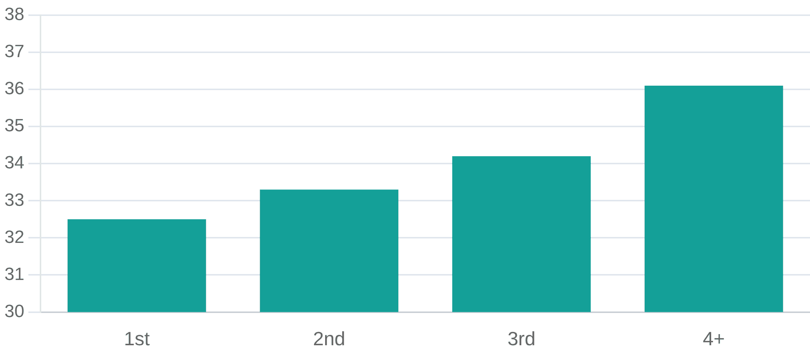
Age - The Dominant Predictor of Success
Critical Finding: Patient age increases 11% across treatment cycles (32.5→36.1 years), confounding direct cycle comparisons.
HFEA 2023: Birth Rate per Embryo Transferred by Age
Age Progression in Our 2017-2018 Cohort
Age Group
Birth Rate
Clinical Context
18-34
35%
Optimal fertility window
35-37
28-30%
Slight decline begins
38-39
20-22%
Moderate decline
40-42
12%
Significant decline
43-44
5%
Donor egg consideration
Analytical Challenge:
Key Takeaway:
The observed decline in success rates across cycles is partially explained by aging of the cohort, not cycle number alone. Ideally, age-stratified analysis would isolate the independent effect of cycle number, but anonymized data constraints limit this approach.
Age is the single most important predictor of IVF success, more influential than cycle number. This underscores the importance of early referral and fertility awareness campaigns.

Slide 6

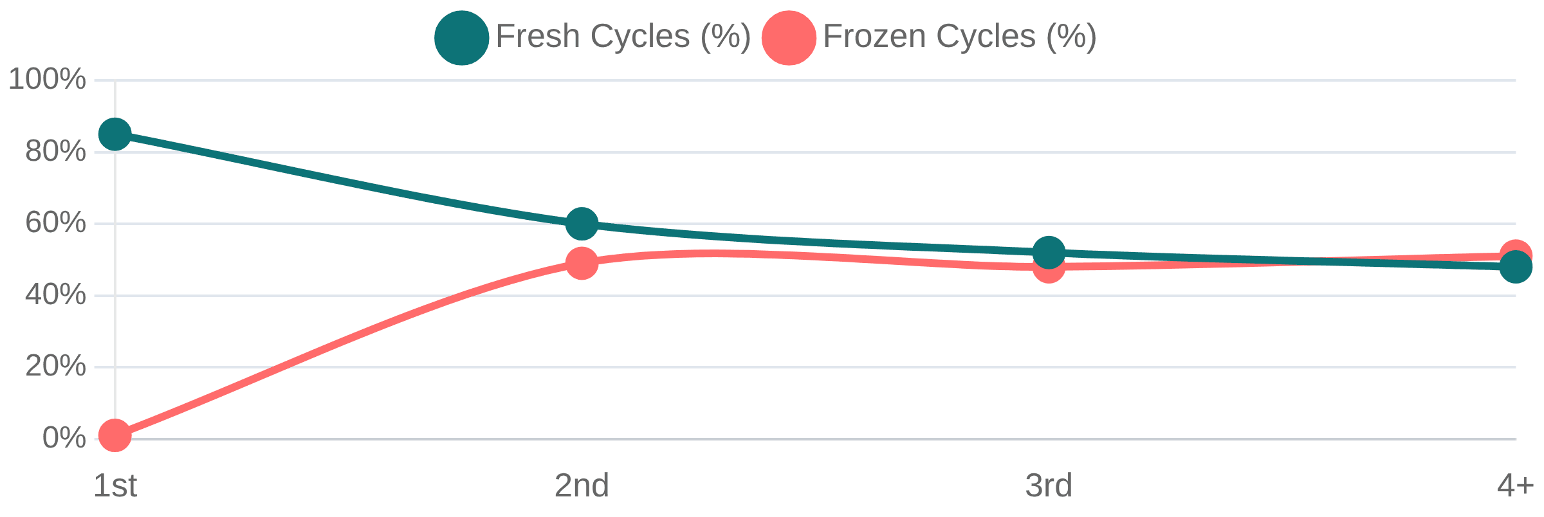
Treatment Composition Shifts Dramatically
Major Confounder: The 1st cycle cohort and 4+ cycle cohort are receiving fundamentally different treatments.
Fresh vs Frozen Embryo Transfer Across Cycles
Cycle
Fresh Cycles
Frozen Cycles
1st
85%
1%
2nd
60%
49%
3rd
52%
48%
4+
48%
51%
Why This Matters
Complete Reversal: First cycle is predominantly fresh (85%), while later cycles are predominantly frozen (51%).
•
Fresh and frozen embryo transfers have different success profiles
•
Comparing success rates across cycles without accounting for this shift compares different treatment modalities
Interpretation
Later cycles increasingly involve treatment escalation strategies (frozen embryo transfer, donor eggs) in response to previous cycle outcomes. This means cycles are NOT independent observations—clinicians adjust protocols based on patient response, creating dependencies in the data.
Donor Egg Usage Also Escalates
•
1st cycle: 3.6% donor eggs
•
4+ cycles: 10.1% donor eggs
(181% increase)

Slide 7

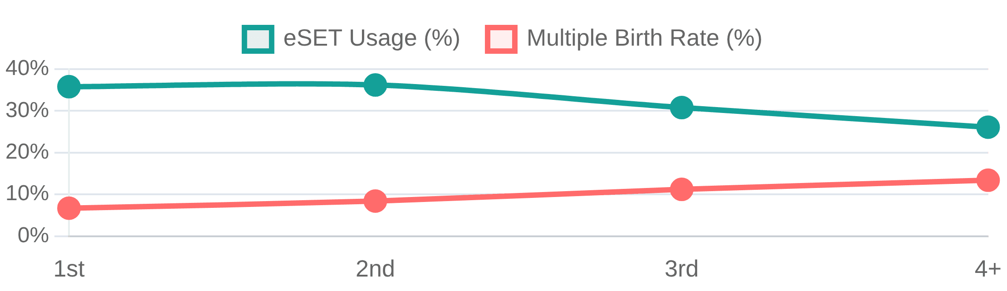
Patient Safety Concern - Multiple Birth Risk Doubles
Critical Safety Finding: As treatment progresses, multiple birth risk increases substantially while protective measures decline.
eSET (Elective Single Embryo Transfer) Usage Declines
Why This Happens
Cycle
eSET Usage
Multiple Birth Rate
•
Repeated unsuccessful cycles create pressure to transfer multiple embryos
1st
35.8%
6.7%
•
Patients seek to maximize success chances
2nd
36.2%
8.4%
•
Multiple pregnancies carry substantially higher risks: preterm birth, low birth weight, maternal complications
3rd
30.8%
11.2%
HFEA Policy Context
4+
26.1%
13.4%
•
HFEA working to reduce multiple birth rates in IVF
•
Targets minimize twin and higher-order pregnancies
Alarming Trend: eSET usage drops to 26.1% in 4+ cycles while multiple births DOUBLE to 13.4%
•
Trend in our data runs counter to safety objectives

Slide 8

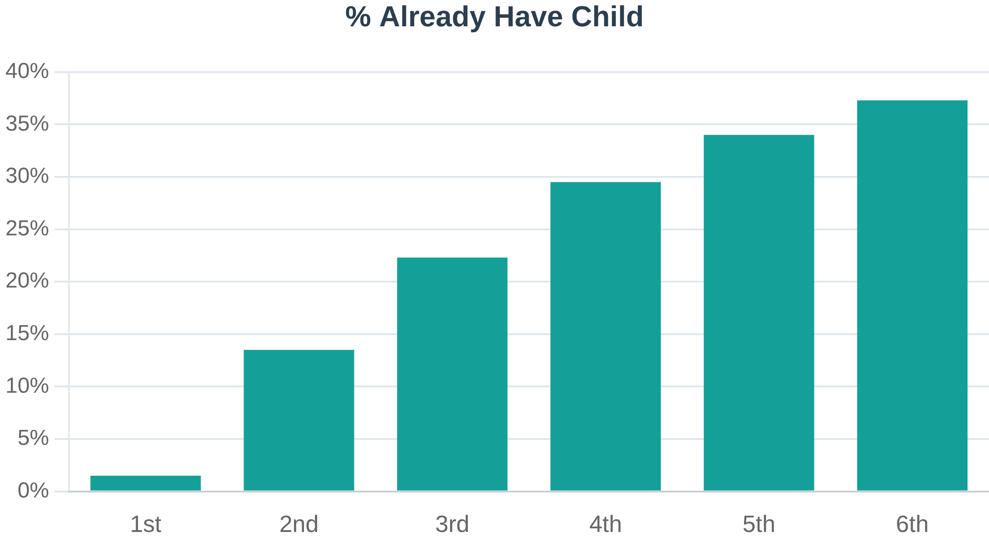
Two Distinct Patient Populations Emerge
Unexpected Finding: By 6th cycle, 37% of patients already have children—seeking additional children, not first-time success.
Policy Question This Raises
Should NHS funding prioritize first-time parents versus those seeking additional children? Current NICE guidelines do not explicitly distinguish. Arguments exist on both sides:
Prioritize First-Time Parents:
•
Addresses involuntary childlessness
•
Maximizes number of families helped
•
Greater psychological and social impact
Equal Treatment for Additional Children:
•
Family size preferences are personal decisions
•
Siblings provide benefits to existing children
Interpretation:
•
Equity principle: same medical need
The 1st cycle cohort is 98.5% seeking their first child, while the 6th cycle cohort is 37% seeking additional children. These are fundamentally different populations with different clinical and policy considerations.
Data Insight:
Later cycles serve different populations. Policy should explicitly address whether funding priorities differ for first versus additional children.

Slide 9

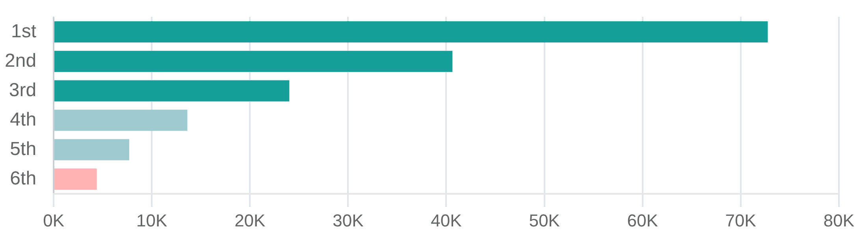
Selection Bias - The Critical Confounder
Most Important Analytical Challenge: Patients reaching 4+ cycles have worse prognosis than the general IVF population.
Patient Cohort Attrition
Why Selection Bias Matters
Healthier patients with better prognoses tend to succeed early and exit the cohort. Those continuing to later cycles have, on average, more challenging fertility issues. This means the 4+ cycle population is not representative of the general IVF population—they are a selected group with worse baseline prognosis.
Cycle
Sample Size
% Remaining
1st
72,758
100%
2nd
40,631
56%
Statistical Implication
3rd
24,011
33%
We cannot directly compare 1st cycle success rates to 4+ cycle success rates and conclude that "later cycles are less successful." The populations are fundamentally different. The apparent decline may reflect patient characteristics rather than cycle number effects.
4th
13,623
19%
5th
7,695
11%
6th
4,400
6%
Continuation Rate Consistency
Interestingly, continuation rates remain stable at 56-59% across all cycle transitions, suggesting the selection mechanism operates consistently throughout the treatment journey.
94% attrition by 6th cycle
Analytical Conclusion
The 4+ cycle data provides insights into persistent treatment seekers but is NOT generalizable to the broader IVF population. Policy decisions should be based primarily on cycles 1-3 where the cohort is more representative.

Slide 10

Data Limitations and Methodological Constraints
Transparency in Analysis: Understanding what our data can and cannot tell us is essential for sound policy recommendations.
1
2
No Funding Source Data
Data is 7 Years Old (2017-2018)
•
Cannot identify NHS-funded vs privately-funded cycles
•
May not reflect current clinical practice
•
Cannot assess compliance with 3-cycle NHS funding policy
•
HFEA reports frozen cycles increased 24% by 2023
•
Cannot analyze whether funding affects continuation decisions
•
Treatment protocols and technology have evolved
3
4
Anonymised Data Constraints
Cycles Are NOT Independent Observations
•
Cannot track individual patient journeys
•
Treatment adjusted between cycles based on response
•
Age bands only (18-34, 35-37, etc.), not exact ages
•
Clinicians modify protocols for patients who don't succeed
•
Cannot perform sophisticated longitudinal analysis
•
Cannot treat as simple comparison of independent groups
•
Missing clinic-level factors and ovarian response data
•
Requires complex statistical methods to properly analyze
What We CAN Conclude Despite Limitations
What We CANNOT Conclude
•
General patterns across cycles (with caveats about confounders)
•
Precise causal effect of cycle number on success
•
Identification of safety concerns (multiple births, eSET decline)
•
Individual patient prognosis for later cycles
•
Population characteristics (age, donor usage, fresh/frozen mix)
•
Policy compliance rates
•
Support for current 3-cycle policy threshold (85% exit by cycle 3)
•
Cost-effectiveness of extending funding beyond 3 cycles

Slide 11

Key Considerations for NICE Guidelines
Policy Question: Does the evidence support the current NICE recommendation of 3 funded IVF cycles for patients under 40?
Evidence Supporting Current 3-Cycle Policy
Areas Requiring Policy Attention
1
1
Diminishing Returns After 3rd Cycle
Multiple Birth Risk Management
•
Success rates remain reasonable through 3rd cycle (25.7%)
•
Strengthen eSET incentives, especially for later cycles
•
•
Published cumulative data shows 61% success after 3 cycles for women <35
Consider policy mechanisms to maintain safety standards
•
85% of patients exit by end of 3rd cycle
•
Balance success optimization with maternal/infant safety
2
2
Increasing Complexity and Confounders in Later Cycles
First-Time vs Additional Children
•
Patient age increases 11% by 4+ cycles
•
Current policy does not distinguish
•
Treatment composition shifts dramatically (85% fresh → 51% frozen)
•
37% of 6th cycle patients already have children
•
Selection bias means 4+ cycle population not representative
•
Should funding priorities differ? Policy should address explicitly
3
3
Safety Concerns Emerge in Later Cycles
Data Collection Improvements
•
Multiple birth risk doubles (6.7% → 13.4%)
•
Add funding source field to enable policy compliance assessment
•
eSET usage drops (35.8% → 26.1%)
•
Improve longitudinal tracking while maintaining privacy
•
Increased pressure for multiple embryo transfer
•
Collect clinic-level quality indicators

Slide 12

Conclusions and Recommendations
Primary Conclusion: Our 2017-2018 data analysis, combined with published literature, supports the current NICE guideline of 3 funded IVF cycles for patients under 40, with priority attention for safety and equity.
1
2
3
Maintain 3-Cycle Funding Policy
Strengthen Multiple Birth Prevention
Clarify Funding Priorities
•
85% exit by end of 3rd cycle
•
Multiple births rise to ~13.4% in later cycles
•
37% of later-cycle patients already have children
•
•
•
Cumulative success ~61% after 3 cycles for women <35
eSET use falls to ~26% in later cycles
Policy currently does not distinguish first vs additional children
•
Diminishing returns beyond cycle 3
•
Pressure for multiple transfers increases with treatment
•
Equity implications need explicit policy direction
Recommendation:
Recommendation:
Recommendation:
Continue current 3-cycle policy as the evidence-based threshold
Implement stronger eSET incentives for later cycles to protect safety
NICE should clarify whether priorities differ for first vs additional children
Future Data Collection Priorities
•
Add funding source field to assess policy compliance
•
Improve longitudinal tracking while preserving privacy
•
Update analysis with more recent data
IVF outcomes are complex; policy should reflect the populations and contexts behind the numbers. The 3-cycle policy is evidence-based but needs ongoing attention to safety and equity.

Slide 13

Questions?
I'm happy to discuss any aspect of the analysis
Thank you for the opportunity to present this analysis of IVF cycle outcomes. I look forward to discussing how data-driven insights can support HFEA's mission to improve fertility treatment outcomes and patient safety.
Ready for your questions and feedback

