Slide 1
Distributed Algorithms
2021
5
CONGEST model: Bandwidth limitations

Slide 2
LOCAL model = port-numbering model + unique identifiers
Nodes have distinct labels from {1, 2, …, poly(n)}

Slide 3
CONGEST model = LOCAL model + bandwidth limitation
Messages at most O(log n) bits

Slide 4
LOCAL · unbounded messages
everything trivial to solve in O(diameter) rounds: gather full input and solve locally
CONGEST · bounded messages
gathering everything is way too expensive
O(diameter) and O(n) is nontrivial

Slide 5
Designing efficient algorithms in CONGEST model

Slide 6
Pipelining
Washing machine
Dryer

Slide 7
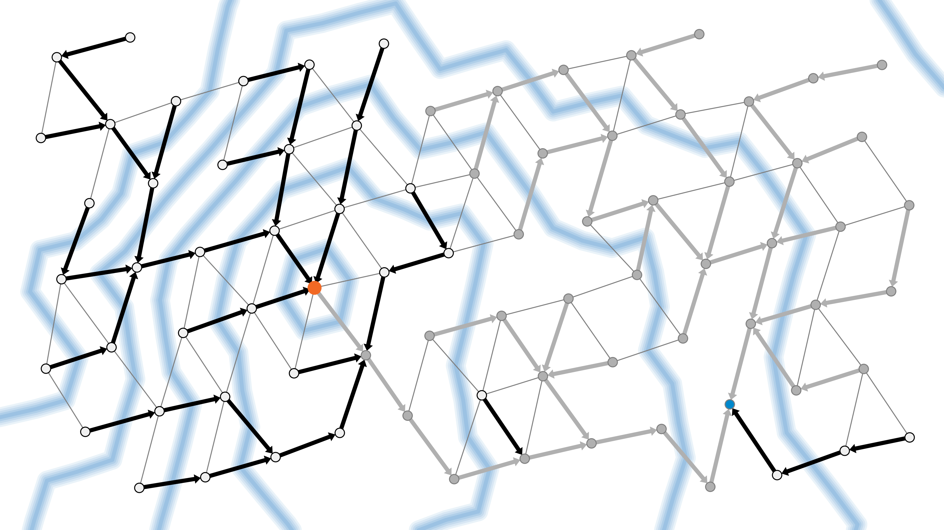
Pipelining
Multiple operations in progress simultaneously
Using different resources
In APSP algorithm:
multiple waves
using different communication links

Slide 8
Pipelining
Does not reduce the total number of messages
only removes idle periods between messages
If all communication links are already sending useful data every round, no room for pipelining

Slide 9
What kind of problems cannot be solved fast in CONGEST model?

Slide 10
Typical hard problems
A: complicated, lots of information
B: bottleneck
can only send small number of bits per round from A to C
C: need to know A
A
B
C

Slide 11
Proving hardness
Counting argument
Many possible inputs in A
Few possible messages across bottleneck B
A
B
C

Slide 12
Proving hardness
Counting argument
Many possible inputs in A
Few possible messages across bottleneck B
Contradiction:
different inputs in A
same messages across B
same output in C
A
B
C

