Slide 1
Distributed Algorithms
2020
1
Warm-up

Slide 2
Welcome!
You should have already done this:
register in Oodi
read instructions in MyCourses
join our Slack workspace
watch two pre-recorded videos
solve this week’s quiz
This week: extra time to solve the quiz until midnight today!

Slide 3
Our weekly routine
Mon: prerecorded videos
Tue: quiz (noon), lecture (12:15pm)
Wed: 1 exercise (midnight)
Thu: exercise session (10:15am)
Fri: 2 exercises (midnight)
Workload:
10–11 h/week

Slide 4
Quiz
One quiz per week, in the lecture notes
Solve by Tuesday at noon
Submit your answer in MyCourses
type the answer in the web form
The answers should be very short
just give the answer, nothing else!
no proofs, no explanations!

Slide 5
Exercises
5+ exercises per week, in the lecture notes
Solve 1 by Wednesday, 2 more by Friday
Submit your answers in MyCourses
submit the answer as an easy-to-read PDF file
The answers need to be complete
full details, complete proofs
e.g. why does your algorithm work correctly?

Slide 6
Challenging exercises
In the lecture notes, marked with a star
Solve at any point during the course
Email your answers to the lecturers
with full details, as an easy-to-read PDF file
The answers need to be complete
full details, complete proofs
e.g. why does your algorithm work correctly?

Slide 7
Grading
To pass the course:
you need to pass both midterm exams
For a good grade:
you need to solve exercises
quiz + exercises = max 96 points in total
challenging exercises = 4 extra points each
80 points = grade 5/5

Slide 8
Learning objectives
Understand models of distributed computing
Design and analyze efficient distributed algorithms
Prove impossibility results
Use standard graph-theoretic concepts
Practiced in exercises
Tested in midterm exams

Slide 9
This is a theory course
100% mathematics
definitions
theorems
proofs …
0% practice
programming
hardware
protocols …
Expected: basic knowledge of university-level mathematics
Example: what is a mathematical proof

Slide 10
Course practicalities
Everything 100% online
Primary tool for communication: Slack
Lectures & exercise sessions: Zoom
Course material, submitting solutions: MyCourses

Slide 11
This week’s content…

Slide 12
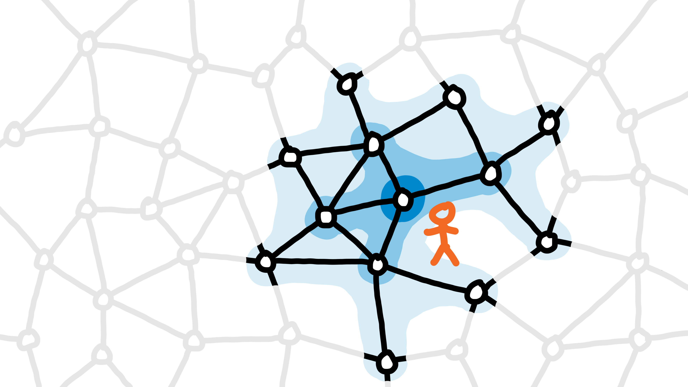
Video 1a: introduction

Slide 13
Quick question to all
What was the key new thing to you in the first video?
Or were you already familiar with the distributed perspective?
Please answer in Slack with one sentence under this thread!

Slide 14
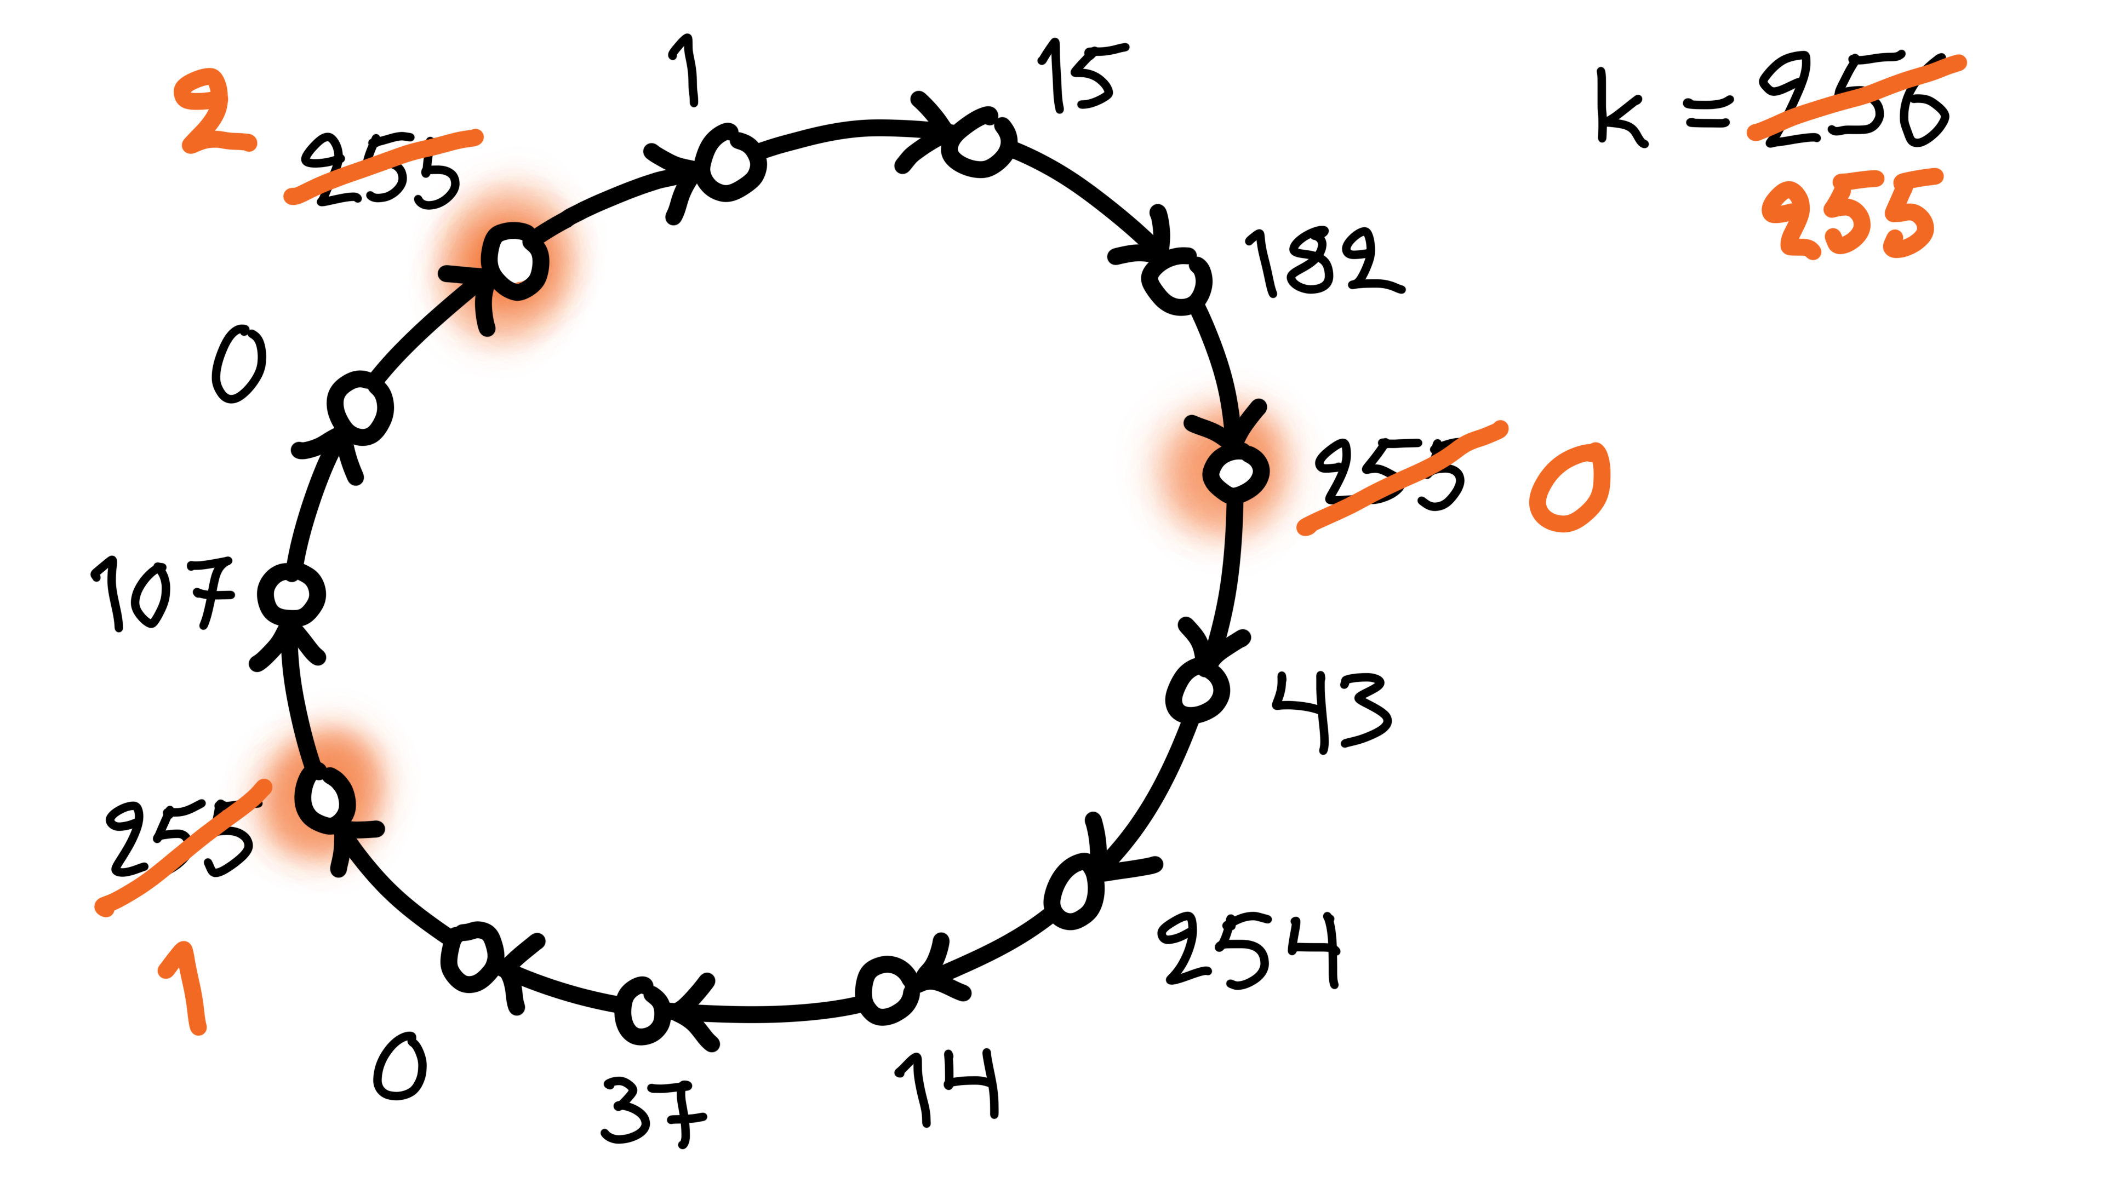
Video 1b: coloring

Slide 15
Slow color reduction
Algorithm idea:
all nodes with the largest color are active
active nodes pick the smallest color that is not used by their neighbors

Slide 16
Group work 1
Consider a simpler algorithm idea:
all nodes pick the smallest color that is not used by their neighbors
What would go wrong?
construct an example in which this algorithm fails!

Slide 17
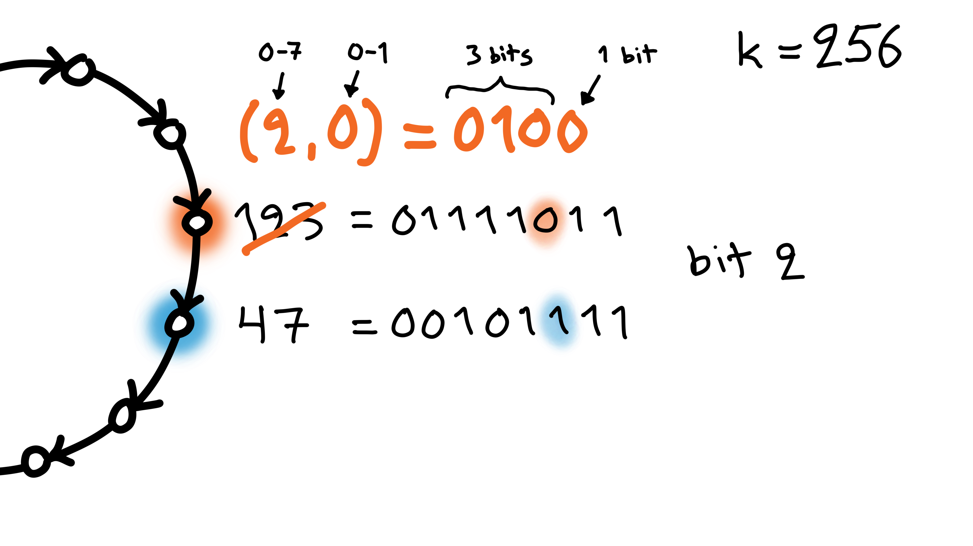
Video 1b: coloring fast

Slide 18
Fast color reduction
Algorithm idea:
find the first bit that differs in successor
index i, bit value b
new color is (i, b)

Slide 19
Group work 2
Algorithm idea:
find the first bit that differs in successor
index i, bit value b
new color is (i, b)
What would go wrong if the new color was just b ?
construct an example in which it fails!

Slide 20
Group work 3
Algorithm idea:
find the first bit that differs in successor
index i, bit value b
new color is (i, b)
What would go wrong if the new color was just i ?
construct an example in which it fails!

Slide 21
Coming next
Week 2: graph theory
Weeks 3–6: models of distributed computing
examples of efficient distributed algorithms
Weeks 7–11: proving impossibility results
Week 12: conclusions, recap

