Slide 1
Distributed Algorithms
2020
9
Round elimination

Slide 2
This week’s plan
Topic: round elimination
function that maps problem X with complexity T to problem X’ = re(X) with complexity T − 1
Video: how to use round elimination
“re” was a black box
Today: how to do round elimination
what happens inside the black box and why?

Slide 3
Round elimination
Basic idea already used by Linial (1987)
“it is not possible to 3-color cycles in o(log* n) rounds”
Until 2015 it was thought this is an ad-hoc trick that only works for graph coloring
Lots of new applications since 2016
General idea formalized in 2019

Slide 4
Weak 3-labeling
Labels: 1, 2, 3
Active nodes:
degree 3
not all labels same
Passive nodes:
degree 2
both labels same

Slide 6
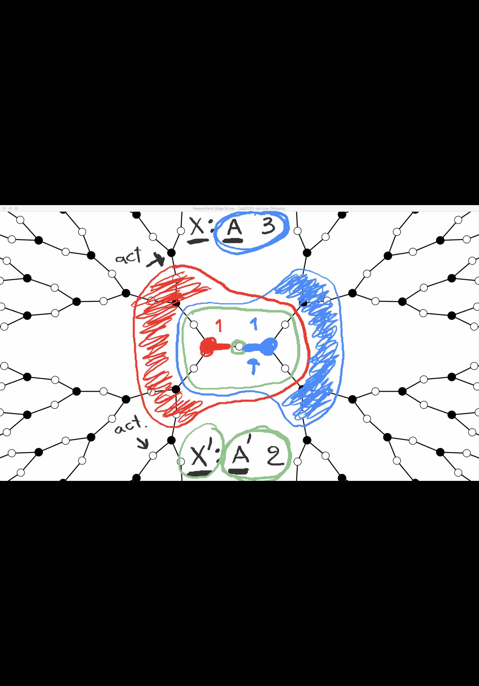

Slide 8
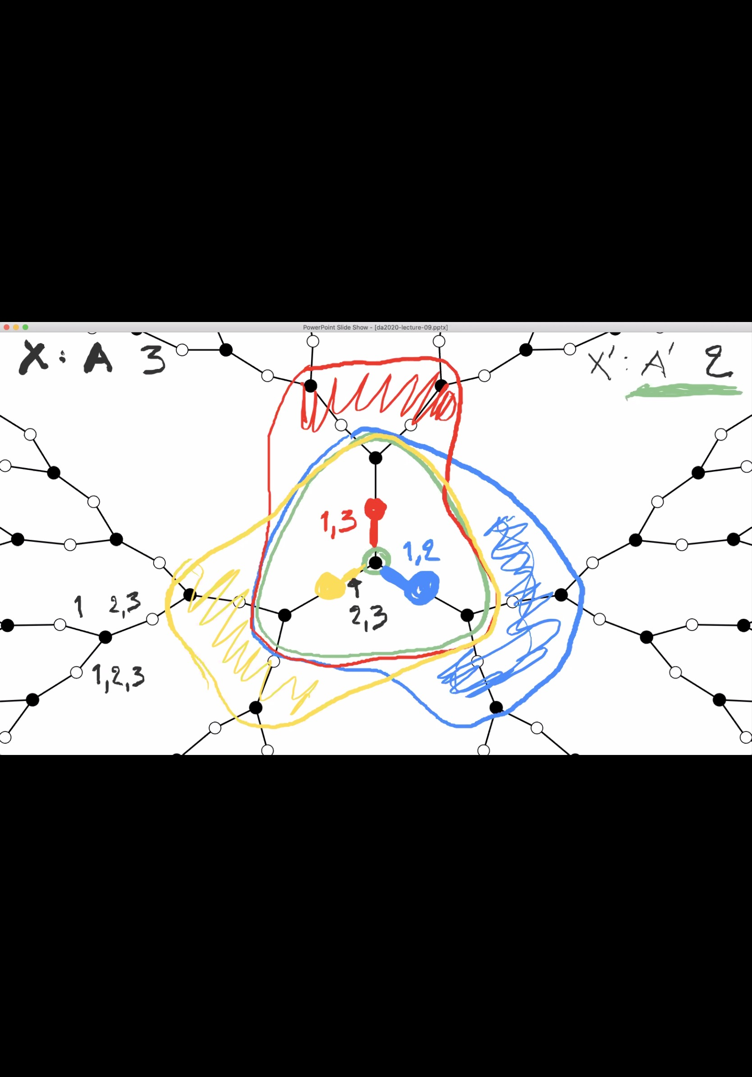

Slide 9
