Slide 1
Distributed Algorithms
2020
11a
Hardness of coloring

Slide 2
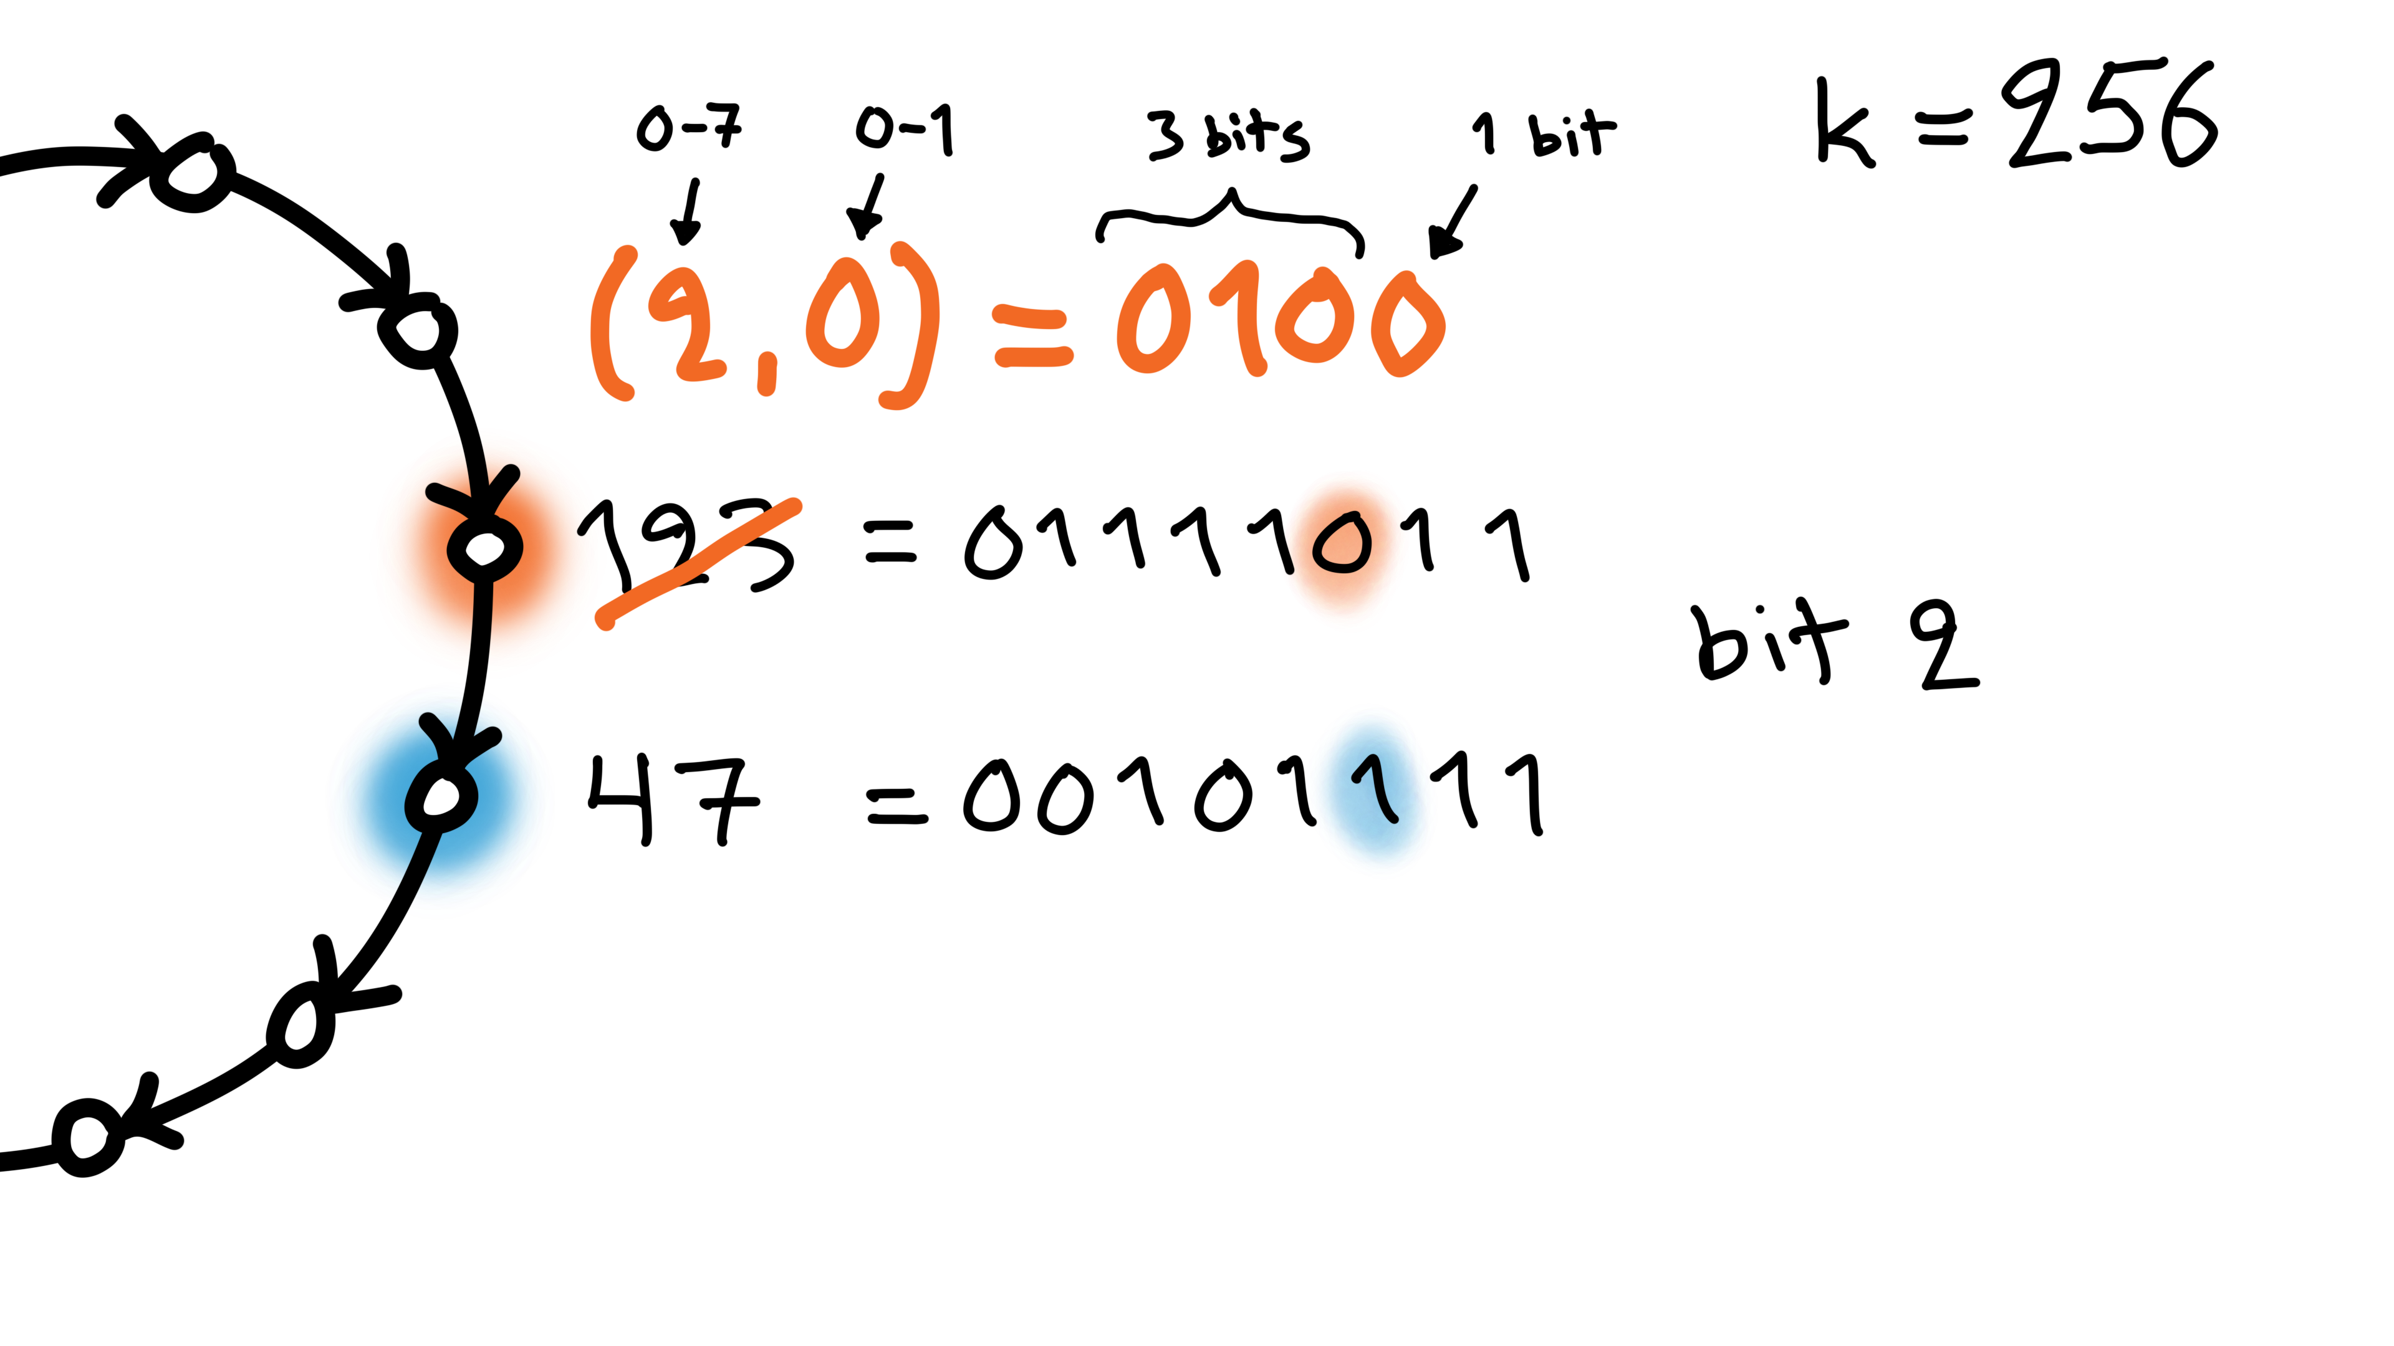
Week 1: fast coloring

Slide 3
3-coloring
O(log* n)
rounds
– LOCAL model
– directed cycles

Slide 4
n^{O(1)}-coloring
0 rounds
(unique IDs)
– LOCAL model
– directed cycles

Slide 5
n^{O(1)}-coloring
3-coloring
0 rounds
(unique IDs)
O(log* n)
rounds
– LOCAL model
– directed cycles

Slide 6
n^{O(1)}-coloring
3-coloring
0 rounds
(unique IDs)
O(log* n)
rounds
Fast color
reduction
2^{k}-coloring
2k-coloring

Slide 7
n^{O(1)}-coloring
3-coloring
0 rounds
(unique IDs)
O(log* n)
rounds
O(log* n) steps
Fast color
reduction
2^{k}-coloring
2k-coloring

Slide 8
n^{O(1)}-coloring
3-coloring
0 rounds
(unique IDs)
O(log* n)
rounds
O(log* n) steps
Fast color
reduction
2^{k}-coloring
2k-coloring
Is this optimal?
Could we find 3-coloring faster?

Slide 9
n^{O(1)}-coloring
3-coloring
0 rounds
(unique IDs)
O(log* n)
rounds
O(log* n) steps
Fast color
reduction
2^{k}-coloring
2k-coloring
Round
elimination

Slide 10
n^{O(1)}-coloring
3-coloring
0 rounds
(unique IDs)
O(log* n)
rounds
O(log* n) steps
Fast color
reduction
2^{k}-coloring
2k-coloring
T − 1 rounds
T rounds
Round
elimination

Slide 11
n^{O(1)}-coloring
3-coloring
0 rounds
(unique IDs)
O(log* n)
rounds
O(log* n) steps
Fast color
reduction
2^{k}-coloring
2k-coloring
T − 1 rounds
T rounds
Round
elimination
k-coloring

Slide 12
n^{O(1)}-coloring
3-coloring
0 rounds
(unique IDs)
O(log* n)
rounds
O(log* n) steps
Fast color
reduction
2^{k}-coloring
2k-coloring
T − 1 rounds
T rounds
Round
elimination
2^{k}-coloring
RE
k-coloring

Slide 13
n^{O(1)}-coloring
3-coloring
0 rounds
(unique IDs)
O(log* n)
rounds
O(log* n) steps
Fast color
reduction
2^{k}-coloring
2k-coloring
T − 1 rounds
T rounds
Round
elimination
2^{k}-coloring
RE
k-coloring
3-coloring
T << log* n
rounds

Slide 14
n^{O(1)}-coloring
3-coloring
0 rounds
(unique IDs)
O(log* n)
rounds
O(log* n) steps
Fast color
reduction
2^{k}-coloring
2k-coloring
T − 1 rounds
T rounds
Round
elimination
2^{k}-coloring
RE
k-coloring
3-coloring
RE
RE
RE
RE
RE
T << log* n
rounds
T steps

Slide 15
n^{O(1)}-coloring
3-coloring
0 rounds
(unique IDs)
O(log* n)
rounds
O(log* n) steps
Fast color
reduction
2^{k}-coloring
2k-coloring
T − 1 rounds
T rounds
Round
elimination
2^{k}-coloring
RE
k-coloring
c-coloring
3-coloring
RE
RE
RE
RE
RE
0 rounds
T << log* n
rounds
T steps

Slide 16
n^{O(1)}-coloring
3-coloring
0 rounds
(unique IDs)
O(log* n)
rounds
O(log* n) steps
Fast color
reduction
2^{k}-coloring
2k-coloring
c = power tower of height T
T − 1 rounds
T rounds
Round
elimination
2^{k}-coloring
RE
k-coloring
c-coloring
3-coloring
RE
RE
RE
RE
RE
0 rounds
T << log* n
rounds
T steps

Slide 17
n^{O(1)}-coloring
3-coloring
0 rounds
(unique IDs)
O(log* n)
rounds
O(log* n) steps
Fast color
reduction
2^{k}-coloring
2k-coloring
c = power tower of height T << n
T − 1 rounds
T rounds
Round
elimination
2^{k}-coloring
RE
k-coloring
c-coloring
3-coloring
RE
RE
RE
RE
RE
0 rounds
T << log* n
rounds
T steps

Slide 18

n^{O(1)}-coloring
3-coloring
0 rounds
(unique IDs)
O(log* n)
rounds
O(log* n) steps
Fast color
reduction
2^{k}-coloring
2k-coloring
c = power tower of height T << n
T − 1 rounds
T rounds
Round
elimination
2^{k}-coloring
RE
k-coloring
c-coloring
3-coloring
RE
RE
RE
RE
RE
0 rounds
T << log* n
rounds
T steps

Slide 19
n^{O(1)}-coloring
3-coloring
0 rounds
(unique IDs)
O(log* n)
rounds
O(log* n) steps
Fast color
reduction
2^{k}-coloring
2k-coloring
c = power tower of height T << n
T − 1 rounds
T rounds
Round
elimination
2^{k}-coloring
RE
k-coloring
c-coloring
3-coloring
RE
RE
RE
RE
RE
0 rounds
T << log* n
rounds
T steps

Slide 20
Round elimination assumes the PN model, it does not work in the LOCAL model

Slide 21
Round elimination assumes the PN model, it does not work in the LOCAL model

Slide 26
1

Slide 27
1

Slide 28
1
1

Slide 29
Negative result for deterministic PN
Negative result for randomized PN ?
randomized round elimination:
A₀ solves X₀ in T rounds with probability p₀
A₁ solves X₁ in T − 1 rounds with probability p₁ < p₀
Negative result for randomized LOCAL
randomized PN can simulate randomized LOCAL
Negative result for deterministic LOCAL
deterministic is a special case of randomized

Slide 30
Negative result for deterministic PN
Negative result for randomized PN
randomized round elimination:
A₀ solves X₀ in T rounds with probability p₀
A₁ solves X₁ in T − 1 rounds with probability p₁ < p₀
Negative result for randomized LOCAL
randomized PN can simulate randomized LOCAL
Negative result for deterministic LOCAL
deterministic is a special case of randomized

Slide 31
Negative result for deterministic PN
Negative result for randomized PN
randomized round elimination:
A₀ solves X₀ in T rounds with probability p₀
A₁ solves X₁ in T − 1 rounds with probability p₁ < p₀
Negative result for randomized LOCAL
randomized PN can simulate randomized LOCAL
Negative result for deterministic LOCAL
deterministic is a special case of randomized

Slide 32
Negative result for deterministic PN
Negative result for randomized PN
randomized round elimination:
A₀ solves X₀ in T rounds with probability p₀
A₁ solves X₁ in T − 1 rounds with probability p₁ < p₀
Negative result for randomized LOCAL
randomized PN can simulate randomized LOCAL
Negative result for deterministic LOCAL
deterministic is a special case of randomized

Slide 33
Negative result for deterministic PN
Negative result for randomized PN
randomized round elimination:
A₀ solves X₀ in T rounds with probability p₀
A₁ solves X₁ in T − 1 rounds with probability p₁ < p₀
Negative result for randomized LOCAL
randomized PN can simulate randomized LOCAL
Negative result for deterministic LOCAL
deterministic is a special case of randomized

Slide 34
Negative result for deterministic PN
Negative result for randomized PN
randomized round elimination:
A₀ solves X₀ in T rounds with probability p₀
A₁ solves X₁ in T − 1 rounds with probability p₁ < p₀
Negative result for randomized LOCAL
randomized PN can simulate randomized LOCAL
Negative result for deterministic LOCAL
deterministic is a special case of randomized
3-coloring
T << log* n
rounds

Slide 35
Negative result for deterministic PN
Negative result for randomized PN
randomized round elimination:
A₀ solves X₀ in T rounds with probability p₀
A₁ solves X₁ in T − 1 rounds with probability p₁ < p₀
Negative result for randomized LOCAL
randomized PN can simulate randomized LOCAL
Negative result for deterministic LOCAL
deterministic is a special case of randomized
w.h.p.
3-coloring
T << log* n
rounds

Slide 36
Negative result for deterministic PN
Negative result for randomized PN
randomized round elimination:
A₀ solves X₀ in T rounds with probability p₀
A₁ solves X₁ in T − 1 rounds with probability p₁ < p₀
Negative result for randomized LOCAL
randomized PN can simulate randomized LOCAL
Negative result for deterministic LOCAL
deterministic is a special case of randomized
w.h.p.
c-coloring
3-coloring
RE
RE
RE
RE
RE
0 rounds
T << log* n
rounds
T steps

Slide 37
Negative result for deterministic PN
Negative result for randomized PN
randomized round elimination:
A₀ solves X₀ in T rounds with probability p₀
A₁ solves X₁ in T − 1 rounds with probability p₁ < p₀
Negative result for randomized LOCAL
randomized PN can simulate randomized LOCAL
Negative result for deterministic LOCAL
deterministic is a special case of randomized
does not fail too often
w.h.p.
c-coloring
3-coloring
RE
RE
RE
RE
RE
0 rounds
T << log* n
rounds
T steps

Slide 38
Negative result for deterministic PN
Negative result for randomized PN
randomized round elimination:
A₀ solves X₀ in T rounds with probability p₀
A₁ solves X₁ in T − 1 rounds with probability p₁ < p₀
Negative result for randomized LOCAL
randomized PN can simulate randomized LOCAL
Negative result for deterministic LOCAL
deterministic is a special case of randomized
does not fail too often
w.h.p.
c-coloring
3-coloring
RE
RE
RE
RE
RE
0 rounds
T << log* n
rounds
T steps

Slide 39
Negative result for deterministic PN
Negative result for randomized PN
randomized round elimination:
A₀ solves X₀ in T rounds with probability p₀
A₁ solves X₁ in T − 1 rounds with probability p₁ < p₀
Negative result for randomized LOCAL
randomized PN can simulate randomized LOCAL
Negative result for deterministic LOCAL
deterministic is a special case of randomized
use randomness to construct identifiers that are unique w.h.p.

Slide 40
Negative result for deterministic PN
Negative result for randomized PN
randomized round elimination:
A₀ solves X₀ in T rounds with probability p₀
A₁ solves X₁ in T − 1 rounds with probability p₁ < p₀
Negative result for randomized LOCAL
randomized PN can simulate randomized LOCAL
Negative result for deterministic LOCAL
deterministic is a special case of randomized

Slide 41
Negative result for deterministic PN
Negative result for randomized PN
randomized round elimination:
A₀ solves X₀ in T rounds with probability p₀
A₁ solves X₁ in T − 1 rounds with probability p₁ < p₀
Negative result for randomized LOCAL
randomized PN can simulate randomized LOCAL
Negative result for deterministic LOCAL
deterministic is a special case of randomized

Slide 42
Negative result for deterministic PN
Negative result for randomized PN
randomized round elimination:
A₀ solves X₀ in T rounds with probability p₀
A₁ solves X₁ in T − 1 rounds with probability p₁ < p₀
Negative result for randomized LOCAL
randomized PN can simulate randomized LOCAL
Negative result for deterministic LOCAL
deterministic is a special case of randomized

Slide 43
Negative result for deterministic PN
Negative result for randomized PN
randomized round elimination:
A₀ solves X₀ in T rounds with probability p₀
A₁ solves X₁ in T − 1 rounds with probability p₁ < p₀
Negative result for randomized LOCAL
randomized PN can simulate randomized LOCAL
Negative result for deterministic LOCAL
deterministic is a special case of randomized

Slide 44
Negative result for deterministic PN
Negative result for randomized PN
randomized round elimination:
A₀ solves X₀ in T rounds with probability p₀
A₁ solves X₁ in T − 1 rounds with probability p₁ < p₀
Negative result for randomized LOCAL
randomized PN can simulate randomized LOCAL
Negative result for deterministic LOCAL
deterministic is a special case of randomized

