Slide 1
YOLO: YOU ONLY LOOK ONCE
Unified, Real-Time Object Detection
Joseph Redmon , Santosh Divvala , Ross Girshick , Ali Farhadi
Presented by - Narmety Vamshi, Manchala Vineel krishna

Slide 2
Contents
What is object detection
Two stage object detection
What is YOLO?
How does YOLO work?
Intersection over Union(IoU)
Non- Maximum Suppression
Average precision
YOLO Versions: Evolution and Improvements
YOLO for Vehicle Detection
Why YOLO Algorithm is important

Slide 3
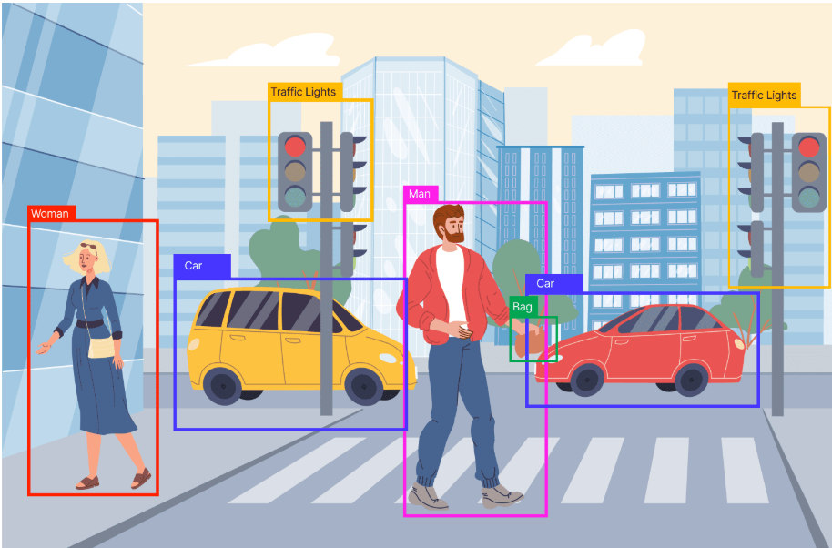
Object Detection
Object detection is a computer vision task that identifies and locates objects in images and videos.
It involves two tasks:
1) Classification:Identifying what the object is.
2) Localization: Identifying where the object is.
Applications:
- Vehicle detection.
- Pedestrian detection.
- Face detection in surveillance systems.
Image credits: https://deeplobe.ai/exploring-object-detection-applications-and-benefits/

Slide 4
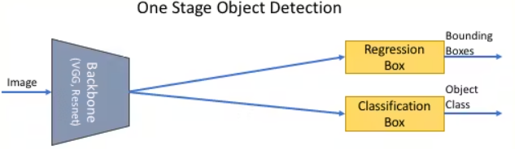
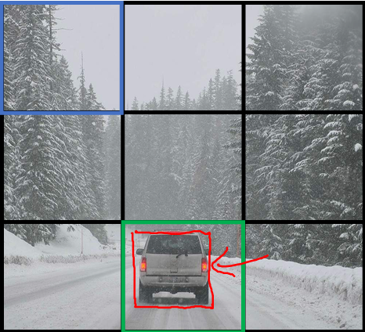

Image credits: https://encord.com/blog/object-detection/

Slide 5
Two stage object detection
Two-Stage Methods:
Region Proposal Networks (RPN) first propose potential object regions.
A classifier is applied on the output from RPN to predict the class and
refine the bounding box.
Example Algorithms:
R-CNN, Fast R-CNN, and Faster R-CNN
Limitations:
Complex architecture with separate region proposal and classification stages.
Slow inference speed due to multi-stage processing.

Slide 6
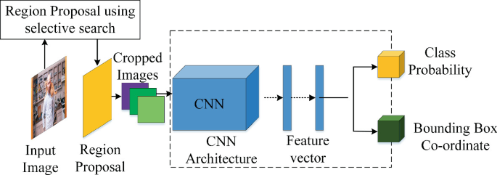
Image credits: https://images.app.goo.gl/LXzd7bYVnMD4GVHz9

Slide 7
What is YOLO?
It is a single-stage object detection algorithm.
In comparison with other object detection algorithms, YOLO proposes the use of an end-to-end neural network that makes predictions of bounding boxes and class probabilities all at once.
Unlike two-stage methods, YOLO:
- Detect objects in a single forward pass of the network.
- Makes it faster and more efficient.

Slide 8
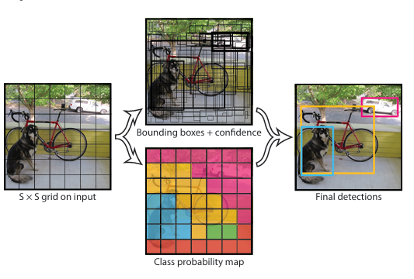
HOW Does YOLO Work?
Input Image Splitting:
- The image is divided into an SxS grid
- Each grid cell is responsible for detection and localization of object
2. Bounding Box Prediction:
- Each grid cell predicts B bounding boxes, Confidence score and Class
probabilities.
- So, the network outputs a list of size SxSx(Bx5+C) .where,
C is the number of classes.
3. Final Detection:
- Combines class scores and confidence scores.
- Applies Non-Maximum Suppression(NMS) to remove overlapping boxes.

Slide 9
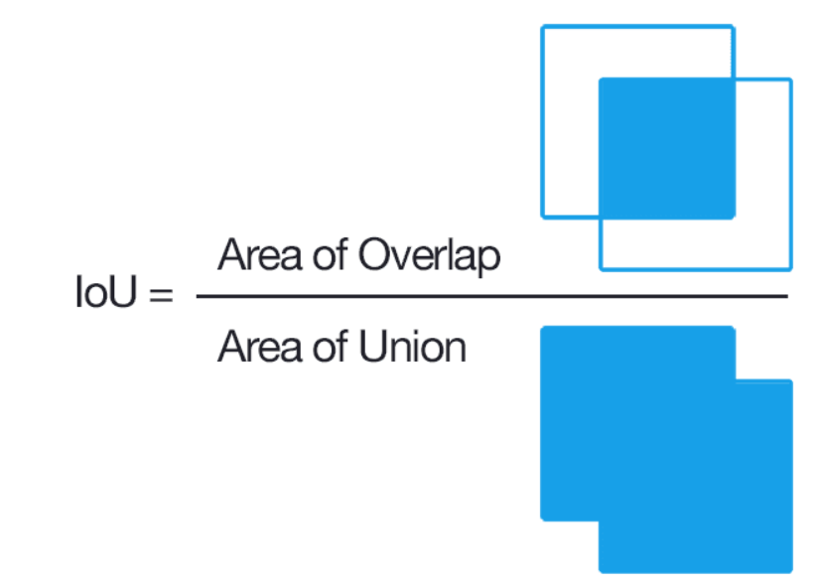
Intersection over Union(IoU)
IoU measures the overlap between two bounding boxes
Intersection over union ensures that the predicted bounding boxes are equal to the real boxes of the objects.
This phenomenon eliminates unnecessary overlapping bounding boxes. The final detection will consist of unique bounding boxes that fit the objects perfectly.
Image credits: https://images.app.goo.gl/JqfqxZdH2i6AzKSw7

Slide 10
Non-Maximum Suppression
It is a post-processing technique used to remove redundant or overlapping bounding boxes and keeps only the most relevant detection.
How NMS Works:
- take the list of predicted bounding boxes with confidence boxes.
- Arrange the boxes by confidence score(descending).
- Select the box with highest score and add this box to the final list.
- Compute IoU between selected box and all remaining boxes.
- Remove boxes with IoU greater than the threshold.
- Continue this process until only the most confident, non-overlapping boxes
remain.

Slide 11
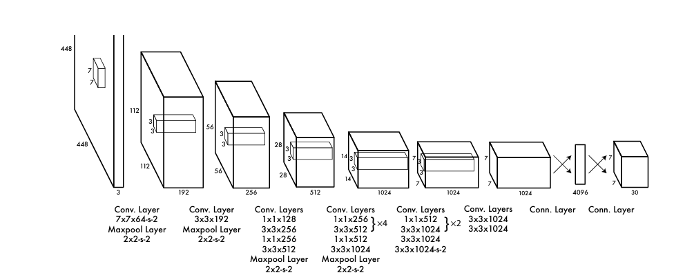
Architecture

Slide 12
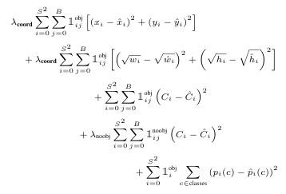
Loss function

Slide 13
Limitations
Each cell predicts a fixed number of boxes, limiting the detection of multiple objects in the same cell.
YOLO struggles with small and overlapping objects.
YOLO struggles with objects of varying scales i.e, Bounding box predictions can be inaccurate for elongated or irregular shapes.

Slide 14
Average Precision
Average Precision (AP) measures the accuracy of object detection by computing the area under the Precision-Recall curve.
AP is calculated by comparing YOLO’s predicted bounding boxes with ground-truth boxes, using IoU thresholds to classify detections as True Positives (TP), False Positives (FP), and False Negatives (FN).
AP is used to evaluate YOLO’s detection performance, reflecting its ability to localize and classify objects accurately.

Slide 15
YOLO Versions: Evolution and Improvements
YOLOv1 (2016) : Introduced real-time object detection by dividing the image into grids and predicting bounding boxes and class probabilities directly.
Basic YOLO: First version with a single CNN model for end-to-end detection.
YOLOv2 (2017) : Improved accuracy with batch normalization, anchor boxes, and multi-scale training.
Compared to YOLOv1: More accurate and faster due to anchor boxes and batch norm
YOLOv3 (2018) : Utilized Darknet-53 as the backbone, introduced multi-scale predictions, and used logistic regression for objectness score.
Compared to YOLOv2: Better accuracy and handling of small objects with multi-scale features.
YOLOv4 (2020) : Enhanced with CSPDarknet53 backbone, mosaic augmentation, and self-adversarial training for better accuracy and speed.
Compared to YOLOv3: Significantly faster and more accurate due to data augmentation and CSP backbone.

Slide 16
YOLOv5 (2020) : First implementation in PyTorch, faster training, smaller model size, and better performance on edge devices.
Compared to YOLOv4: Easier deployment with PyTorch and better efficiency.
YOLOv6 (2022) : Optimized for industrial applications with anchor-free detection and an improved backbone architecture.
Compared to YOLOv5: Faster inference and more efficient for industrial-scale deployment.
YOLOv7 (2022) : Achieved state-of-the-art performance with extended model architecture and optimized training techniques.
Compared to YOLOv6: Improved accuracy and real-time inference speed.
YOLOv8 (2023) : Introduced by Ultralytics, featuring a redesigned architecture, anchor-free detection, and support for object segmentation.
Compared to YOLOv7: More accurate and versatile with built-in segmentation support.

Slide 17
YOLO for Vehicle Detection
Real-Time Detection : YOLO’s speed makes it ideal for real-time vehicle detection in traffic surveillance, autonomous driving, and intelligent transportation systems.
High Accuracy with Fast Inference : Detects and classifies multiple vehicles in a single pass with minimal latency.
Single-Stage Architecture : Eliminates the need for region proposal, allowing direct detection of vehicles in one go.
Grid-Based Localization :Efficiently locates vehicles by dividing the image into grids, each responsible for detecting vehicles within its region.
Scalability and Deployment : Lightweight versions like YOLOv5 and YOLOv8 are optimized for deployment on edge devices (e.g., traffic cameras, drones).

Slide 18
Application Areas :
- Smart parking systems
- Vehicle counting and traffic flow analysis
- Speed estimation and license plate recognition (when extended with OCR)
- Accident detection and traffic rule enforcement
Robust to Variations : Can detect vehicles in different sizes, orientations, and lighting conditions due to advanced training and augmentation techniques.
Integrated with NMS and IoU : Ensures only the most confident and non-overlapping vehicle detections are considered, improving the quality of outputs.

Slide 19
Why YOLO Algorithm is important
Fast Object Detection : YOLO is very fast and can detect objects in real-time, which is useful for tasks like self-driving cars, security cameras, and live video analysis.
High Accuracy : YOLO gives accurate results and makes fewer mistakes by reducing background errors. It correctly identifies and locates objects in images.
Good at Learning : YOLO has strong learning ability. It can learn how different objects look and use that knowledge to detect them in new images.
All-in-One Process : YOLO does everything—detecting and classifying objects—in a single step, making it simple and efficient compared to older methods.

Slide 20
Used in Real-World Applications : It is widely used in areas like traffic monitoring, face detection, medical imaging, and robotics because of its speed and reliability.
Supports Multiple Object Detection : YOLO can detect several objects at the same time, even if they are of different types (cars, people, animals, etc.) in one image.
Reduces False Detections : YOLO uses techniques like Intersection over Union (IoU) and Non-Maximum Suppression (NMS) to avoid showing wrong or overlapping boxes, improving output quality.

