Slide 1
Student Exam Performance Analysis
Author: Nangi Vineela
Domain: Data Analytics
Libraries: Pandas, Numpy, Matplotlib, Seaborn

Slide 2
Introduction
This project analyzes student’s exam performance using Python libraries(Pandas, Numpy, Matplotlib ,Seaborn).
It explores how factors like gender, parental education, and test preparation affect math, reading, and writing scores.
Key insights are visualized through bar charts, histograms, and heatmaps for better understanding.

Slide 3
Dataset Overview
Total Rows: 1000
Total Columns: 8
Columns: gender, race/ethnicity, parental level of education, lunch, test preparation course, math score, reading score, writing score

Slide 4
Sample Data (Top 5 Rows)
gender | race/ethnicity | parental level of education | lunch | test preparation course | math score | reading score | writing score
female | group B | bachelor's degree | standard | none | 72 | 72 | 74
female | group C | some college | standard | completed | 69 | 90 | 88
female | group B | master's degree | standard | none | 90 | 95 | 93
male | group A | associate's degree | free/reduced | none | 47 | 57 | 44
male | group C | some college | standard | none | 76 | 78 | 75

Slide 5
Data Analysis Performed
Grouped average scores by gender
Visualized distribution of Math scores
Created correlation heatmap between scores
Checked dataset info, summary statistics, and missing values

Slide 6
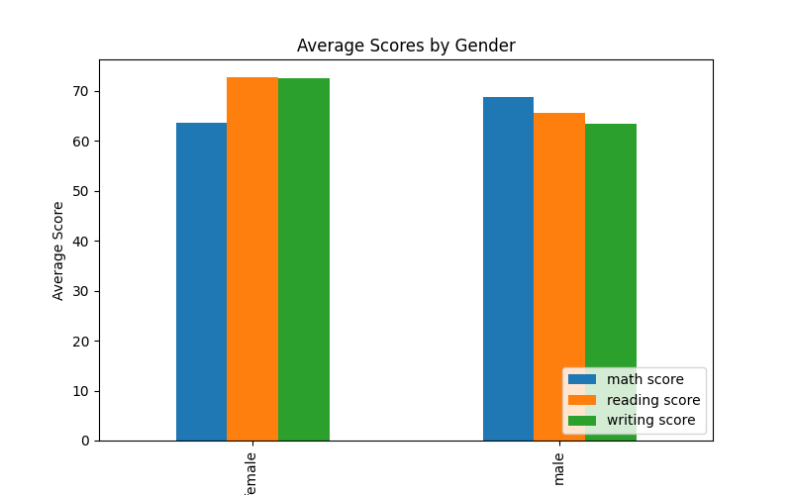
Outputs

Slide 7
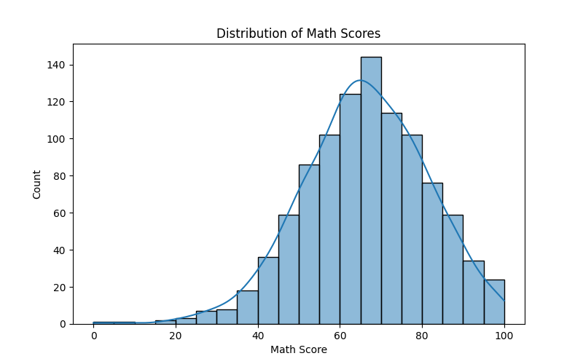
Outputs

Slide 8
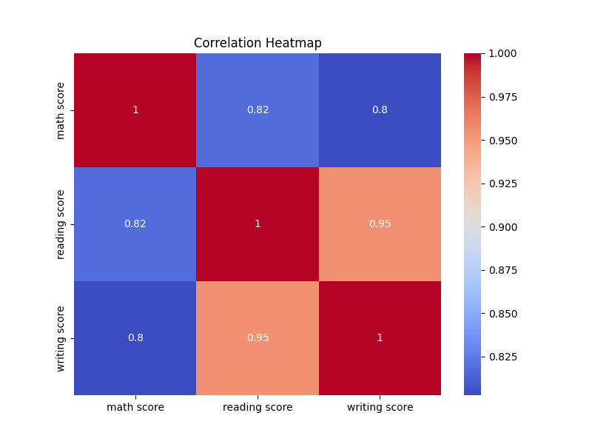
Outputs

Slide 9
Conclusion
Female students scored higher on average in reading and writing.
Math scores showed a wider distribution, indicating varied performance.
Positive correlation observed between reading and writing scores.
These insights can help teachers focus on weaker areas for improvement.

Slide 10
THANK YOU

