Slide 1
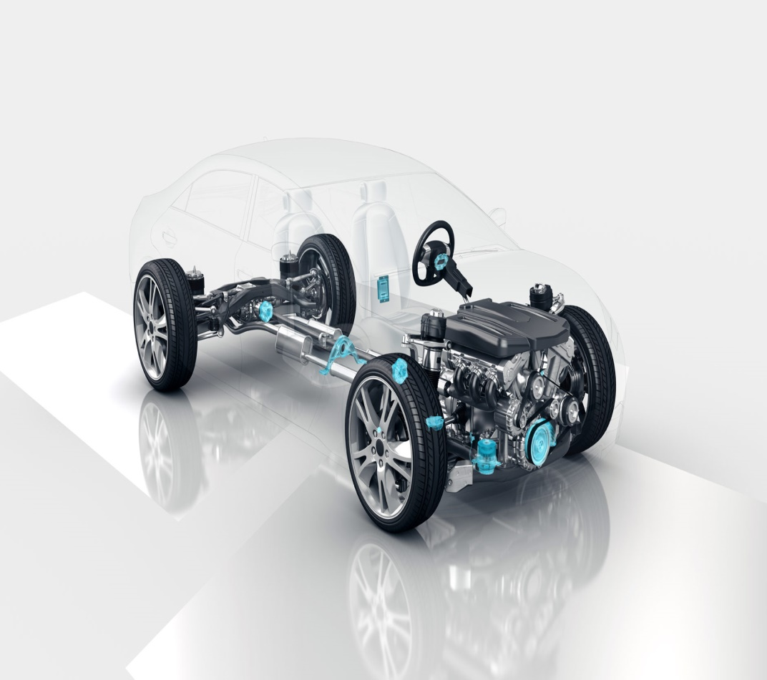
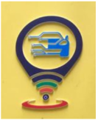

Center for Intelligent Mobility (CIM)
Envisions Smarter and Safer Mobility
Research Experience for Undergraduates(REU) – Review
Title: Hybrid Equivariant-Invariant Feature Learning for Visual perception in Dynamic visual environments
Students Details:
1.VINEET DESAI USN:01FE22BEC176
Guide Details:
Prof. Preeti Pillai
Dr.Ujwala Patil
Dr.Nalini Iyer

Slide 2
Center for Intelligent Mobility (CIM)
Envisions Smarter and Safer Mobility
Contents
Introduction
Problem statement
Literature survey
Objectives
Theoretical background
Proposed model architecture
Data flow diagram
Results and evaluation metrices
Visual Results

Slide 3
Center for Intelligent Mobility (CIM)
Envisions Smarter and Safer Mobility
Introduction
Dynamic visual environments (autonomous driving, robotics, surveillance) are unpredictable with changing viewpoints, motions, lighting, and weather.
Challenge: Deep models fail under distribution shifts → lose geometric consistency or semantic reliability.
Equivariance preserves geometry, invariance preserves meaning — but each alone is insufficient.
Existing test-time adaptation often ignores symmetry constraints.
Vision: A hybrid equivariant–invariant representation, combined with test-time adaptation, for robust perception in deployment.

Slide 4
Center for Intelligent Mobility (CIM)
Envisions Smarter and Safer Mobility
Problem Statement
Hybrid Equivariant-Invariant Feature Learning for visual perception in Dynamic visual environments.
Inference:
A hybrid equivariant–invariant representation, combined with test-time adaptation, is required to achieve robust, efficient, and continually adaptive perception in real-world dynamic environments.

Slide 5
Center for Intelligent Mobility (CIM)
Envisions Smarter and Safer Mobility
Literature Survey:
Title | Methodology | Results | Gaps
Robust Perception through Equivariance | Applies input transformations (e.g., rotation, flip, translation) during inference to test if the network output transforms consistently. Introduces a symmetry-consistency loss at test time: penalizes prediction differences between original and transformed inputs. Does not require retraining — applied directly on pretrained models. Evaluated on classification (ImageNet), segmentation (Cityscapes), and detection (MS-COCO) tasks to show improved robustness. | ImageNet (classification): improved top-1 accuracy under corrupted inputs. Cityscapes (segmentation): higher mIoU when tested with rotated or shifted inputs. MS-COCO (detection): improved mAP under viewpoint transformations. Overall: enforcing equivariance at test time → significant robustness without retraining. | Only handles equivariance; ignores invariance. Extra test-time computation (multiple transformations). No mechanism for continual adaptation when domains shift over time.

Slide 6
Center for Intelligent Mobility (CIM)
Envisions Smarter and Safer Mobility
Literature Survey:
Title | Methodology | Results | Gaps
Exploring Complementary Strengths of Invariant and Equivariant Representations for Few-Shot Learning | Proposes joint feature learning of invariance and equivariance in a single model. Adds two auxiliary self-supervised tasks: Transformation discrimination task: predicts which transformation was applied → encourages equivariance. Instance discrimination task: distinguishes between samples regardless of transformations → encourages invariance. Trains the model to balance both tasks, ensuring the feature space encodes structure (equivariance) and stability (invariance). Tested in few-shot learning setups to show the hybrid approach generalizes better than either alone. | MiniImageNet: improved 1-shot and 5-shot classification accuracy compared to invariant-only or equivariant-only methods. CIFAR-FS and TieredImageNet: consistent gains across few-shot learning tasks. Demonstrated that hybrid features outperform both extremes. | Experiments limited to few-shot classification; not applied to dense perception tasks (detection/segmentation). No adaptation strategy — assumes training and test domains are similar. Trade-off between invariance/equivariance is not dynamically managed.

Slide 7
Center for Intelligent Mobility (CIM)
Envisions Smarter and Safer Mobility
Literature Survey:
Title | Methodology | Results | Gaps
A Materials Foundation Model via Hybrid Invariant-Equivariant Architectures | Builds a hybrid architecture that combines invariant and equivariant layers. Equivariant layers are placed in parts of the network where geometric structure matters (e.g., forces, 3D positions). Invariant layers are used where global semantic information suffices, improving computational efficiency. The design is mathematically proven to respect physical constraints like O(3) equivariance and force conservation. Trained on molecular dynamics datasets and compared to full-equivariant baselines, showing faster inference while retaining accuracy. | Molecular dynamics datasets: Force prediction MAE/RMSE as low as equivariant-only models. Inference throughput ~22.6 samples/s (≈2× faster than full-equivariant baseline at 9.4 samples/s). Proved it’s possible to combine accuracy + efficiency in a hybrid model. | Evaluated mainly on physics/molecular data, not visual perception tasks. Hybrid principles not directly validated for image/video tasks. No consideration of domain adaptation or deployment-time shifts.

Slide 8
Center for Intelligent Mobility (CIM)
Envisions Smarter and Safer Mobility
Literature Survey:
Title | Methodology | Results | Gaps
TestDG: Test-time Domain Generalization for Continual Test-time Adaptation | Frames Continual Test-Time Adaptation (CTTA) as an online learning process. Introduces a domain information extractor that captures domain-specific cues, amplified for easier separation. Maintains a prototype memory queue storing embeddings of past domains. Alternates between two adaptation steps: Domain step → updates domain extractor + amplifier (encoder frozen). Invariant step → aligns current domain embeddings to prototypes using MMD (encoder updated). Incorporates domain change detection to trigger adaptation only when significant shifts occur. | DomainNet, Office-Home, CIFAR-10C/100C, ImageNet-C: 1.Outperformed state-of-the-art CTTA baselines (CoTTA, TENT). 2.Maintained higher accuracy and mIoU across sequential domain shifts. 3.Stable under continual adaptation due to prototype memory + domain detection. | Focused only on invariance (domain removal). Does not preserve equivariance constraints (geometric consistency may be lost). Prototype memory can grow large in long-term deployments.

Slide 9
Center for Intelligent Mobility (CIM)
Envisions Smarter and Safer Mobility
Objectives:
Design a hybrid feature backbone that jointly learns equivariant features (for geometric consistency) and invariant features (for semantic stability).
Visualize and analyze the learned equivariant and invariant feature representations to interpret model behavior under geometric transformations.

Slide 10
Center for Intelligent Mobility (CIM)
Envisions Smarter and Safer Mobility
Theoretical background:-
  Equivariance:
  A representation is equivariant if a transformation applied to the input results in a predictable transformation in the output.
  Mathematically,
  f(T(x)) = T'(f(x))
  Example: Rotating an image by 90° causes the feature map to rotate by 90°.
Invariance:
A representation is invariant if it remains unchanged under transformations of the input.
Mathematically,
f(T(x)) = f(x)
Example: The class label or object identity remains the same after rotation or flipping.

Slide 11
Center for Intelligent Mobility (CIM)
Envisions Smarter and Safer Mobility
Proposed work:-
Dual-Branch Hybrid Architecture
Shared ResNet-50 backbone extracts low-level features.
Two specialized heads:
  Equivariant Head:
  Convolutional layers produce spatially structured feature maps sensitive to transformations.
  Invariant Head:
  Global pooling + MLP projects to stable embeddings, robust to transformations.
Loss Function:
L_total = λ_eqv * L_eqv + λ_inv * L_inv
  L_eqv: Mean Squared Error between transformed feature maps.
  L_inv: NT-Xent (contrastive) loss ensuring invariance in embedding space.

Slide 12
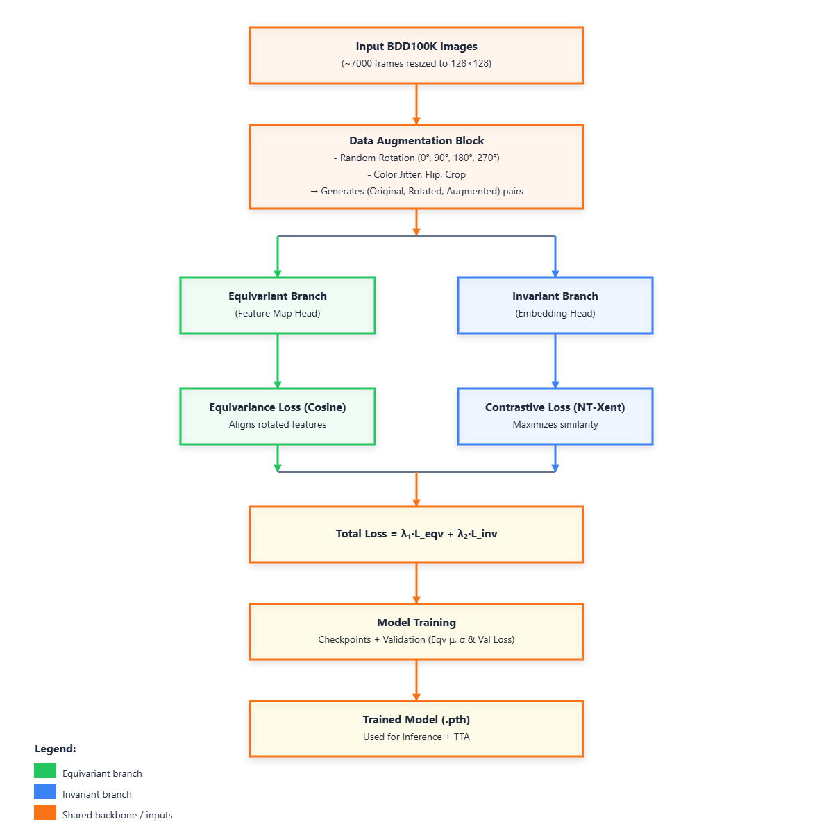
Center for Intelligent Mobility (CIM)
Envisions Smarter and Safer Mobility
Data flow diagram:-

Slide 13
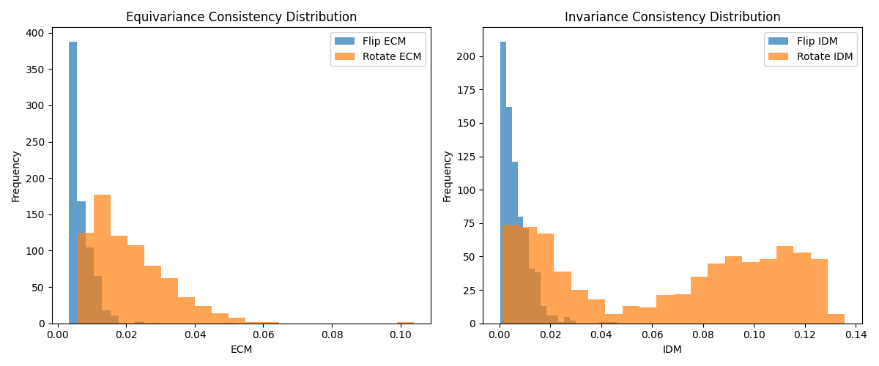
Center for Intelligent Mobility (CIM)
Envisions Smarter and Safer Mobility
Results and evaluation metrices:-
Quantitative Evaluation-
Equivariance Consistency Metric (ECM):
Measures how consistently the feature maps transform under input rotation/flip.
  Lower ECM → stronger geometric consistency.
Invariance Difference Metric (IDM):
Measures how stable the invariant embeddings remain under transformations.
  Lower IDM → stronger semantic stability.

Slide 14
Center for Intelligent Mobility (CIM)
Envisions Smarter and Safer Mobility
Results and evaluation metrices:-
Quantitative analysis of the above mentioned metrices was done 760 unseen data.
Transformation | ECM (mean) | IDM (mean) | Correlation
Flip | 0.006862 | 0.006516 | 1.0000
Rotate (90°) | 0.021081 | 0.065820 | 1.0000

Slide 15
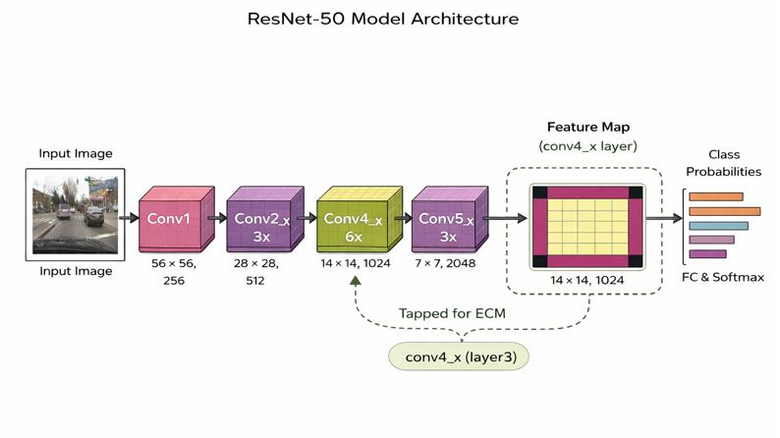
Center for Intelligent Mobility (CIM)
Envisions Smarter and Safer Mobility
Model Architecture:-

Slide 16
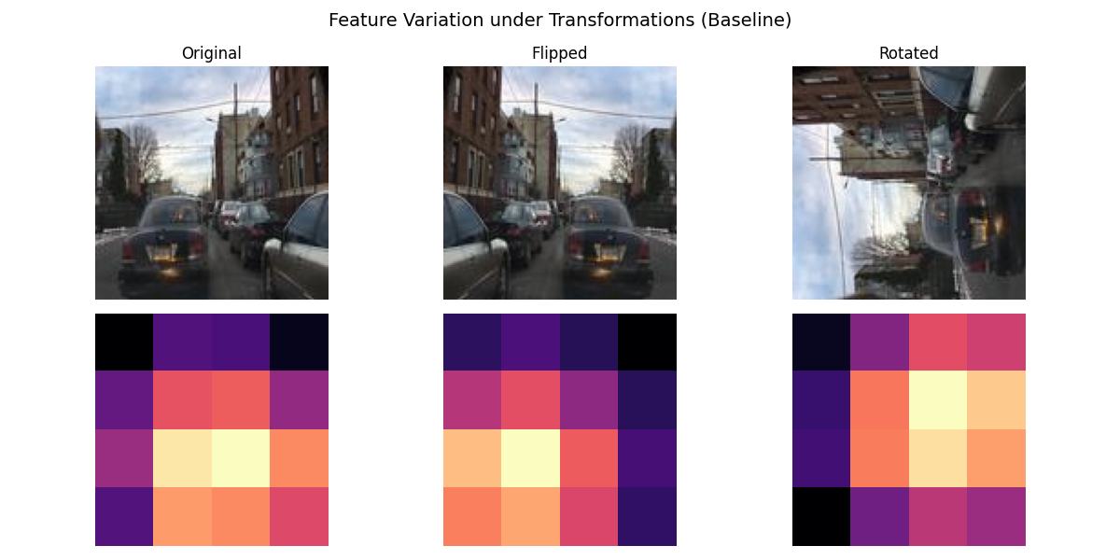
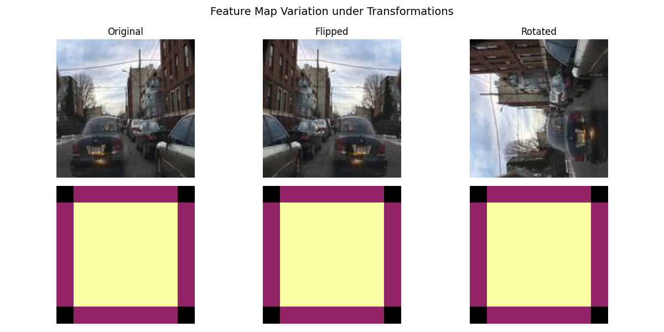
Center for Intelligent Mobility (CIM)
Envisions Smarter and Safer Mobility
Visual results:-
Baseline CNN(Res-Net50)
ECM (Flip): 1.568478
ECM (Rotate): 4.214605
IDM (Flip): 0.000914
IDM (Rotate): 0.006081
Dual Branch CNN
ECM (Flip): 0.010106
ECM (Rotate): 0.015568
IDM (Flip): 0.000061
IDM (Rotate): 0.011262

Slide 17
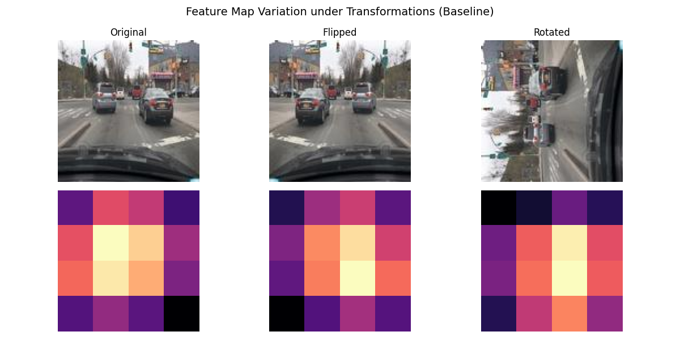
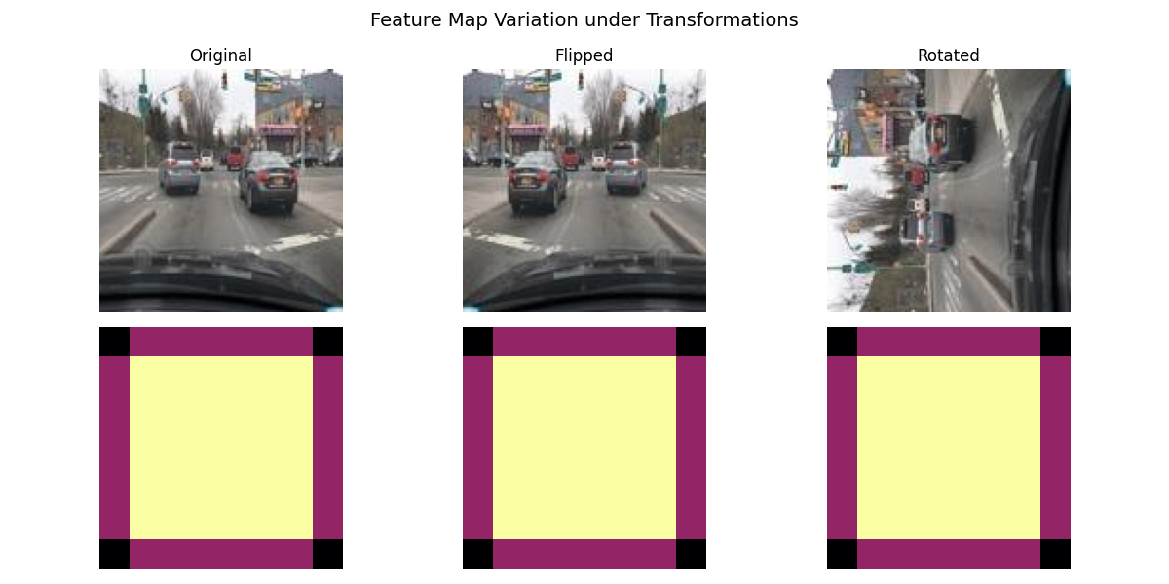
Center for Intelligent Mobility (CIM)
Envisions Smarter and Safer Mobility
Visual results:-
Baseline CNN(Res-Net50)
ECM (Flip): 1.268820
ECM (Rotate): 4.054253
IDM (Flip): 0.001348
IDM (Rotate): 0.005362
Dual Branch CNN
ECM (Flip): 0.010840
ECM (Rotate): 0.025333
IDM (Flip): 0.000010
IDM (Rotate): 0.024821

Slide 18
Center for Intelligent Mobility (CIM)
Envisions Smarter and Safer Mobility
Conclusion:-
This project addressed the challenge of robust visual perception in dynamic real-world environments.
A dual-branch equivariant–invariant learning framework was proposed to jointly preserve geometric consistency and semantic stability.
The shared ResNet-50 backbone enabled efficient feature reuse while separating learning objectives.
Quantitative evaluation using ECM and IDM demonstrated significant improvements over the baseline CNN.
Qualitative visualizations further confirmed structured geometric behavior and stable semantic representations.
The results validate that explicitly modeling equivariance and invariance leads to more reliable perception under distribution shifts.

Slide 19
Center for Intelligent Mobility (CIM)
Envisions Smarter and Safer Mobility
Thank You

