Slide 1

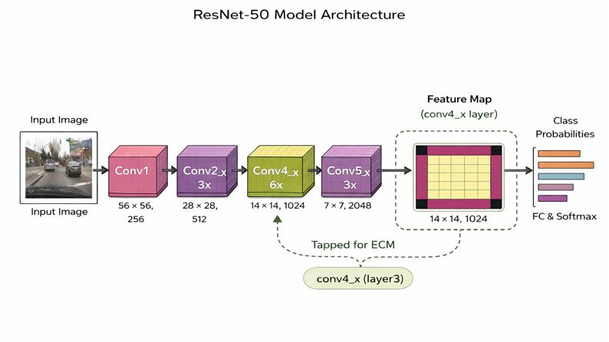
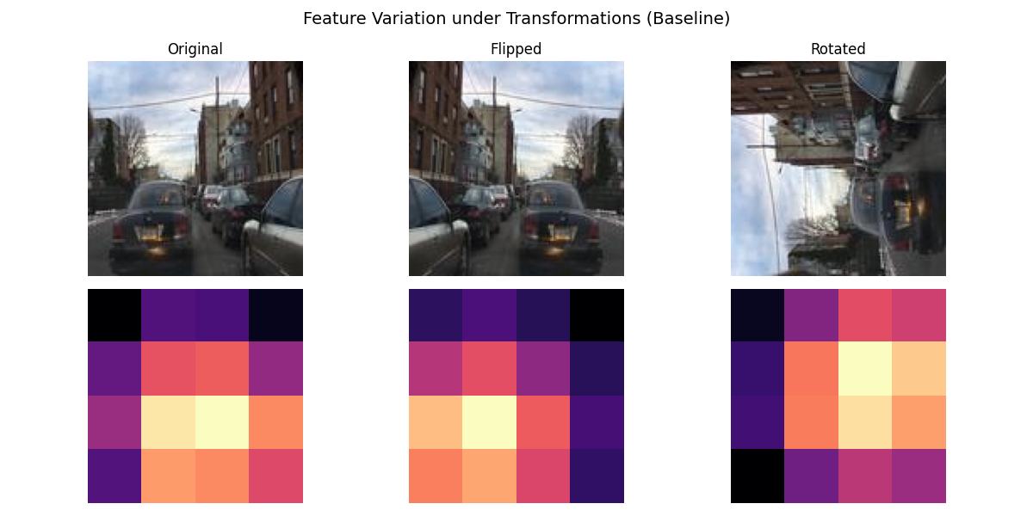
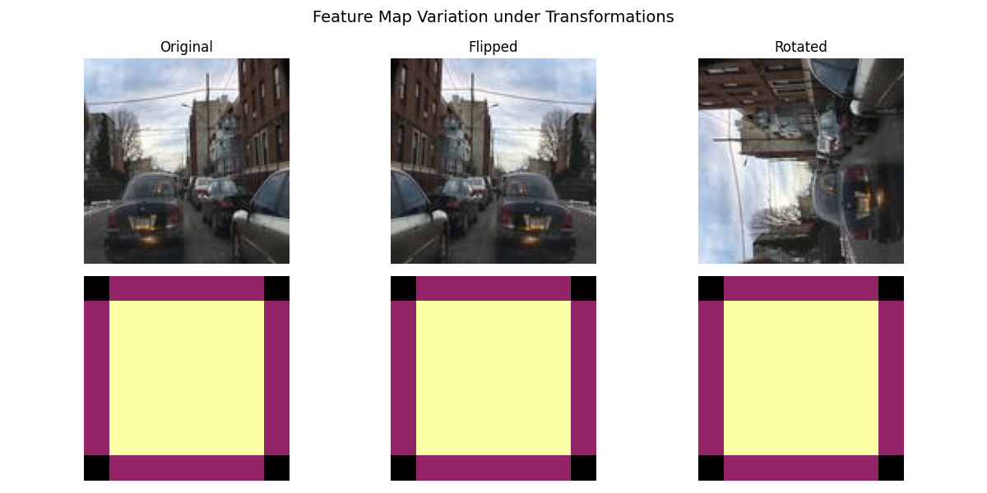
Hybrid Equivariant-Invariant Feature Learning for Visual perception in Dynamic visual environments.
Vineet V Desai
Dr. Ujwala Patil, Dr. Nalini Iyer and Prof Preeti Pillai
Department: Electronics and Communication.
Problem statement
Dual Branch CNN(Res-Net50)
Results
Existing vision models struggle under geometric and appearance variations. This work enables robust perception by jointly learning equivariant and invariant representations.
Utilizes a ResNet-50 backbone to extract shared low- and mid-level visual features from input images.
Splits the shared features into two specialized branches: an equivariant branch for preserving geometric structure and an invariant branch for stable semantic representation.
The equivariant branch enforces predictable feature transformations under rotations using spatial feature alignment.
Quantitative Results:
Transformation | ECM (mean) | IDM (mean) | Correlation
Flip | 0.006862 | 0.006516 | 1.0000
Rotate (90°) | 0.021081 | 0.065820 | 1.0000
Objectives
Design a hybrid feature backbone that jointly learns equivariant features (for geometric consistency) and invariant features (for semantic stability).
Visualize and analyze the learned equivariant and invariant feature representations to interpret model behavior under geometric transformations.
Visual Results:
Baseline CNN(Res-Net50)
Contributions
Introduced a dual-branch hybrid architecture for joint equivariant and invariant learning
Proposed ECM and IDM for direct representation-level evaluation.
Demonstrated improved robustness under real-world distribution shifts
Dual Branch CNN(Rest-Net50)
Literature survey
  The invariant branch produces transformation-insensitive embeddings using global pooling and contrastive learning.
  Trained using complementary equivariance and invariance losses, enabling robust generalization to unseen transformations.
  Controlled data augmentations generate paired views to jointly learn geometric consistency and semantic stability.
Standard CNNs provide translation equivariance but fail under rotations, viewpoint, and scale changes, leading to poor robustness in real-world settings.
Equivariant networks improve geometric consistency but often increase complexity and lack flexibility for unconstrained environments.
Invariant and contrastive learning methods enhance semantic stability but may discard important spatial and geometric information.
Conclusion
A dual-branch equivariant–invariant framework enables robust visual representations by preserving geometric consistency and semantic stability. The shared ResNet-based design generalizes well to unseen transformations, supporting reliable real-world perception.
Research Experience for Undergraduates 2025-2026
Notes:
1

