Slide 1
Knowledge Base - Document Indexing & RAG System
To build a system that:
Downloads documents from Confluence
Extracts and chunks data from PDF, DOCX, and XLSX files
Embeds data using SentenceTransformers
Stores and queries embeddings in ChromaDB
Uses a local LLM (via Ollama) for contextual question-answering (RAG)

Slide 2
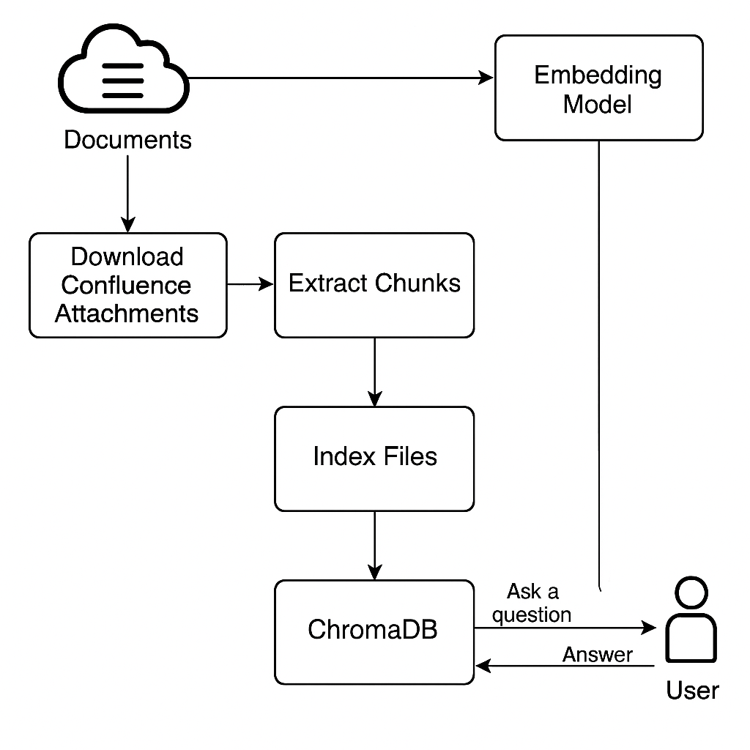
Step 1: Download from Confluence
The process begins by connecting to Confluence using the REST API. Using Python's `requests` and `HTTPBasicAuth`, attachments from a specific page are downloaded. These files can be PDFs, DOCX, or XLSX and are saved locally for processing.

Slide 3
Step 2: Extract Chunks from Documents
Documents are parsed based on type: - PDFs are parsed using `PyMuPDF` (fitz) - Excel files are parsed using `pandas` - Word documents are parsed using `python-docx` Each document is chunked into blocks of 300 words for embedding.

Slide 4
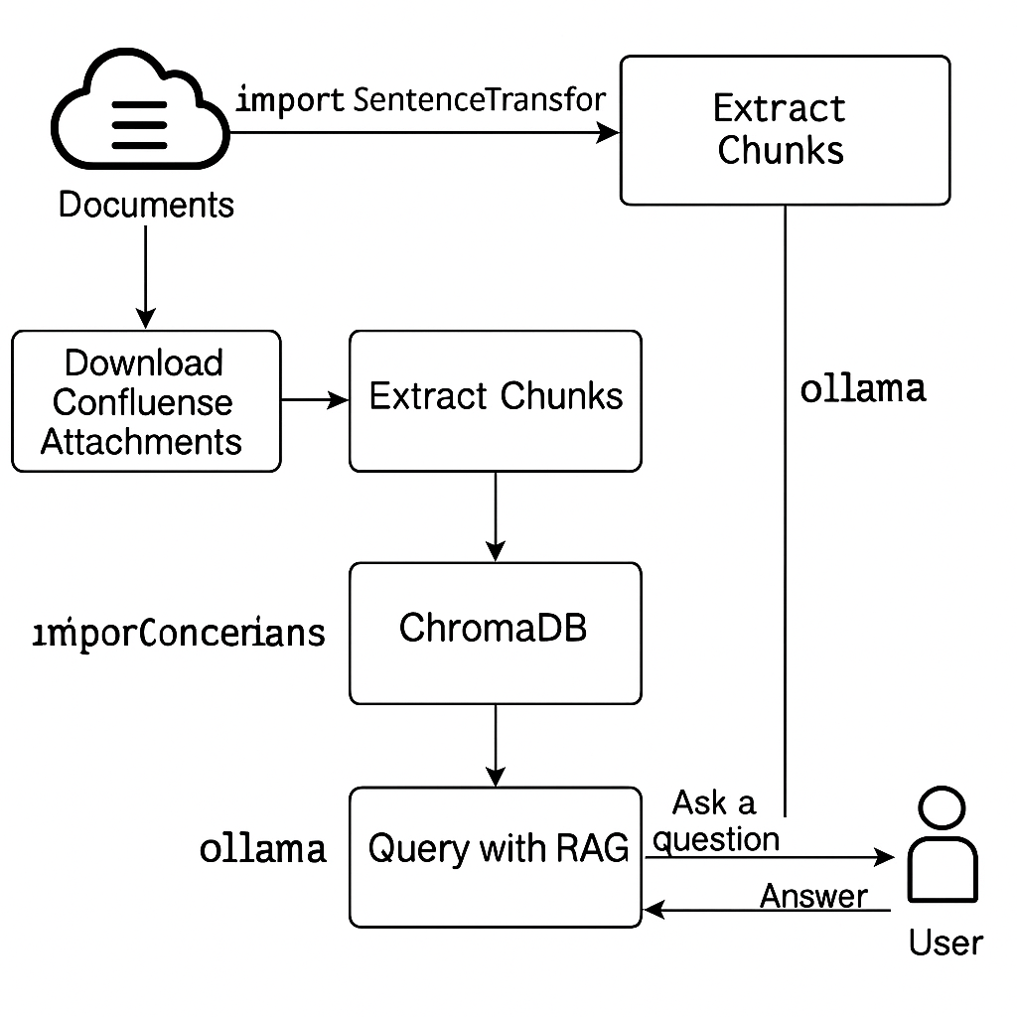
Step 3: Generate Embeddings
`SentenceTransformer` (all-MiniLM-L6-v2) is used to encode each chunk into a dense vector. These embeddings allow semantic comparison between query and document chunks.

Slide 5
Step 4: Store in ChromaDB
All document chunks and their embeddings are stored in a ChromaDB collection. Metadata such as file type, source, and page/sheet/row info is also stored for filtered search.

Slide 6
Step 5: Query and RAG using Ollama
When the user asks a question, its embedding is compared with ChromaDB to retrieve top-matching chunks. These context chunks are passed to a local LLM (Ollama) via prompt for generating a final answer.

Slide 7
End-to-End Workflow Summary
The system handles full document processing from Confluence download to LLM-powered query answering. Technologies used: `requests`, `fitz`, `pandas`, `docx`, `SentenceTransformer`, `ChromaDB`, and `Ollama`.

Slide 8
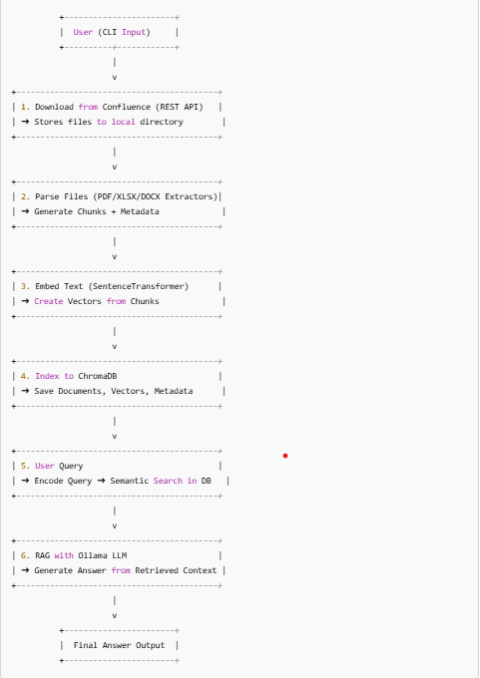
Data Flow Diagram

Slide 9
Tech Stach Summary
Component | Tool/Library
Vector DB | ChromaDB
Embedding Model | SentenceTransformers
LLM | Ollama (phi:latest)
File Parsing | PyMuPDF, pandas, python-docx
HTTP API | requests + HTTPBasicAuth
Local Storage | OS filesystem
Interface | Command Line (CLI)

