Slide 1
YULU BIKES
Analysis of the factors affecting Customer Demand

Slide 2
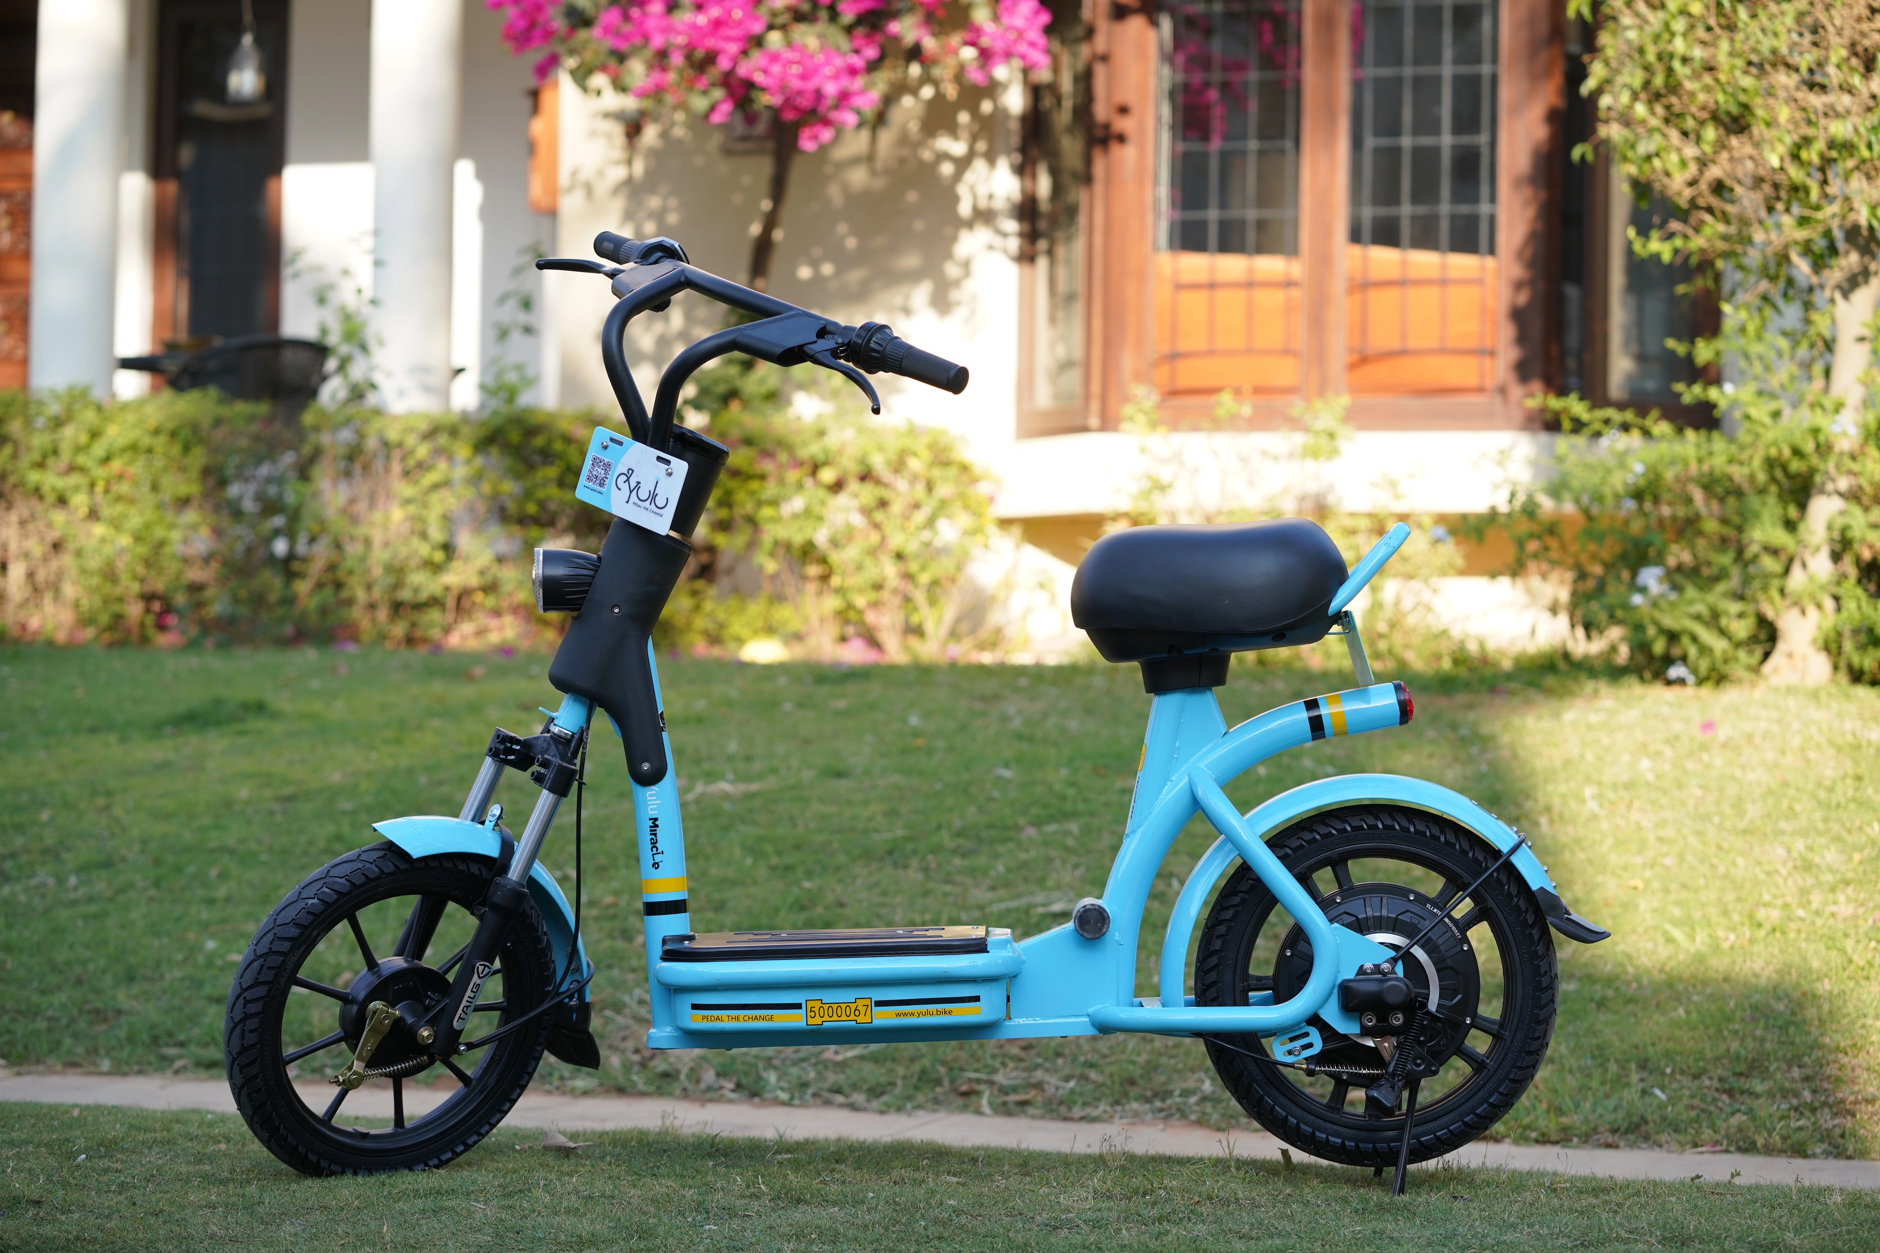
WHAT ARE YULU BIKES
Yulu is a technology-driven mobility platform that enables Integrated Urban Mobility across public and private modes of transport. Using Micro Mobility Vehicles (MMVs) through a user-friendly mobile app, Yulu enables first and last-mile connectivity that is seamless, shared and sustainable.

Slide 3
Yulu Wants to know !!!
What are the conditions where the probability is highest for Yulu Bikes demand?
What time of the day can Yulu Bikes experiment with surge pricing?
Does seasonality play a role in the demand?
How to increase the number of registered customers?
Is the demand effected by the fact that the day is a holiday or a working day?
What role does weather play on Yulu Bikes demand?
Do we see any trend in the demand for Yulu Bikes? How can we leverage it?

Slide 4
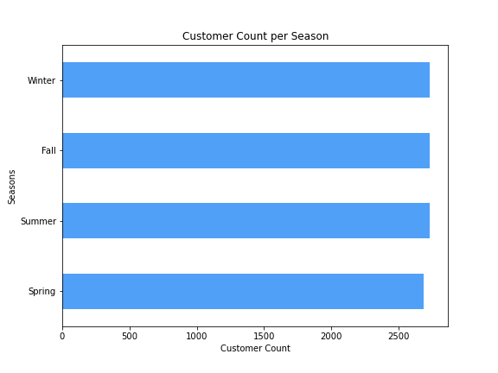
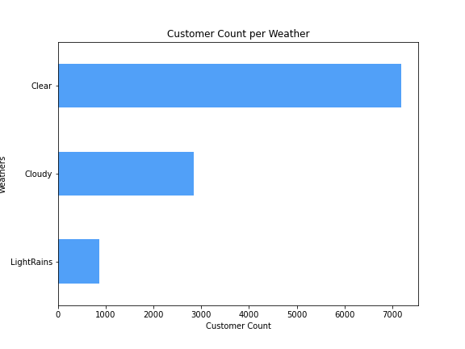
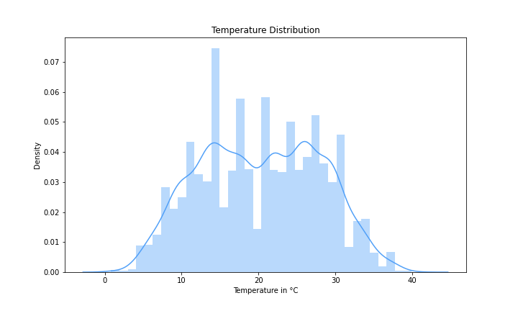
Season & Weather Data
The data provided by Yulu consists of equal proportions of records for all the 4 seasons, hence quite a balanced quarterly and yearly analysis can be ensured.
For the weather data, there are 8.5 times more records for clear sky than light rains as well as 2.5 times more records for cloudy sky compared to light rains. This imbalance is on expected lines as is indicative of the average weather conditions in the country.
The temperature range of the data varies from 1°C to 41°C, averaging at 20°C, with highest density being around 10°C - 30°C.

Slide 5
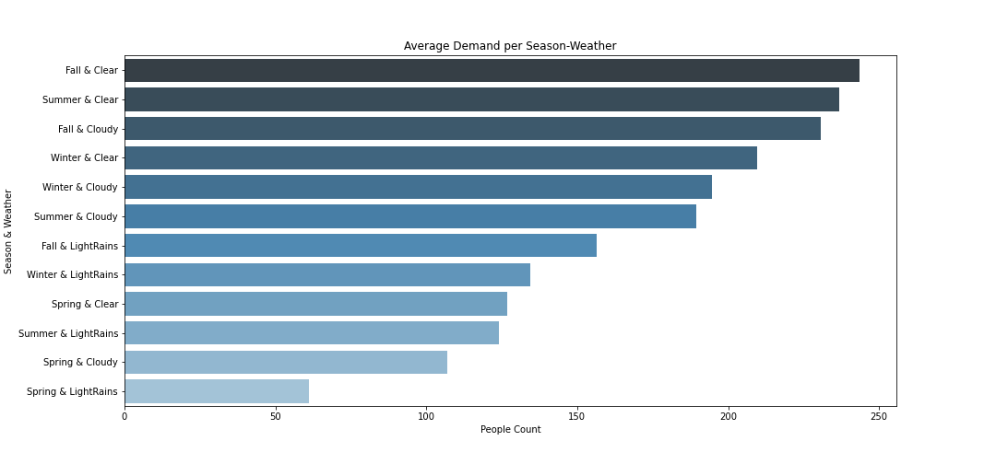
Demand per Season & Weather
Majority Yulu customers prefer a clear weather on almost all the seasons except spring.
The second most preferred weather is cloudy, followed by light rains.
A clear or cloudy weather in either Fall or Winter attracts the highest number of customers at Yulu.

Slide 6
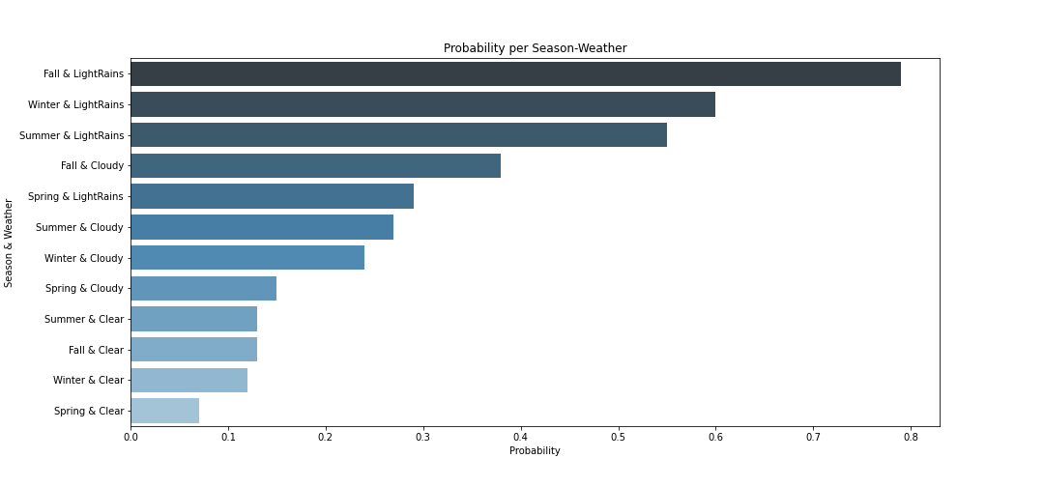
Probability per Season & Weather
Although the customer count during light rains is less, we find that there is the highest probability of a customer to ride a Yulu bike during light rains with 80% !!
In fact, light rains make the customers use Yulu in almost every season.
Second most probable condition is a cloudy day during the Fall.

Slide 7
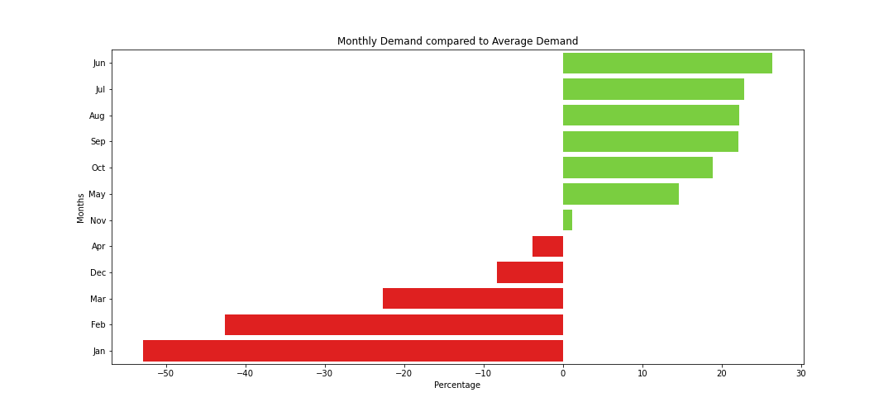
Demand Per Month
Months from May to Oct see the above average demand in the customer count than the average demand, peaking at June with 26%
Jan, Feb and Mar sees the highest dip in customer demand on the same parameter, with demand dropping more than 50% in Jan.

Slide 8
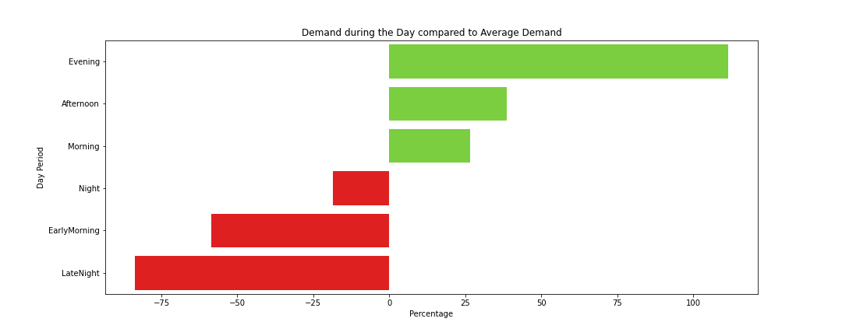
Demand during the Day
Day Period | Timings
EarlyMorning | 4:00 am-7:59 am
Morning | 8:00 am-11:59 am
Afternoon | 12:00 pm-4:59 pm
Evening | 5:00 pm-7:59 pm
Night | 8:00 pm-11:59 pm
Late Night | 12:00 am-3:59 am
Evening time (5pm to 8pm) sees the above average demand in the customer count than the average demand, at 111%.
Customer demand slumps after 8pm until 8 am, which is on expected lines.
Night hours (8pm-12am) is one area that has a great scope for growth.

Slide 9
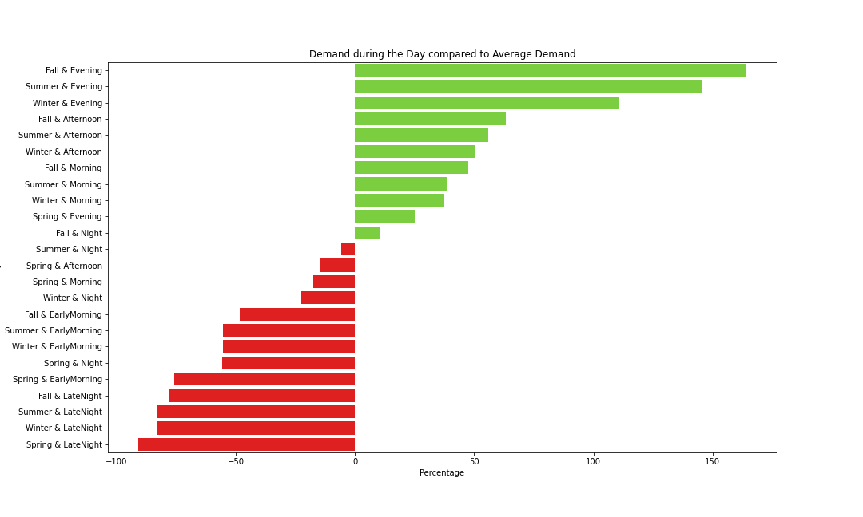
Demand during the day
Evening time sees the surge in demand in all the seasons than the average demand, followed by Afternoon time. Fall & Evening sees the highest jump with 164%, followed by Summer evening and Winter evening at 145% and 111% respectively
The only time afternoon time sees a slump is during Spring season.
Summer and winter mornings (8am to 12 noon) are also very unpopular for Yulu Bikes.
Jan, Feb and Mar sees the highest dip in customer demand on the same parameter, with demand dropping more than 50% in Jan.

Slide 10
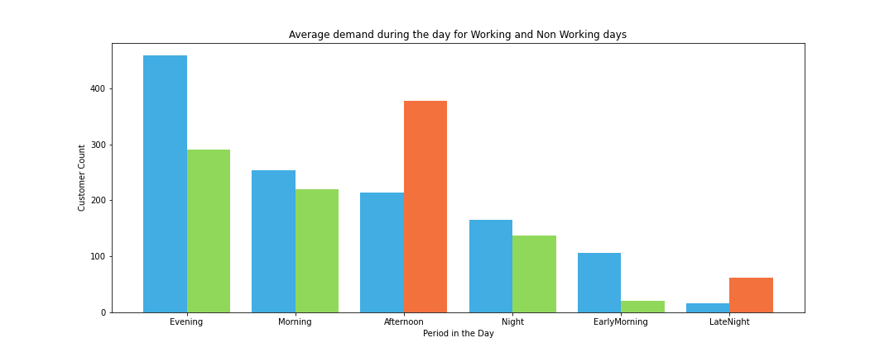
Working vs Non Working Day
Working
Non Working
Reverse Trend
The general trend is the expected one i.e. Evening, Morning and Afternoon are the day period with highest demand in Yulu Bikes, with late night hours and early morning hours is the time with least demand, with working days have higher demand than non working days.
However, an interesting insight is the fact that the demand during afternoon hours is much higher on a holiday than a working day.
There is also a higher demand on a holiday for Yulu Bikes during late night hours compared to the working days.

Slide 11
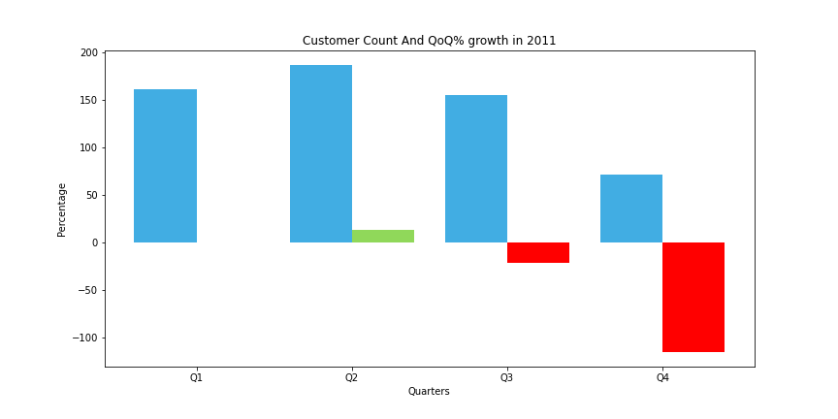
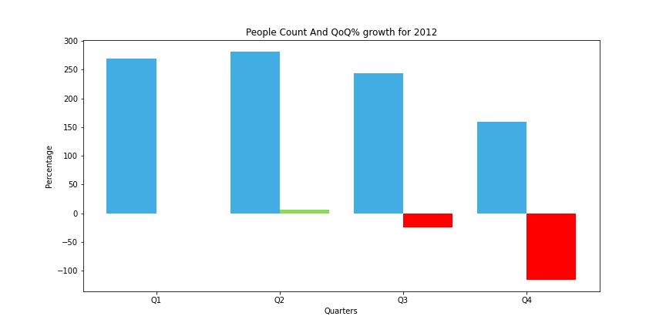
Quarterly Growth
Average Traffic
Q0Q %
In 2011, there is a slight increase of 14% in Q2, and we can see a decrease of 21% in Q3 and but the customer demand dropped very drastically in Q4, with demand dropping by 115%.
In 2012, we see the exact same trend as we saw in 2011!
There is again a slight increase of 6% in Q2, and we can see a decrease of 25% in Q3 and but the customer demand dropped very drastically in Q4, with demand dropping by 116%.

Slide 12
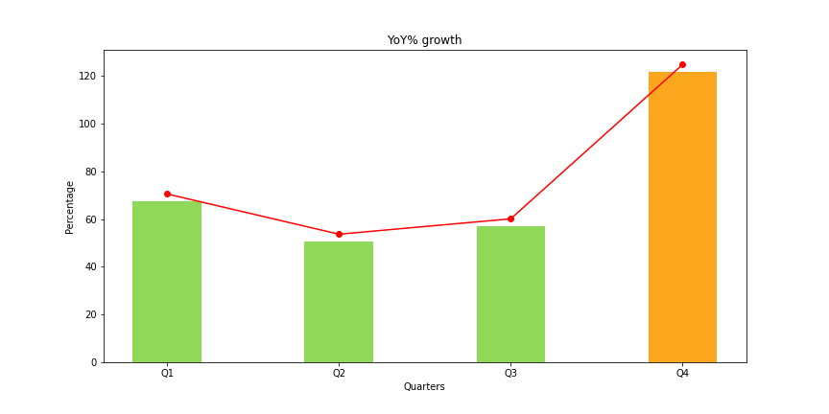
Yearly Growth
Quarters | YoY %
Q1 | 67.52
Q2 | 50.67
Q3 | 57.11
Q4 | 121.76
Analyzing the YoY Growth, things look very optimistic for Yulu Bikes as their popularity is on the rise annually.
All the quarters have seen a positive growth in the year 2012, with 68% in Q1, 51% in Q2, 57% in Q3.
Although Q4 is the worst performing quarter in terms of demand for each year, but the demand is actually seen to be increasing very drastically in Q4 with a whooping 121% jump in the demand.

Slide 13
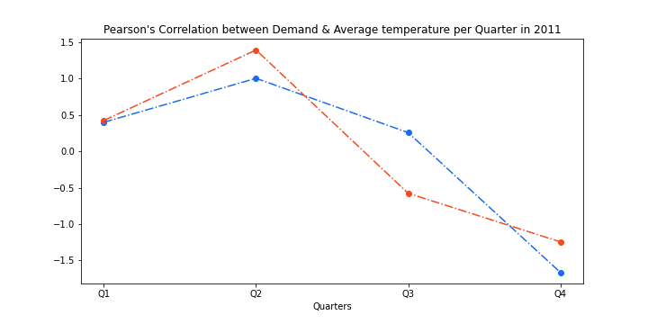
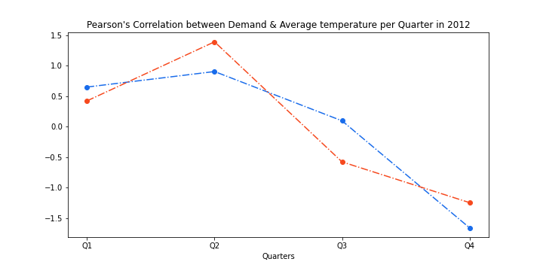
Effect of Temperature on Demand
Average Traffic
Average Temperature
We can see a huge positive correlation between customer count and the average temperature (around 90%).
As the temperature decreases, the demand for Yulu bikes also decreases.

Slide 14
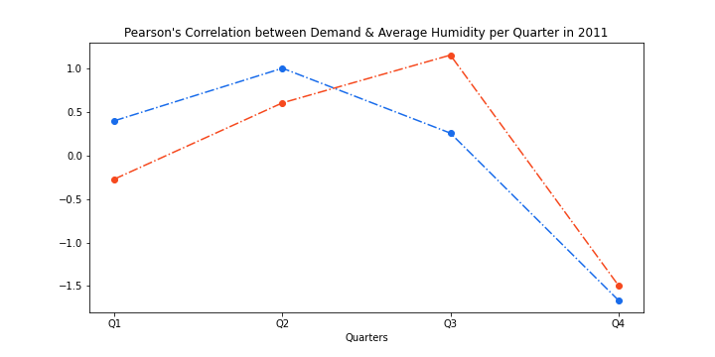
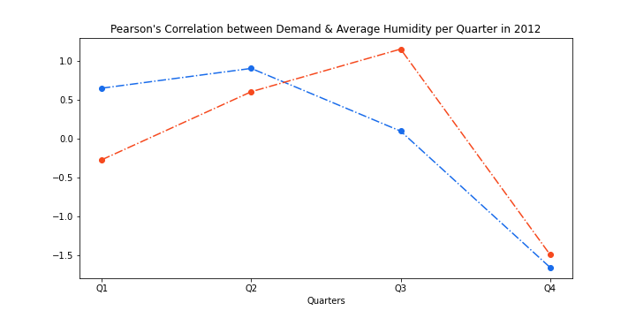
Effect of Humidity on Demand
Average Traffic
Average Humidity
We can see a huge positive correlation between customer count and the average humidity (around 80%)
As the humidity decreases, the demand for Yulu bikes also decreases.

Slide 15
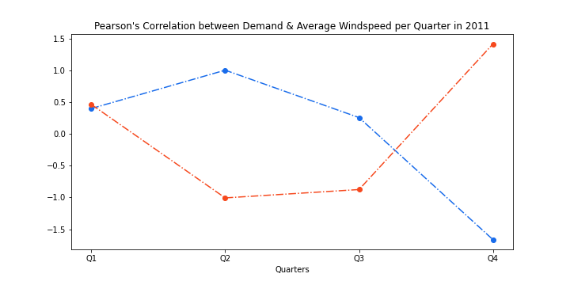
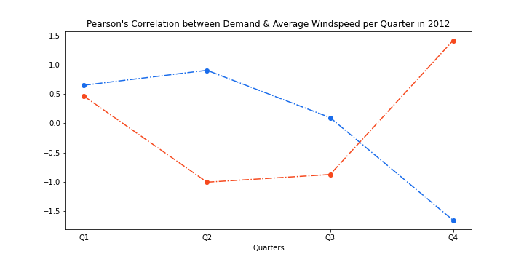
Effect of Windspeed on Demand
Average Traffic
Average Windspeed
We can also see a very strong negative correlation between customer count and windspeed ( -80%)
As the windspeed increases, the demand for Yulu bikes actually decreases.

Slide 16
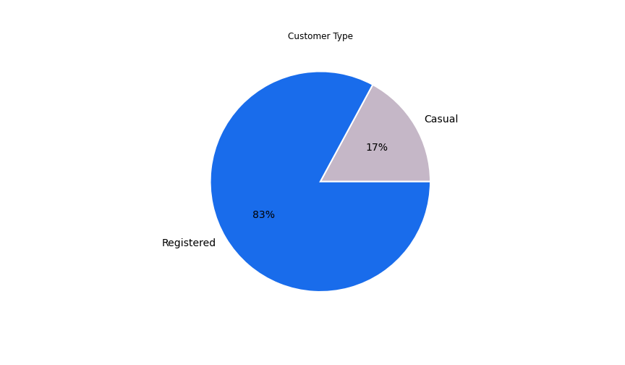
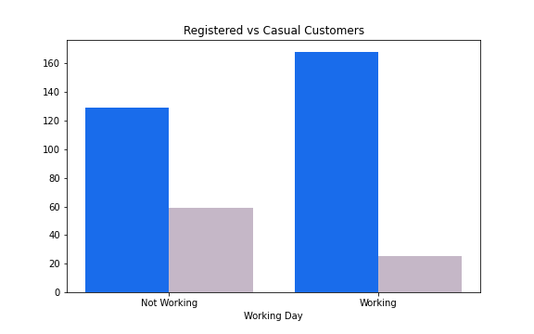
Registered vs Casual Customers
Casual Customers
Registered Customers
A great news for Yulu Bikes, 83% of the total customers are actually registered users.
Registered customers prefer using the Yulu bikes during the working days, that could be due to the fact that most of the working professionals prefer registered services for daily commuting.
Non registered (casual) customers prefer using Yulu on a holiday more than a working day

Slide 17
Recommendations To The Leadership
Overall, things look very optimistic for Yulu Bikes. The popularity of Yulu Bikes is on a rise per year.
All the quarters have seen a positive YoY growth :
Q1 : +68%
Q2 : +51%
Q3 : +57%
Q4 : +122%
SEASONS :
Yulu sees the highest demand during Fall and Summer seasons, while demand drops during Spring.
YULU : should focus on strengthening the demands in Fall and Summer, while need to focus on creating marketing campaigns & providing lucrative offers during Spring season.

Slide 18
Recommendations To The Leadership
WEATHER :
Majority of the customers prefer a clear weather, with cloudy weather being the second most preferred weather.
YULU : should experiment with surge pricing on a cloudy day.
SEASON + WEATHER :
The top most conditions with the highest demand for Yulu Bikes are during Clear weather during Fall, Summer and Winter, along with Cloudy conditions during Fall and Winter.
YULU : should experiment with surge pricing for conditions such as:
Fall & Clear
Summer & Clear
Winter & Clear
Fall & Cloudy
Winter & Cloudy

Slide 19
Recommendations To The Leadership
HIGHEST PROBABILITY OF A CUSTOMER VISIT :
The highest probabilities for the customers to use a Yulu Bike is during
Fall with Light Rains : 80%
Light Rains in Winter : 60%
Light Rains in Summer : 55%.
YULU : should experiment with surge pricing during Light Rains throughout the year.
WORKING DAY vs HOLIDAY :
We do not see any significant difference of working/non working days for any season as such. Fall and Summer are most preferred ,Clear skies are most preferred by the customers.
However, on a holiday, Yulu is more in demand by customers that are not registered.
YULU : should focus on creating loyalty campaigns on holidays, to convert the casual customers into registered customers.

Slide 20
Recommendations To The Leadership
TEMPERATURE :
Temperature has very strong correlation with Yulu customer count i.e. around 90%.
Temp where demand increases : around the average temp of 26°C, with the range of 10°C to 41°C
Temp where demand decreases : as the average temp drops below 17°C, with the range of 6°C to 30°C
Temp where demand perishes : as the average temp drops below 12°C, with the range of 0°C to 29°C
Temperature with the highest growth YoY (122%) : average temp of 12°C, with the range of 0°C to 29°C
YULU : should look to increase their operations in the cities where mostly the temperature range lies between 17°C and 41°C.
YULU : should also start new marketing ventures during the colder seasons where the temp range is 0°C to 12°C, which is the temp range with fastest growing customer demand.

Slide 21
Recommendations To The Leadership
Quarter | Average Humidity (%) | Average Windspeed (kmph)
Q1 | 60.85 | 13.41
Q2 | 64.12 | 11.51
Q3 | 66.17 | 11.68
Q4 | 56.29 | 14.64
HUMIDITY AND WINDSPEED :
Humidity has very strong positive correlation with Yulu customer count i.e. around 80%.
Windspeed has very strong negative correlation with Yulu customer count i.e. around -80%.
YULU : should target cities and seasons where humidity is in the range of 60% to 70%.
YULU : should target cities and weather where windspeed is on a lower side, usually less than 12 Km/h.

Slide 22
Recommendations To The Leadership
SPIKES DURING THE DAY :
Evening, Morning and Afternoon are the day period with highest demand in Yulu Bikes, but 8pm to 12 am is the time where demand decreases.
Working days have higher demand than non working days.
Although, demand during afternoon & late night hours is much higher on a holiday than on a working day.
Evening time sees the surge in demand in all the seasons than the average demand, followed by Afternoon time. Fall & Evening sees the highest jump with 164%, followed by Summer evening and Winter evening at 145% and 111% respectively
YULU : should experiment with surge pricing during 5pm to 8pm time period during the day, throughout the year.
YULU : on a holiday, should try targeted ad campaigns during 12noon to 5pm as well as during 12am to 4 am time period.
YULU : should try lucrative offers during night time (8pm to 12am) as this is the time which has a very good scope of growth.

Slide 23
Thank you for your time
VINEET PANDYA
Data Scientist
LinkedIn : https://www.linkedin.com/in/vineet-pandya/
Kaggle : https://www.kaggle.com/vineetpandya/code
Medium : https://medium.com/@vineet.pandya
Email : vineet.pandya@yahoo.com
Phone : +91 - 8770836371

