Slide 1
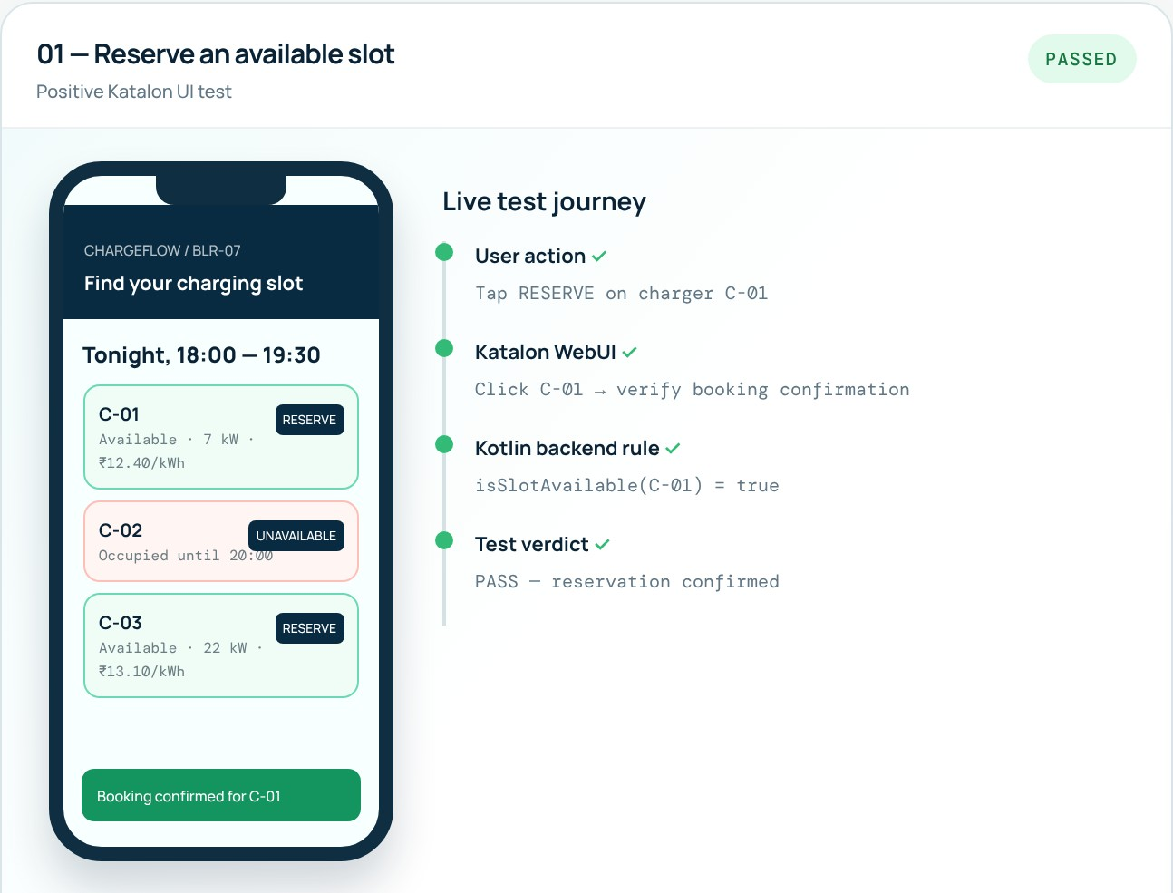
BMSCE
LOGO
B.M.S. College of Engineering, Bengaluru
Department of Artificial Intelligence and Data Science
ALTERNATIVE ASSESSMENT TOOL · SOFTWARE TESTING
ChargeFlow: Testing a Smart EV Charging Reservation System
Katalon Studio · JUnit 5 · PIT mutation testing
SUBMITTED BY
Manoj Kumar N
1BM23AD032
Vineet Kamath
1BM23AD069
UNDER THE GUIDANCE OF
Dr. Lakshmishree K P
Snapshot: ChargeFlow demo running test case 01 (reserve a slot)
Notes:
Introduce the team, the guide and ChargeFlow, a smart EV charging reservation app we tested with Katalon, JUnit and PIT.

Slide 2
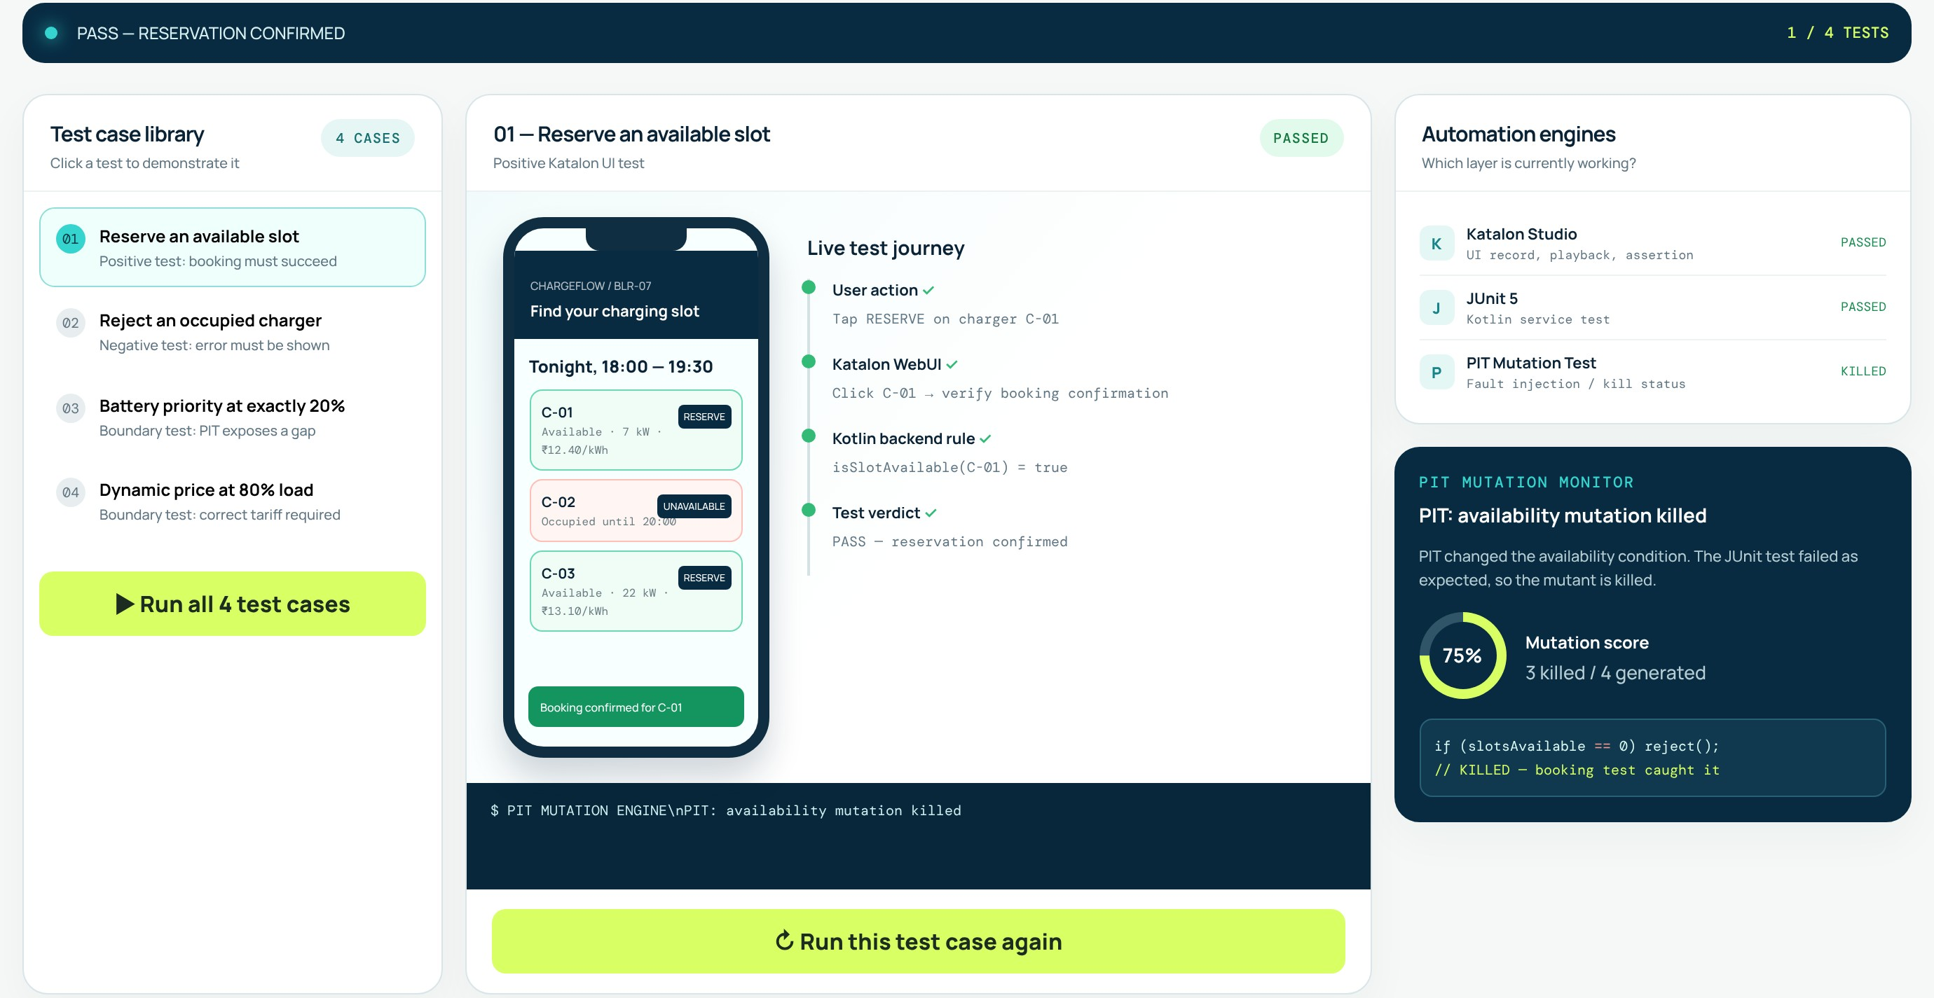


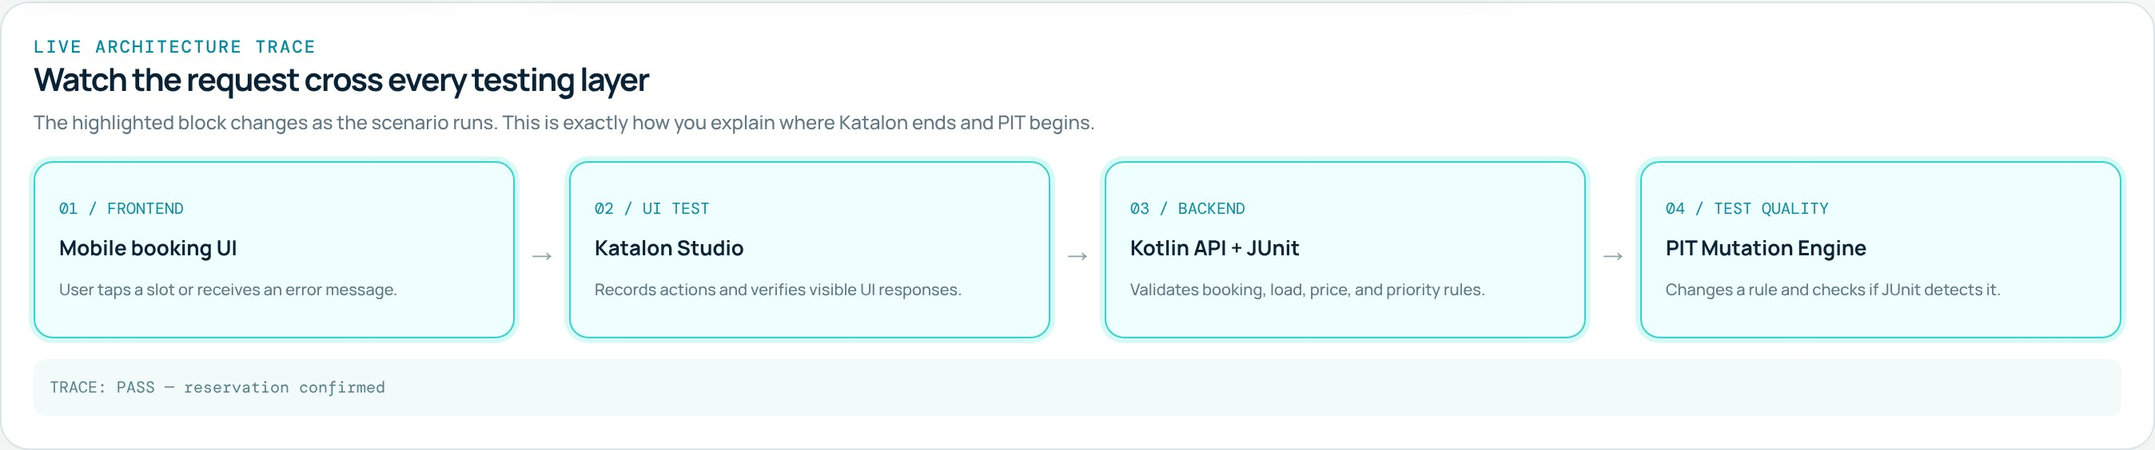

Project overview: what we tested
ChargeFlow lets EV drivers reserve a charging slot. Its backend enforces three business rules, and each rule has its own test case.
Slot availability
Book a free charger; reject a busy one (TC‑01, TC‑02)
Low-battery priority
Battery at or below 20% gets HIGH priority (TC-03)
Dynamic tariff
Peak price at 80% station load (TC-04)
Notes:
The top snapshot is our testing dashboard: test library, phone UI, live journey and PIT monitor. The bottom strip is the architecture trace: UI, Katalon, Kotlin backend with JUnit, then PIT.

Slide 3
Katalon Studio: automating the UI tests
Katalon Studio is a test-automation tool built on Selenium. It drives the app the way a user would: it clicks, types and then checks what appears on screen.
1
Record
Use Record Web to capture our clicks on ChargeFlow (e.g. tap RESERVE on C-01).
2
Object Repository
Katalon saves each button and label as a Test Object with a locator (XPath / CSS).
3
Add assertions
WebUI.verify… keywords check the expected result, e.g. the "Booking confirmed" message.
Execute & report
Run on Chrome; Katalon replays the steps and logs PASS / FAIL with screenshots.
// TC-01 — Katalon test script (Groovy)
WebUI.click(findTestObject('btn_Reserve_C01'))
WebUI.verifyElementText(findTestObject('msg_Snack'),
'Booking confirmed for C-01')
4
Notes:
Katalon records the user flow, stores each UI element as a test object, adds verify keywords as assertions, and replays the flow to report pass or fail. The snapshot shows TC-01 passing.

Slide 4




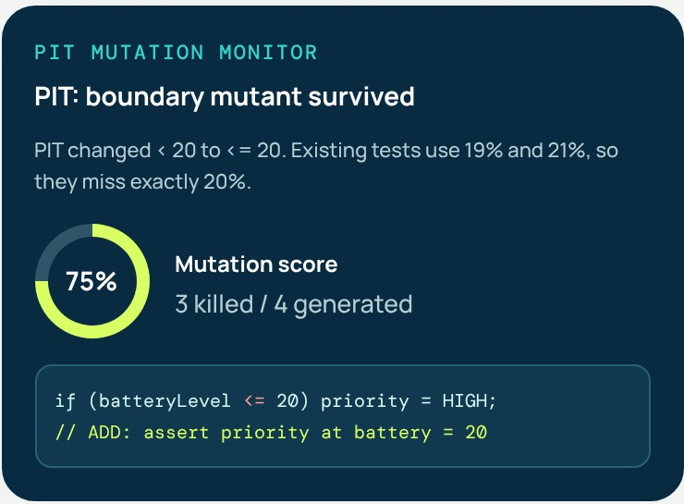
PIT: testing our tests with mutation testing
1. Mutate
2. Run JUnit
3. Killed or survived
4. Mutation score
PIT makes small changes ("mutants") to the compiled code, e.g. < becomes <=.
Our JUnit 5 tests run again against every mutant.
A failing test means KILLED (good). All passing means SURVIVED: a weak test.
Killed ÷ total mutants. It measures test strength, not just coverage.
What PIT found in ChargeFlow
4 mutants generated, 3 killed, so the score is 75%.
The survivor: PIT changed batteryLevel < 20 to <= 20. Our tests only used 19% and 21%, so the code at exactly 20% was never checked.
Fix: we added a JUnit test at batteryLevel = 20. The mutant is now killed and the score is 100%.
Snapshot: PIT monitor for TC-03
Notes:
PIT checks whether our JUnit tests would catch real bugs. It injects small faults; a good test fails and kills the mutant. Our battery-priority test missed the 20% boundary; after adding that test, all mutants are killed.

Slide 5



Results and conclusion
# | Test case | Tool / technique | Result
TC-01 | Reserve an available slot | Katalon · positive test | PASS
TC-02 | Reject an occupied charger | Katalon · negative test | PASS
TC-03 | Battery priority at exactly 20% | JUnit + PIT · boundary value | FIXED
TC-04 | Peak tariff at exactly 80% load | JUnit + PIT · boundary value | PASS
4 / 4
test cases passing
75% → 100%
mutation score after the fix
Test every layer
Test the exact boundary
Measure test strength
Katalon checks what the user sees; JUnit checks the rules underneath.
Bugs hide at 20% and 80%, not at 19% or 81%.
PIT found a weak test that coverage alone could not reveal.
Thank you · Questions?
Notes:
All four test cases pass. PIT raised our mutation score from 75% to 100% once the boundary test was added. Thank the guide and invite questions.

