Slide 1
IBM University Engagement Project Submission
“Exploring the Power of Agentic AI with IBM Granite and LangFlow”

Slide 2

Project Tile – [Fitness Buddy: AI Powered Personal Fitness Coach]
Domain of Project – [Healthcare / Fitness ]
Student Name | Recent Passport Photo | Email ID | Mobile number [WhatsApp]
Vineet Singh |  | av.brothers2209e@gmail.com | 9569842479

Slide 3
Problem Statement -
Problem Statement No. 13: Fitness Buddy
The Challenge
In today’s fast-paced world, many individuals struggle to maintain a healthy lifestyle due to lack of personalized guidance, time constraints, and inconsistent motivation. Traditional fitness solutions often require expensive subscriptions, in-person consultations, or rigid schedules that do not adapt to personal preferences or daily routines.
Objective
There is a growing need for an accessible, friendly, and intelligent virtual assistant that can provide on-demand fitness advice, healthy lifestyle suggestions, and basic nutrition guidance—all tailored to individual needs and available at any time.
Fitness Buddy aims to solve this problem by offering a conversational AI-powered health and fitness coach that can:
• Recommend home workouts and routines based on user input.
• Provide motivational tips and daily fitness inspiration.
• Suggest simple, nutritious meal ideas.
• Encourage habit-building and consistency.

Slide 4
Technology Used
Tech Stack (Mandatory)
Use any one of the following approaches:
LangFlow + IBM watsonx.ai + Granite Models
IBM Cloud Agentic Lab with IBM Granite Models
Replicate with LangChain + RAG + IBM Granite Models
I used LangFlow + IBM watsonx.ai + Granite Models
IBM Watsonx.ai
Used for accessing IBM Granite AI Models.
IBM Granite Model
Granite 4-h-small Instruct
LangFlow
Used to build visual AI workflow.
Agentic AI
For intelligent decision making.

Slide 5
Proposed Solution -
Proposed Solution: AI-Powered Fitness Buddy
The proposed solution is a multi-agent AI-powered Nutrition Agent built using LangFlow, IBM watsonx.ai, and Granite Models to provide personalized, real-time dietary guidance. The system addresses challenges in diet planning, nutrition tracking, and preventive healthcare through an intelligent, modular architecture.
At its core, the solution uses a Retrieval-Augmented Generation (RAG) pipeline to fetch accurate nutritional data from trusted sources such as USDA and WHO datasets. This data is embedded and stored in a vector database, enabling the system to retrieve and summarize food nutrition details (calories, macros, vitamins) using Granite models.
The system consists of four key agents:
Nutrition Knowledge Agent retrieves and summarizes nutritional information using RAG.
Diet Recommendation Agent generates personalized meal plans based on user inputs such as age, health conditions, dietary preferences, and fitness goals.
Health Advisory Agent provides preventive health suggestions, including disease-specific diets (e.g., diabetes-friendly or heart-healthy plans).
Food Log & Feedback Agent allows users to log meals via text, voice, or images and delivers instant nutritional analysis with actionable feedback.
The solution includes a user-friendly dashboard (built with Streamlit or React) that visualizes daily and weekly nutrient intake, highlights deficiencies, and tracks progress toward health goals.
LangFlow is used to orchestrate agent workflows, while watsonx.ai ensures scalable model deployment, embeddings, and AI governance. Granite models power reasoning, summarization, and personalization.
Overall, this solution delivers an end-to-end intelligent nutrition assistant that promotes healthier lifestyles through personalized insights, real-time feedback, and preventive healthcare recommendations.

Slide 6
Langflow component Used -
1) Chat Input - Interface where users enter their queries, preferences, or meal details (text/voice/image).
2) IBM watsonx AI Agent - Processes user input using Granite models to generate personalized nutrition insights and recommendations.
3) Name of IBM Granite model - Granite-3.3-8B-Instruct → Fast, efficient for real-time diet recommendations
4) Chat output - Displays AI-generated responses such as diet plans, nutritional analysis, and health suggestions.
5) File component - Stores and retrieves user data, meal logs, and nutritional datasets for analysis and tracking.
6) Prompt Component - Provides system instructions and defines the Fitness Buddy behavior.

Slide 7
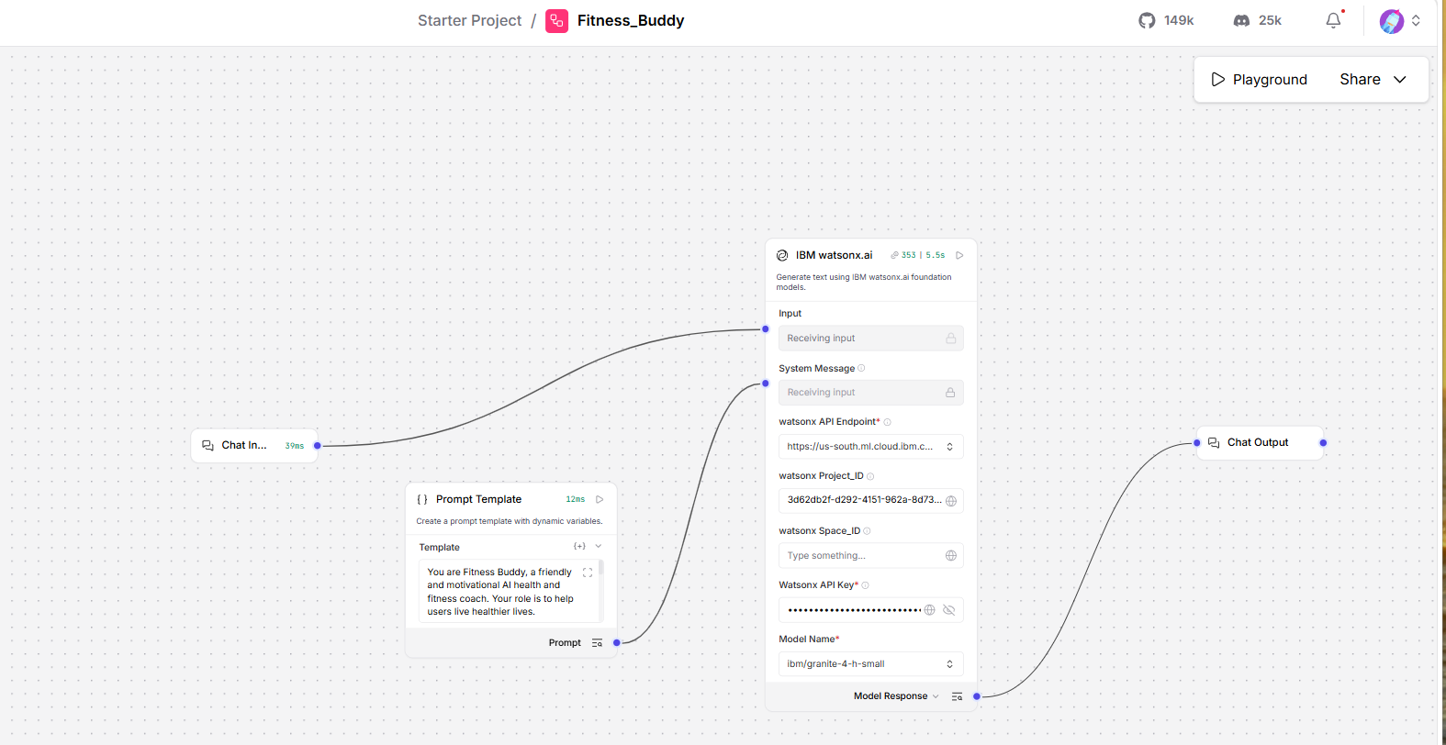
Langflow workflow -

Slide 8

Architecture blueprint

Slide 9

Role of Agentic AI in the solution
Role of Agentic AI in Fitness Buddy
Agentic AI enables Fitness Buddy to function as an intelligent and autonomous fitness coach rather than a basic chatbot. Using IBM watsonx.ai and IBM Granite models, it coordinates multiple specialized agents to provide personalized fitness support.
Each agent performs a specific role such as workout planning, nutrition guidance, motivation delivery, and progress tracking while collaborating to achieve user fitness goals. This multi-agent architecture improves efficiency and personalization.
Agentic AI provides context awareness by understanding user preferences, fitness levels, health goals, and daily routines. It adapts recommendations based on changing user needs and fitness progress.
Additionally, agents communicate with each other to provide balanced workout, nutrition, and lifestyle suggestions.
Overall, Agentic AI makes the system proactive, personalized, and goal-oriented, acting like a smart digital fitness coach available anytime.

Slide 10
Technology Used
LangFlow platform -For designing and orchestrating multi-agent workflows visually
IBM Granite model - Granite-4-h-small-Instruct for natural language understanding, fitness coaching, and personalized recommendations.
IBM Cloud – It provides the infrastructure to build, deploy, and scale the Fitness Buddy efficiently. IBM Cloud enables a reliable, secure, and scalable environment for deploying the Fitness Buddy.
Agentic AI – Enables autonomous decision-making and collaboration among multiple specialized fitness agents.
IBM Watsonx.ai - For model deployment, embeddings, and AI governance
Dashboard Interface- Used to display workout plans, goals, and progress tracking.

Slide 11
Novelty and Uniqueness
The proposed Fitness Buddy stands out by combining Agentic AI, personalization, and motivational intelligence into a single fitness coaching system.
• Multi-Agent Intelligence – multiple specialized agents collaborate to provide workout, nutrition, and motivation support.
• Personalized Fitness Plans – Tailors workout routines based on fitness goals and user preferences.
• Continuous Motivation – Provides daily fitness inspiration and habit-building reminders.
• Real-Time Adaptation – Updates recommendations according to user feedback and progress.
• Simple Nutrition Guidance – Suggests healthy meals and lifestyle improvements.
• User-Friendly Interaction – Supports natural language conversations.
• Scalable & Enterprise Ready – Built on IBM watsonx.ai and IBM Granite Models.
This makes the solution a smart, adaptive, and proactive digital fitness coach rather than a simple fitness chatbot.

Slide 12
Git Hub Link
GitHub URL – https://github.com/VineetSinghSF/Fitness_Buddy_Agentic_AI

Slide 13
Future Scope
1. Wearable Device Integration –
The system can be integrated with fitness trackers and smartwatches to collect real-time health metrics such as steps, calories burned, heart rate, and sleep patterns. This will help Fitness Buddy generate more accurate and personalized recommendations.
2. AI-Powered Voice Assistant & Multilingual Support –
Future versions can support voice-based interaction and multiple languages. Users will be able to receive fitness guidance and motivation in their preferred language, making the solution more accessible and inclusive.
·
·
·

Slide 14


