Slide 1

DEPARTMENT OF COMPUTER SCIENCE AND ENGINEERING
EXPLAINABLE LINK & QR
RISK SCREENING
An Offline, Deterministic Classical Symbolic AI Framework for Web Security
Presented by: Vineeth P-240701589|Tharun SK-240701563
Department: Computer Science and Engineering
College Name: Rajalakshmi Engineering College
Academic Year: 2026–2027 | Course: Foundations of Artificial Intelligence
Notes:
Good morning, respected evaluators. Today I present our Artificial Intelligence capstone project: Explainable Link and QR Risk Screening. Our system demonstrates classical symbolic AI: A* heuristic search and forward-chaining propositional Horn logic, delivering a 100% offline, privacy-preserving, and mathematically provable security screening tool.

Slide 2


01 · ABOUT THE PROJECT
OFFLINE, DETERMINISTIC & FULLY EXPLAINABLE LINK SCREENING
Screen web URLs and QR codes locally with zero cloud dependencies, zero DNS lookups, and zero black-box ML.
100%
Air-Gapped & Offline
Zero external network requests, zero remote DNS queries, and zero tracking. Operates in isolated and restricted environments.
2
Classical AI Engines
Primary AI: PL-FC-Entails Forward Chaining over Horn logic. Secondary AI: A* Heuristic Search for string typosquatting detection.
0
Black-Box ML or Hallucination
Every risk verdict is 100% mathematically proven and justified by a complete proof-tree DAG mapping back to observable lexical facts.
2
Notes:
Slide 2 gives an executive overview of the project. Unlike cloud security services that upload links to external servers or use black-box neural networks, our system operates completely offline using two classical AI engines: PL-FC-Entails forward chaining and A* search. There is zero statistical guessing; every verdict is supported by a formal proof tree.

Slide 3

02 · PROBLEM AND OBJECTIVES
ADDRESSING CYBER THREATS WHILE PRESERVING PRIVACY & EXPLAINABILITY
The Problem
Our Objectives
• Malicious links & QR codes rely on subtle structural deceptions (embedded credentials with '@', direct IP hosts, typosquatted brand domains).
• Cloud-based threat scanners leak internal corporate links, confidential parameters, and user browsing telemetry to third parties.
• Deep learning and LLMs operate as uninterpretable 'black boxes', giving vague probabilities (e.g. '87% risky') without auditability.
• Air-gapped and high-security networks cannot perform live DNS lookups or connect to cloud reputation feeds.
• Strict RFC 3986 Lexical Anatomy Parsing: Extract observable facts from URL components and offline OpenCV QR matrices.
• A* Heuristic Search Formulation: Detect brand typosquatting by finding optimal edit distance paths with an admissible heuristic.
• Propositional Horn Logic Engine: Execute PL-FC-Entails forward chaining over definite Horn clauses for linear-time deduction.
• Explainable AI (XAI) Synthesis: Construct visual proof-tree DAGs verifying every conclusion from ground facts to final risk verdict.
3
Notes:
Slide 3 compares the cyber threat problem against our system's core objectives. Attackers rely on deceptive URL syntax that evades standard filters. Meanwhile, cloud security feeds violate data privacy and deep learning classifiers cannot explain their verdicts. Our objective is to prove that classical symbolic AI provides the ideal transparent, air-gapped solution.

Slide 4


03 · TECHNOLOGY STACK
THREE CORE CLASSICAL AI AND COMPUTATIONAL FOUNDATIONS
RFC 3986 Lexical Engine
Syntactic Decomposition
Dissects input URLs into Scheme, Host, Port, Userinfo, Path, Query, and Fragment. Identifies IPv4/IPv6, octal/hex encodings, and dangerous executable file extensions.
A* Heuristic Search
Secondary AI Engine
Formulates string typosquatting as discrete graph search. Computes f(n)=g(n)+h(n) using an admissible length-discrepancy heuristic h(n) across 100+ curated brand names.
PL-FC-Entails Logic
Primary AI Reasoning
Forward-chaining inference over positive definite Horn clauses (P1 ^ ... ^ Pn => Q). Operates with an Agenda queue and dynamic premise count table in linear O(n) time.
100% Deterministic Architecture: Python 3.11 Standard Library + OpenCV (QR Decoder) + Flask Presentation. Zero external APIs or cloud dependencies.
4
Notes:
Slide 4 presents our three pillars. First, the RFC 3986 lexical parser extracts observable ground facts. Second, our secondary AI, A* heuristic search, explores string-edit state space to identify brand typosquatting. Third, our primary AI, PL-FC-Entails, applies forward chaining over propositional Horn clauses to logically deduce risks in linear time.

Slide 5



04 · KEY FEATURES
SIX CAPABILITIES DELIVERING UNCOMPROMISED SECURITY
Offline QR Matrix Decoding
Lexical Anatomy Analysis
A* Brand Typosquatting
Extracts 2D barcode payload via OpenCV without network communication or cloud telemetry.
Deconstructs credentials (@ symbol), raw IP hosts, non-standard ports, and file extensions.
Detects lookalikes (e.g. 'paypa1', 'g00gle') using admissible heuristic search against 100+ brands.
Forward-Chaining Reasoning
Explainable Proof Trees
Interactive Web Dashboard
Propositional Horn logic engine guarantees deterministic risk deductions with zero hallucination.
Synthesizes Directed Acyclic Graphs linking raw lexical facts to rules and final verdict.
Clean presentation dashboard featuring real-time risk screening and live SVG proof-tree viewer.
5
Notes:
Slide 5 outlines the six core features. The offline QR decoder extracts raw links from uploaded images without third-party APIs. The lexical analyzer detects hidden credentials and IP masking. A* search detects brand impersonation. Forward chaining enforces positive logic. Finally, proof trees and our interactive web dashboard make every decision fully transparent.

Slide 6
05 · HOW IT WORKS
FIVE SEQUENTIAL PHASES FROM INPUT TO PROVEN RISK VERDICT
1
2
3
4
5
Input
Lexical Parse
A* Search
Inference
Explain
URL string or offline QR code image upload.
RFC 3986 parser extracts Scheme, Host, Path, Port & Userinfo.
Computes optimal edit distance path vs brand dictionary.
PL-FC-Entails forward chaining fires Horn clause rules.
Synthesizes proof tree DAG and categorical risk verdict.
6
Notes:
Slide 6 visualizes our end-to-end processing pipeline. Phase 1 accepts a URL or QR code. Phase 2 extracts lexical ground facts. Phase 3 uses A* search to check brand similarity. Phase 4 runs forward-chaining deduction over the knowledge base. Finally, Phase 5 produces the categorical verdict and generates the proof tree DAG.

Slide 7
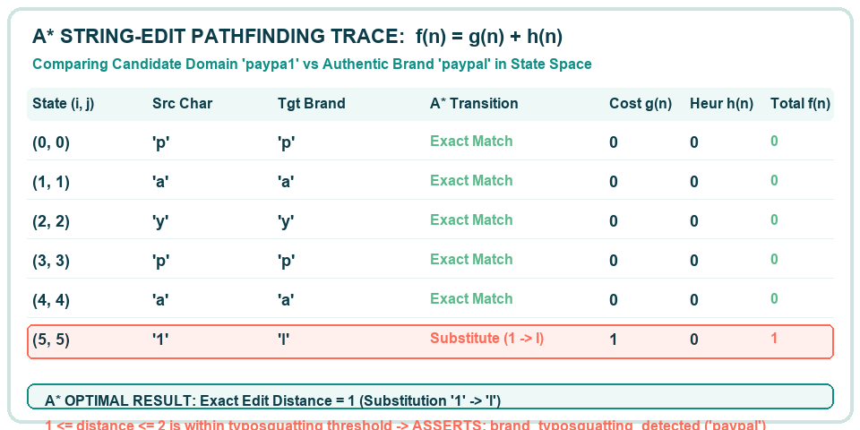
06 · HEURISTIC SEARCH
DETECTING BRAND TYPOSQUATTING VIA OPTIMAL STRING PATHFINDING
7
Notes:
Slide 7 dives into the mathematical formulation of our secondary AI: A* search for brand typosquatting. We formulate typosquatting as shortest-path search in string-edit state space. The evaluation function is f(n) = g(n) + h(n). Here g(n) is the accumulated edit cost, and h(n) is the length discrepancy heuristic, which is proven admissible. In this trace, 'paypa1' reaches 'paypal' with cost 1, asserting the typosquatting fact.

Slide 8
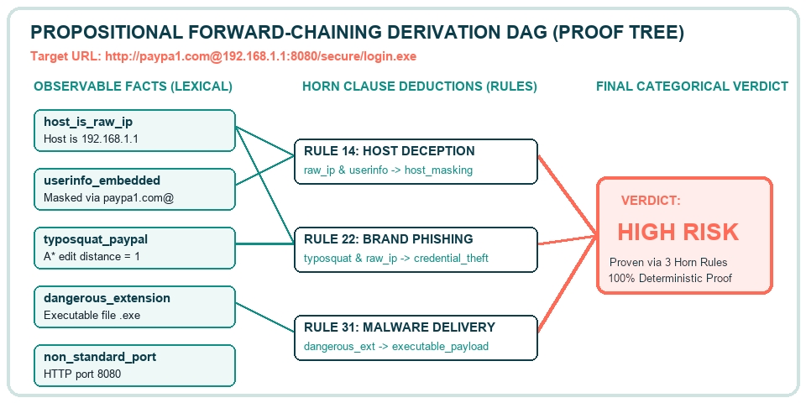
07 · LOGIC & EXPLAINABILITY
FROM OBSERVABLE FACTS TO PROVEN VERDICTS VIA FORWARD CHAINING
8
Notes:
Slide 8 demonstrates our primary AI: PL-FC-Entails forward chaining and proof tree synthesis. In this concrete example, the input URL triggers five observable lexical facts. The forward chaining engine evaluates definite Horn clauses in linear time. When rule premises are satisfied, intermediate deductions fire, culminating in a HIGH RISK verdict with a complete, tamper-proof proof tree.

Slide 9

CONCLUSION
DETERMINISTIC, PRIVACY-FIRST LINK SCREENING WITH PROVABLE EXPLANATIONS
100% Air-Gapped
Zero remote queries, zero DNS resolutions, and zero telemetry. Protects confidential internal links and operates seamlessly in air-gapped security perimeters.
True Explainable AI
Replaces opaque, black-box confidence scores with mathematical proof-tree DAGs. Every categorical risk verdict is transparently justified to security analysts.
Provably Optimal
A* search guarantees minimum string edits with admissible heuristics; PL-FC-Entails executes in linear time without risk of infinite loops or hallucination.
Thank you — Questions & Answers
Thirumala Sri (240701569)
Rajalakshmi Engineering College
9
Notes:
In conclusion, our project demonstrates that classical symbolic AI offers superior transparency, mathematical provability, and zero data leakage compared to modern black-box machine learning for link and QR screening. Thank you for your time and guidance. I now welcome any questions.

