Slide 1
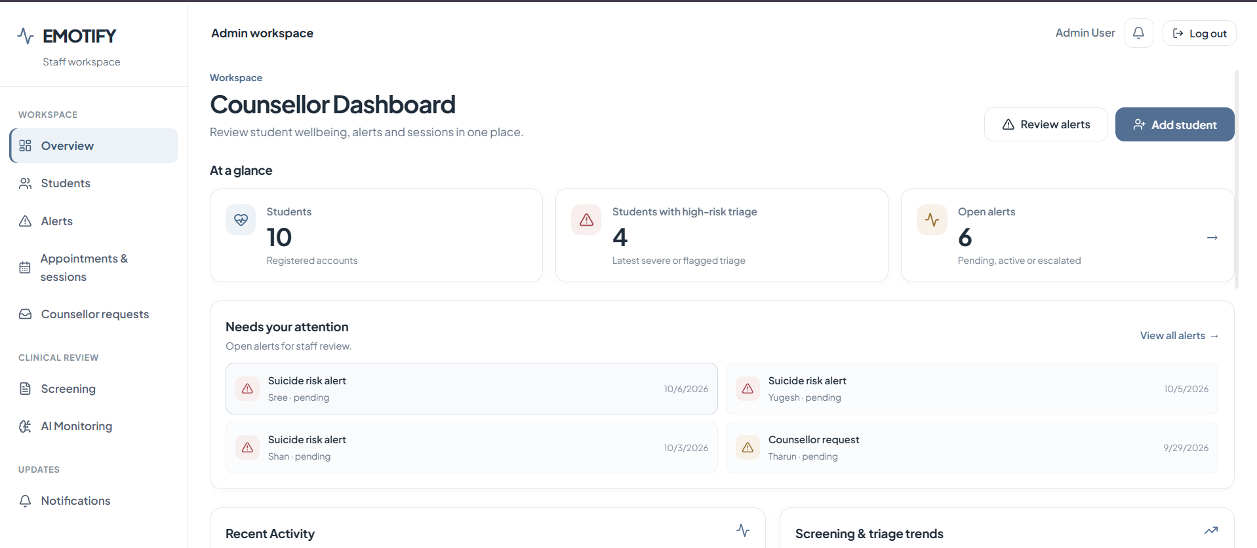
The Emotify Counsellor Dashboard
Seeing every student clearly, and acting at the right moment
Client presentation · October 2026
Notes:
Welcome. Today we will walk through the Emotify Counsellor Dashboard: the website your counselling team uses alongside the Emotify student app. The goal is simple: help counsellors see who needs support, decide what to do, and make sure it gets done.

Slide 2



Why counsellors need a single view
Struggles stay hidden
Signals are scattered
Time is limited
Many students do not ask for help until things feel serious.
Moods, questionnaires and requests for help arrive in different places, at different times.
Counsellors need to know who to see first, without searching for it.
The dashboard brings everything into one place and puts the most urgent students first.
Notes:
Counselling teams tell us the same three things. Students who are struggling often stay quiet. The warning signs exist, but they are spread across different places. And there is never enough time to go looking. The dashboard is built to solve exactly this.

Slide 3




How it works, in three steps
1. Students use the app
2. Emotify spots what matters
3. Counsellors see it and act
Daily mood check-ins, short wellbeing questionnaires, coping exercises and a friendly chat companion called Emoty.
Safety concerns, wellbeing that is getting worse, and direct requests for help are picked up automatically.
Everything appears on the dashboard, so the counsellor can review it, call, book a session or adjust support.
Only signed-in staff can open the dashboard. Students keep using the app as normal; the dashboard simply makes sure the right signals reach a person.
Notes:
This is the whole idea in one slide. Students use the app for their own wellbeing. In the background, Emotify notices the moments that matter. Those moments show up on the counsellor's dashboard so a human can respond.

Slide 4





A counsellor’s day with Emotify
Sign in
See who needs attention
Review an alert
Decide the next step
Reach out and follow up
Open the secure staff portal
Urgent items are listed first
Understand what happened
Choose the right level of support
Call, book a session, track it
The rest of this presentation walks through each of these moments on the real screens.
Notes:
Here is a typical day. The counsellor signs in, sees straight away who needs attention, reviews what happened, decides on the right level of support, and then reaches out and follows up. Let us look at each step.

Slide 5
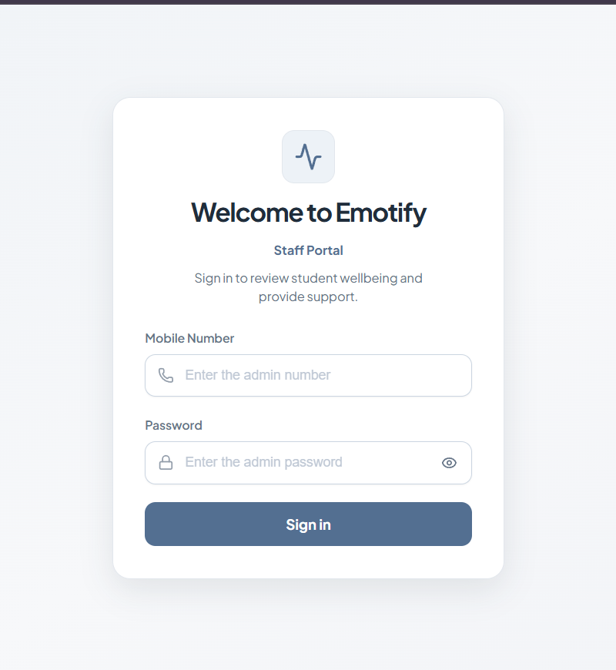








Secure sign-in, one simple menu
Everything a counsellor needs is one click away:
Overview
A summary of the day
Students
Everyone in your care
Alerts
Safety concerns to review
Appointments
Session requests and bookings
Counsellor requests
Students asking to talk
Screening
Wellbeing results overall
AI monitoring
Conversations with Emoty
Notifications
Anything new
Screens show test data
Notes:
Counsellors sign in with their own staff account. Once inside, there is one menu on the left with eight areas. We will visit each of them.

Slide 6

What matters today, at a glance
10
students registered
4
students at high risk
6
open alerts
Screens show test data
“Needs your attention” lists the newest urgent items first, such as safety alerts and requests to talk, so nothing important is buried.
Notes:
This is the first screen after signing in. Three numbers tell the counsellor how things stand: how many students, how many are currently at high risk, and how many alerts are still open. Below that, the Needs your attention list shows the most urgent items, newest first. In this test data, three safety alerts and one request to talk are waiting.

Slide 7
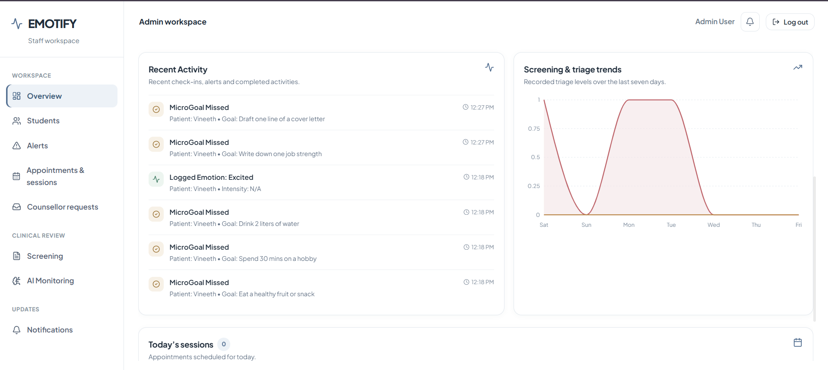


Spot patterns, not just incidents
Recent activity
See what students are doing in the app, such as moods logged or goals missed.
Weekly trends
A seven-day chart shows whether wellbeing results are improving or slipping.
Today’s sessions
How many appointments are booked for today.
Notes:
Further down the same page, counsellors see recent activity from students and a seven-day trend. This helps them notice a pattern, for example a student who has stopped completing their small daily goals, before it becomes a crisis.

Slide 8

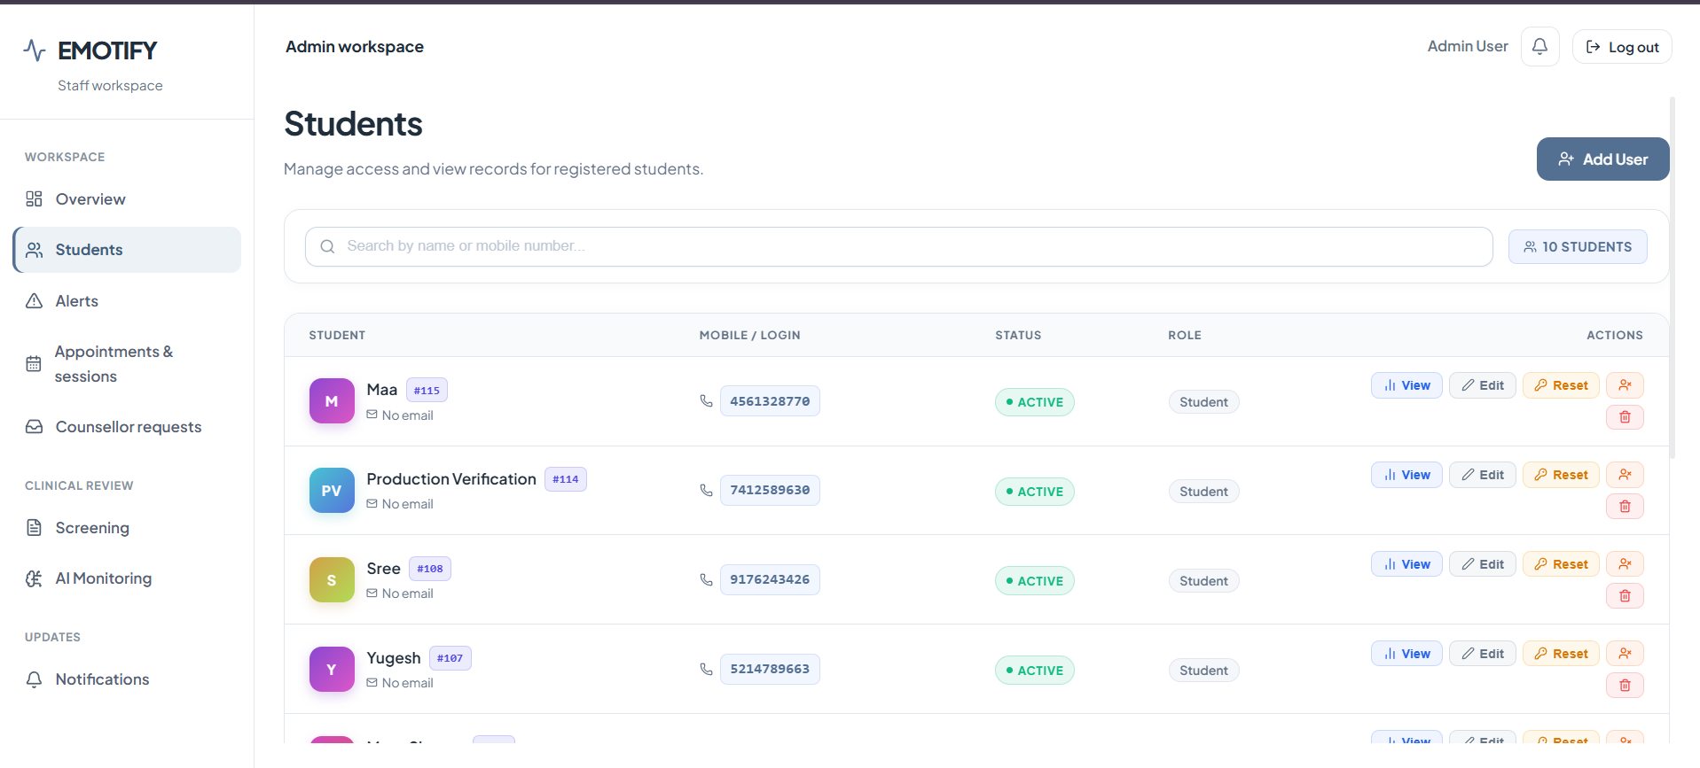



Every student in one directory
Find anyone fast
Search by name or mobile number.
Open the full picture
View a student’s profile and history.
Manage accounts
Edit details or reset a forgotten password.
Assign and add
Assign a counsellor or register a new student.
Screens show test data
Notes:
The Students page is the team's directory. Counsellors can find any student quickly, open their profile, help with account issues like a forgotten password, and make sure each student is assigned to a counsellor.

Slide 9
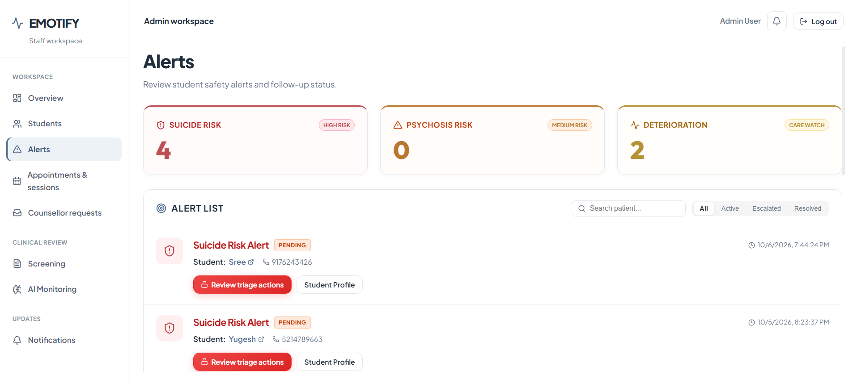
Safety alerts are raised automatically
When a student’s answers suggest they may be at risk, or their wellbeing gets worse, an alert appears straight away.
4
Suicide risk
High priority
0
Psychosis risk
Medium priority
2
Getting worse
Care watch
Filter by Active, Escalated or Resolved · Screens show test data
Notes:
Alerts are the heart of the safety side. Emotify raises them on its own: for example when a questionnaire answer points to a risk of self-harm, or when a student's results get noticeably worse. Each alert shows the student and their phone number, with buttons to review next steps or open the student's profile.

Slide 10
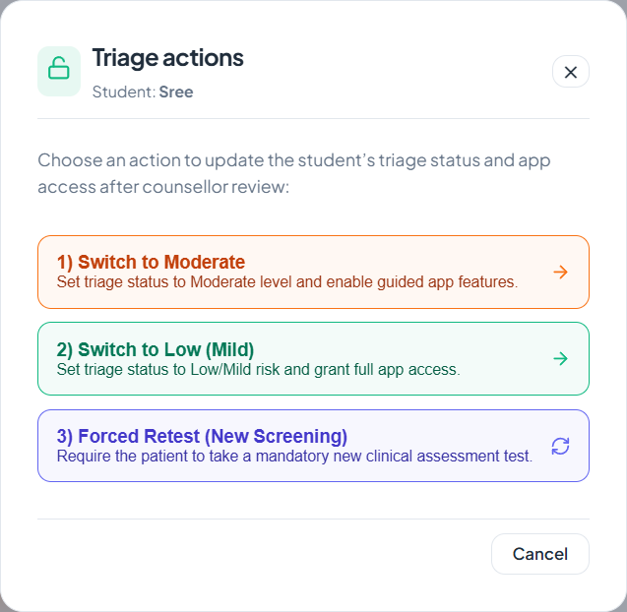
Technology flags it, the counsellor decides
After reviewing an alert, the counsellor chooses the student’s level of support:
Moderate support
Guided features in the app are switched on for the student.
1
Low (mild)
Full access to every tool in the app.
2
New questionnaire
The student is asked to complete a fresh wellbeing check before continuing.
3
The student’s app updates to match this choice.
Notes:
This is an important point for your team: Emotify never makes the clinical decision. It raises the flag, and the counsellor decides. With one click they can set the student to moderate support, to low risk with full access, or ask the student to take a new wellbeing questionnaire. The student's app updates to match.

Slide 11
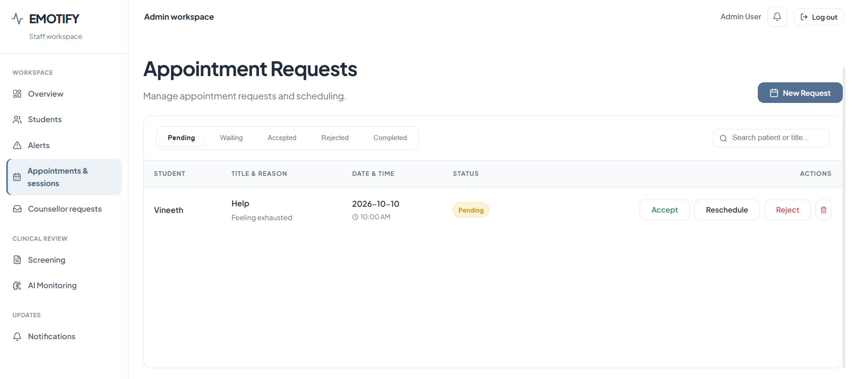


Appointments without the back-and-forth
Pending
Waiting
Accepted
Completed
Students request
They book from the app and say why, e.g. “Feeling exhausted”.
Counsellors respond
Accept, reschedule or decline in one click.
Everyone stays informed
Each request moves through clear stages.
Screens show test data
Notes:
Students request sessions from the app and give a short reason. Counsellors see the request with the preferred date and time, and can accept, reschedule or decline it. Every request moves through clear stages, so nothing gets lost in email.

Slide 12
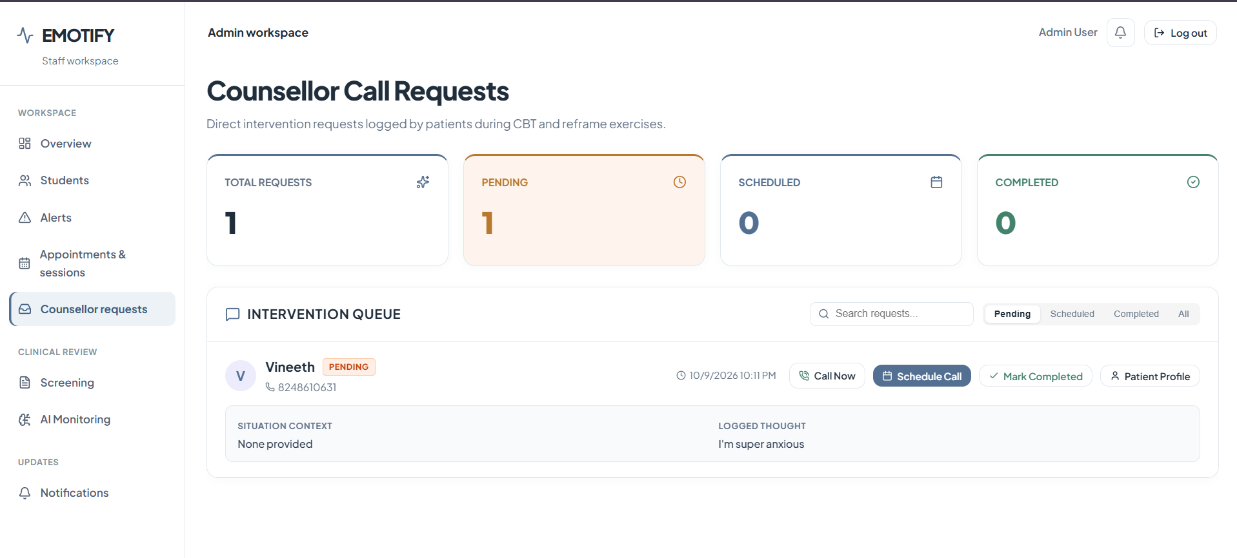

When a student asks for help, it reaches a person
“I’m super anxious”
A thought a student shared during a thinking exercise arrives with their request to talk.
Call now
Reach the student straight away.
Schedule a call
Pick a time that works.
Screens show test data
Mark completed
Keep a clear record.
Notes:
Inside the app's thinking exercises, a student can ask to speak to a counsellor. That request arrives here together with the context, for example the thought they wrote down. The counsellor can call immediately, schedule a call, and mark it completed afterwards.

Slide 13
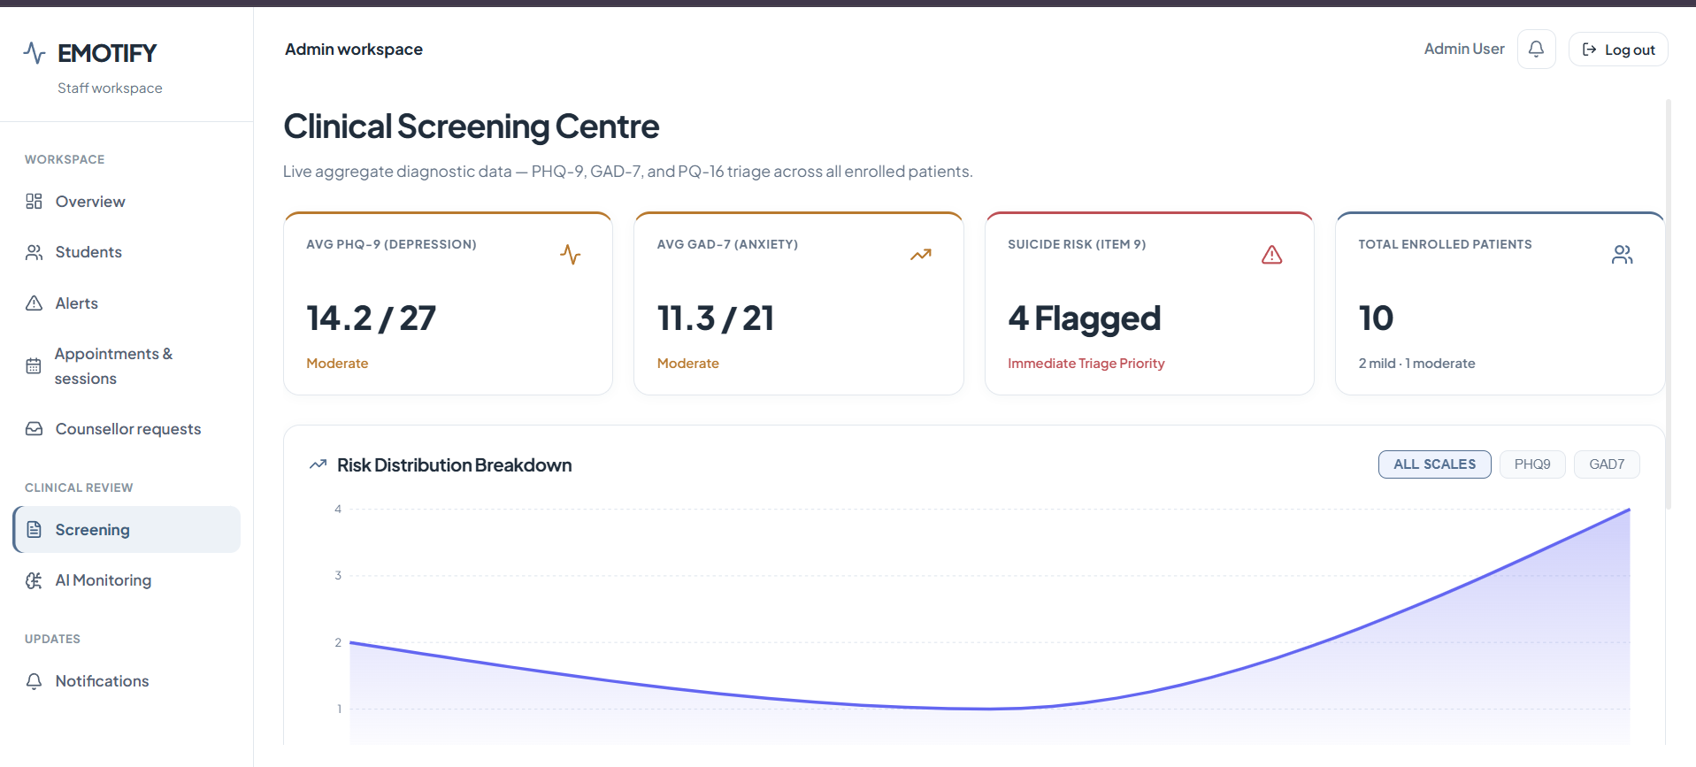
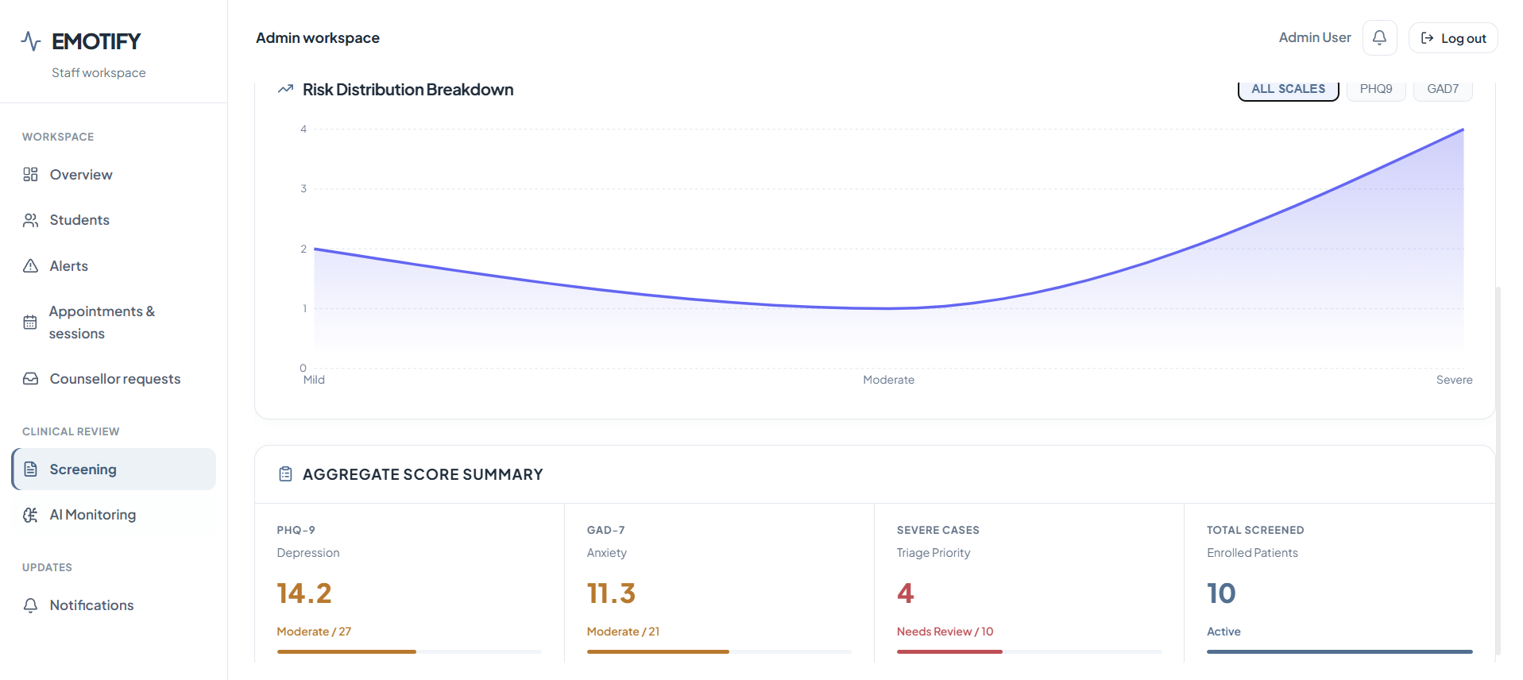
The big picture on student wellbeing
Students complete short, well-established questionnaires in the app. The Screening Centre combines everyone’s results.
14.2/27
11.3/21
4
10
Average mood score
Moderate (PHQ-9 mood check)
Average anxiety score
Moderate (GAD-7 anxiety check)
Students flagged
On the self-harm question, for priority follow-up
Students screened
Everyone enrolled so far
Notes:
The Screening Centre gives leadership and counsellors the overall picture. It combines results from three short, widely used questionnaires: a mood check, an anxiety check and a check on unusual experiences. In this test data the average mood and anxiety scores are both in the moderate range, and four students are flagged on the self-harm question for priority follow-up.

Slide 14
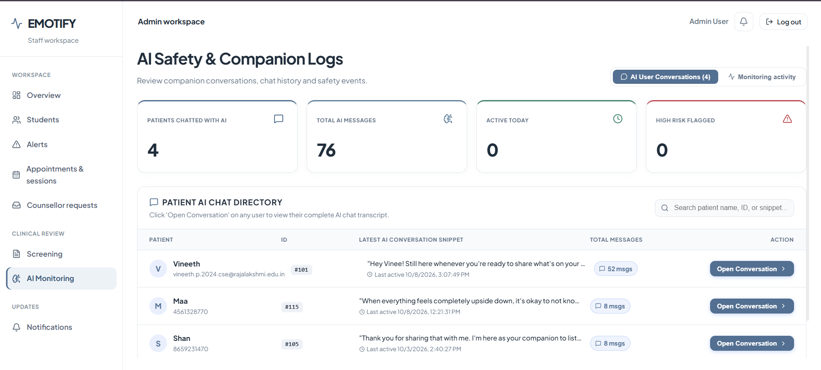

Keeping the AI companion safe
4
students chatted with Emoty
76
messages exchanged
0
high-risk messages flagged
Screens show test data
Counsellors can open any conversation, and risky messages are flagged so the team can step in.
Notes:
Students can talk to Emoty, the app's AI companion, at any time. This page gives the team oversight: how many students are chatting, how many messages, and whether anything concerning has been flagged. Any conversation can be opened and read if needed.

Slide 15
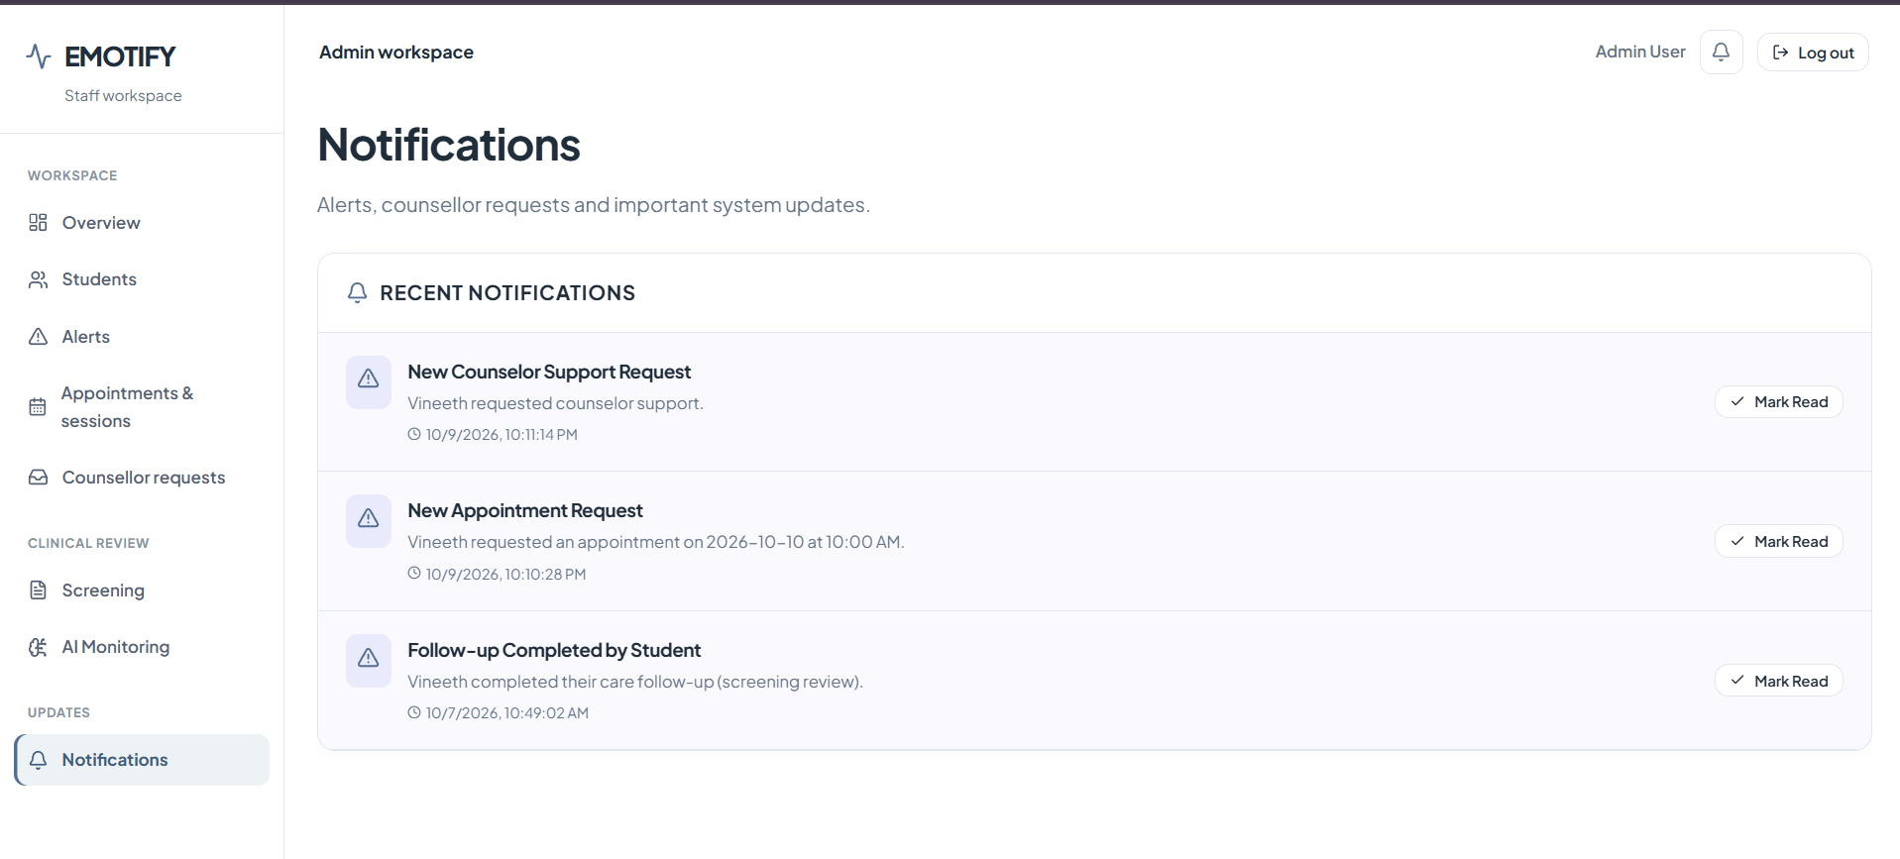

Nothing slips through
New support requests
A student has asked to talk to a counsellor.
New appointment requests
With the date and time the student prefers.
Follow-ups completed
A student has finished a task the team set.
Mark as read
Clear each item once it has been handled.
Screens show test data
Notes:
Finally, the Notifications page collects everything new in one list: support requests, appointment requests and completed follow-ups. Counsellors mark each one as read once they have dealt with it.

Slide 16

Use case: from a worrying answer to a phone call
1
2
3
A student answers
During a wellbeing questionnaire, one answer suggests thoughts of self-harm.
An alert is raised
Emotify creates a high-priority alert straight away.
It appears first
The alert sits at the top of “Needs your attention”.
4
5
6
The counsellor decides
They review it and choose the right level of support.
They reach out
A call is made or a session is booked.
It is followed through
The follow-up is tracked until it is completed.
An illustrative example based on the test data shown in this presentation.
Notes:
Let us put it all together with one example. A student is filling in a wellbeing questionnaire in the app, and one answer suggests thoughts of self-harm. Emotify raises a high-priority alert immediately. It appears at the top of the counsellor's dashboard. The counsellor reviews it, decides on the right level of support, calls the student or books a session, and the follow-up is tracked until it is done. What might have gone unnoticed is now handled by a person, quickly.

Slide 17



What it means for your institution
For counsellors
For students
For the institution
Time goes to the students who need it most
One place for alerts, requests and sessions
Clear records of what was done
Help arrives sooner, even if they don’t ask
Support matched to how they are doing
A friendly app they actually use
A live picture of student wellbeing
Based on well-established questionnaires
Confidence that concerns are followed up
Notes:
To summarise the value. Counsellors spend their time where it matters and have everything in one place. Students get help sooner, often before they would have asked. And the institution gets a live, evidence-based view of student wellbeing, with confidence that concerns are followed up.

Slide 18


See who needs help.
Decide quickly.
Follow through.
Suggested next steps
Live demo with your counselling team
Agree how alerts and follow-ups are handled
Thank you
Start a pilot with a group of students
Notes:
Emotify helps your team see who needs help, decide quickly and follow through. As next steps, we suggest a live demo with your counselling team, agreeing together how alerts and follow-ups should be handled, and then a pilot with a group of students. Thank you, and happy to take questions.

