Slide 1
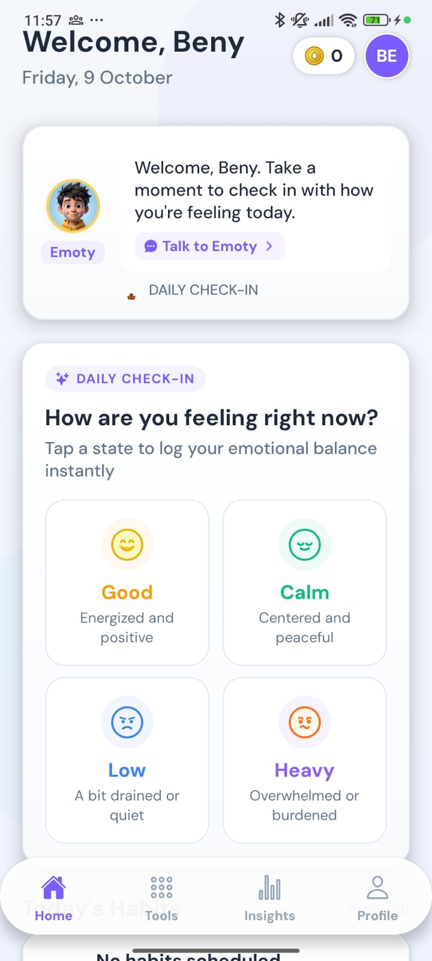
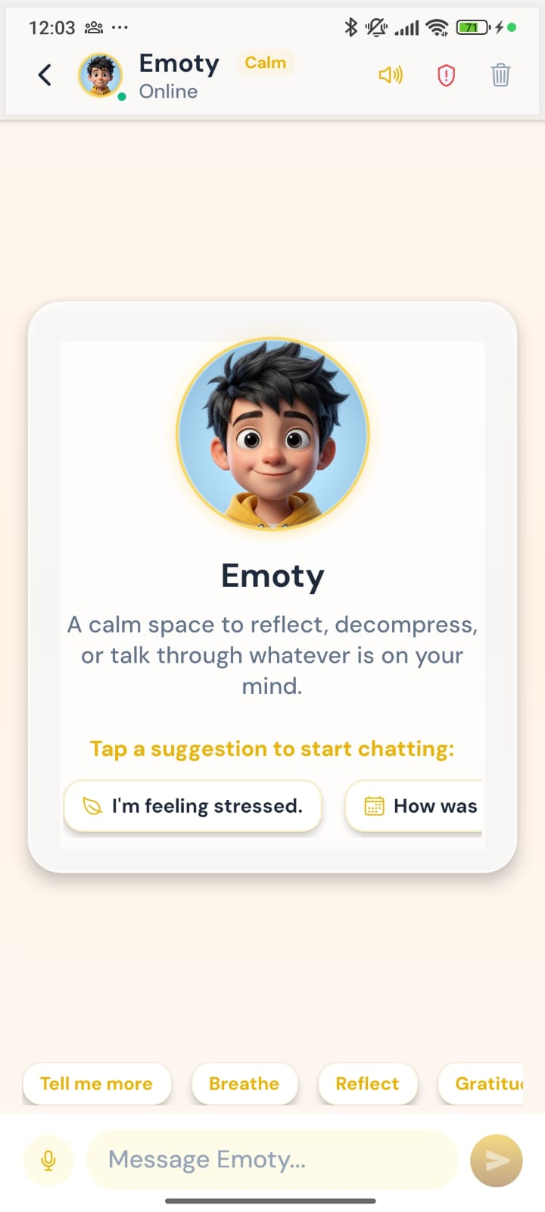
Emotify for students
A friendly, private companion for everyday wellbeing, with a counsellor one tap away
Client presentation · October 2026
Notes:
Today we will walk through the Emotify student app: what students see, how it supports them day to day, and how it connects them with your counselling team when they need it.

Slide 2



Why students need it
Feelings are hard to name
Asking for help feels big
Help has office hours
Many students know something is off but cannot put it into words.
Booking a counsellor can feel like a step too far, so students wait.
Hard moments happen late at night and during exams, not only in office hours.
Emotify gives students a gentle space to understand how they feel, and a direct bridge to a counsellor.
Notes:
Students often struggle quietly. They may not have the words for how they feel, they may hesitate to book a counsellor, and difficult moments rarely happen during office hours. Emotify is designed for exactly these gaps.

Slide 3





The student journey
Sign up
Meet Emoty
Quick wellbeing check
Everyday support
Reach a counsellor
With a mobile number
Choose a companion
Three short questionnaires
Check-ins and calming tools
Request a session any time
The following slides follow a new student, step by step, through the real app. All screens show test data.
Notes:
Here is the journey at a glance: a student signs up, meets their companion Emoty, completes a short wellbeing check, then uses the app for everyday support, with a counsellor always one request away.

Slide 4
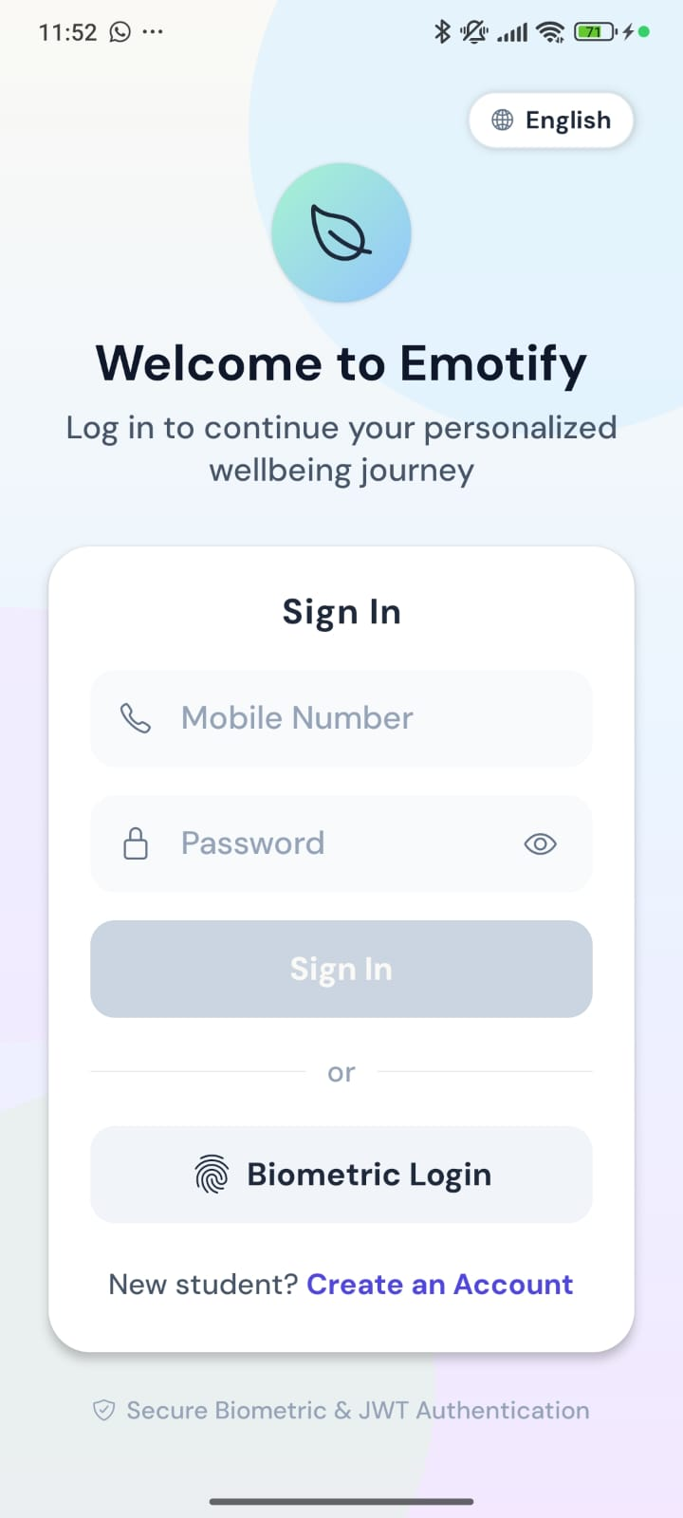
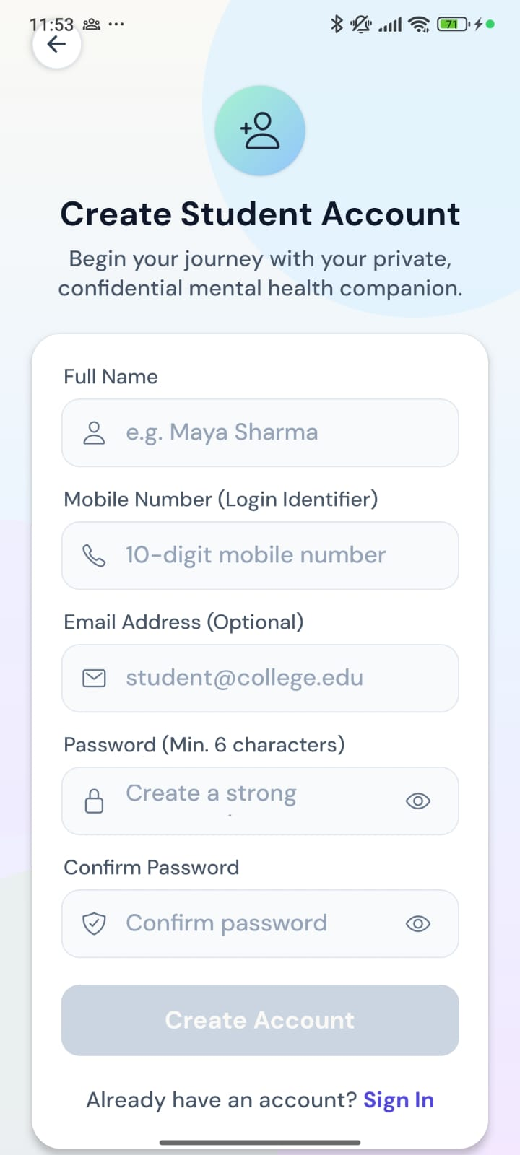




Getting started takes a minute
Mobile number login
No email needed; the mobile number is the student’s login.
Fingerprint or face unlock
Quick, secure sign-in on the student’s own phone.
Choice of language
Students can switch the app language from the first screen.
Private by design
Only the student signs in to their own app.
Sign in
Create an account
Notes:
Getting started is quick. Students create an account with their mobile number and a password, and can then sign in with fingerprint or face unlock. They can also choose their language right from the first screen.

Slide 5
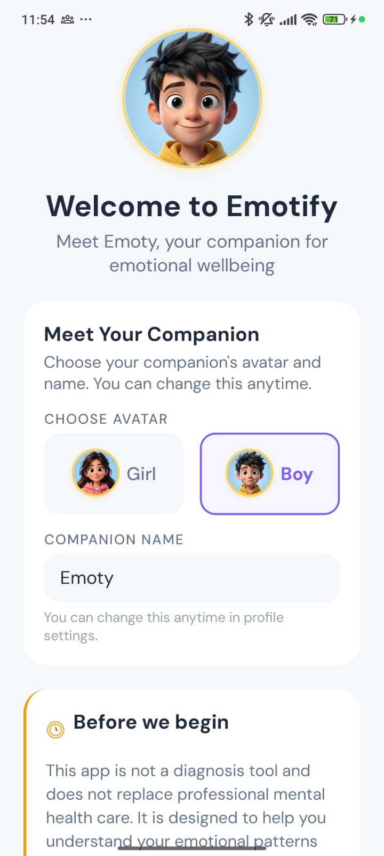
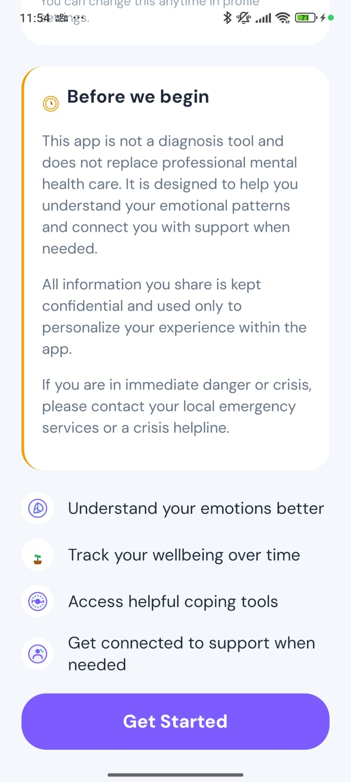
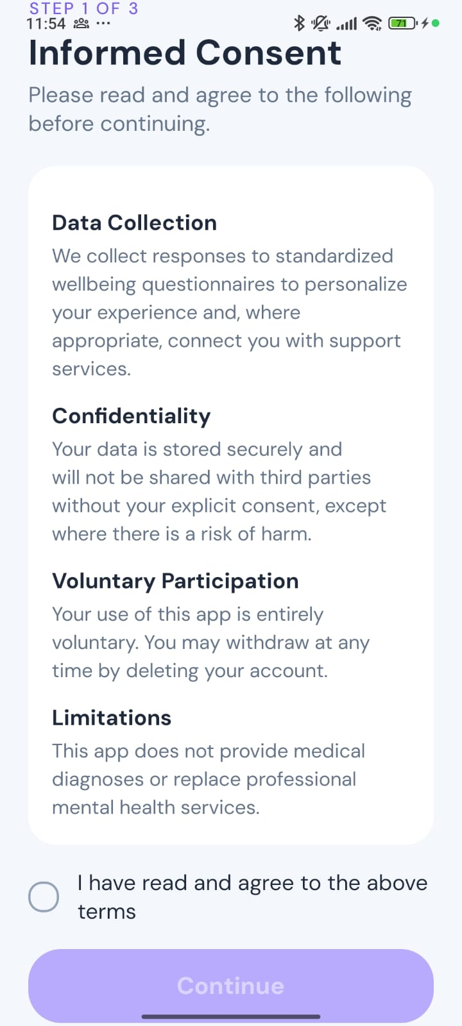


Meet Emoty, with honest expectations
A friendly companion
Students pick Emoty’s look and can rename it later.
Clear about what it is
Not a diagnosis tool, and not a replacement for professional care.
Informed consent
Students read and agree to how their information is used.
Choose a companion
Before we begin
Consent
Notes:
Students meet Emoty, the friendly companion that appears throughout the app, and choose how it looks. Before anything else, the app is honest about what it is and is not: it does not diagnose, and it tells students what to do in a crisis. Students then give informed consent.

Slide 6
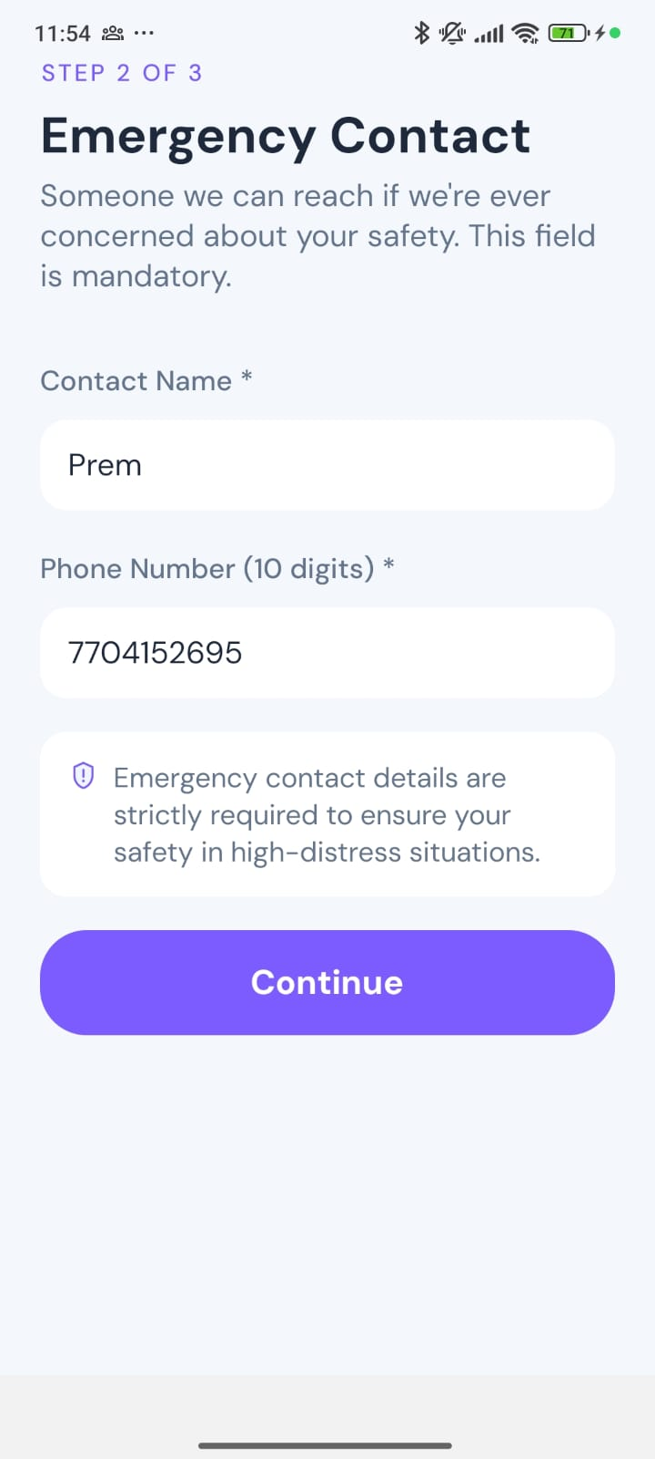
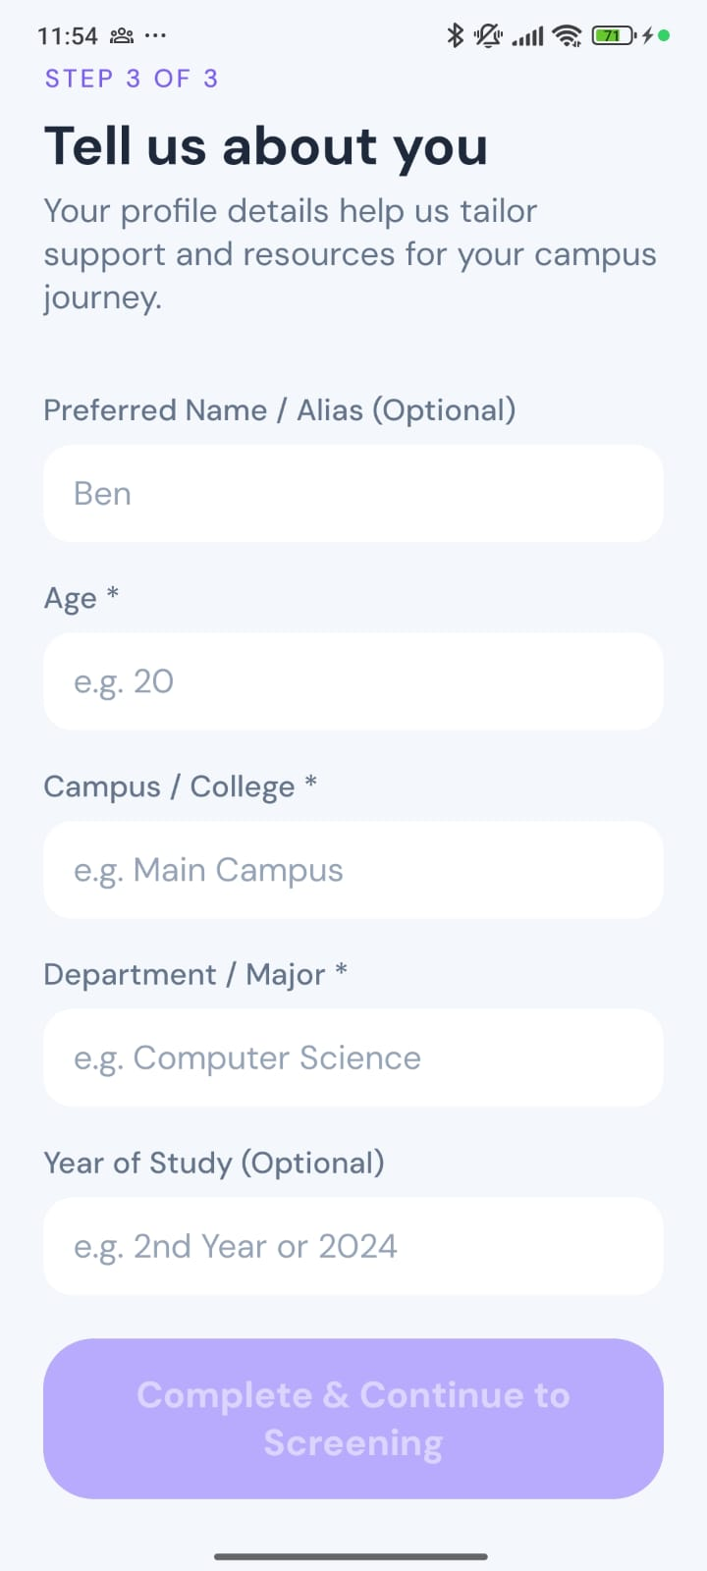


Safety is built in from day one
An emergency contact is required
Every student names someone the team can reach if there is ever a serious concern about their safety.
A few details about the student
Preferred name, age, campus and department help tailor support.
Emergency contact
About you
Notes:
Safety starts at sign-up. Every student must add an emergency contact, so the team can act if there is ever a serious concern. Students also share a few details, such as their preferred name and campus, so support feels personal.

Slide 7
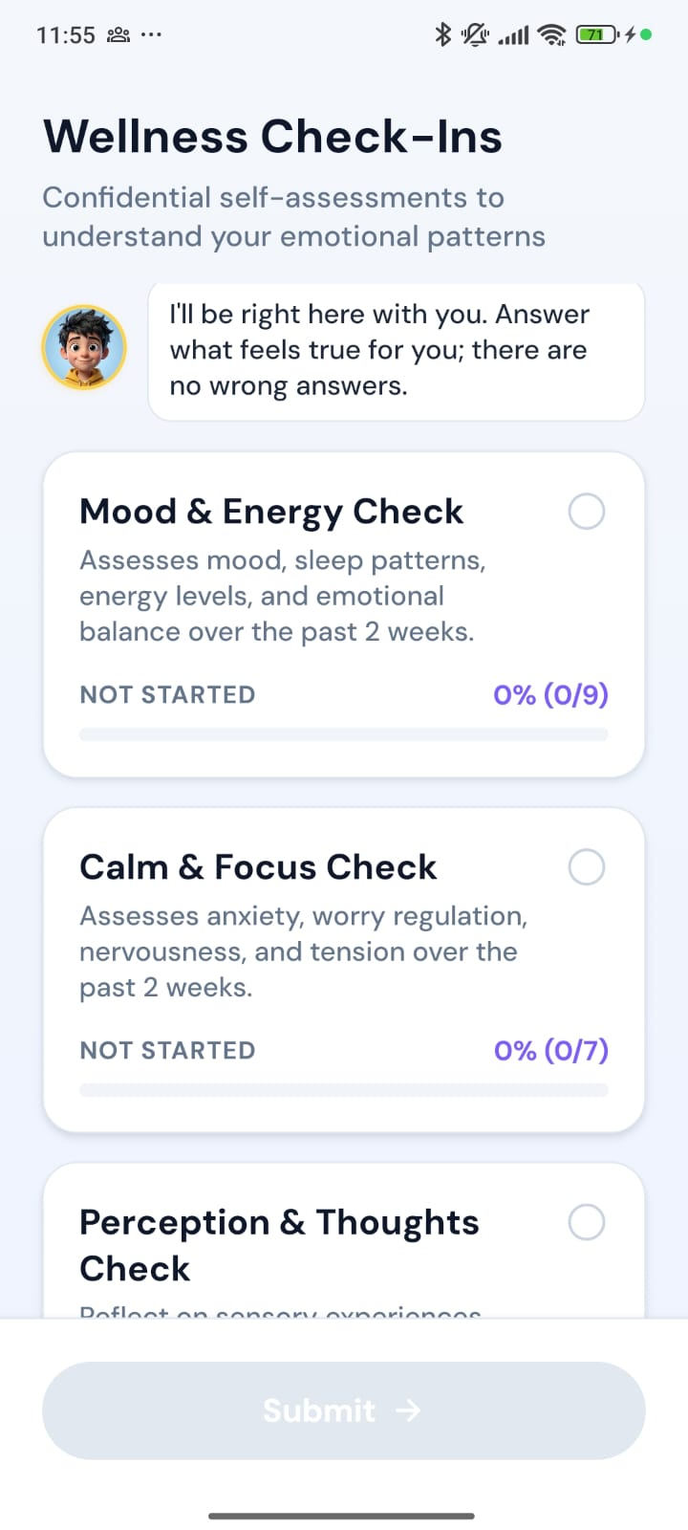
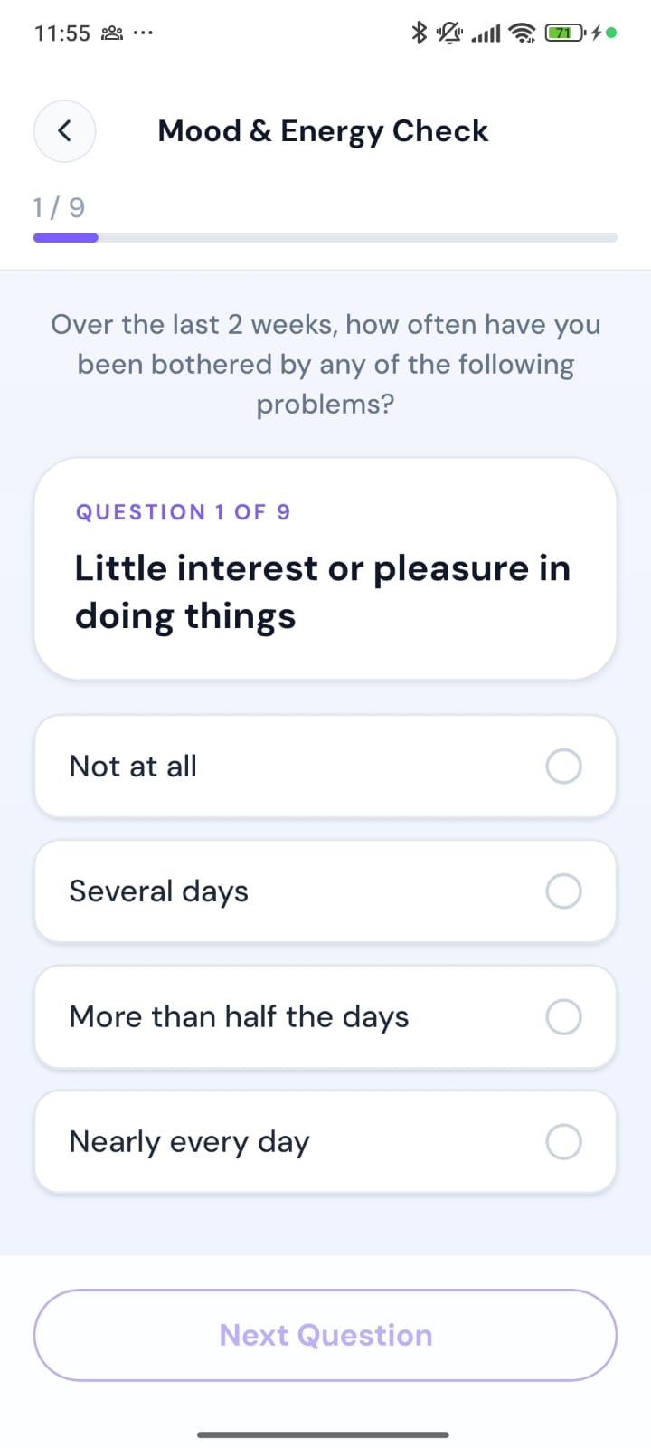
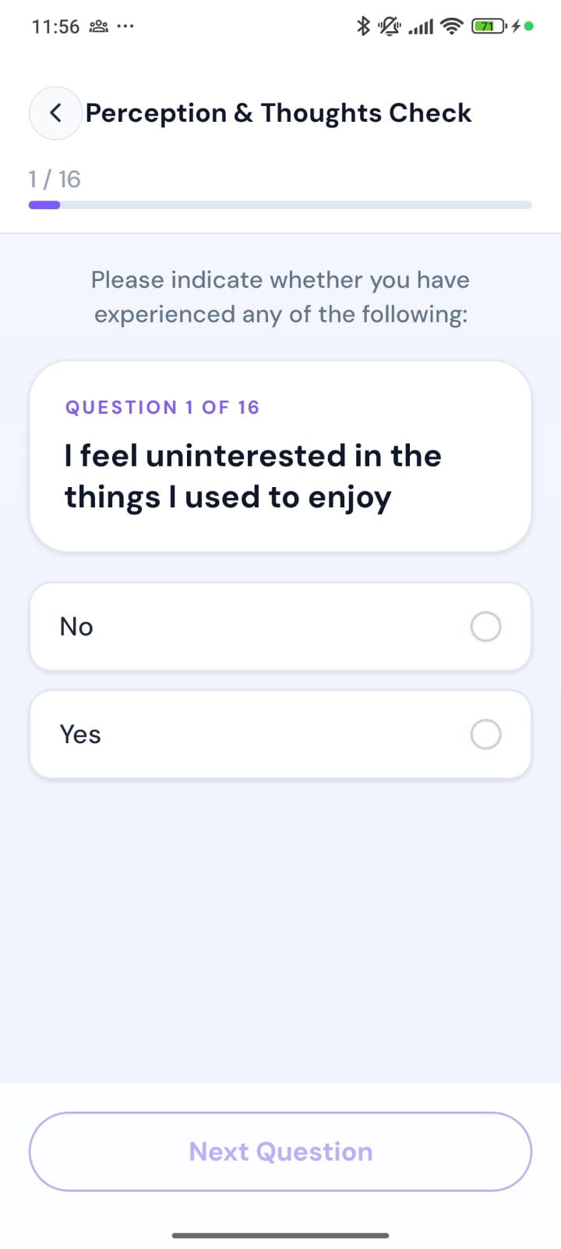
A short, friendly wellbeing check
Mood & Energy Check
9 questions on mood, sleep and energy
Calm & Focus Check
7 questions on worry and tension
Perception & Thoughts Check
16 yes/no questions on unusual experiences
Well-established questionnaires, with friendly names. Emoty reminds students there are no wrong answers.
Three short checks
One question at a time
Simple answers
Notes:
Next, students complete a short wellbeing check. Behind the friendly names are well-established questionnaires that counsellors already trust. Questions appear one at a time, and Emoty reassures students that there are no wrong answers.

Slide 8
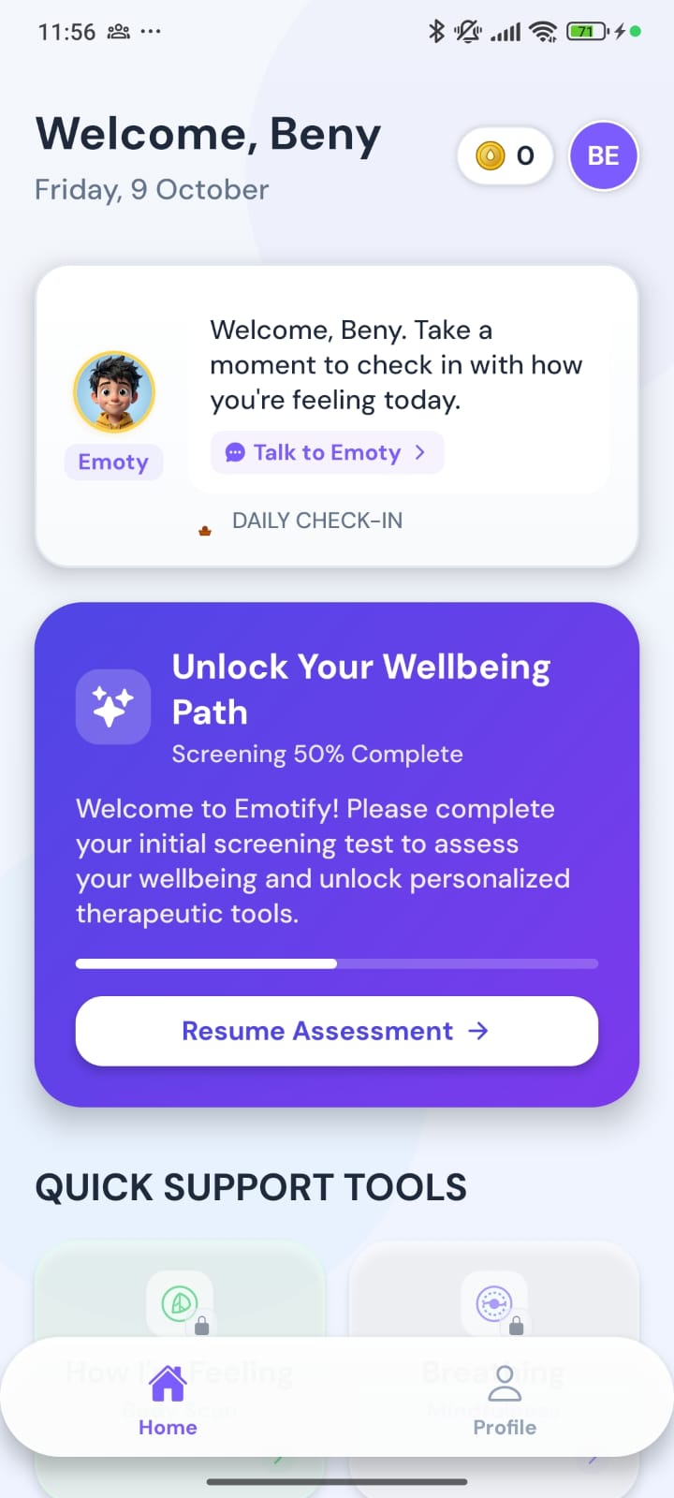



Finishing the check unlocks the app
Tools stay locked until the check is done
So every student starts with a clear picture of how they are.
Students can pick up where they left off
Progress is saved, with a Resume button on Home.
Then the full app opens
Tools, Insights and a daily check-in all become available.
Before
After
Notes:
Until the check is finished, the support tools are locked. This makes sure the counselling team has a starting picture for every student. Progress is saved, so a student can stop and resume. Once complete, the whole app opens up.

Slide 9
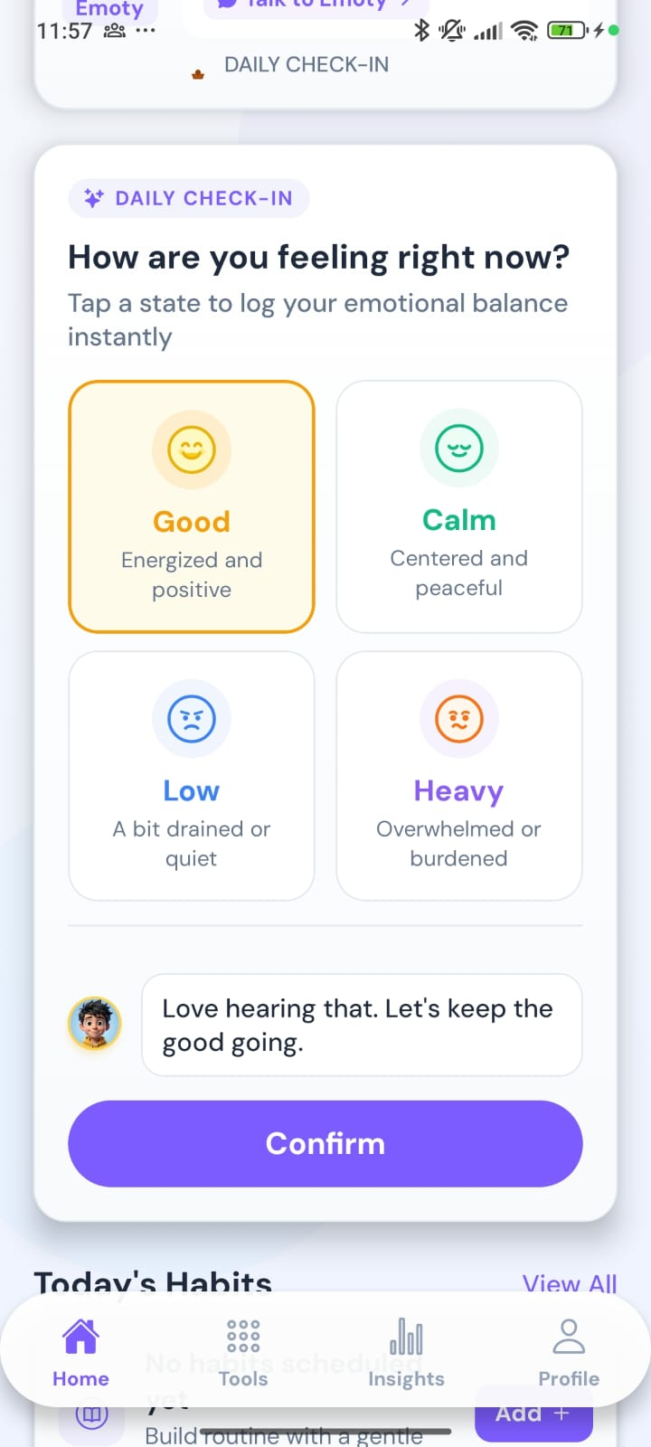
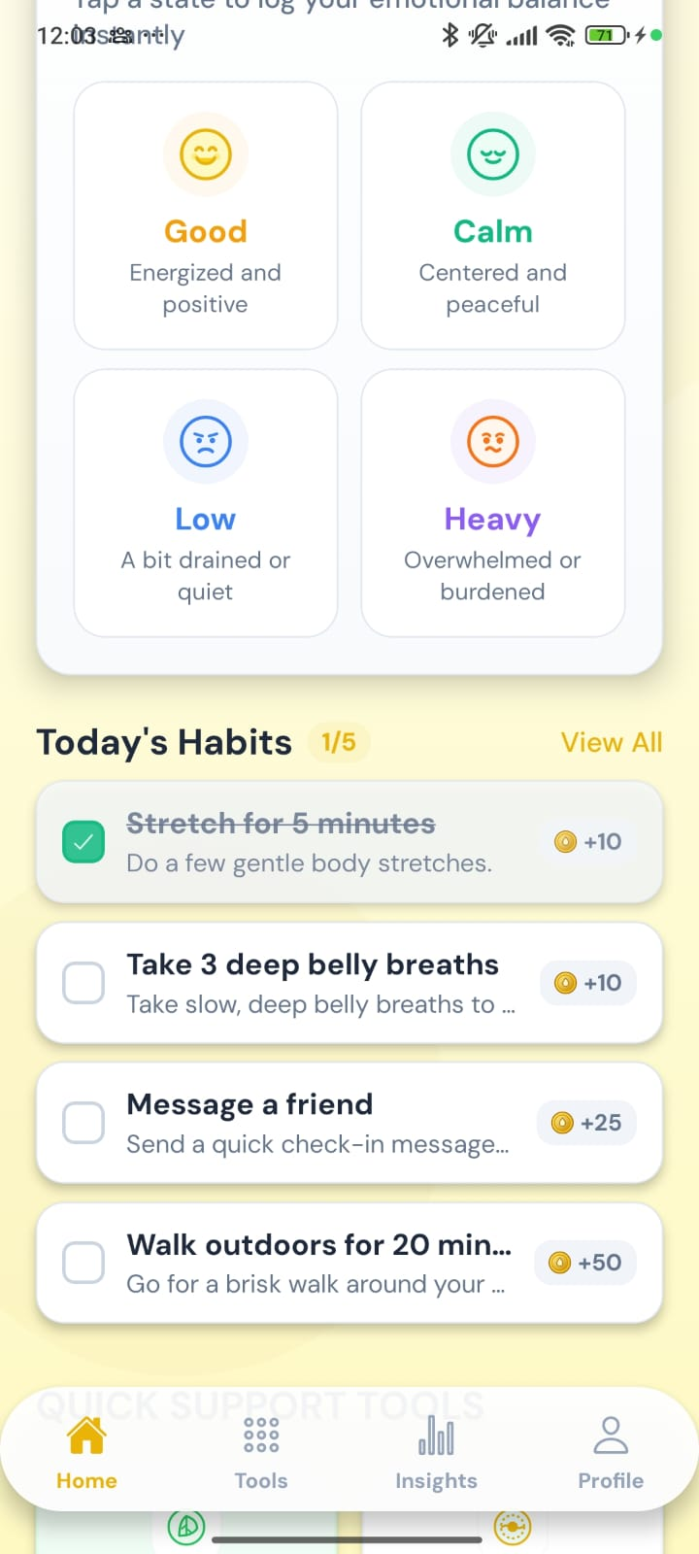
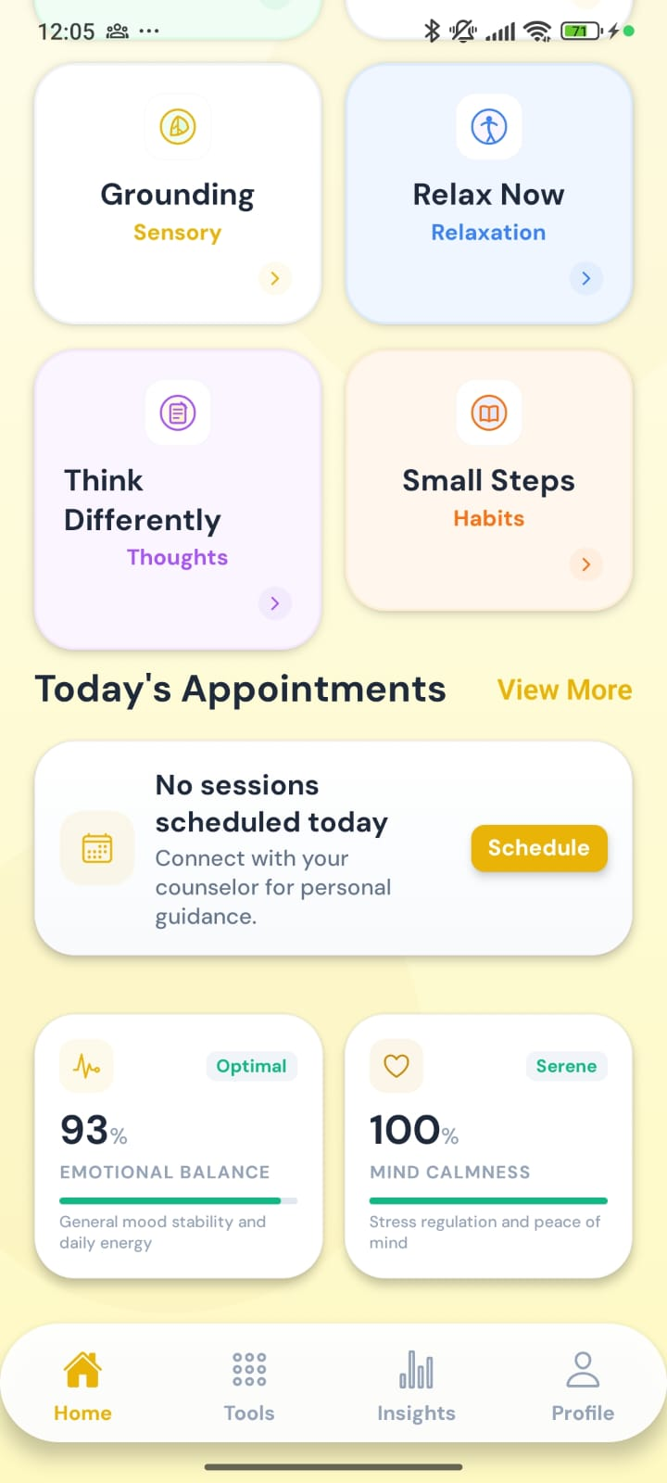



Home: a daily check-in in one tap
Four simple choices
Good, Calm, Low or Heavy, and Emoty responds kindly.
Small daily habits
Short tasks like a stretch or a walk earn Calm Points.
Easy-to-read wellbeing
Simple percentages for emotional balance and calm.
How are you feeling?
Today’s habits
Tools and wellbeing
Notes:
Home is where students land every day. A one-tap check-in asks how they feel right now, and Emoty responds. Small habits, like stretching or a short walk, earn Calm Points. Simple indicators show their emotional balance and calm, based on their latest check.

Slide 10
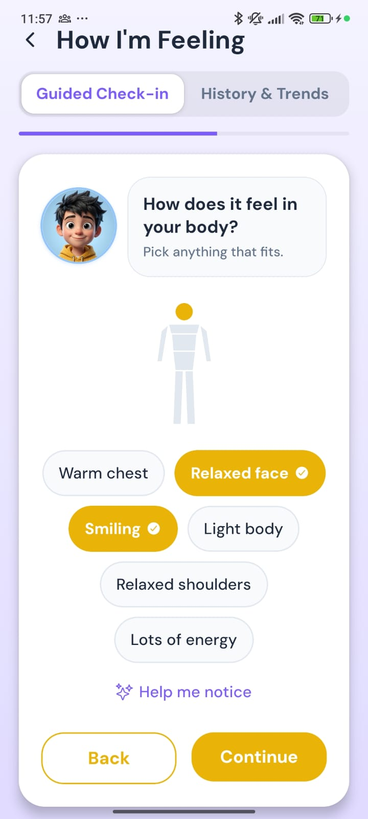
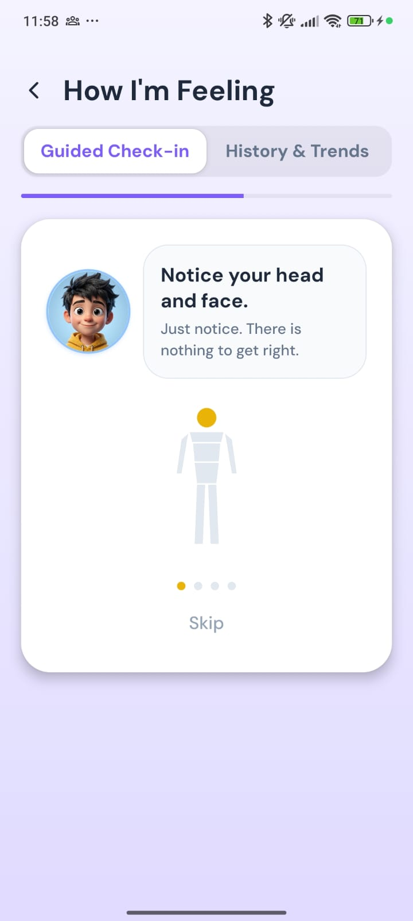
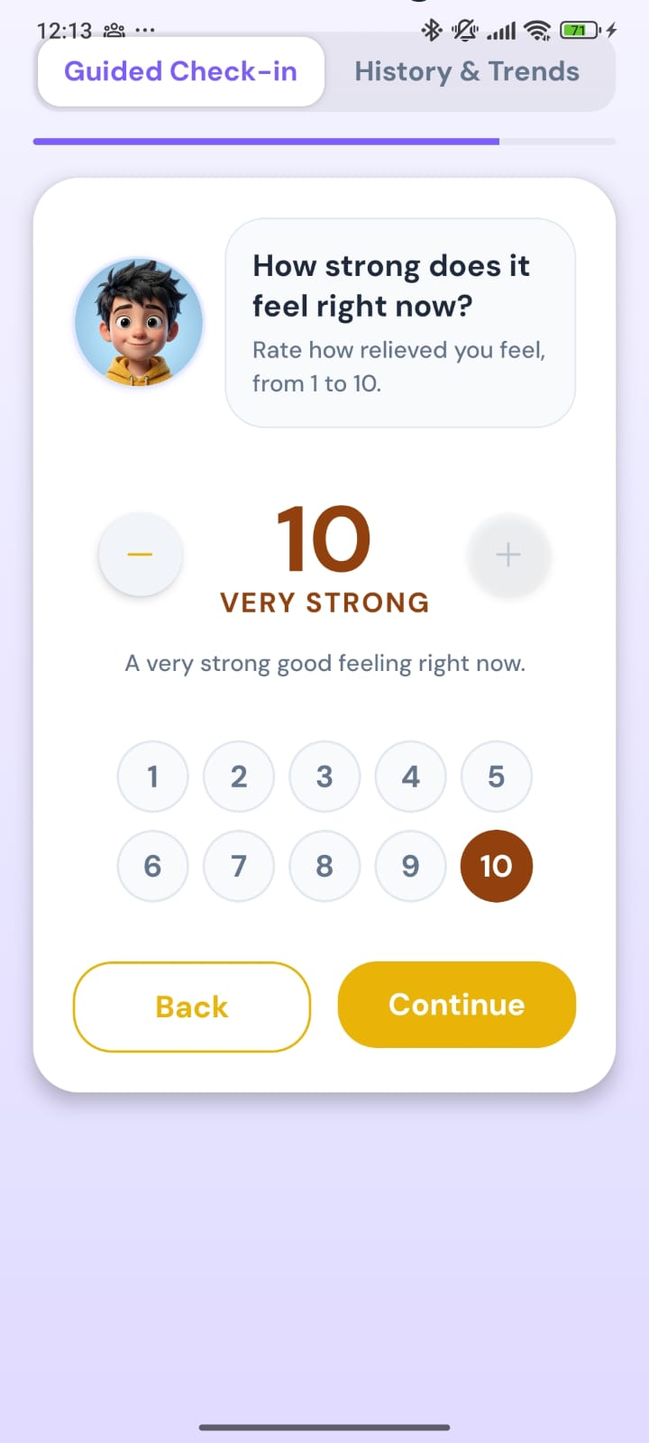
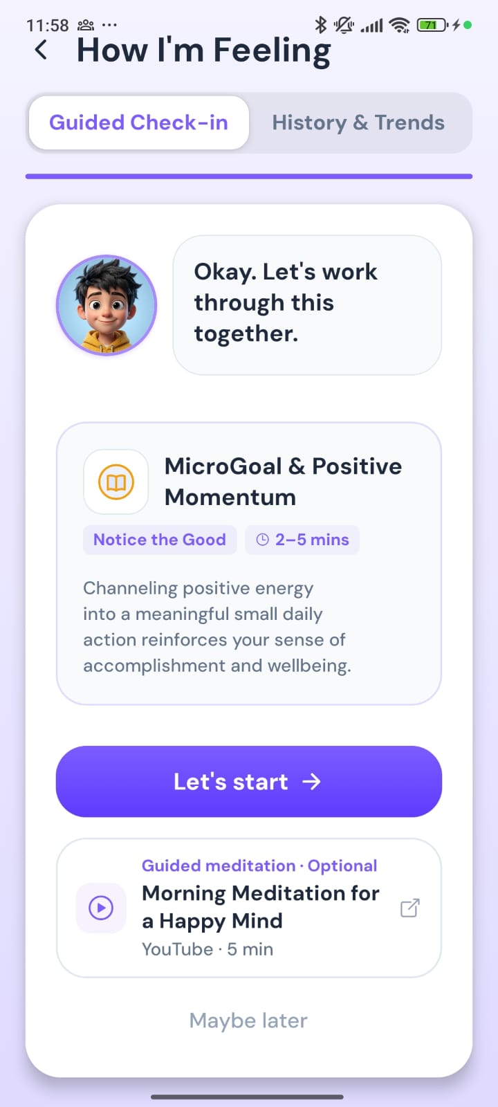
How I’m Feeling: a guided check-in
1. Notice the body
2. A gentle body scan
3. How strong is it?
4. A matched activity
Students name the feeling, notice where it shows up, rate how strong it is, and get one activity that fits, with an optional guided meditation.
Notes:
How I'm Feeling helps students put feelings into words. They pick the feeling, notice how it shows up in their body, with an optional short body scan if they are unsure, and rate how strong it is. Emoty then suggests one activity that matches, with an optional guided meditation video.

Slide 11
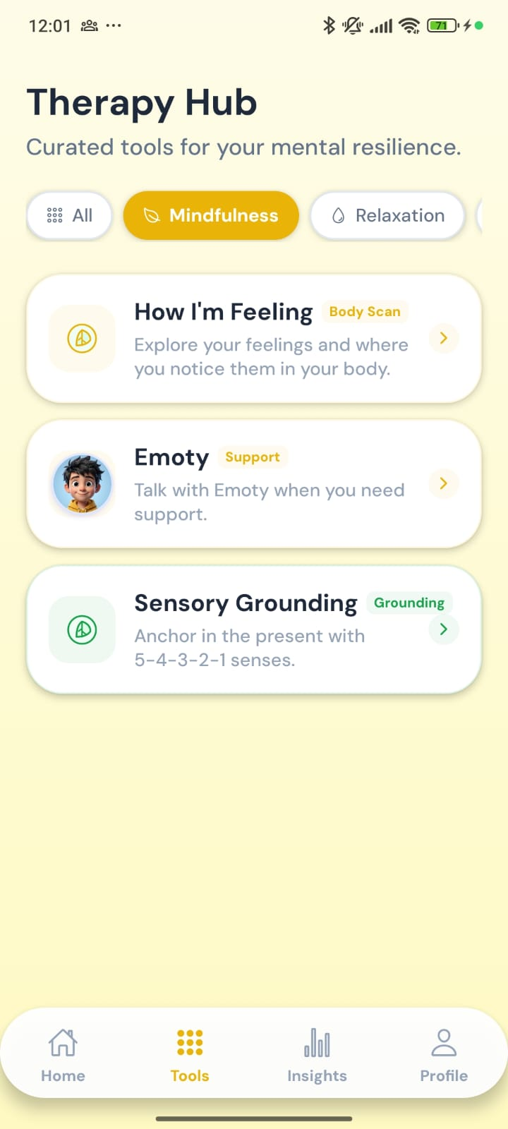
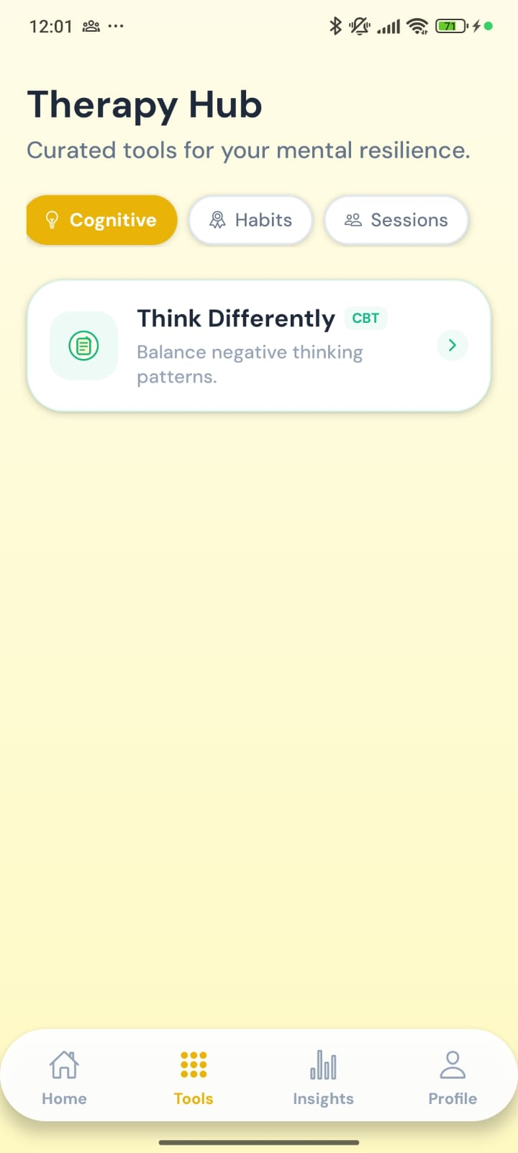
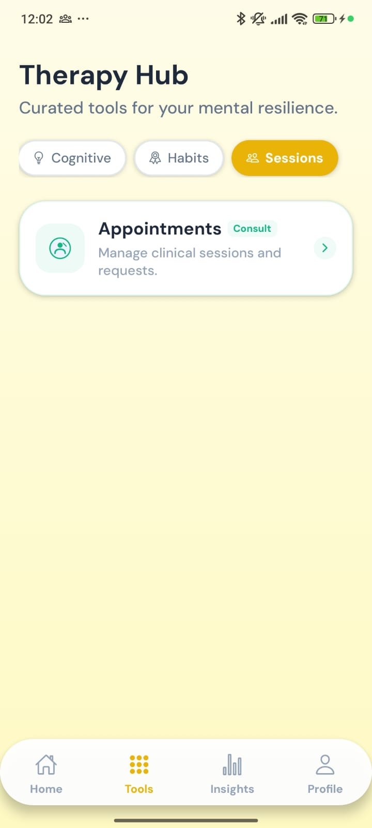


A toolkit for every kind of moment
Mindfulness
How I’m Feeling, Emoty, Sensory Grounding
Relaxation
Relax Now, guided muscle relaxation
Cognitive
Think Differently, for unhelpful thoughts
Habits
Small Steps, for daily wins
Sessions
Appointments with a counsellor
Mindfulness
Cognitive
Sessions
Notes:
The Tools tab, called the Therapy Hub, groups every tool by what the student needs: mindfulness, relaxation, working with thoughts, building habits, and booking a session with a counsellor.

Slide 12
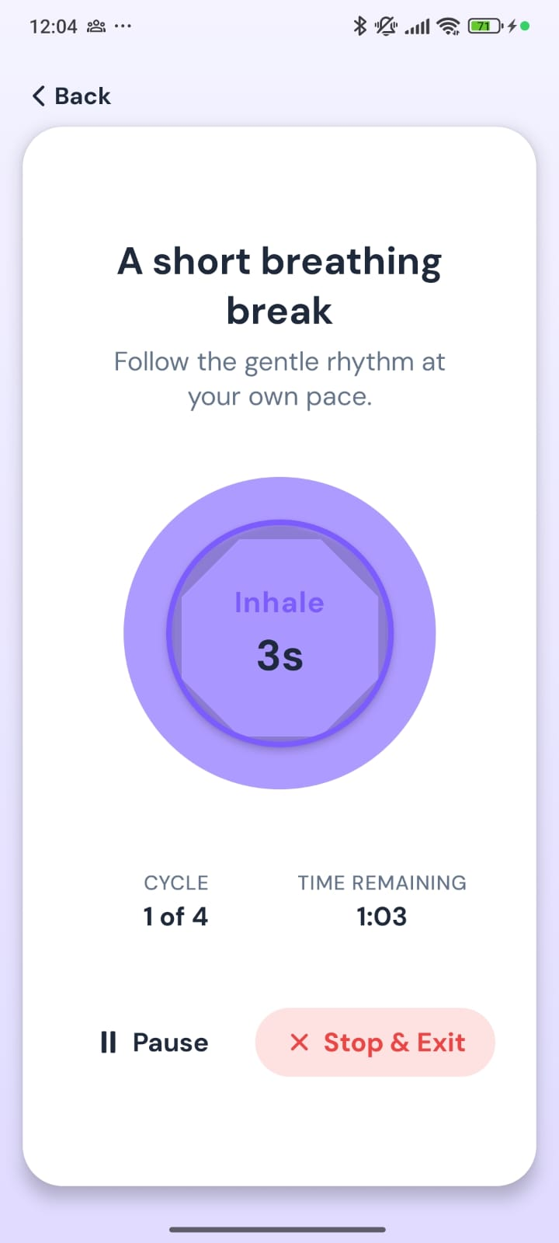
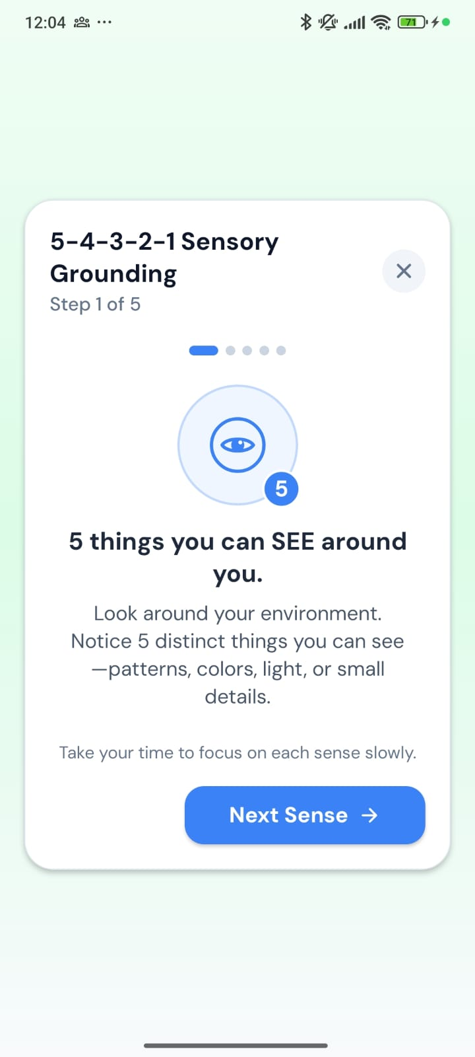
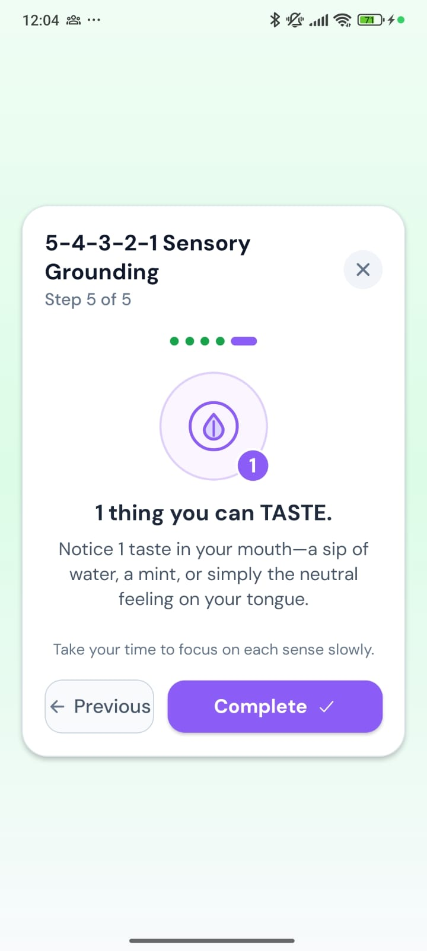
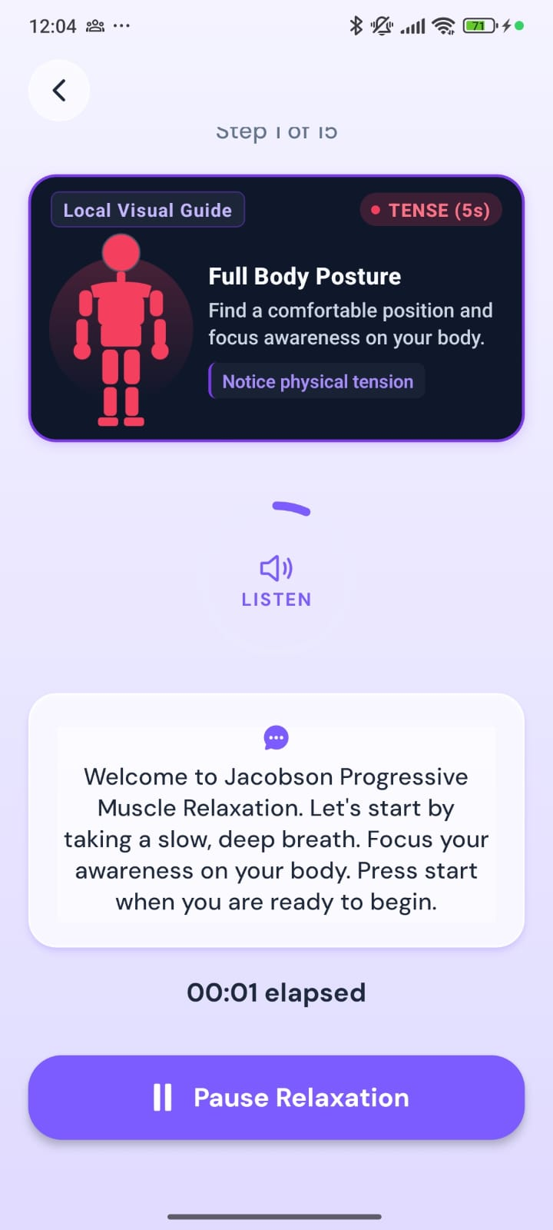
Calm the body in a few minutes
Breathing
Grounding: see
Grounding: taste
Muscle relaxation
Short, guided exercises with clear steps, timers and spoken instructions. Each takes only a few minutes.
Notes:
For moments of stress, students have short guided exercises: a breathing break with a gentle animated rhythm, the 5-4-3-2-1 grounding exercise that brings attention back to the present through the senses, and a guided muscle relaxation with spoken instructions.

Slide 13
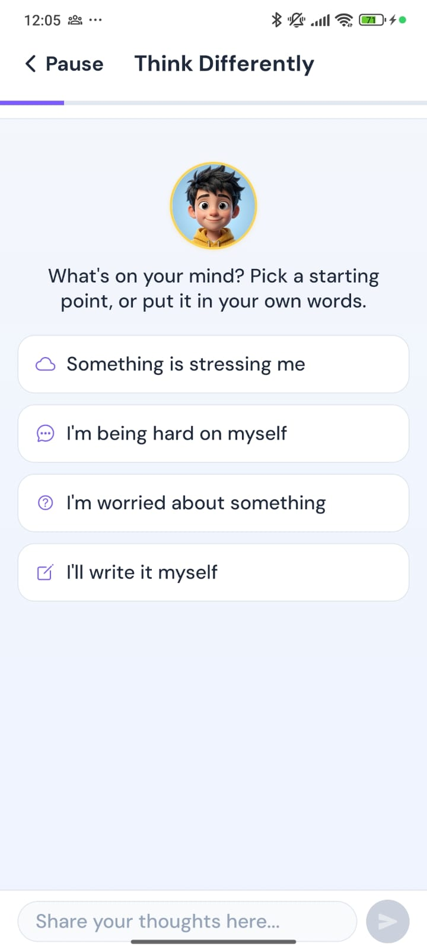
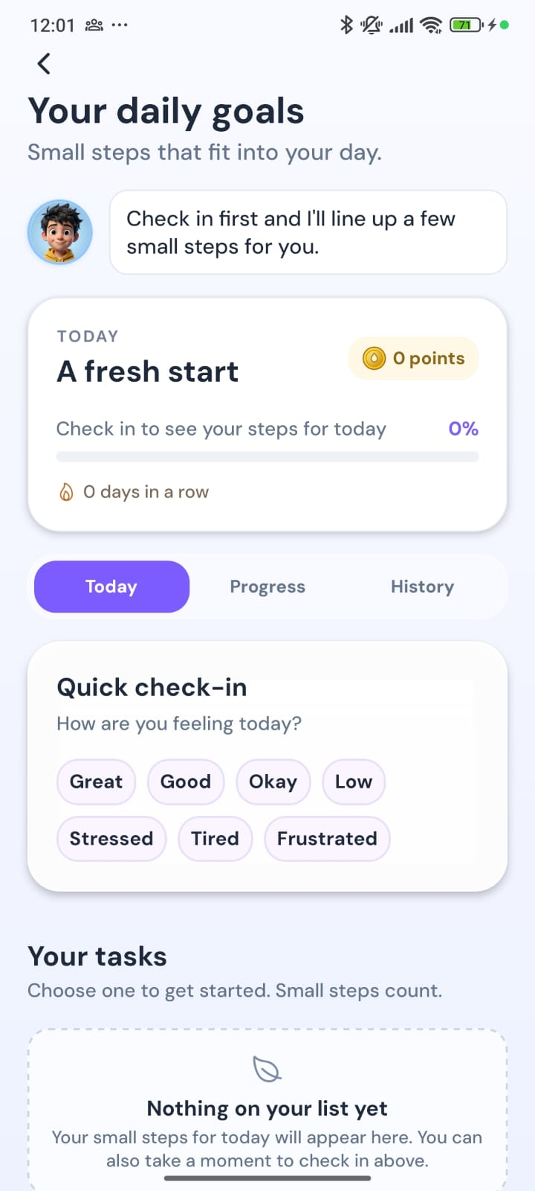
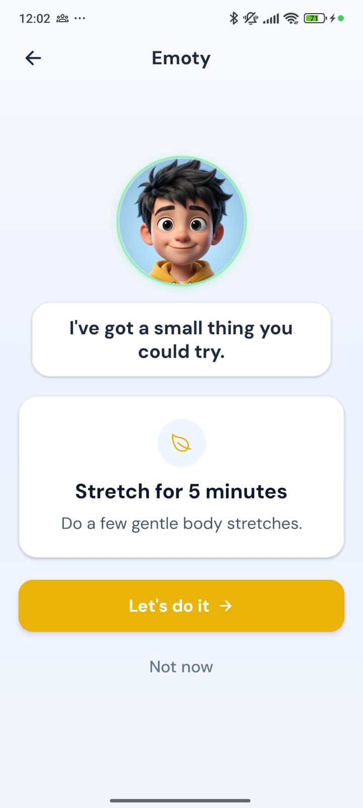

Untangle thoughts, build small wins
Think Differently
Pick a starting point like “I’m being hard on myself” and work through it step by step.
Small Steps
Emoty suggests one achievable action, such as a five-minute stretch.
Help is built in
From these exercises, students can ask to speak to a counsellor.
Think Differently
Daily goals
A small step
Notes:
For the mind, Think Differently helps students work through unhelpful thoughts, starting from simple prompts. Small Steps turns good intentions into one small, achievable action each day. And at any point, a student can ask to speak with a counsellor.

Slide 14
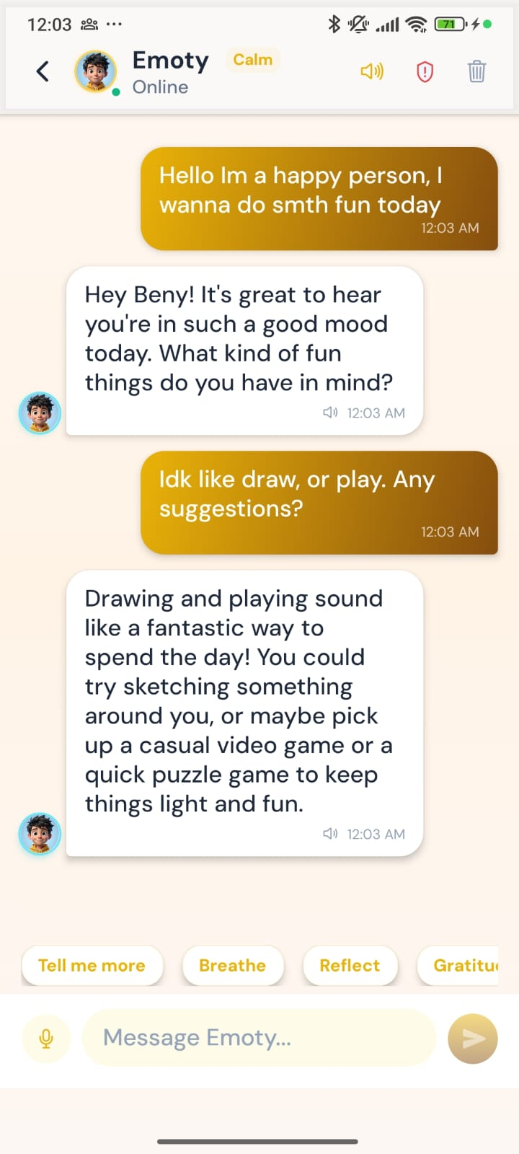

Emoty: someone to talk to, any time
Always available
Students can talk or type whenever they need to, day or night.
Warm and personal
Emoty uses the student’s preferred name and can read replies aloud.
Safely supervised
Counsellors can review conversations, and risky messages are flagged.
Quick suggestions
One-tap prompts like “Breathe” or “Reflect” to get started.
Start a conversation
A supportive reply
Notes:
Emoty is the app's AI companion. Students can chat by typing or speaking, at any time. Replies are warm and personal. Importantly, this is supervised: counsellors can review conversations on their dashboard, and risky messages are flagged for the team.

Slide 15
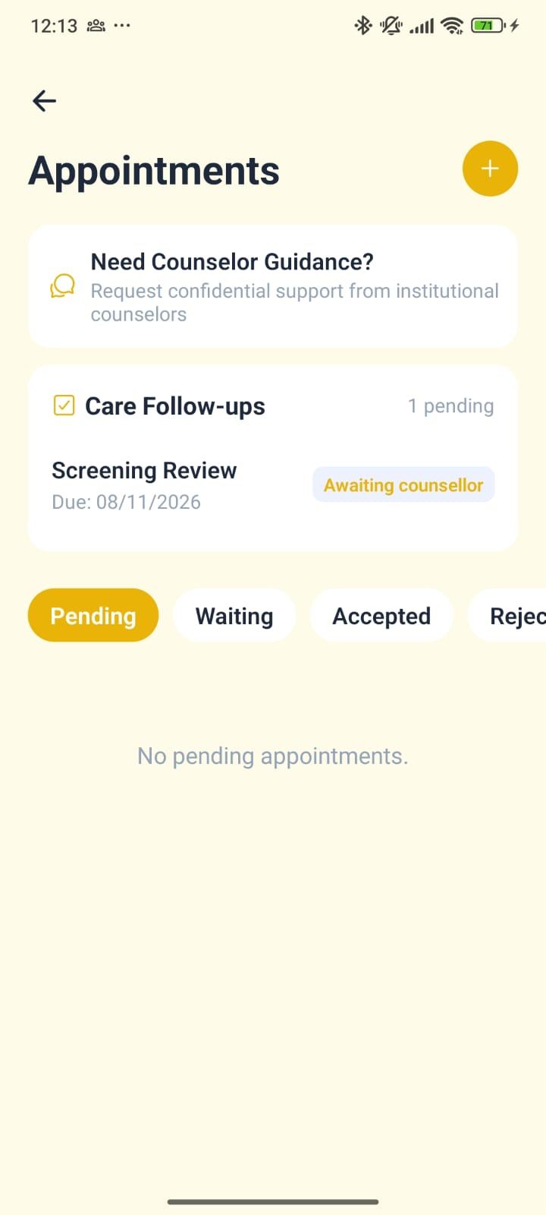

A counsellor is always one tap away
Ask for guidance
A confidential request goes straight to the counselling team.
Linked to the Counsellor Dashboard
Book a session
Students choose a time and share a short reason.
Every request appears instantly for the counselling team.
Safety concerns from questionnaires raise an alert automatically, even if the student never asks.
Follow-ups in one place
Tasks from the care team, such as a screening review, with their status.
Notes:
Students are never on their own. From Appointments they can ask for confidential guidance or book a session, and see follow-ups from the care team. Everything here connects to the Counsellor Dashboard we presented earlier, and safety concerns raise an alert automatically, even if a student never asks for help.

Slide 16
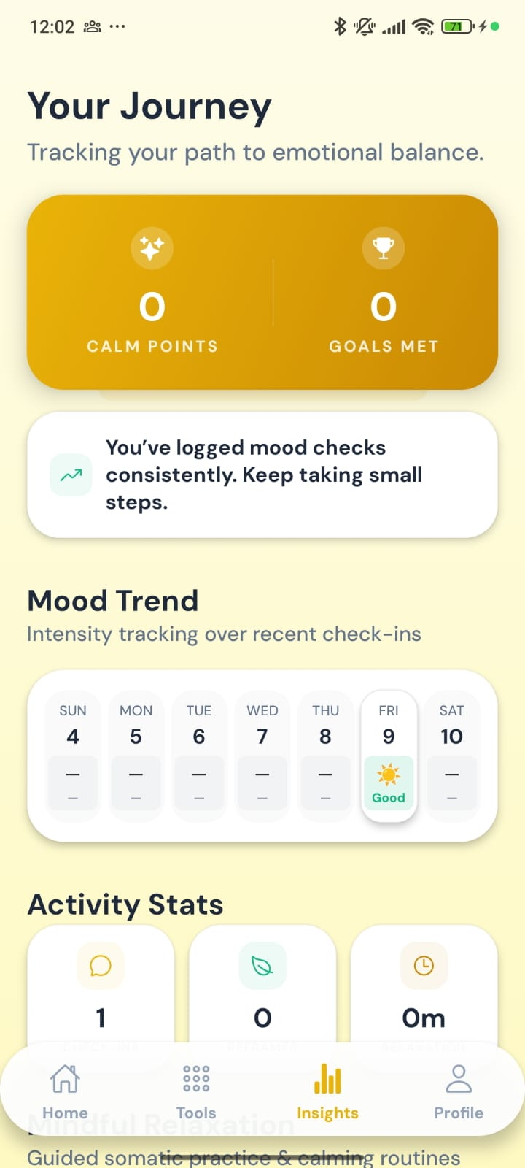
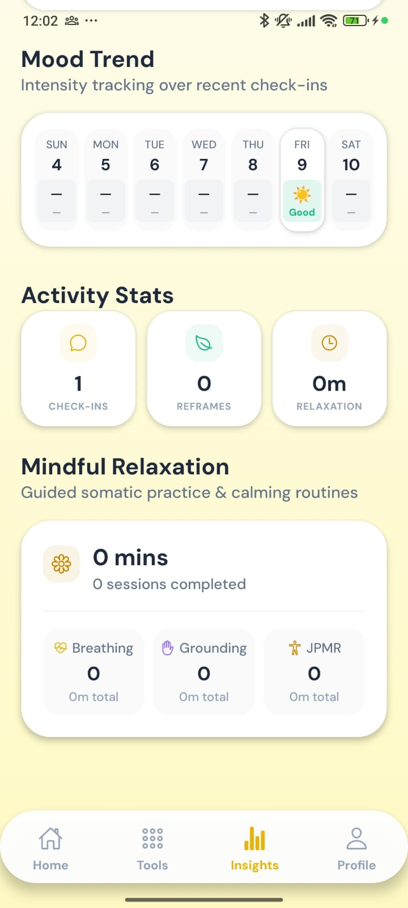

Students can see their own progress
Mood over the week
A simple calendar shows each day’s check-in.
Points and goals
Calm Points and goals met reward steady effort.
Activity at a glance
Check-ins, thought exercises and minutes of relaxation.
Gentle encouragement
Short messages celebrate consistency.
Your Journey
Activity
Notes:
Insights lets students see their own progress: their mood across the week, Calm Points and goals met, and how much time they have spent on exercises. Encouraging messages reward consistency rather than perfection.

Slide 17
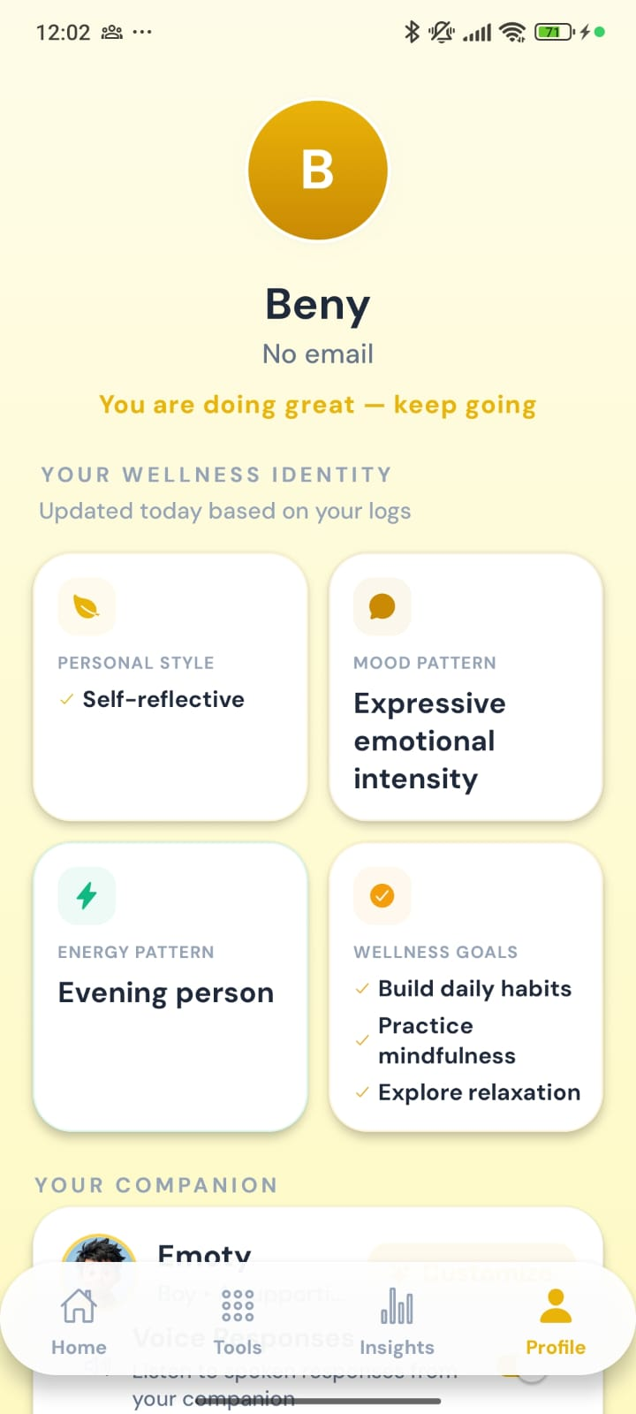
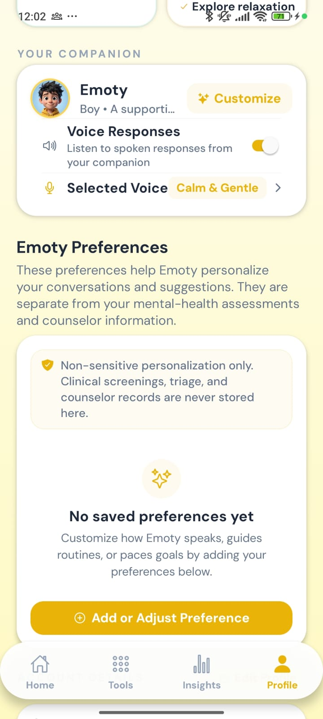

An app that gets to know them
Wellness identity
Style, mood and energy patterns, updated from the student’s activity.
Make Emoty their own
Change the look, name and voice, or turn spoken replies on or off.
Clear boundaries
Personal preferences are kept separate from clinical records.
Wellness identity
Companion settings
Notes:
The profile shows a simple wellness identity that updates as the student uses the app, and lets them personalise Emoty's look, name and voice. Personal preferences are kept separate from screenings and counsellor records.

Slide 18




Use case: a stressful exam week
1
2
3
A heavy morning
A student taps “Heavy” in the daily check-in, and Emoty offers to explore it.
Finding the words
The guided check-in helps them name the feeling and notice tension in the body.
A matched activity
Emoty suggests a short calming exercise, which they complete in five minutes.
4
5
6
A small win
They accept a small step for the day and earn Calm Points.
Still worried that night
They chat with Emoty, which stays supportive and safely supervised.
Talking to a person
They request a session, and it appears on the counsellor’s dashboard.
An illustrative example of how a student might use the app.
Notes:
Here is how it comes together. During exam week, a student starts the day feeling heavy. The guided check-in helps them understand what they feel, and Emoty suggests a short calming exercise. They take one small step for the day. That night, still worried, they talk to Emoty, and then request a session with a counsellor, which appears straight away on the counsellor's dashboard.

Slide 19

What it means for your institution
For students
For counsellors
For the institution
Private support, any time of day
Help to understand their feelings
A simple path to a counsellor
Students arrive better prepared
Early warning when someone is at risk
Fewer students slipping through
Higher engagement with wellbeing
Based on well-established questionnaires
Care that continues between sessions
Notes:
For students, Emotify is private support at any hour and a simple path to a counsellor. For counsellors, students arrive better prepared and risks surface early. For the institution, it means care that continues between sessions, built on trusted questionnaires.

Slide 20

Support in their pocket.
Help one tap away.
Suggested next steps
Hands-on demo of the student app
Agree the onboarding and consent wording
Thank you
Start a pilot with a group of students
Notes:
Emotify puts support in students' pockets, with a counsellor one tap away. As next steps, we suggest a hands-on demo of the app, agreeing the onboarding and consent wording with your team, and a pilot with a group of students. Thank you.

