Slide 1

Department of Avionics,
Indian Institute of Space Science and Technology
AV224 - Computer Organization & Operating Systems
Instructor: Vineeth B. S. (vineethbs@iist.ac.in)
Lecture 17
20/02/2017
Figures in these lecture slides are taken from Hennessy and Patterson's
Computer Organization and Design
(Copyright © 2014 Elsevier Inc. All rights reserved)

Slide 2
Review: Multi cycle data path processors
Multicycle data path execution time vs Single cycle data path execution time
Multicycle data path architecture
Reuse of components
Additional registers to hold intermediate values
Multiplexers and additional control signals
Steps in executing an instruction
Instruction Fetch
Instruction Decode and Register read
ALU operations
Data access
Register write

Slide 3
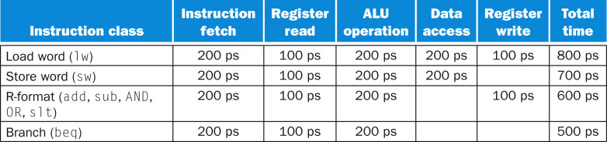
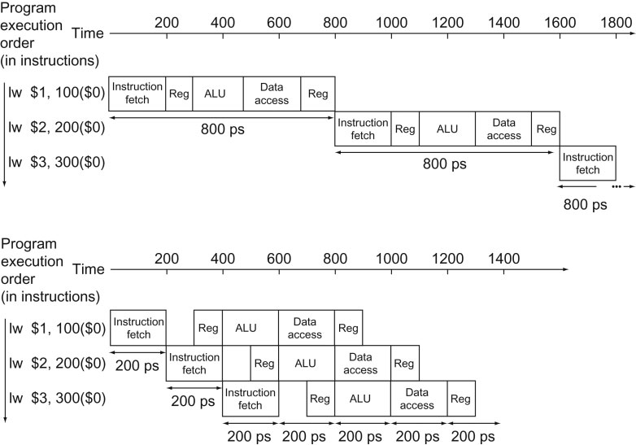
Time gain from a pipelined datapath

Slide 4
Time gain from a pipelined datapath
TimeBetweenInstructions_{Pipelining} = TimeBetweenInstructions
Number of Pipeline Stages
Is it always possible to pipeline?
The speedup factor is the number of pipeline stages.
So is it better to increase the number of pipeline stages?
Is it always possible to achieve this speedup?

Slide 5
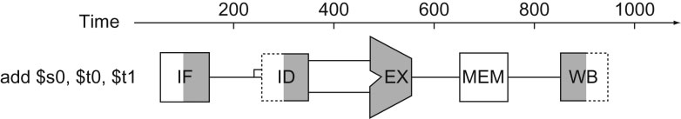
Is it always possible to pipeline - Design of instruction sets and their encoding for pipelining
Fixed size instructions - For example, in the processor that we had looked that all the instructions were 32 bits in size. This means that the instruction could be completely fetched in the first pipeline stage and could be decoded in the second stage. For a variable length instruction, further fetches might be required.
Small number of instruction formats - The bits which are used to decide the register indices are fixed in a large number of instructions. So the register can be read in parallel with the decoding of the instruction and generation of control signals.
No operations on operands in memory - Memory is accessed using separate load and store instructions. The execute stage is therefore used only for address computation.
Operands are kept aligned in memory - Multiple fetches to obtain a single operand from memory is not required.

Slide 6
Hazards in pipelining
There could be cases where it is not possible to pipeline the next instruction along with the current instruction - these are called hazards
Instructions could share the same resource - structural hazard
An instruction uses data which is available only when a previous instruction has finished execution - data hazard
The instruction that needs to be executed depends on the execution of a previous instruction - control hazard
Structural hazards in pipelining
The hardware does not support the combination of instruction stages currently in the pipeline
Suppose we only had a single memory to store data and code ...
May need multiple copies of components.
Another load

Slide 7
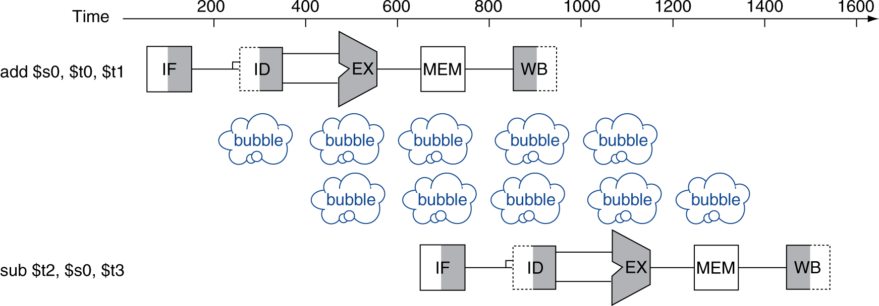
Data Hazard
Data hazards occur when an instruction needs the "result" of a previous instruction which has not completed
For example
add r1, r2, r3 // r1 = r2 + r3
sub r4, r1, r5 // r4 = r1 - r5
r2 + r3
r2, r3
r1 = r2 + r3
add
sub
r1, r5
Pipeline stall

Slide 8
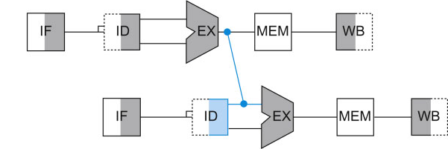
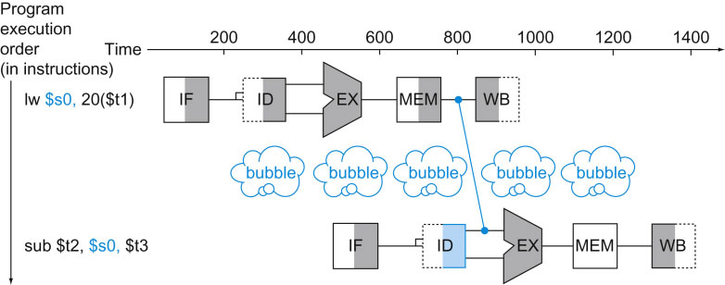
Data Hazard
Avoiding data hazards by forwarding or bypassing
add r1, r2, r3 // r1 = r2 + r3
sub r4, r1, r5 // r4 = r1 - r5
The result r1 is available early and can be forwarded to the next instruction
Sometimes a pipeline stall is required even if there is forwarding
load r1, memloc
sub r2, r1, r3

Slide 9
Data Hazard
Data hazards can be handled to some extent at compile/assembly time
load r1, memloc1
load r2, memloc2
add r3, r1, r2
sw r3, memloc3
load r4, memloc4
add r5, r1, r4
load r1, memloc1
load r2, memloc2
load r4, memloc4
add r3, r1, r2
sw r3, memloc3
add r5, r1, r4
stall
stall
Here the sequence of instructions on the left lead to two stalls even with forwarding.
A good assembler (compiler if this is obtained from say C code) would reorder the code so that there are no stalls.

Slide 10
Control Hazard
Suppose we have a beq instruction
The result of the comparison decides which instruction is to be fetched.
Cannot start fetching the next instruction!
Stall till we know what instruction to fetch
Use branch prediction to decide which instruction to fetch - prediction might be wrong!
Static branch prediction rules - backward jumps are always taken, forward jumps are not taken

Slide 11
Summary
Pipelining does not decrease the execution time of an instruction
Pipelining decreases the total time it takes to execute a large number of instructions
The speedup is the number of pipeline stages
Instruction sets play a major role in pipeline implementation
Pipelining may not always be possible
Structural hazards
Data hazards
Control hazards
Reference - Hennessy and Patterson

