Slide 1

Department of Avionics,
Indian Institute of Space Science and Technology
AV224 - Computer Organization & Operating Systems
Instructor: Vineeth B. S. (vineethbs@iist.ac.in)
Lecture 18
21/02/2017
Figures in these lecture slides are taken from Hennessy and Patterson's
Computer Organization and Design
(Copyright © 2014 Elsevier Inc. All rights reserved)

Slide 2
Review of Pipelining
Pipelining does not decrease the execution time of an instruction
Pipelining decreases the total time it takes to execute a large number of instructions
The speedup is the number of pipeline stages
Instruction sets play a major role in pipeline implementation
Pipelining may not always be possible
Structural hazards
Data hazards
Control hazards
Today's class
Pipelined data path and control
Pipelined data path and control for handling hazards

Slide 3
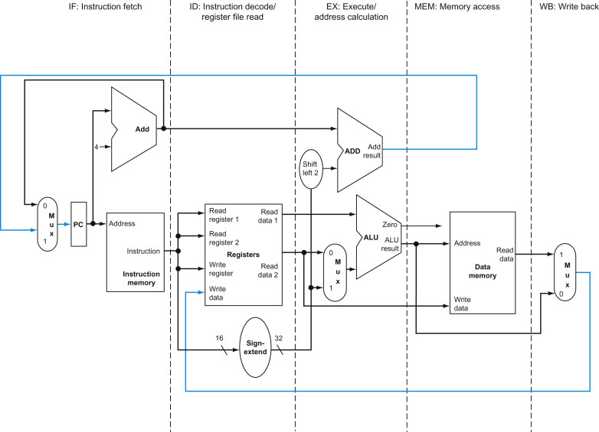
Pipelining for the single cycle data path
Divide the data path into five stages
IF
ID
EX
MEM
WB
Note that data goes from left to right but there are two exceptions
Updated PC is fed back - causes control hazards
Data is written back - causes data hazards

Slide 4
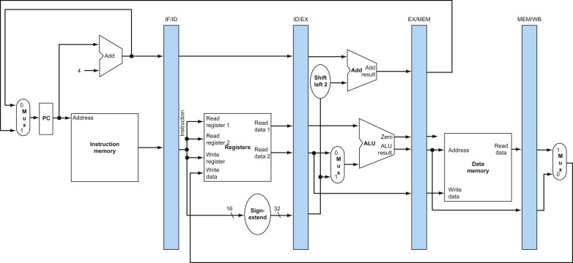
Pipelining for the single cycle data path
Registers are used in between stages to hold values to be used in further pipeline stages. Values could be contents of registers, register indices, memory addresses, offsets etc.
These intermediate registers need to be large enough to hold all these values.

Slide 5
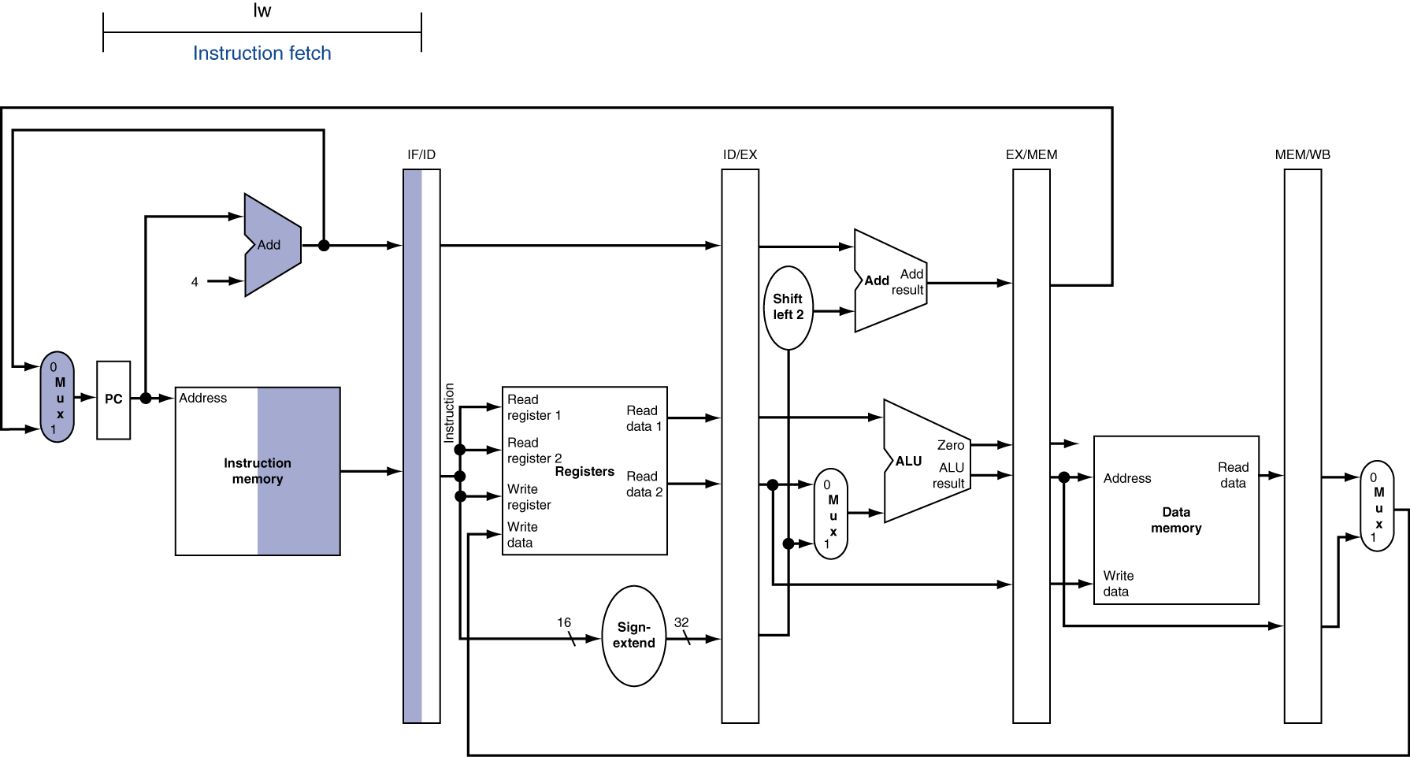
Pipelining - single cycle - load instruction

Slide 6
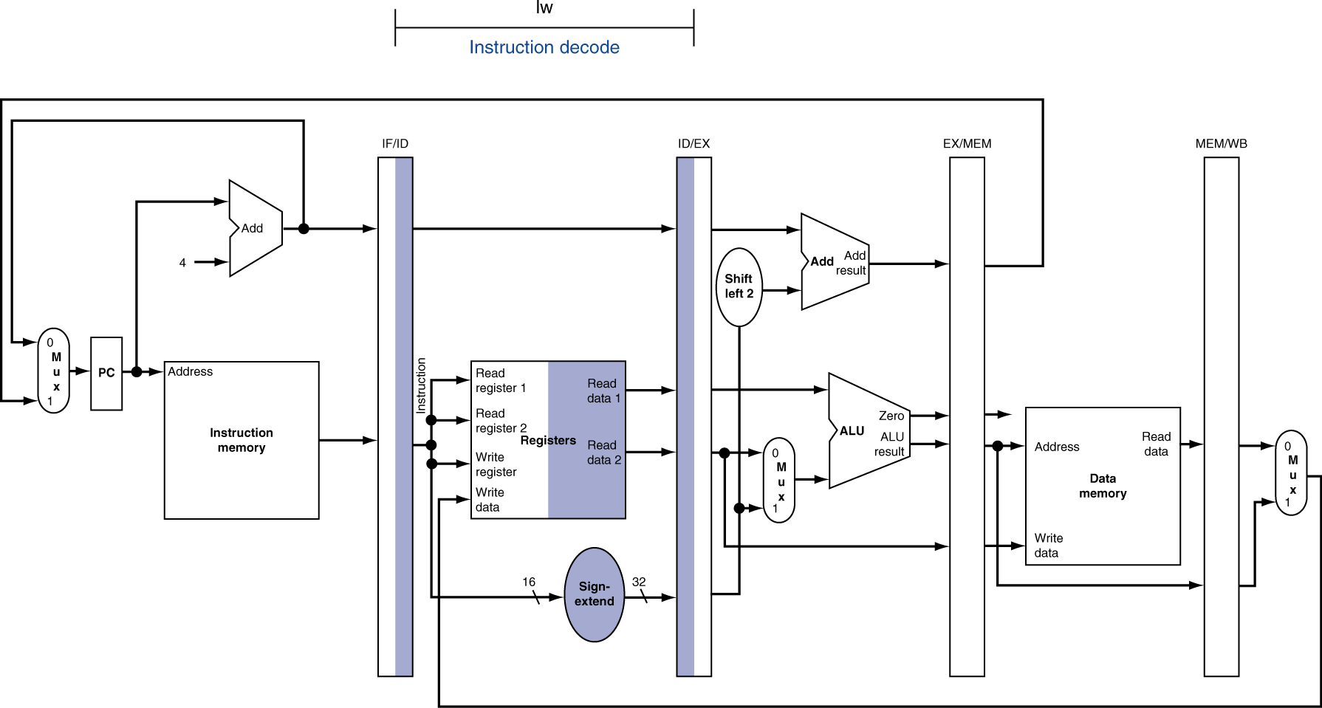
Pipelining - single cycle - load instruction

Slide 7
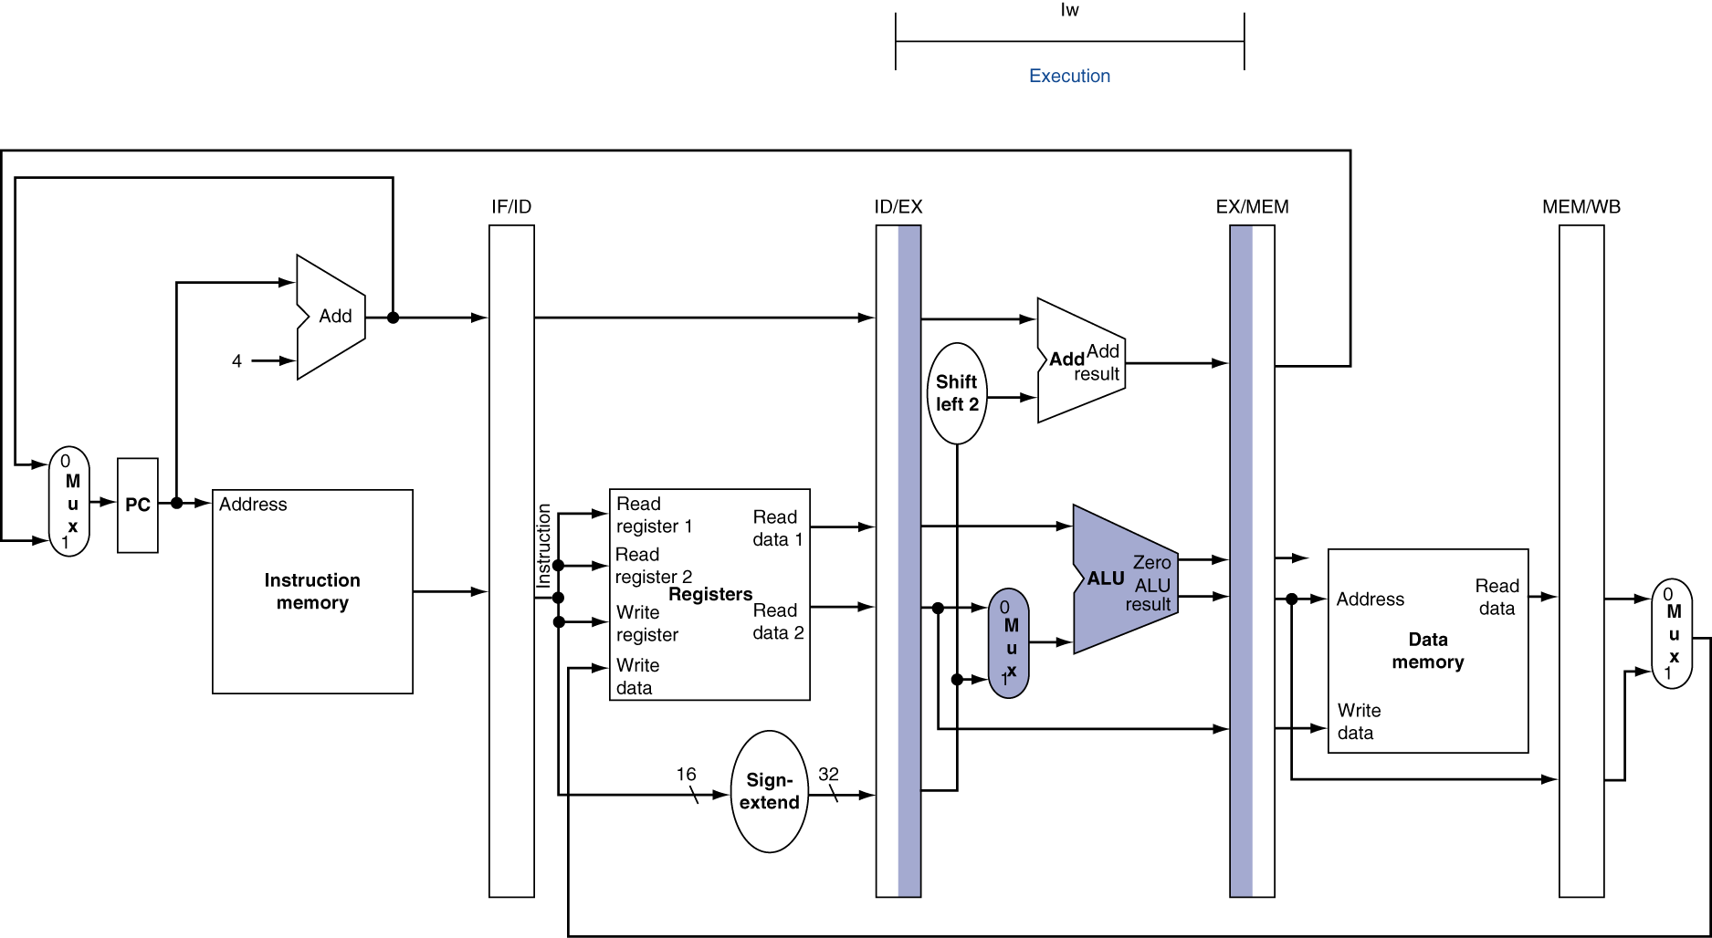
Pipelining - single cycle - load instruction

Slide 8
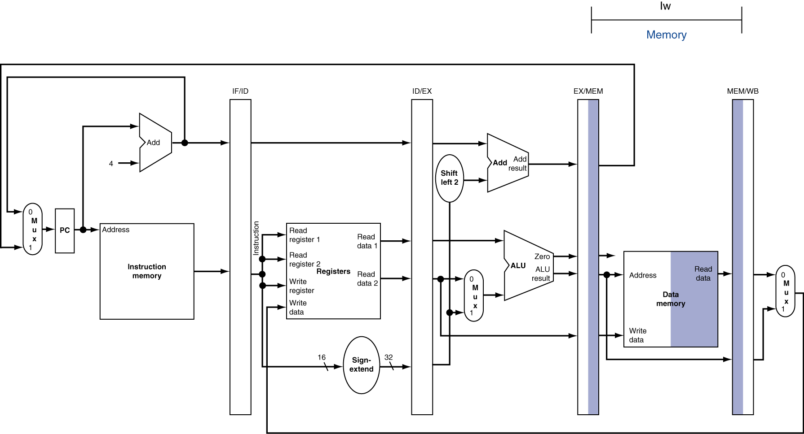
Pipelining - single cycle - load instruction

Slide 9
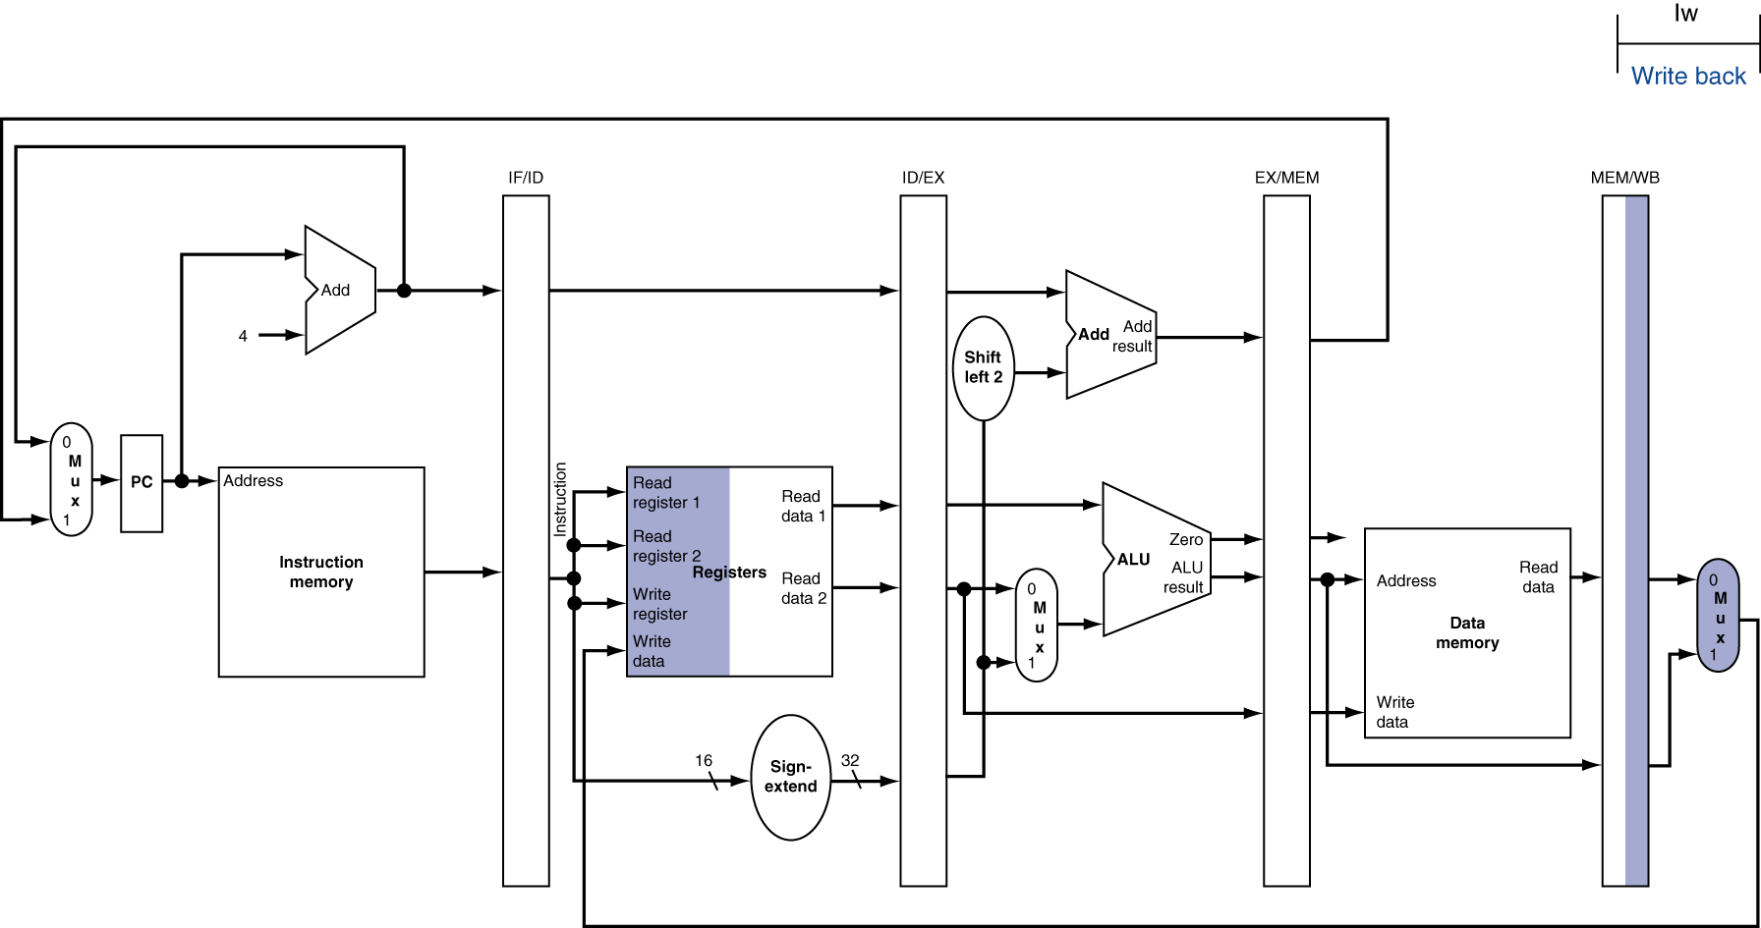
Pipelining - single cycle - load instruction
Write
Register
Index from?

Slide 10
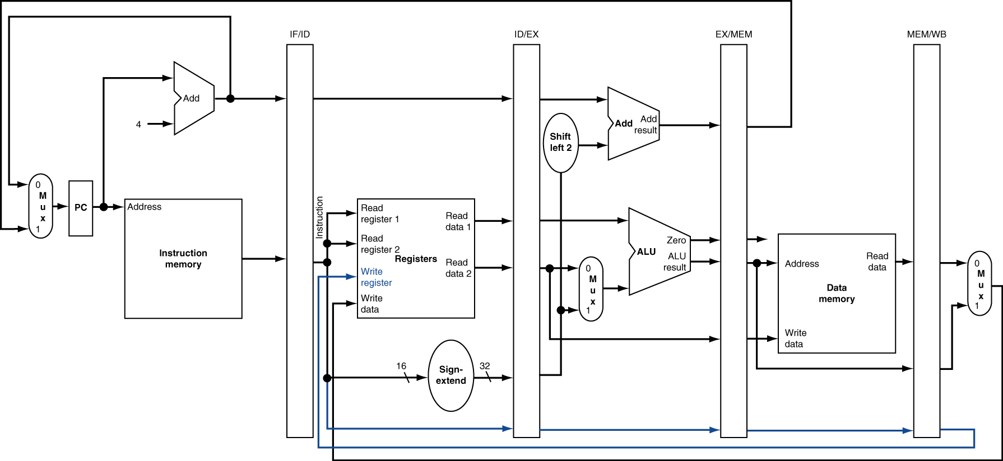
Pipelining - single cycle - load instruction (note what needs to be stored!)

Slide 11
Pipelining - single cycle - store instruction

Slide 12
Pipelining - single cycle - store instruction

Slide 13

Pipelining - single cycle - store instruction

Slide 14
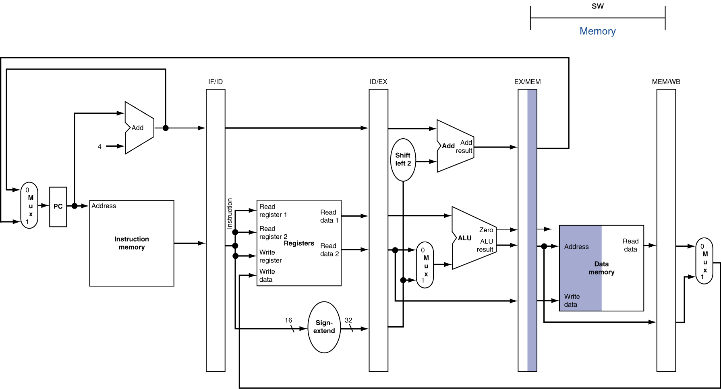
Pipelining - single cycle - store instruction

Slide 15
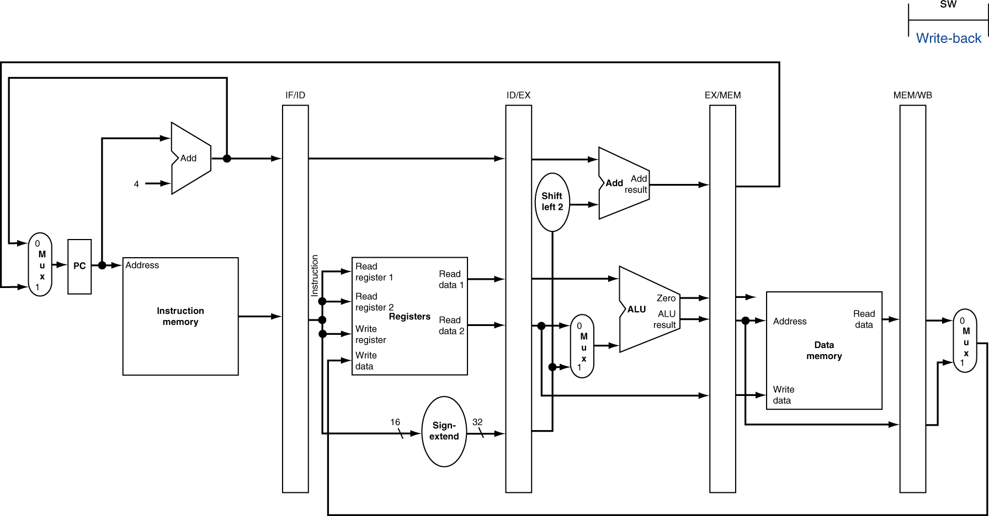
Pipelining - single cycle - store instruction

Slide 16
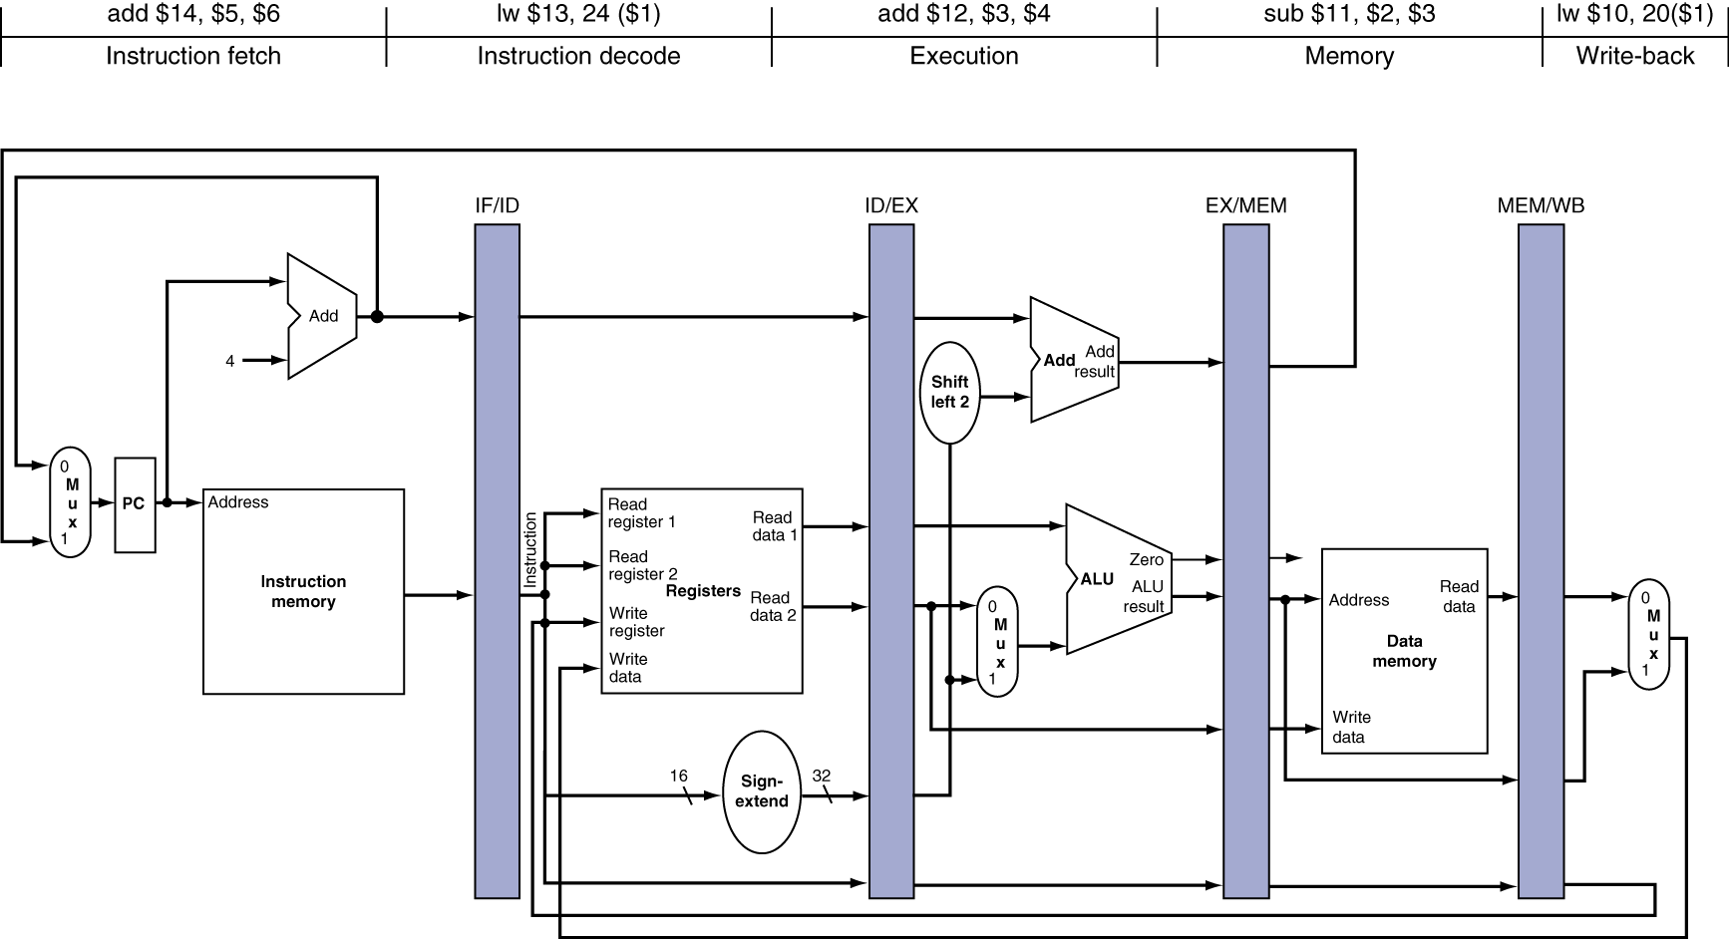
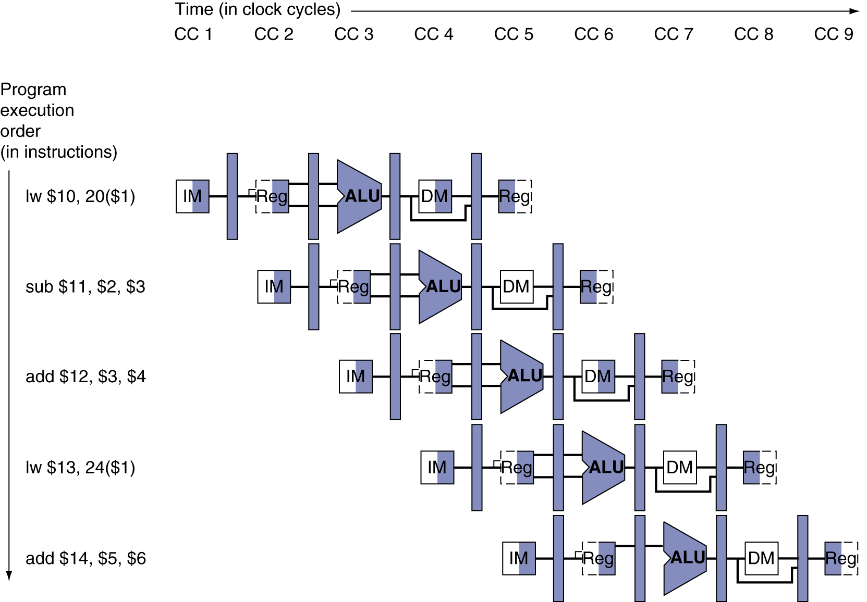
Graphical illustration of pipelining
Single cycle
Multi cycle

Slide 17
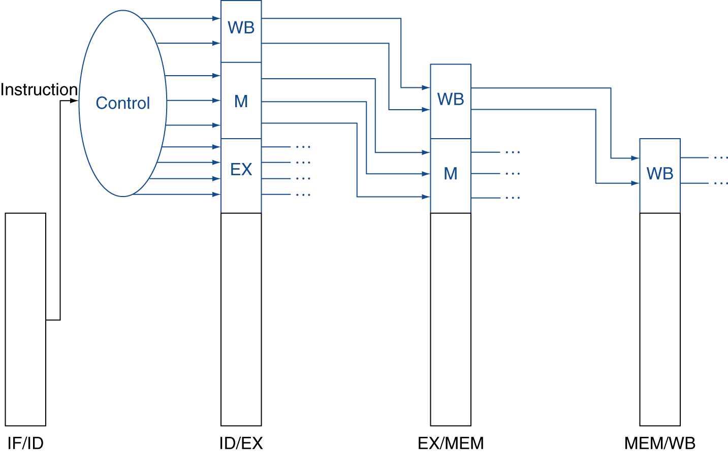
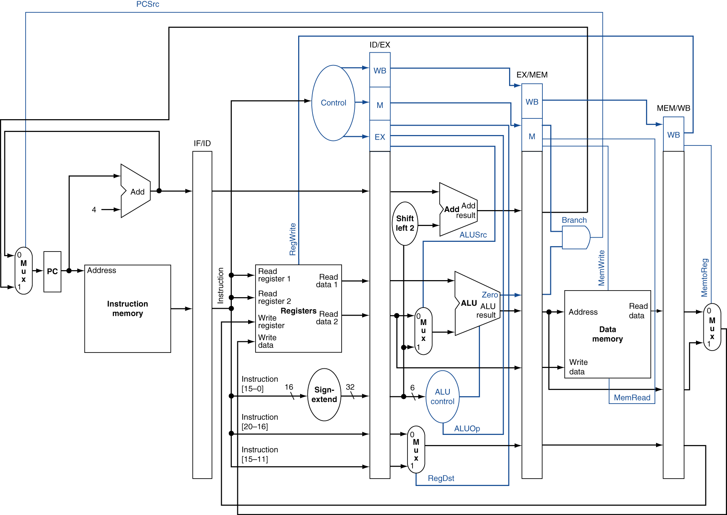
Control signals for pipelining
Note that control signals are derived from the instruction.
However, the control signals have to be propagated to the different stages in the pipeline using the registers

Slide 18
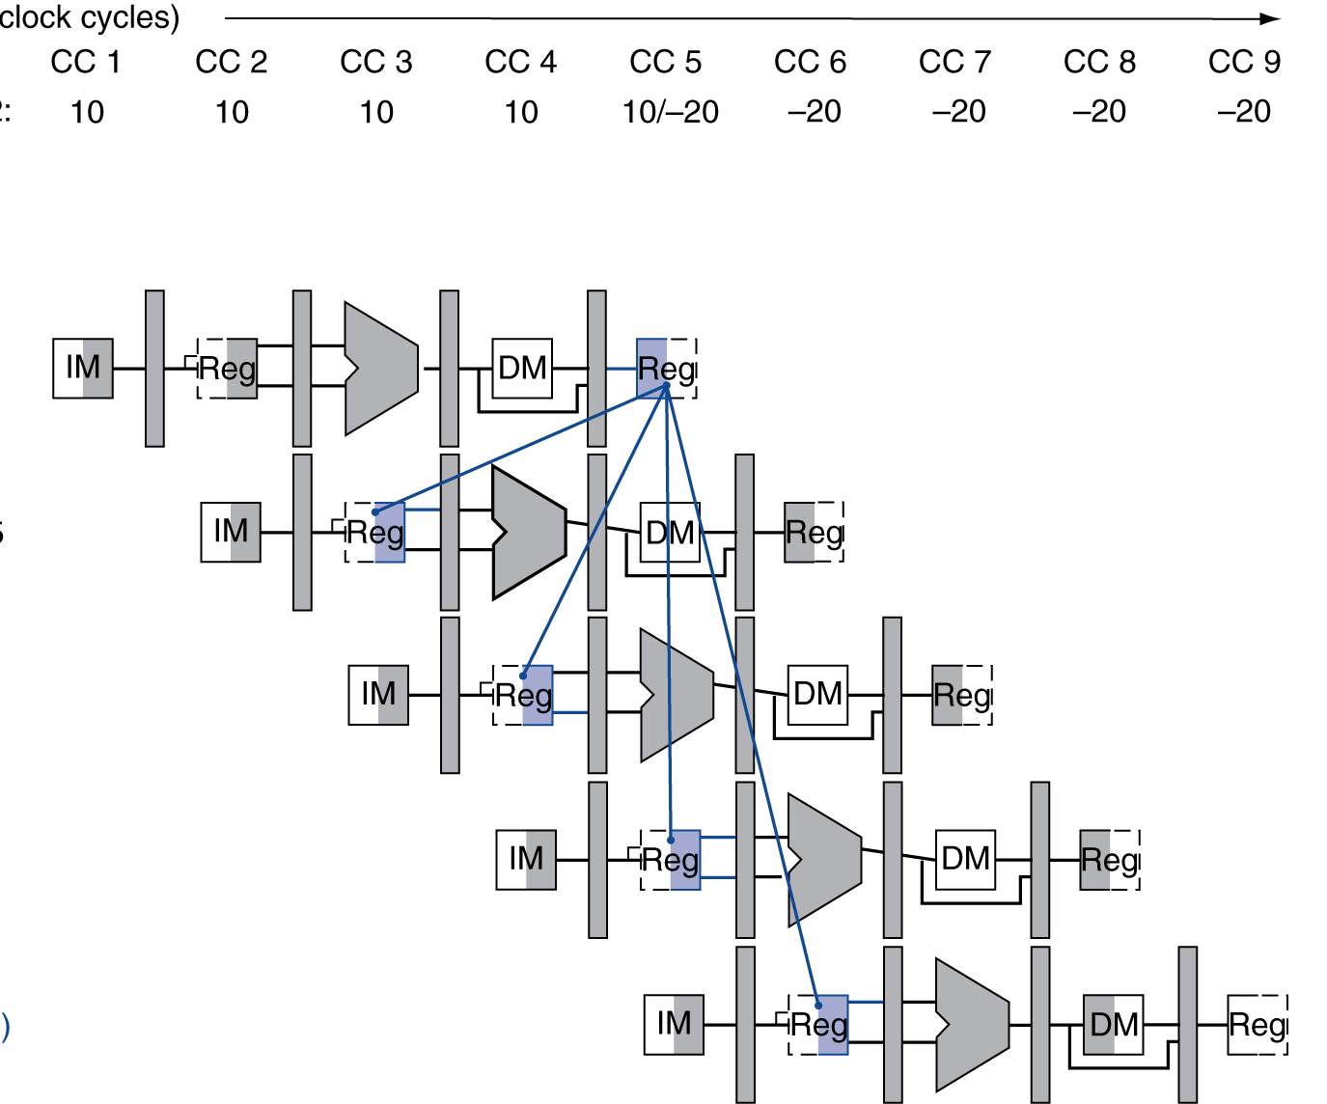
Data hazards and adding forwarding in the datapath
Consider the following code
sub r2, r1,r3 and r12,r2,r5 or r13,r6,r2 add r14,r2,r2 sw r15,[r2 + 100]
Suppose the value is 10 and after the first sub operation is completed it becomes - 20.

