Slide 1

Department of Avionics,
Indian Institute of Space Science and Technology
AV224 - Computer Organization & Operating Systems
Instructor: Vineeth B. S. (vineethbs@iist.ac.in)
Lecture 19
22/02/2017
Figures in these lecture slides are taken from Hennessy and Patterson's
Computer Organization and Design
(Copyright © 2014 Elsevier Inc. All rights reserved)

Slide 2
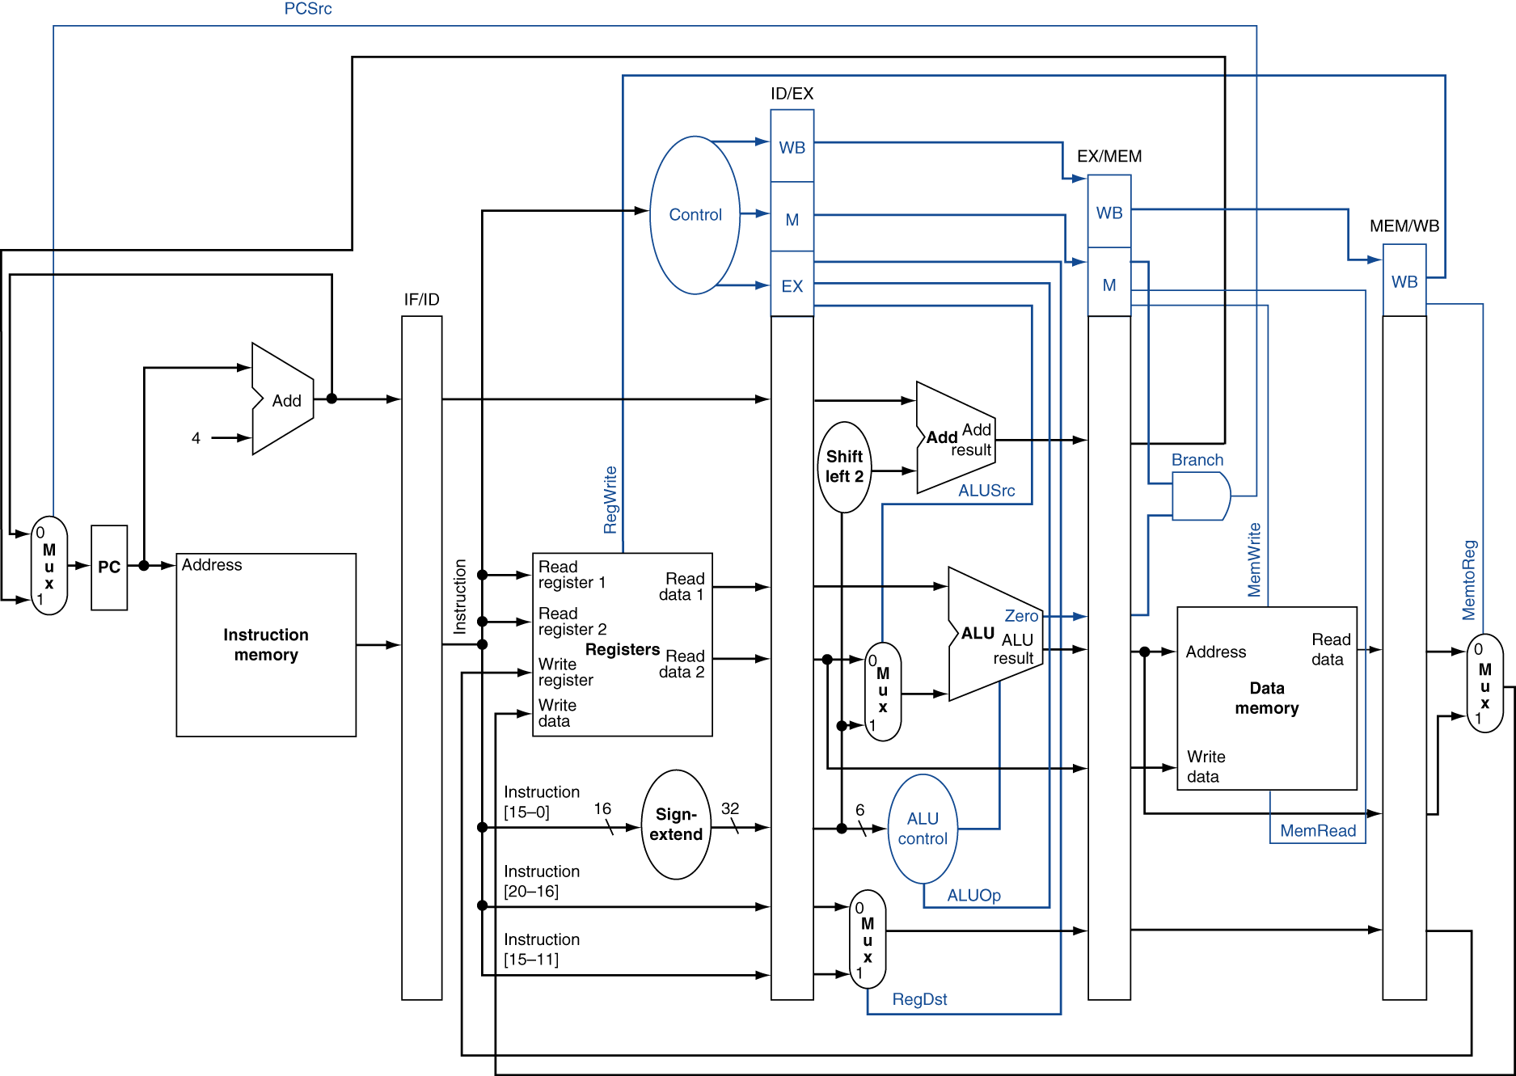
Review of Pipelining
Pipelined data path and control
The single cycle data path is modified to get the pipelined data path
The data path is split according to the five stages (sub steps) in the execution of an instruction
Pipeline registers - temporary registers at the interface between each stage
Pipeline registers has to hold
Register values
Parts of the instruction and control signals
Register addresses or indices
Control signals are derived as before

Slide 3
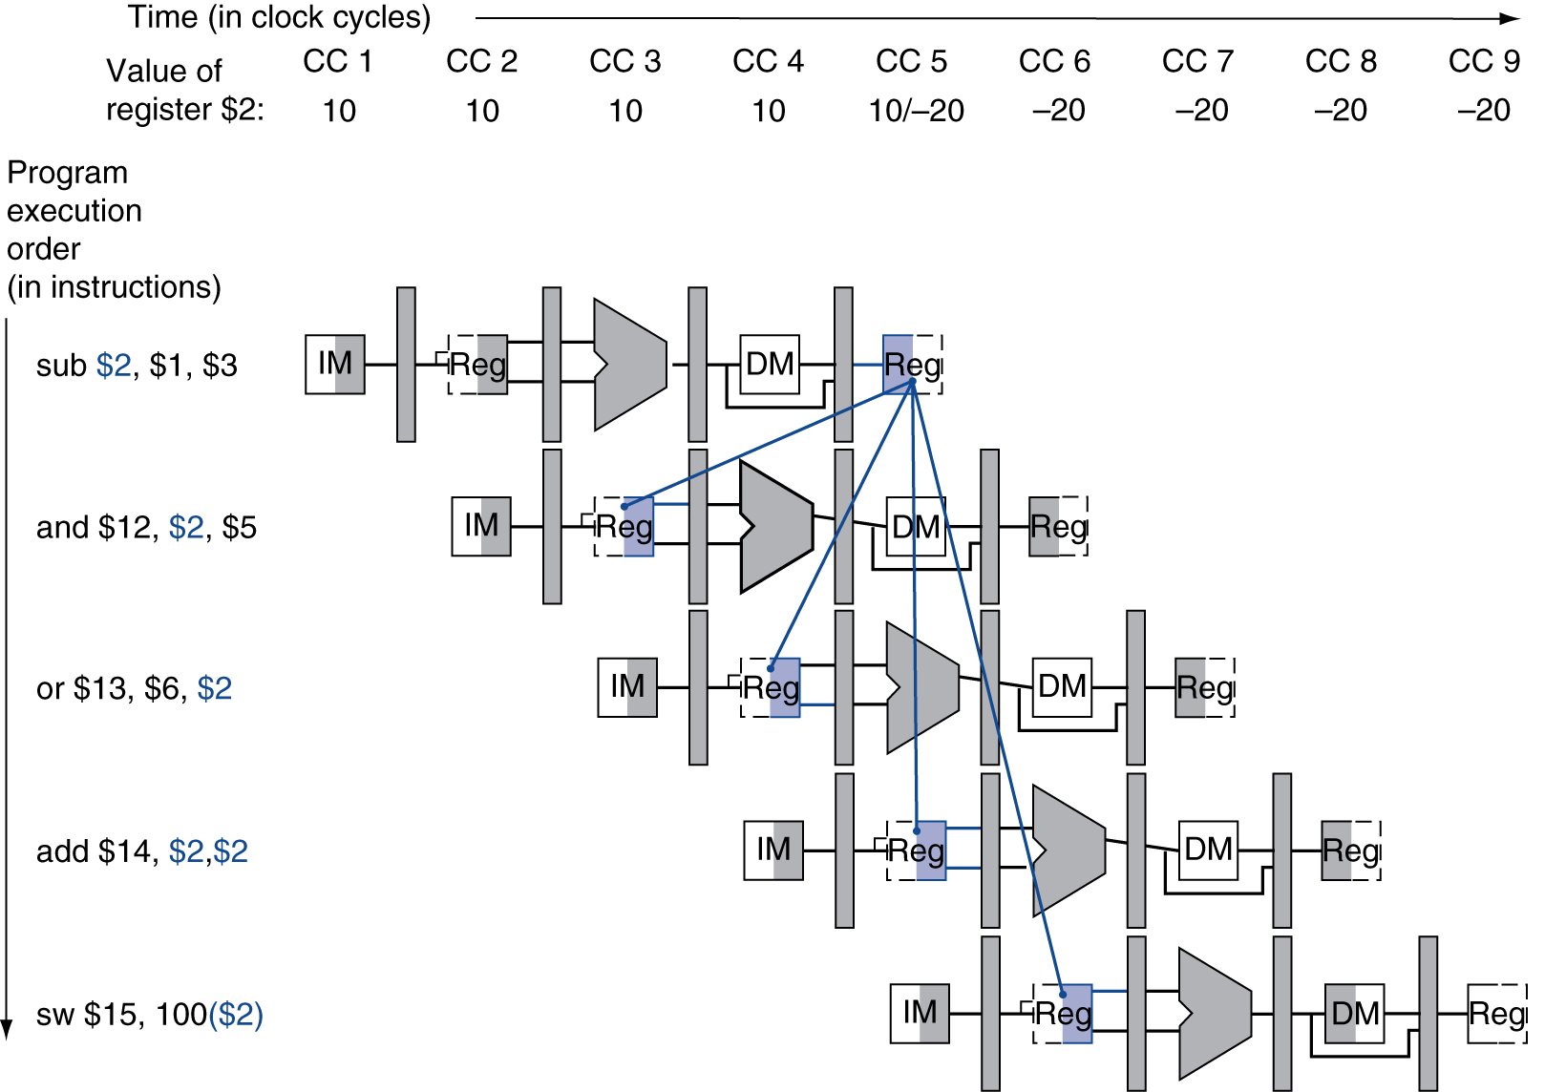
Data hazards and adding forwarding in the datapath
Consider the following code
sub r2, r1,r3 and r12,r2,r5 or r13,r6,r2 add r14,r2,r2 sw r15,[r2 + 100]
Suppose the value is 10 and after the first sub operation is completed it becomes - 20.
For the last two instructions are there any data hazards?

Slide 4
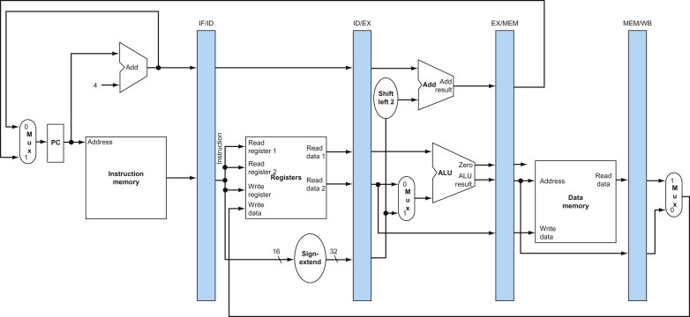
Some notation for thinking about data hazards
Pipeline temporary registers would hold the register indices as an instruction proceeds along the steps in a pipeline
Suppose the register index of the first source register is denoted as RegisterRs
The index RegisterRs stored in a particular pipeline register is denoted as PipelineRegister.RegisterRs
Example: ID/Ex.RegisterRs
So we have the following types of data hazards
From EX/MEM to ID/EX
EX/MEM.RegisterRd is needed by ID/EX.RegisterRs
EX/MEM.RegisterRd is needed by ID/EX.RegisterRt
From MEM/WB to ID/EX
MEM/WB.RegisterRd is needed by ID/EX.RegisterRs
MEM/WB.RegisterRd is needed by ID/EX.RegisterRt
The type is decided by the forwarding which needs to be done!

Slide 5
Types of Data hazards (or forwarding)
Consider the following code
sub r2, r1,r3 and r12,r2,r5 or r13,r6,r2 add r14,r2,r2 sw r15,[r2 + 100]
1.1
2.2
Types of data hazards
From EX/MEM to ID/EX
EX/MEM.RegisterRd is needed by ID/EX.RegisterRs
EX/MEM.RegisterRd is needed by ID/EX.RegisterRt
From MEM/WB to ID/EX
MEM/WB.RegisterRd is needed by ID/EX.RegisterRs
MEM/WB.RegisterRd is needed by ID/EX.RegisterRt

Slide 6
Detecting Data hazards and forwarding
Types of data hazards
From EX/MEM to ID/EX
EX/MEM.RegisterRd is needed by ID/EX.RegisterRs
EX/MEM.RegisterRd is needed by ID/EX.RegisterRt
From MEM/WB to ID/EX
MEM/WB.RegisterRd is needed by ID/EX.RegisterRs
MEM/WB.RegisterRd is needed by ID/EX.RegisterRt
Suppose the control logic just checks
EX/MEM.RegisterRd == ID/EX.RegisterRs
We could additionally see if the register file will be written. Can check the RegWrite bit being propagated in EX/MEM.
Depending on the type of the hazard we need to forward the right data to the right operand at the execution stage

Slide 7
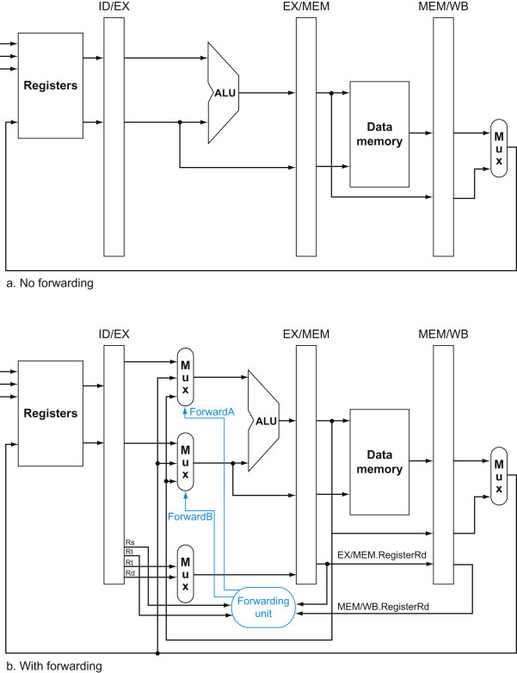
Detecting Data hazards and forwarding
Suppose the control logic just checks
EX/MEM.RegisterRd == ID/EX.RegisterRs
We could additionally see if the register file will be written. Can check the RegWrite bit being propagated in EX/MEM.
Depending on the type of the hazard we need to forward the right data to the right operand at the execution stage

Slide 8
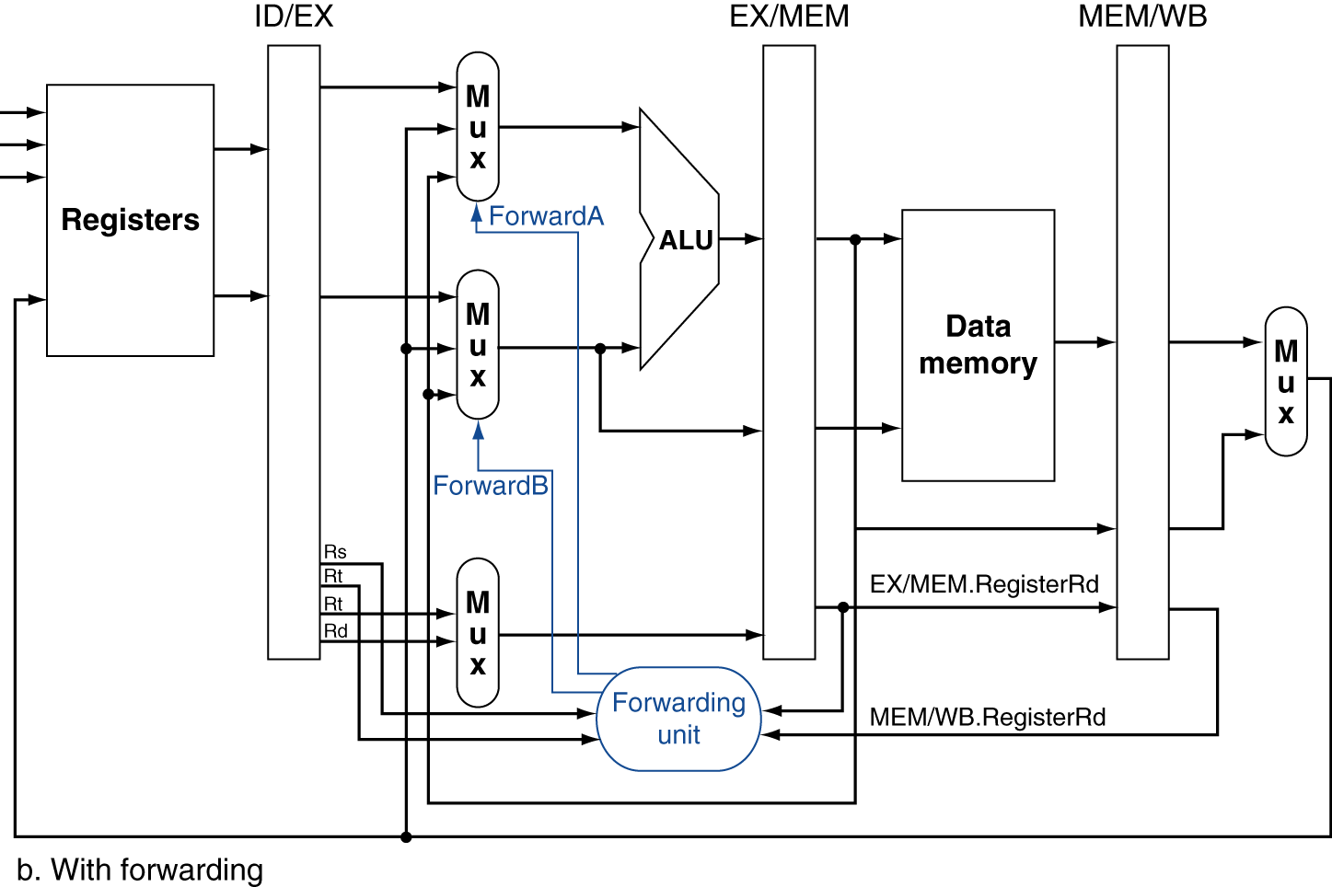
Detecting Data hazards and forwarding
Suppose the control logic just checks
EX/MEM.RegisterRd == ID/EX.RegisterRs
We could additionally see if the register file will be written. Can check the RegWrite bit being propagated in EX/MEM.
Depending on the type of the hazard we need to forward the right data to the right operand at the execution stage
From EX/MEM
if (EX/MEM.RegWrite) and (EX/MEM.RegisterRd = ID/EX.RegisterRs)) ForwardA = 10
if (EX/MEM.RegWrite) and (EX/MEM.RegisterRd = ID/EX.RegisterRt)) ForwardB = 10
From MEM/WB
if (MEM/WB.RegWrite) and (MEM/WB.RegisterRd = ID/EX.RegisterRs)) ForwardA = 01
if (MEM/WB.RegWrite) and (MEM/WB.RegisterRd = ID/EX.RegisterRt)) ForwardB = 01

Slide 9
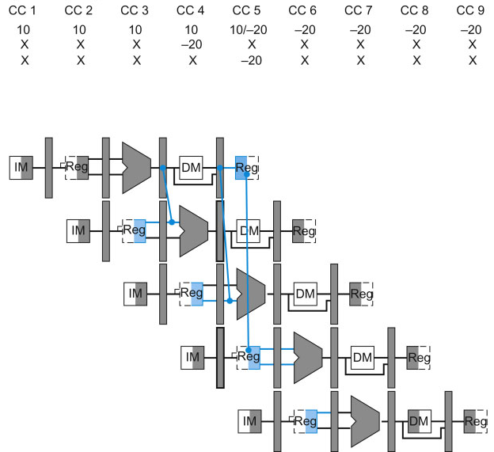
Detecting Data hazards and forwarding
Which path?
Which path?
Which path?

Slide 10
Is this logic enough?
Consider the sequence of instructions
add r1, r1, r2
add r1, r1, r3
add r1, r1, r4
Value of r1 from prev. instruction, but what does our logic do?
From EX/MEM
if (EX/MEM.RegWrite) and (EX/MEM.RegisterRd = ID/EX.RegisterRs)) ForwardA = 10
if (EX/MEM.RegWrite) and (EX/MEM.RegisterRd = ID/EX.RegisterRt)) ForwardB = 10
From MEM/WB
if (MEM/WB.RegWrite) and not (EX/MEM.RegWrite) and (EX/MEM.RegisterRd = ID/EX.RegisterRs)) and (MEM/WB.RegisterRd = ID/EX.RegisterRs)) ForwardA = 01
if (MEM/WB.RegWrite) and not (EX/MEM.RegWrite) and (EX/MEM.RegisterRd = ID/EX.RegisterRt)) and (MEM/WB.RegisterRd = ID/EX.RegisterRt)) ForwardB = 01

Slide 11
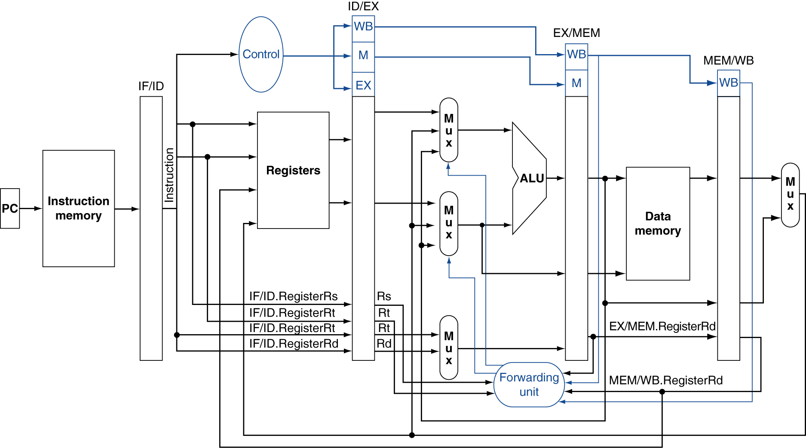
More complete data path to handle hazards via forwarding.

Slide 12
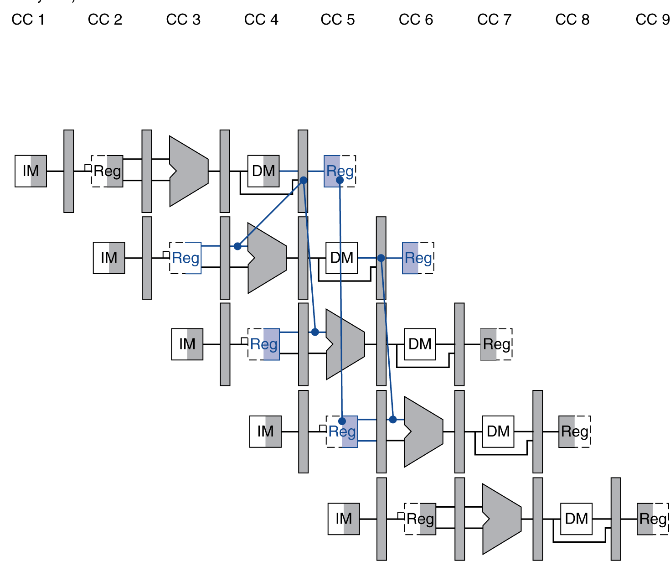
Is this enough?
Well, we have forgotten about the hazard with the load instruction
Recall that we needed a pipeline stall even with forwarding, since the required data is available only after the MEM stage of the pipeline
load r1, [r2 +100]
add r3, r1, r4

Slide 13
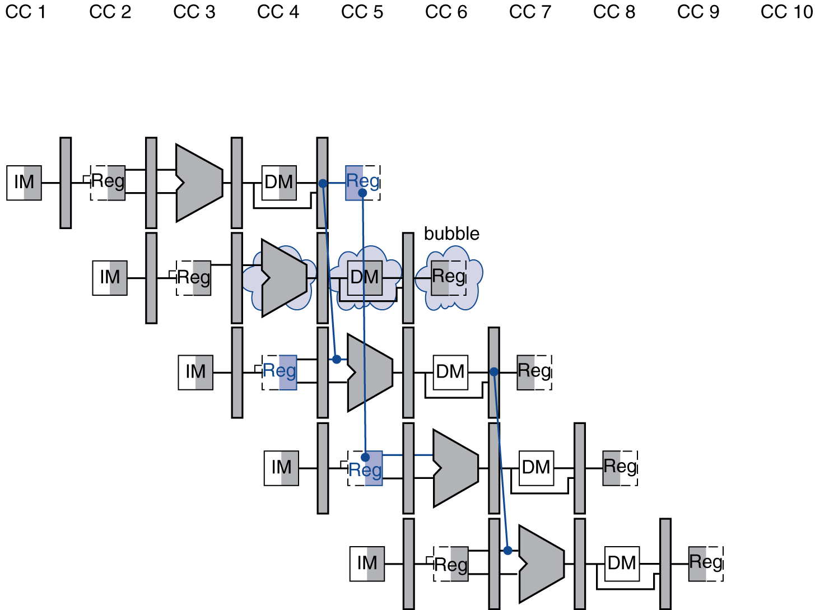
Handling the load hazard
Have to stall the processor
We need a hazard detection unit in addition to a forwarding unit in order to do this
During instruction decode we have the following in the ID/EX register
ID/EX.MemRead, ID/EX.RegisterRt
And for the succeeding instruction in the IF/ID register
IF/ID.RegisterRs, IF/ID.RegisterRt
The hazard detection unit does the following
If ID/EX.MemRead and ((ID/EX.RegisterRt = IF/ID.RegisterRs) or (ID/EX.RegisterRt = IF/ID.RegisterRt))
then stall the pipeline
Stalling the pipeline
Control signals are not asserted - no read or write
PC is not updated, IF/ID register is not changed
A NOP (no operation) is said to happen
load r1, [r2 +100]
add r3, r1, r4
add r3, r1, r4

Slide 14
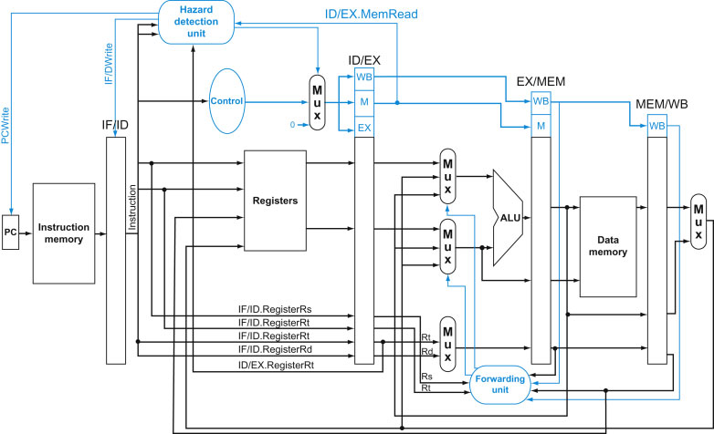
More complete data path to handle hazards via forwarding and to detect load hazard.

Slide 15
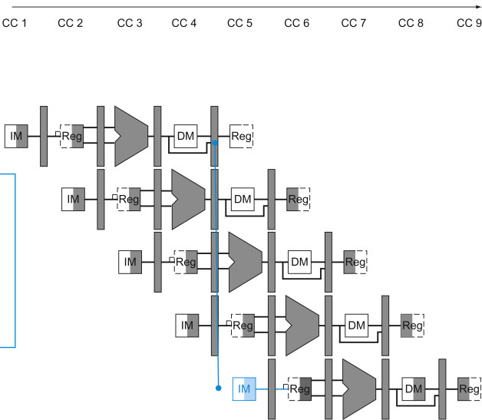
Handling control hazards
Control hazards - the position that we want to branch to, or the right value of updated PC is not available at the right time
40: beq r1, r2, 10
44: add r10, r12, r13
48: add r10, r12, r14
52: add r10, r12, r15
80: load r3, [r17 + 10]

Slide 16
Handling control hazards
We have seen that branch prediction can be used to get some pipelining gain if we have control hazards.
Branch prediction - a simple rule that decides how the pipeline should proceed, independent of what actually happens during a conditional branch
Assume branch is not taken
If branches are not taken half of the time, then the total number of cycles that we would have stalled is reduced by half if the cost in discarding instructions is small.
If the prediction is wrong, then we have the flush the registers - all pipeline registers have to be cleared

