Slide 1

Department of Avionics,
Indian Institute of Space Science and Technology
AV224 - Computer Organization & Operating Systems
Instructor: Vineeth B. S. (vineethbs@iist.ac.in)
Lecture 27
15/03/2017 & 16/03/2017
Some of the figures in these lecture slides are taken from Silberschatz et al.'s
Operating System Concepts and the xv6 book.

Slide 2
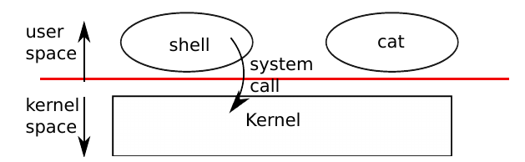
Review ...
Operating system
Resource manager
Abstraction of low level details
Interprocess communication
System calls
fork(), exec()
Today's class
System calls for abstraction of low level details

Slide 3
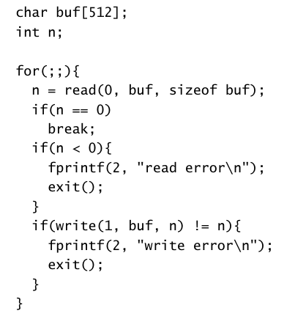
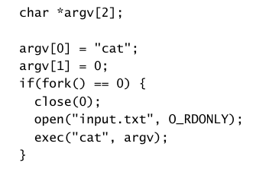
I/O and file descriptors
read() and write() system calls for reading and writing from devices as well as files
xv6 tries to provide a file like interface to both devices and actual files
For each process, we identify different files (i.e. devices or actual files) using a file descriptor
Each process has a file descriptor table starting with 0
0 is standard input
1 is standard output
2 is standard error
read(fd, buf, n)
write(fd, buf, n)
open()
close()
fork() copies file descriptor tables
parent and child has the same offset
dup() duplicates file descriptors across processes
"cat"

Slide 4
Pipes
Plumbing for processes - allows processes to communicate with each other
A pipe is buffer or memory area in the kernel which is exposed to processes as a pair of file descriptors - one for reading and another for writing
Writing data to one end of the pipe makes it available for reading from the other end
For example, cat names.txt | grep vineeth in the shell
Pipes are made using the pipe() system call

Slide 5
Filesystem
Storage provides a way to store and retrieve blocks of bytes
Users need a better organized way of looking at blocks of bytes
Files - a collection of bytes (which can be interpreted in an appropriate way) with a filename
Directories - collection of files and other directories
xv6 provides data files and directories
Directories form a tree
Tree starts at a root /
Path is used to specify the location in a tree /a/b/c and /a/b/d
mkdir() - e.g. mkdir("/dir")
chdir()
mknod() - make a device file
Information about each file - using the fstat() syscall
Each file consists of filename(s) or links, and inode

Slide 6
System programs
Programs which make up your computer system and makes running other user programs easier
Example: GNU (a large set of system programs) + Linux kernel
Example: GNU + Hurd (Mach) kernel
What do system programs do?
File manipulation
touch, head, tail
emacs, grep, sed
Status information
du, df
Programming language support
gcc, g++, as
Program loading and execution
Communications
Background services

Slide 7
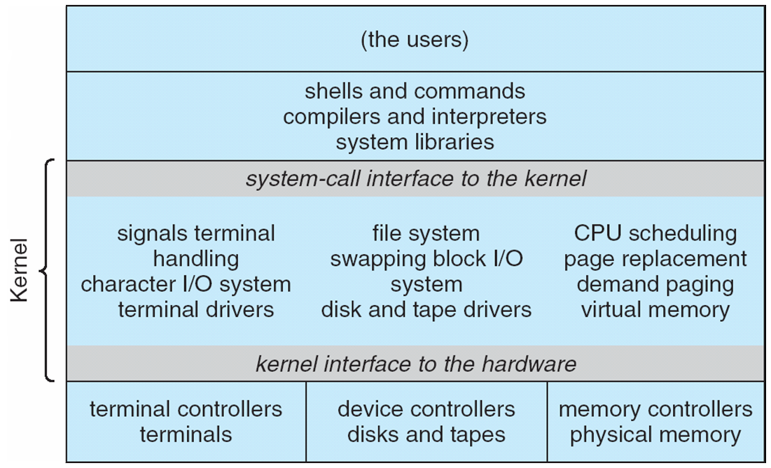
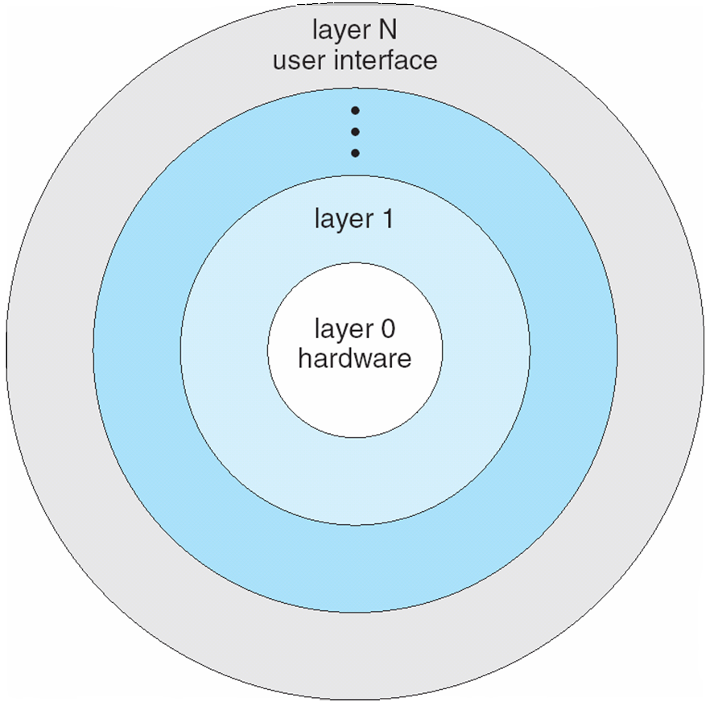
Architecture of operating systems
Architecture types
Monolithic
Microkernel
Modular
Monolithic architecture

Slide 8
Microkernel architecture
Only a small (micro) part of the kernel (which actually requires hardware protection) is implemented in kernel mode.
Other services are implemented as user programs
Example - Mach (Mac OS X kernel (Darwin) partly based on Mach
Communication takes place between user modules using message passing

Slide 9
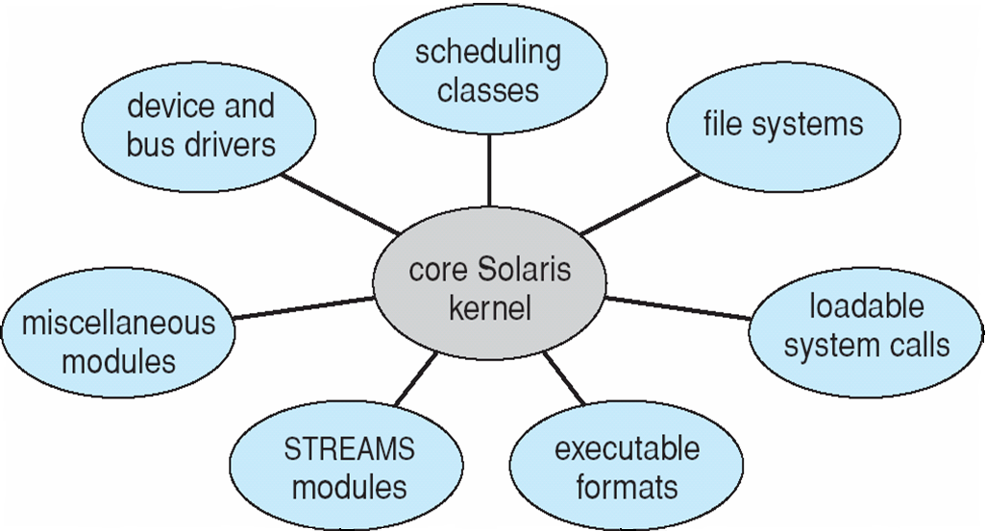
Modular architecture
Many modern operating systems implement loadable kernel modules
Kernel loads modules if needed
Linux - many drivers are loaded as modules only for devices which exist in the system
Solaris
Exercise: Read about the operating system architecture for Android

Slide 10
The boot process
When the processor is switched on, the microprocessor starts at a fixed instruction memory location
Firmware ROM used to hold initial boot code - mapped to this fixed location
Operating system must be made available to hardware so hardware can start it
Bootstrap loader, stored in the above ROM or EEPROM locates the kernel, loads it into memory, and starts it
Nowadays, this is done by a two-step process where a stage one bootloader loads a larger stage two loader which loads the operating system
Example: GRUB - selection from multiple operating systems from multiple disks, versions, kernel options

Slide 11
Todays class
Operating system
Resource manager
Abstraction of low level details
Interprocess communication
System calls
fork(), exec()
I/O - read() and write()
Pipes
Filesystem
References
xv6 book
Syscalls & architecture of OSes - Chapter 2 of Silberschatz et al.

