Slide 1

Department of Avionics,
Indian Institute of Space Science and Technology
AV224 - Computer Organization & Operating Systems
Instructor: Vineeth B. S. (vineethbs@iist.ac.in)
Lecture 28
16/03/2017
Some of the figures in these lecture slides are taken from Silberschatz et al.'s
Operating System Concepts and the xv6 book.

Slide 2
Review ...
Operating system
Resource manager
Abstraction of low level details
Interprocess communication
System calls
fork(), exec()
I/O - read() and write()
Pipes
Filesystem
System programs
Boot process
Today's class
Processes
Processes in xv6

Slide 3
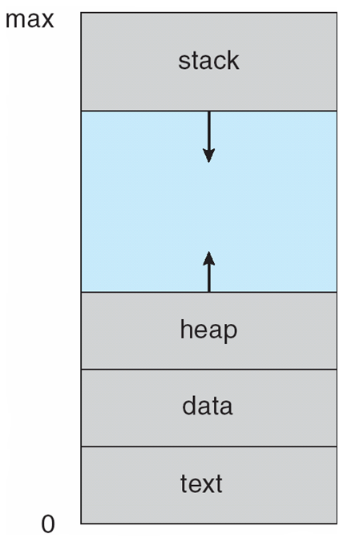
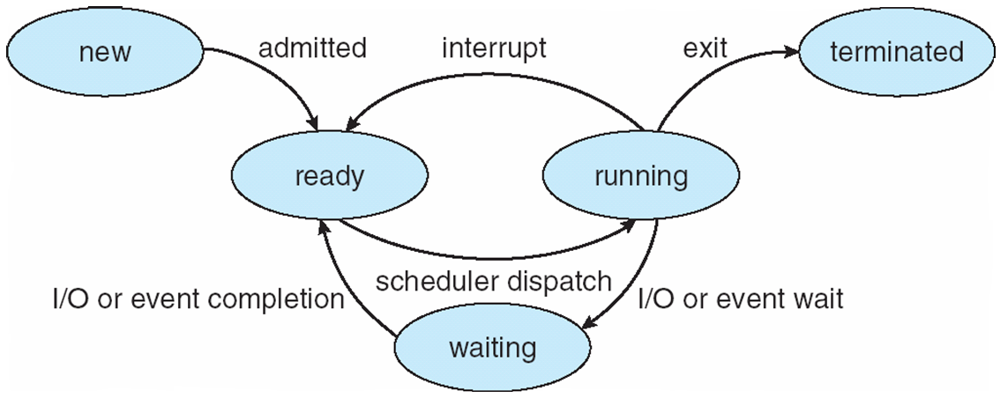
Processes
Operating system
Multiplexing
Isolation
Interaction
Process – a program in execution; process execution must progress in sequential fashion
The program code, also called text section
Current activity including program counter, processor registers
Stack containing temporary data
Function parameters, return addresses, local variables
Data section containing global variables
Heap containing memory dynamically allocated during run time
Processes have state

Slide 4
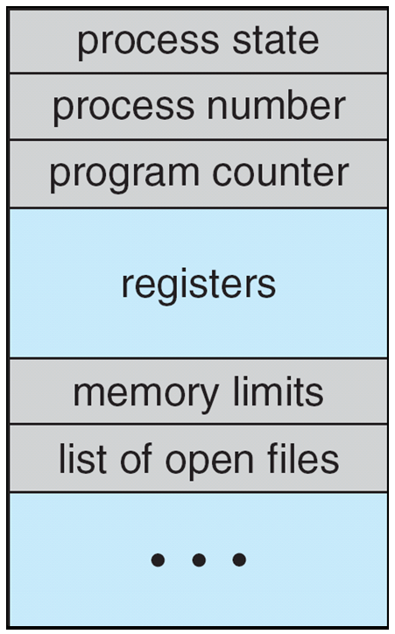
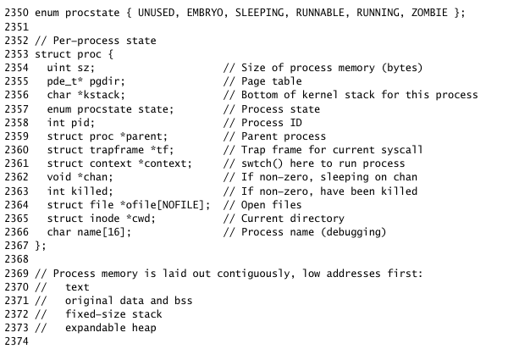
Keeping track of processes
The operating system uses special data structures to keep track of processes
PCB - process (or task) control block
Process state – running, waiting, etc
Program counter – location of instruction to next execute
CPU registers – contents of all process-centric registers
CPU scheduling information- priorities, scheduling queue pointers
Memory-management information – memory allocated to the process
Accounting information – CPU used, clock time elapsed since start, time limits
I/O status information – I/O devices allocated to process, list of open files

Slide 5
Threads
Processes usually have a single thread of execution
A sequence of instructions that are fetched and executed
But modern computers have multiple processors
Consider having multiple program counters per process
Multiple locations can execute at once
Multiple threads of control -> threads
Must then have storage for thread details, multiple program counters in PCB

Slide 6
Summary ...
Operating system
Resource manager
Abstraction of low level details
Interprocess communication
System calls
fork(), exec()
I/O - read() and write()
Pipes
Filesystem
System programs
Boot process
Processes
Process control block

