Slide 1

Department of Avionics,
Indian Institute of Space Science and Technology
AV224 - Computer Organization & Operating Systems
Instructor: Vineeth B. S. (vineethbs@iist.ac.in)
Lecture 29
21/03/2017
Some of the figures in these lecture slides are taken from Silberschatz et al.'s
Operating System Concepts and the xv6 book.

Slide 2
Review ...
Processes
Today's class
Scheduling of processes
xv6 operating system
processes in the xv6 operating system

Slide 3
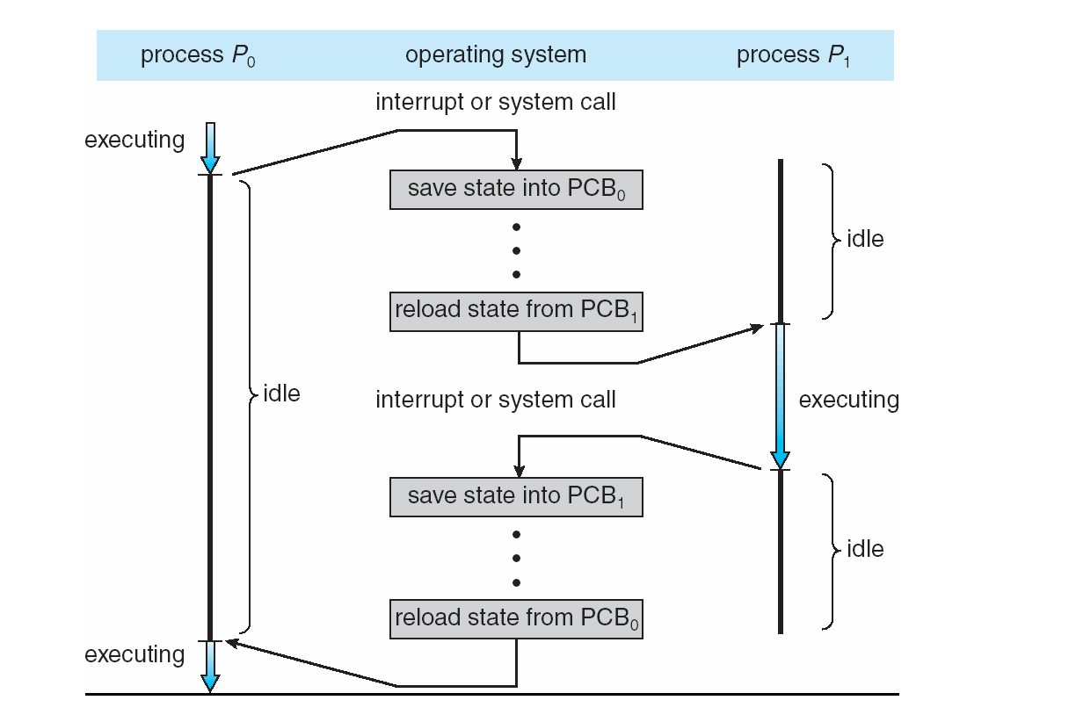
Time sharing between processes

Slide 4
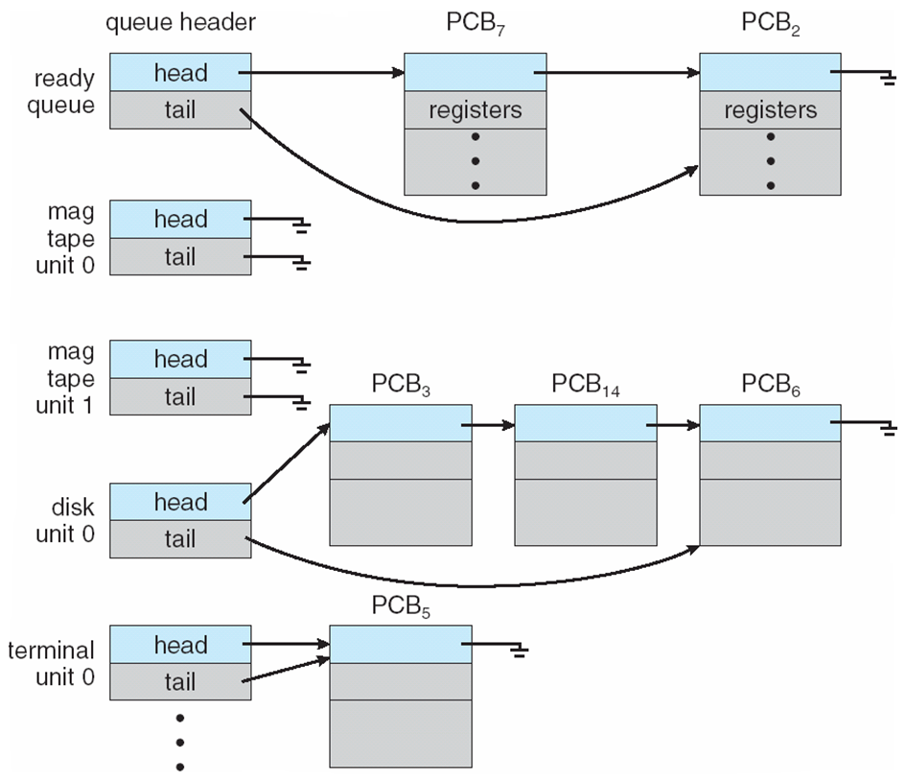
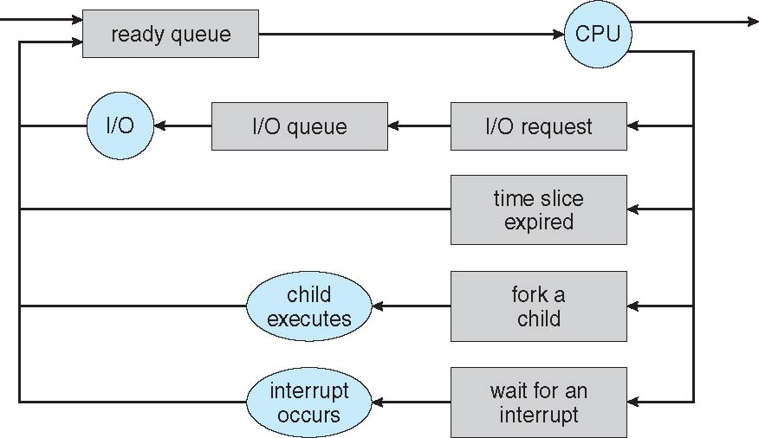
Process scheduling
Efficient use of CPU
Switch processes onto CPU for time sharing
Process scheduler does this selection among available processes for next execution
Multiple scheduling queues of processes may be present
Job queue – set of all processes in the system
Ready queue – set of all processes residing in main memory, ready and waiting to execute
Device queues – set of processes waiting for an I/O device
Processes migrate among the various queues

Slide 5
Schedulers
Short-term scheduler (or CPU scheduler) – selects which process should be executed next and allocates CPU
Sometimes the only scheduler in a system
Short-term scheduler is invoked frequently (milliseconds) ⇒ (must be fast)
Long-term scheduler (or job scheduler) – selects which processes should be brought into the ready queue
Long-term scheduler is invoked infrequently (seconds, minutes) ⇒ (may be slow)
The long-term scheduler controls the degree of multiprogramming
Processes can be described as either:
I/O-bound process – spends more time doing I/O than computations, many short CPU bursts
CPU-bound process – spends more time doing computations; few very long CPU bursts
Long-term scheduler strives for good process mix

Slide 6
The xv6 operating system
xv6 has a monolithic kernel
is designed to run on 80386 or later x86 processors
not a co-operative multiprogramming OS
interaction to hardware via OS via systemcalls
fork(), exec(), open(), read(), write(), close()
x86 supports
user mode and kernel mode
in kernel mode can execute privileged instructions
special instruction for switching from user to kernel mode - the int instruction
the control branches to a location in the kernel which handles system calls - just like exceptions and interrupts which we have studied before
all of xv6 runs in kernel mode (monolithic kernel)

Slide 7
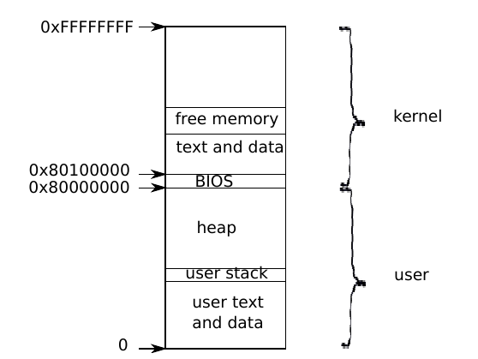
Processes in the xv6 operating system
The unit of isolation is a process
An process gets the illusion that it is using a complete computer
Private address space
xv6 needs to maintain separate page tables for virtual to physical address mapping
xv6 actually maps the kernel's code to a high memory area for each process.
Syscalls execute in this memory area.
Syscall routines can access user data directly

Slide 8
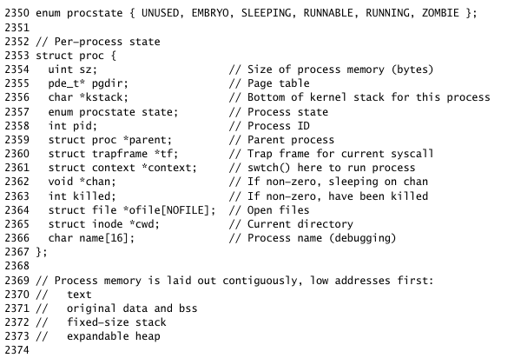
Processes in the xv6 operating system
xv6 maintains per process state within a structure
Each process has a thread of execution
this is again an abstraction by xv6 that is used to indicate what is getting executed
a thread can be suspended and later resumed
time sharing is done between threads
A thread of execution has its own stack for storing process specific variables, function return addresses
Associated with the kernel there is also another stack - the kernel stack, which is used when within the kernel mode
What do the following mean?
pgdir
state
pid

Slide 9
How is the first process run?
Demonstrations will be done in QEMU - how to go through QEMU in step by step?
Booting of xv6 (demonstrations in QEMU)
Loading of xv6 kernel
How does the kernel create its own address space?
Creating and running the first process (a shell?)
The first process using a system call

Slide 10
The boot process in more detail
The boot loader
Starts executing a program called BIOS (basic input output system)
Stored in non-volatile storage on the motherboard
BIOS loads the first sector of the hard disk
The first 512 bytes (remember CHS)
This is also called the boot sector
Boot sector contains a boot loader
BIOS loads the boot loader from the boot sector to address 0x7c00 and then jumps to that
When the processor starts it emulates an 8088 processor
Bootloader should change from 8088 to the more modern processor (real to protected mode)
Load xv6 kernel into memory
Transfer control to the kernel
Booting is usually a two step process
UEFI - unified extensible firmware interface
allows for larger kernels to be read

Slide 11
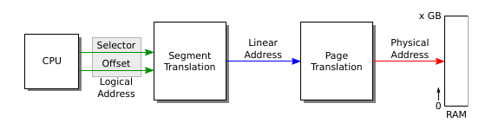
x86 Real and Protected mode
Real mode
8 16 bit registers
20 bit address
Segment registers for additional bits
Multiple segment registers by 16 and add to other registers
21 bit segment:offset address
Addressing in x86 is a little complicated ...
Bootloader does not use paging - linear addresses are physical addresses
Under xv6
x86 logical addresses = xv6 virtual addresses

Slide 12
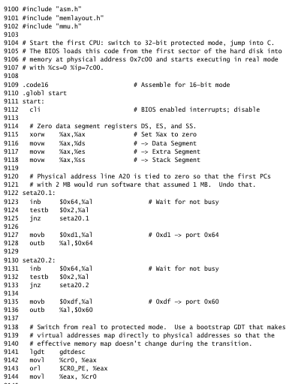
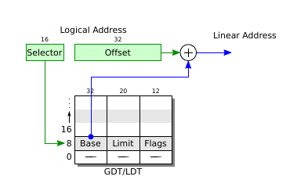
Code overview
Disable interrupts
Initialize to known values
Hack for handling the 21st bit

Slide 13
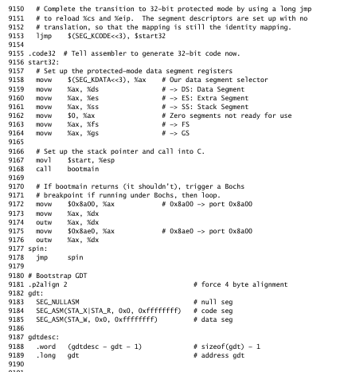
Code overview
Start using GDT
Setup stack for kernel
Infinite loop

Slide 14
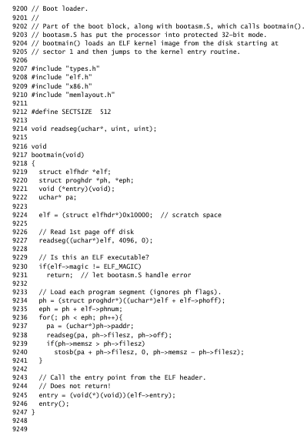
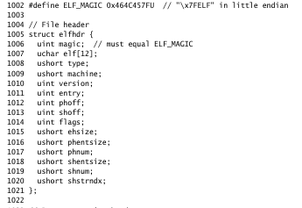
Code overview
1st sector bootloadar,
2nd sector kernel

Slide 15
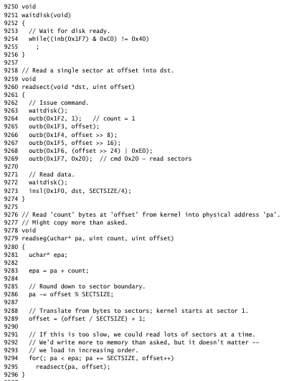
Code overview

Slide 16
Bootloading the kernel
x86 paging is not enabled
logical addresses = linear addresses = physical addresses
Bootloader loads kernel to 0x100000
Kernel is linked to use the virtual address 0x80100000
Can't load since there might not be physical memory at those locations
0xa0000:0x100000 might contain memory mapped I/O
Since the kernel is linked to use addresses starting at 0x80100000
We need to set up a page table
Maps addresses starting at 0x80000000 to physical address 0x00000000
* Also map addresses at 0x0 to physical address 0x00000000
And start using page tables!
Also need to set up a stack
The lower address mapping can be removed, once we jump to higher addresses
Kernel linked @
0x80100000
Kernel @
0x100000
0xa0000:0x100000

