Slide 1

Department of Avionics,
Indian Institute of Space Science and Technology
AV224 - Computer Organization & Operating Systems
Instructor: Vineeth B. S. (vineethbs@iist.ac.in)
Lecture 13
08/02/2017
Figures in this lecture slides are taken from Hennessy and Patterson's
Computer Organization and Design
(Copyright © 2014 Elsevier Inc. All rights reserved)

Slide 2
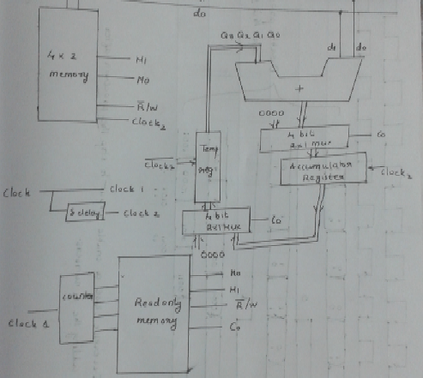
Review of the design

Slide 3
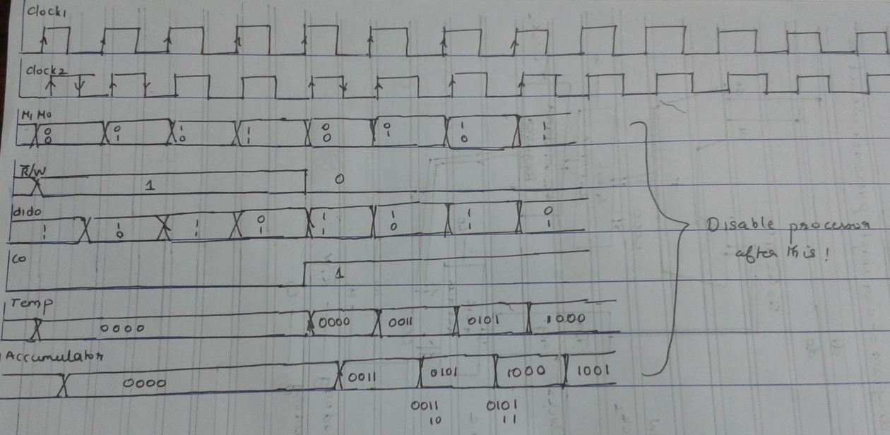
Timing diagram

Slide 4
Summary
The major features of this example which needs to be remembered are
The finite state machine model used for describing the processor's working
The instruction ROM and the feature that control signals can be hardcoded into the memory within the ROM
Registers for storing the state of the processor; e.g. accumulator - just a collection of D FFs
The use of multiplexers in the processor to handle different kinds of data (different addressing modes)
Isolation using tristate logic devices
Complex instructions (such as add 4 numbers) might take multiple clock cycles.
Simple instructions take one clock cycle
Difference between CISC and RISC
7. Executing two disjoint instructions in parallel
8. Iterative nature of design
References
Any good textbook on digital logic
Appendix (online) of Hennessy and Patterson (http://www.cs.tufts.edu/comp/140/)
Exercises
Implement logic for enabling and disabling the processor - draw the new arch. and timing diagram
Implement logic for enabling and disabling the memory device - draw the new arch. and timing diagram
Implement a 4 bit upcounter using flip flops

Slide 5
Today's class
Single cycle processor datapath
Then move to multicycle processor datapath and pipelining
Start reading Hennessy and Patterson - Chapter 4
We will be walking through the design of a processor which can execute not just one instruction
The processor will execute instructions such as
load, store
add, sub, and, or
beq, jump
These are different classes/types of instructions requiring different implementations

Slide 6
Why are we looking at processor design?
A processor executes a series of instructions to complete a given task
The task is specified as a sequence of assembly language instructions
This is converted by the assembler to a sequence of binary instructions (machine code)
A task has then an instruction count - which is decided by how good the assembler is
Each instruction in the sequence might take a certain number of clock cycles - the processor is characterized by "clocks per instruction" (CPI)
The processor also has a clock period (Tc)
The instruction count, CPI, and Tc decide how fast the task gets executed
Optimizing the instruction count - compiler/assembler optimization, ISA design
How small can Tc be?
Power consumption - dependence on Tc
Propagation delay
Understanding the clocks per instruction ...

Slide 7
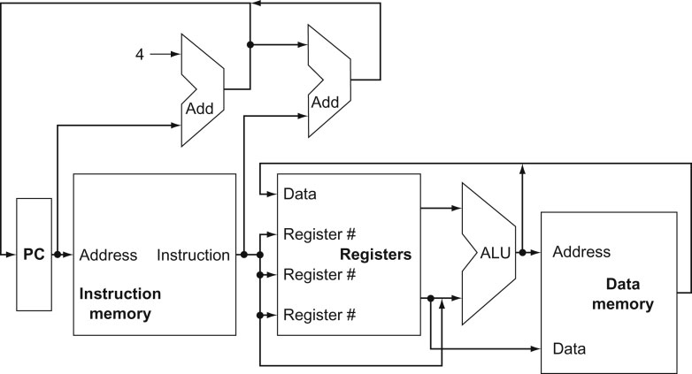
Processor design - an initial high level view
Why should the processor contain all these blocks?
What are the instructions that we want to implement?
add r1, r2, r3 ; r1 = r2 + r3
load r1, [r2 + offset]
beq offset
For executing any instruction that we are going to implement we need the following two steps
The instruction has to be fetched from memory. The PC is used to index an instruction memory. The instruction is a sequence of bits which will contain an op-code, and useful information for generating control signals also.
Registers will have to be read or written to

Slide 8
Processor design - an initial high level view
Why should the processor contain all these blocks?
Almost all instructions will use the ALU after reading the registers
Memory reference instructions will use the ALU for computing addresses
Arithmetic and logic instructions
Conditional branches will have to check for equality, greater than or less than relationships

Slide 9
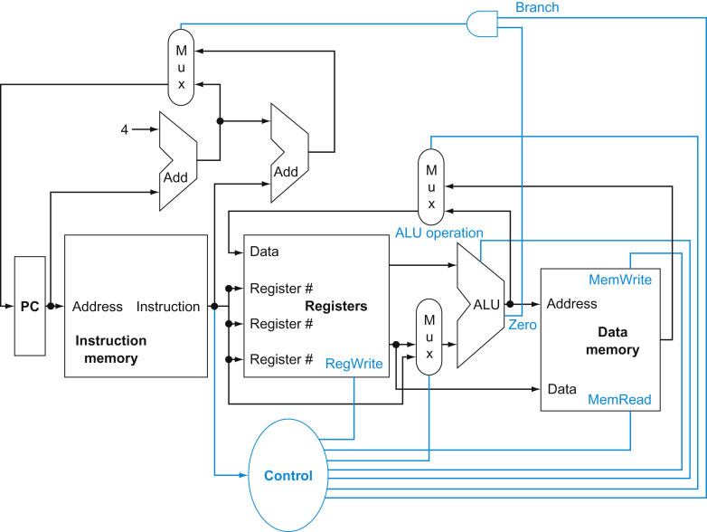
Processor design - more detailed initial high level view
We also need some additional components in this high level view
Data comes from different sources
But only one source at a time
So multiplexers have to be used
Control signals for controlling multiplexers as well as other blocks (e.g. RegWrite, MemWrite, MemRead etc)

Slide 10
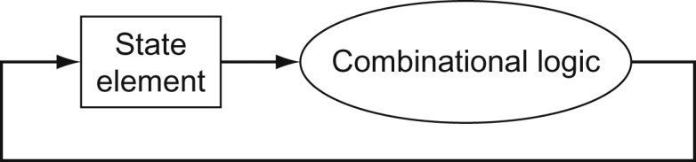
A convention to ease our design
We will assume that there is no instability in edge-triggered circuits even if the following feedback configuration is used.
We will assume that signal transitions are instantaneous
Need to very careful when actually designing such circuits

Slide 11
What is a processor data path?
A data path element is used to operate on or store data within a processor.
Example elements are memories, ALU, adders, registers
The data path is the path through which data flows when a particular operation is done
The data path consists of a subset of all data path elements arranged in a sequence or order.

Slide 12
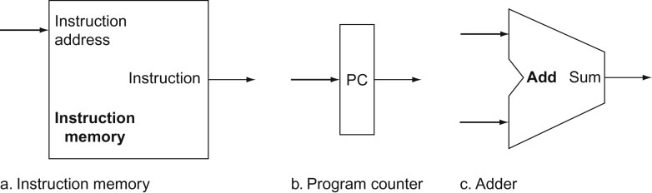
Instruction fetch data path
The instruction fetch data path is used to fetch instructions from an instruction memory, usually in sequence
The instruction memory
Has instruction address as input - byte addressable. The output is the instruction
Each instruction is 32 bits wide
What happens when an instruction address is put on the instruction address input lines?
Why assume that instructions are of fixed width?

Slide 13
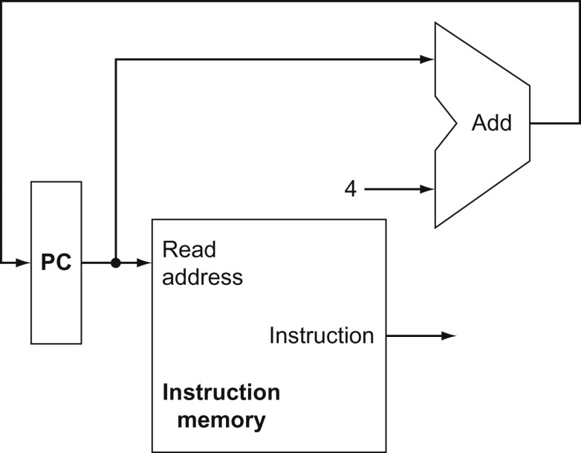
Instruction fetch complete data path
The components are put together as shown
Example use
0004
0000
0004

Slide 14
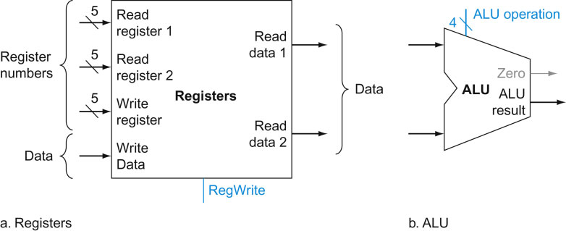
Implementing arithmetic-logical and memory load/store instructions
Recall that we want to implement three kinds of instructions of which two kinds are
Arithmetic-logical - add, sub, and, or
Memory load and store - load store
The arithmetic-logical instructions are of the form
add r1, r2, r3 ; r1 = r2 + r3
load r1, [r2 + offset]
Note that the registers can be any of the available registers and not just r1, r2, and r3
In order to implement these instructions we need the following blocks
There is a register file containing 32 registers
Multi-ported register file
Each register is 32 bits wide
The ALU is a combinational logic circuit. It can do a number of operations such as add/subtract/and/or depending on the control signal given to it.
The ALU operates on 32 bit numbers

Slide 15
Implementing arithmetic-logical instructions
Suppose we want to implement add r1, r2, r3
32 bits
op-code | rs | rt | rd | shift | func
2
Contents 2
3
1
Contents 3

Slide 16
Summary
Single cycle processor datapath
Then move to multicycle processor datapath and pipelining
Reading assignment
Start reading Hennessy and Patterson - Chapter 4
Find out whether there are processors with variable length instruction codes
Think about how you will modify the data path shown here for instruction execution in that case?

