Slide 1

Department of Avionics,
Indian Institute of Space Science and Technology
AV224 - Computer Organization & Operating Systems
Instructor: Vineeth B. S. (vineethbs@iist.ac.in)
Lecture 36
06/04/2017
Some of the figures in these lecture slides are taken from Silberschatz et al.'s
Operating System Concepts and the xv6 book.

Slide 2
Review ...
Short term scheduling
Performance metrics for scheduling
Scheduling policies
FCFS
SJF and SRTF
Priority
Round robin
Starvation and aging
Multilevel queues
Today's class
Real time CPU scheduling
Performance analysis of CPU scheduling
Little's law

Slide 3
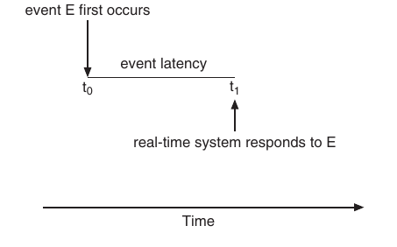
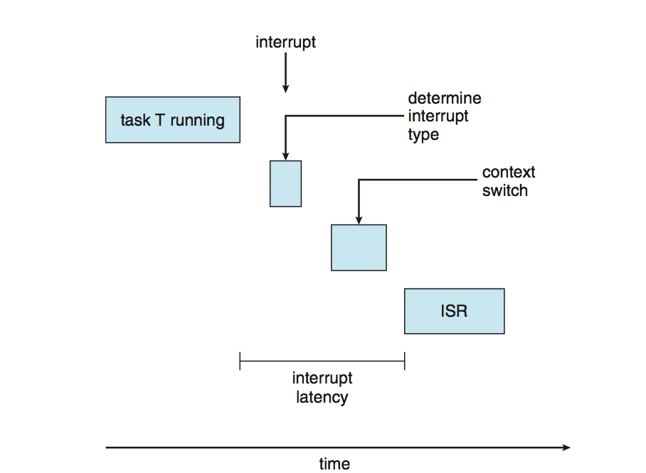
Real time CPU scheduling
Hard real time system
Finish tasks before their deadline
Soft real time systems
Priority is guaranteed for critical processes
Event latency is important
Components of event latency
Interrupt latency
Dispatch latency
For real time systems we need preemptive priority based scheduling
Soft real time performance from this
Hard real time using dynamically varying priorities and pre-emption

Slide 4
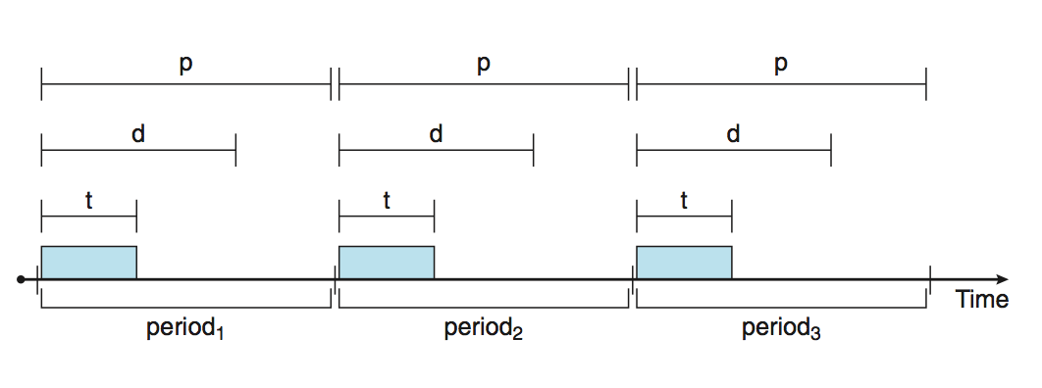
Hard real time systems
Usually in systems with real time requirements we also have periodic processes
Each process generates events periodically
Processes have to declare periods and deadlines within which the events have to be processed
Operating system might do admission control - decide which all processes can actually be serviced

Slide 5
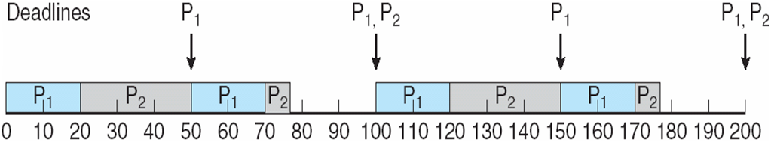
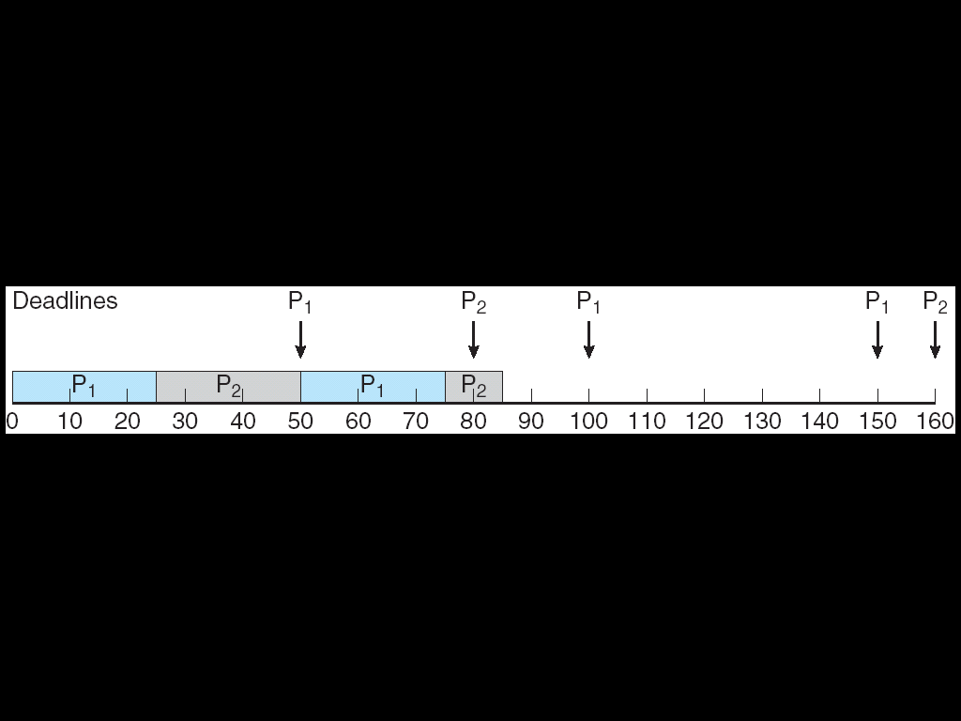
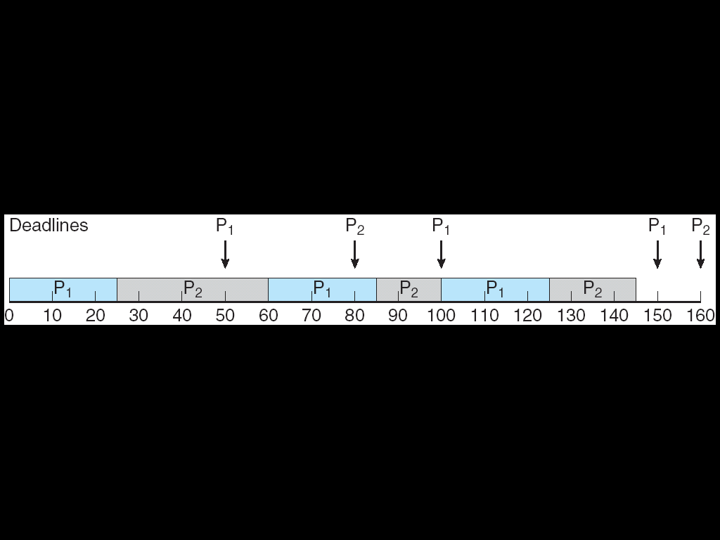
Real time CPU scheduling
Rate monotonic scheduling for periodic processes
Shorter periods - higher priority
Longer periods - less priority
Priority is inverse of the period
Example: P1 (d = p = 50, t = 20), P2 (d = p = 100, t = 35)
Deadlines can be missed
Example: P1 (d = p = 50, t = 25), P2 (d = p = 80, t = 35)
Earliest deadline first (EDF)
Earlier deadline - higher priority

Slide 6
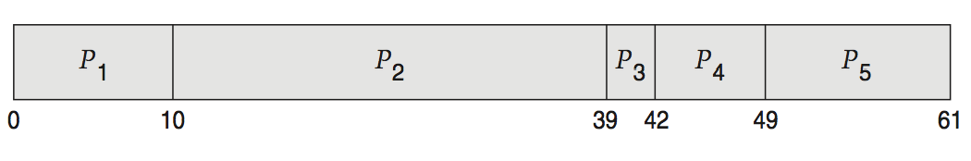
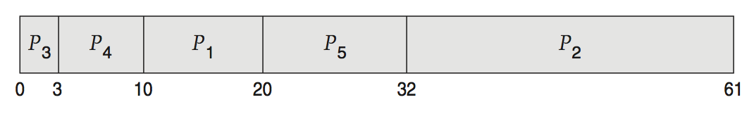
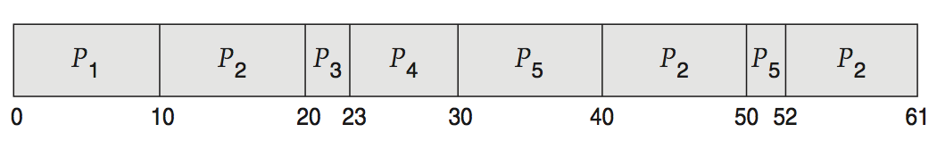
Evaluation of scheduling algorithms
Deterministic approaches
Suppose there are 5 processes arriving at time 0 with burst times 10, 29, 3, 7, 12
Evaluation for each kind of scheduling algorithm: FCFS, non-preemptive SJF, RR
Queueing theory
Uses probability models for describing how processes are generated, and what their burst times are
Analytical results for average queue length, average delay
Fundamental result - Little's law:
the arrival rate of processes x the average delay in waiting in the ready queue = the average number of processes in the ready queue
Simulations

Slide 7
Little's law
Number of processes
Departure
A new process arrives
1
0
Time
Delay 1
Delay 3
Delay 2

Slide 8
Little's law
Number of processes
Average delay = (Delay 1 + Delay 2 + Delay 3)/3
Average queue length = Total area / Total time
But Total area = (Delay 1 + Delay 2 + Delay 3)
So
Average delay =
(Average queue length x Total time) / 3
and 3 / Total time is the arrival rate
Departure
A new process arrives
1
0
Time
Delay 1
Delay 3
Delay 2

Slide 9
Summary
Scheduling policies for CPU
Performance metrics
Common scheduling methods
FCFS
SJF
SRTF
Priority
RR
Multilevel queues
Real time scheduling
Rate monotonic
EDF
Performance analysis - Little's law
Reference: Silberschatz et al. (Topics from Ch. 6)

