Slide 1

Department of Avionics,
Indian Institute of Space Science and Technology
AV224 - Computer Organization & Operating Systems
Instructor: Vineeth B. S. (vineethbs@iist.ac.in)
Assignment 12
10/04/2017

Slide 2
Questions (from Silberschatz et al.)
Suppose there is a logical address space of 64 pages each of 1024 words mapped into physical memory of 32 frames
How many bits are there in the logical address for bytes?
How many bits are there in the physical address for bytes?
Note that one word = 4 bytes
Read about first-fit, best-fit, and worst-fit algorithms for contiguous memory allocation
Given six memory partitions of 300 KB, 600 KB, 350 KB, 200 KB, 750 KB,and 125 KB (in order), how would the first-fit, best-fit, and worst-fit algorithms place processes of size 115 KB, 500 KB, 358 KB, 200 KB, and 375 KB (in order)? Rank the algorithms in terms of how efficiently they use memory?
Assuming a 1-KB page size, what are the page numbers and offsets for the following address references (provided as decimal numbers):
3085
42095
215201
650000
2000001

Slide 3
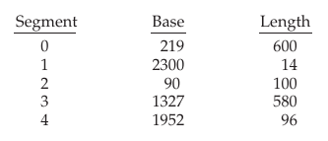
Questions (from Silberschatz et al.)
Consider a paging system with the page table stored in memory.
If a memory reference takes 50 nanoseconds, how long does a paged memory reference take?
If we add TLBs, and 75 percent of all page-table references are found in the TLBs, what is the effective memory reference time? (Assume that finding a page-table entry in the TLBs takes 2 nanoseconds, if the entry is present.)
Consider the following segment table
What are the physical addresses for the following logical addresses?
(0, 430), (1, 10), (2, 500), (3, 400), (4, 112)

