Slide 1

Department of Avionics,
Indian Institute of Space Science and Technology
AV224 - Computer Organization & Operating Systems
Instructor: Vineeth B. S. (vineethbs@iist.ac.in)
Lecture 38
11/04/2017
Some of the figures in these lecture slides are taken from Silberschatz et al.'s
Operating System Concepts and the xv6 book.

Slide 2
Review ...
The role of memory management
Programmer's view of memory
Multiprocessing
Execution time address binding
Memory protection
Logical and Physical address space
Memory management methods
Contiguous memory allocation
Segmentation
Today's class
Presenting a large memory
Swapping
Processes are allocated contiguous memory areas
Paging
Segmented paging

Slide 3
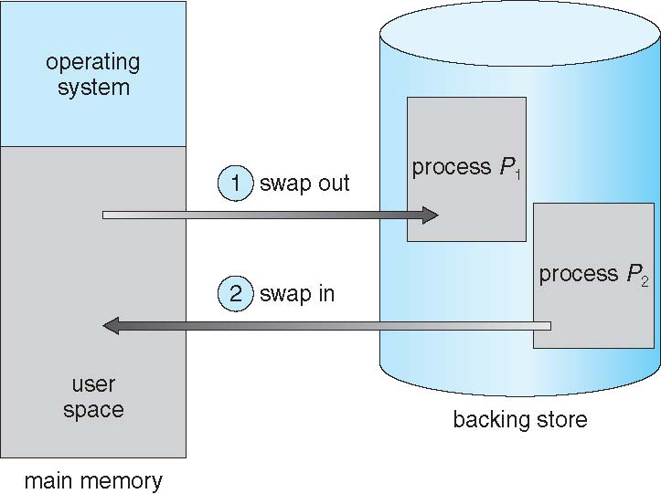
Swapping
In our discussions in last class ...
all processes were kept in memory (which limits the number of processes which can be concurrently executed)
Suppose we have a "backing store"
such as a large hard disk
keeps "images" of the processes
then low priority or waiting processes can be swapped out into the disk
The operating system maintains a queue of the processes on disk which can be swapped in when possible
Note that address binding now occurs at swap time
Each time a process is swapped in after being swapped out the actual physical addresses may change

Slide 4
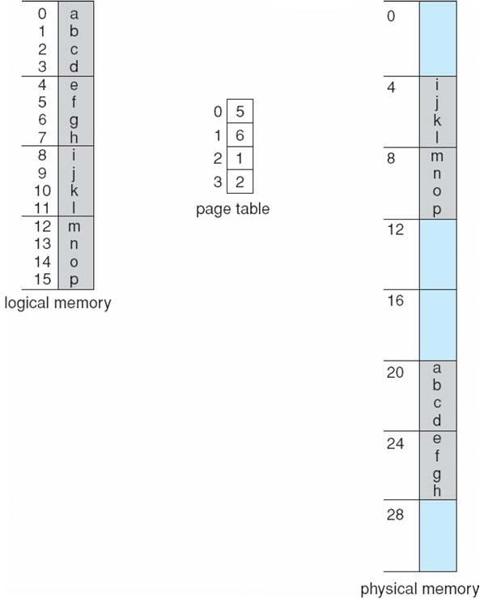
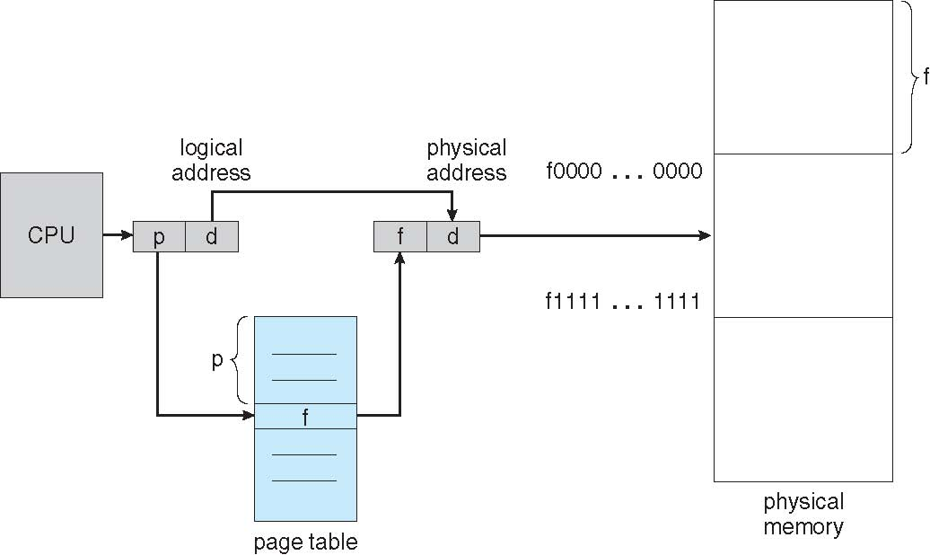
Paging
Divide physical memory into pages/frames
Logical memory space is also divided into pages/frames
Mapping is between logical pages/frames to physical pages/frames
Recall the two parts of the virtual memory address
Mapping is done via a page table
But the programmer does not see this division!

Slide 5
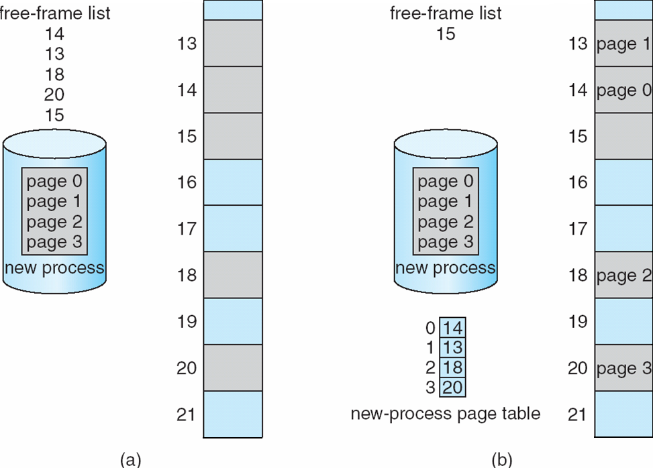
Paging
The operating system keeps track of allocated pages and free pages/frames
A program which needs X amount of memory or ceiling(X/S) pages is allocated ceiling(X/S) pages
Note that physical memory allocation need not be contiguous - the pages can be separated
Solves the fragmentation problem that we have seen earlier - this is called external fragmentation problem
Introduces internal fragmentation problem - suppose X = n S + 1, then S - 1 extra bytes will be allocated
Possible to have shared pages

Slide 6
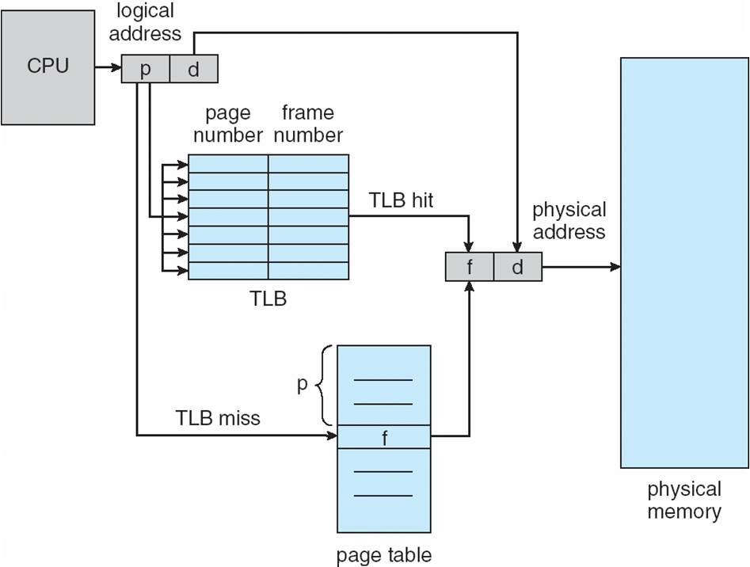
Paging - Hardware support
Each process has a page table in memory
Page table base register - point to the page table
Page table length register - holds the number of pages
2 memory accesses needed
Use TLB to cache page mapping lookups
Memory protection using additional flag bits
R/W or Read only or Execute only

Slide 7
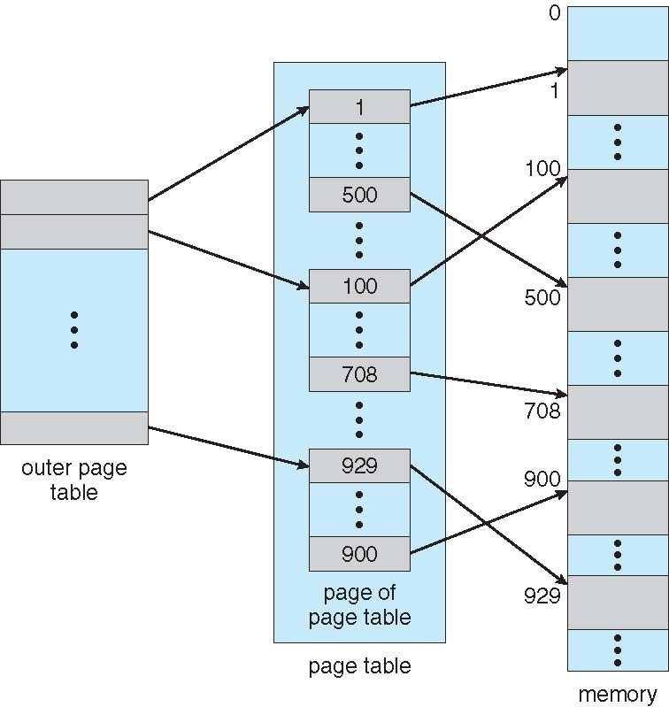
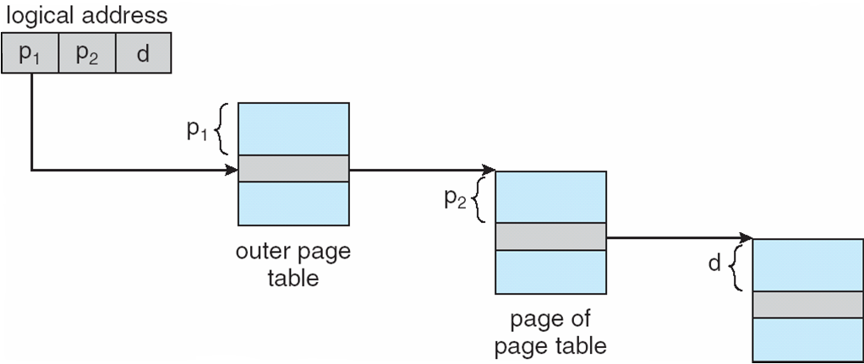
Implementations of page tables - Hierarchical
The page table could be paged
Suppose logical address space is 32 bits
Page size is 1024 bytes
Page offset is 10 bits
Page number is 22 bits
Can we store all page table entries on a single page?
Split the page number into smaller fields - directories and obtain a hierarchical implementation
Hierarchical page tables
Outer page number or page directory
Page number
Offset
Exercise - Read about hierarchical page tables when the logical address space is 64 bits

Slide 8
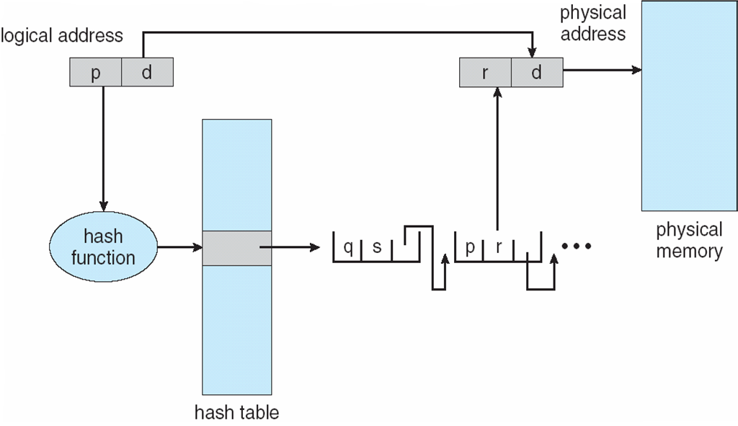
Implementations of page tables - Hashed page tables
Hash functions
Given a string, computes a n bit representation
Cryptographic hash functions
One way property
Uniformity as well as other properties
If the logical address space is large, then we need large number of rows in the page table
Hash logical addresses (or the page numbers) into smaller number of bits
The page table is indexed by the hash value
But each row now holds a linked list of logical pages with their mappings
Compared with hierarchical tables we don't need a constant number of lookups in every access

Slide 9
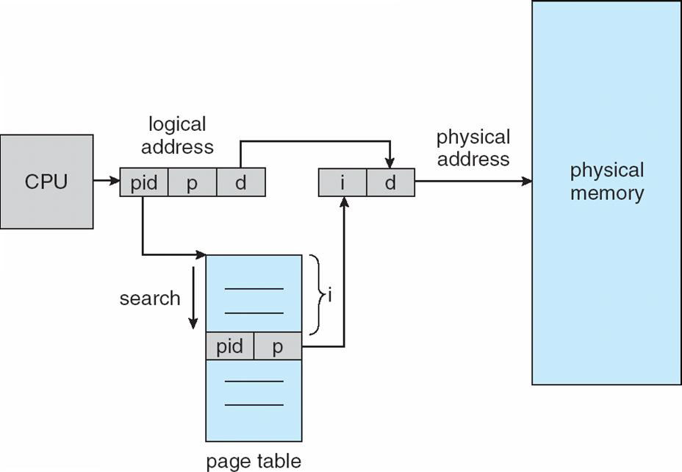
Implementations of page tables - Inverted page tables
Each process has its own page table
Forward mapped page tables
There are only n physical pages.
Maintain a table where for each physical page store the logical page which is mapped to it (an inverse mapping)
Need to store process identification information also!

Slide 10


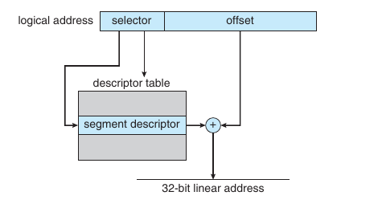
Segmentation and Paging (e.g. in IA-32)
Segments themselves can be paged
Need two address mappings!
In IA-32 each segment could be as large as 4 GB
And there could be 16K segments per process
16K segments = 8K private and 8K shared
8K private - LDT (local descriptor table)
8K shared - GDT (global descriptor table)
The logical address put out by the CPU is a (segment (actually selector), offset) from which a linear address is computed.
selector:

Slide 11
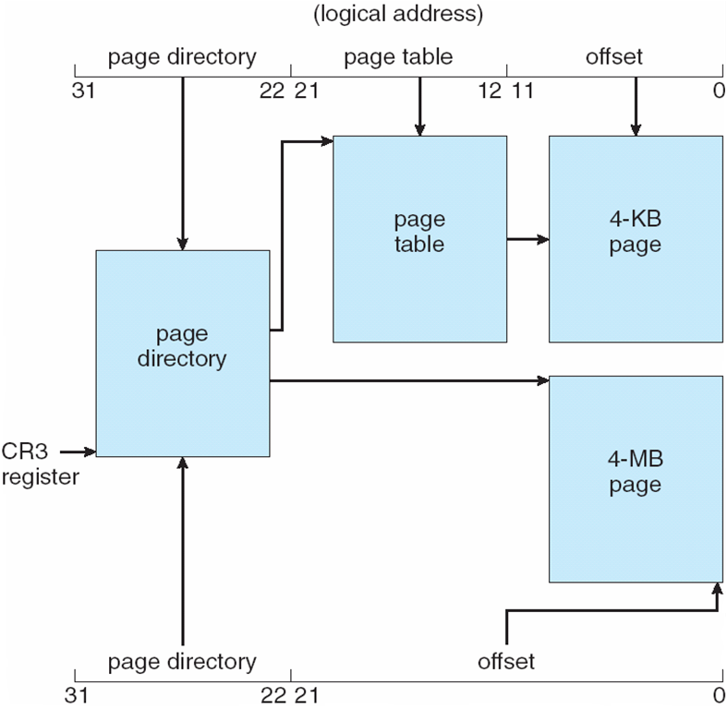

Segmentation and Paging (e.g. in IA-32)
The 32 bit linear address is mapped into a physical address using paging
The architecture allows for hierarchical paging or a simple page table - using two different page sizes
linear address:

Slide 12
Summary
Role of memory managment
Memory management techniques
Contiguous memory allocation
Segmentation
Swapping
Paging
Segmentation and Paging (eg. IA-32)
Reference: Silberschatz et al. (Topics from Ch. 8)

