Slide 1

Department of Avionics,
Indian Institute of Space Science and Technology
AV224 - Computer Organization & Operating Systems
Instructor: Vineeth B. S. (vineethbs@iist.ac.in)
Assignment 4
09/02/2017

Slide 2
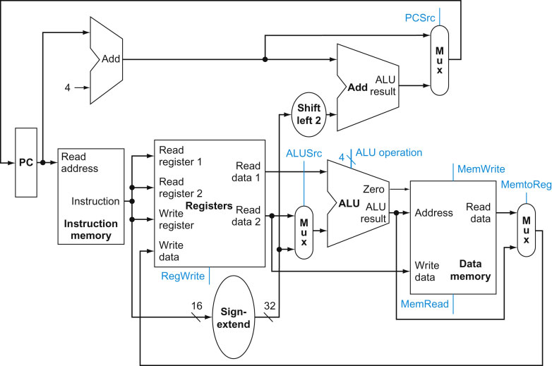
Questions
Single cycle processor design (Hennessy and Patterson)
Draw the complete path taken for the load and store instructions in the diagram on the right.
(Hennessy and Patterson) How will you implement the jr (jump register) instruction using a suitable modification to the datapath shown?
The instruction is jr registerindex (e.g. jr r1)
What the instruction does is that PC is updated with the contents of r1

