Slide 1

Department of Avionics,
Indian Institute of Space Science and Technology
AV224 - Computer Organization & Operating Systems
Instructor: Vineeth B. S. (vineethbs@iist.ac.in)
Assignment 10
05/04/2017

Slide 2
Questions from Silberschatz et al.
Find out what the "system clock" does. Why do you think disabling interrupts frequently affects the system clock?
Show that if wait() and signal() are not executed atomically then mutual exclusion may be violated
Consider a banking system that maintains an account balance with two functions: deposit(amount) and withdraw(amount). These two functions are passed the amount that is to be deposited or withdrawn from the bank account balance. Assume that a husband and wife share a bank account. Concurrently, the husband calls the withdraw() function and the wife calls deposit(). Describe how a race condition is possible and what might be done to prevent the race condition from occurring. What is the variable on which a race condition might occur?

Slide 3
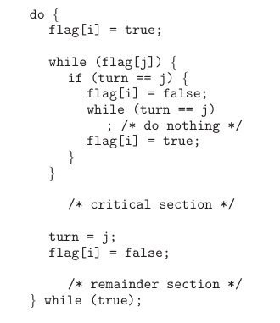
Questions from Silberschatz et al.
Dekker's solution to the critical section problem. Consider two processes P1 and P2 which share the variables
boolean flag[2]; // initially false
int turn;
The processes have the structure shown
Show that all three requirements for the solution to the critical section are satisfied here.

Slide 4
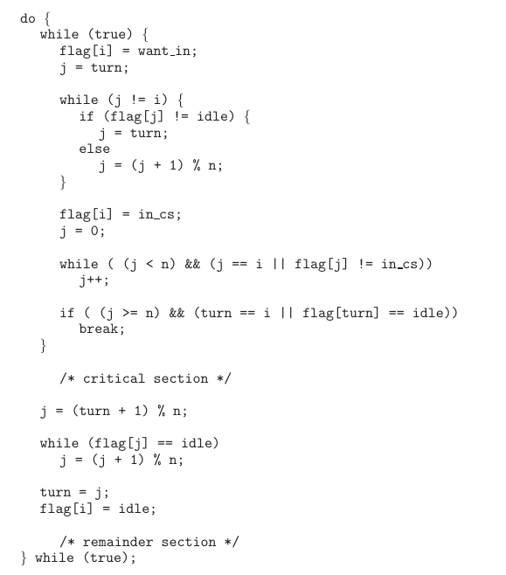

Questions from Silberschatz et al.
Eisenberg's and McGuire's solution to the critical section problem. Consider n processes which share the variables
Assume that the process structure is as given on the right.
Show that all three requirements of the critical section problem's solution are satisfied

