Slide 1

Department of Avionics,
Indian Institute of Space Science and Technology
AV224 - Computer Organization & Operating Systems
Instructor: Vineeth B. S. (vineethbs@iist.ac.in)
Assignment 9
17/03/2017

Slide 2
Questions
Operating systems (from Silberschatz et al.)
Which of the following instructions should be privileged?
Set value of timer.
Read the clock.
Clear memory.
Issue a trap instruction.
Turn off interrupts.
Modify entries in device-status table.
Switch from user to kernel mode.
Access I/O device.
Reading assignment - SMP systems, Operating system shells
Write a short note on the read() and write() system calls for your linux system. Try to use the "man pages" for this.

Slide 3
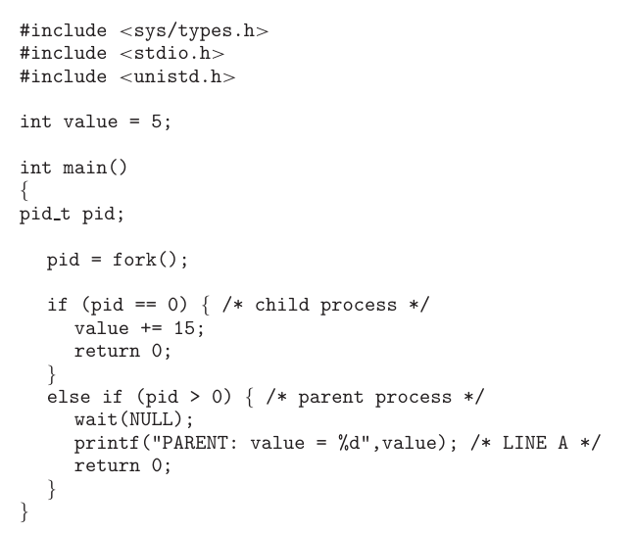
Questions
What will be the output at LINE A?

Slide 4
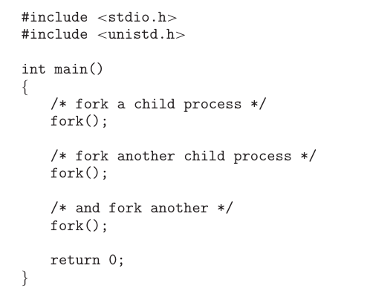
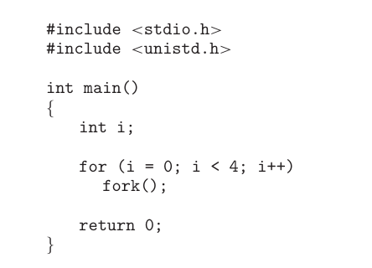
Questions
Including the initial parent process, how many processes are created by the programs shown here?

Slide 5
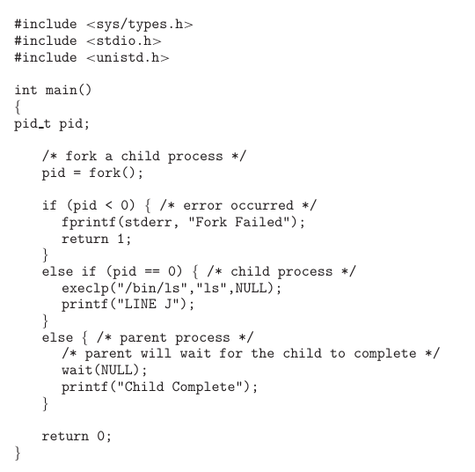
Questions
Under what conditions is the statement printf("LINE J") reached?

Slide 6
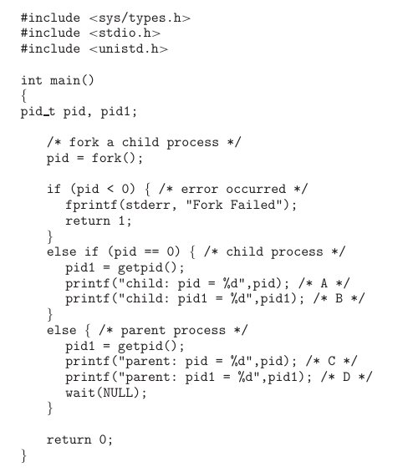
Questions
What are the values of PID at A, B, C, and D?

Slide 7
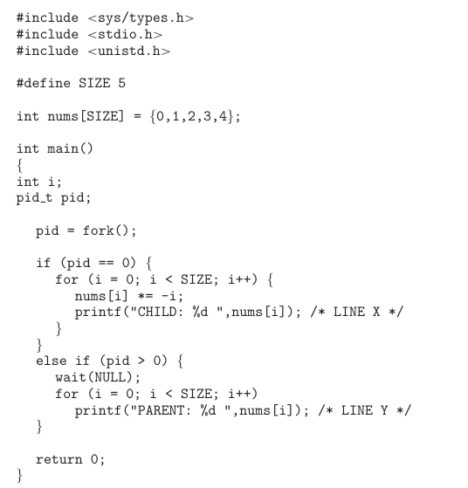
Questions
What is the output at lines X and Y?

Slide 8
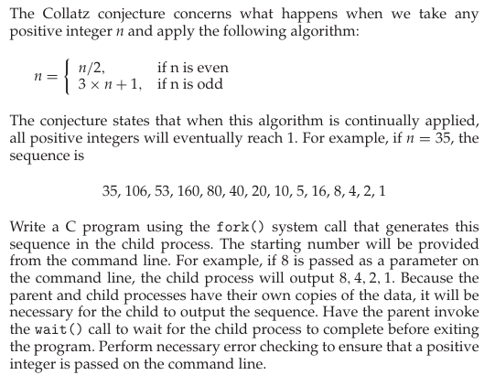
Questions
Problem from Silberschatz et al.

