Slide 1

Department of Avionics,
Indian Institute of Space Science and Technology
AV224 - Computer Organization & Operating Systems
Instructor: Vineeth B. S. (vineethbs@iist.ac.in)
Lecture 21
28/02/2017
Figures in these lecture slides are taken from Hennessy and Patterson's
Computer Organization and Design
(Copyright © 2014 Elsevier Inc. All rights reserved)

Slide 2
Where are we?
Program 1
Program 2
Program n
...
Operating System
ISA
Interface to H/W
Chapter 5
Hardware
Processor
Memory
Input
Output

Slide 3
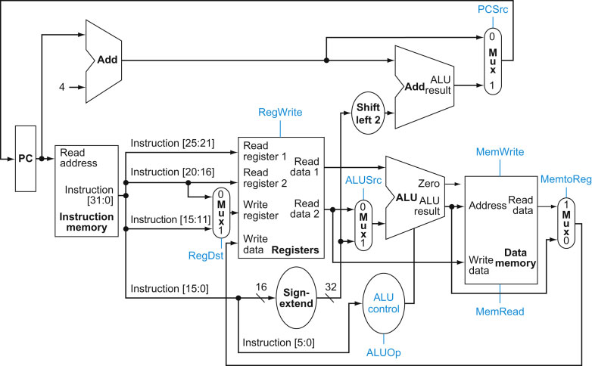
The need for memory and how we view this?
Programmers view of memory
Large memory
Low cost
Fast access
Instructions
Data
In every clock cycle!

Slide 4
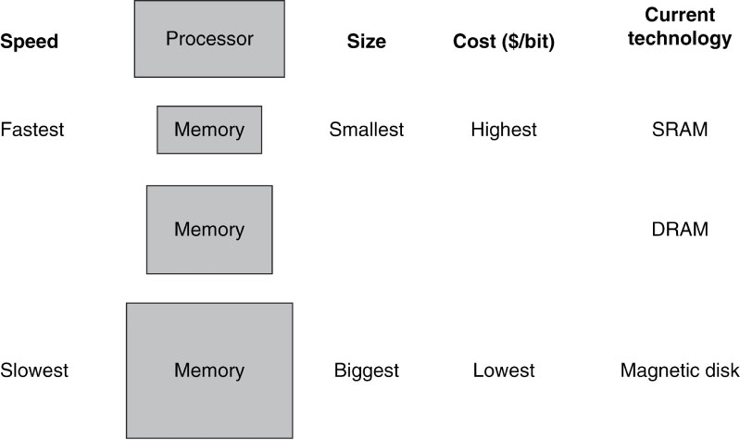
Types of memory
SRAM - Static RAM
Access times of the order of ns
DRAM - Dynamic RAM
Access times of the order of 10s of ns
Magnetic memory (hard disks)
Access times of the order of ms

Slide 5
Building large & fast memory
Exploit the locality principle
Temporal locality
If an item in memory is referenced, then it will be referenced again in the near future
Spatial locality
If an item in memory is referenced, then items whose addresses are nearby will be referenced in the near future
Use a hierarchy of memories to build up a large fast memory using the above locality principles
Processor
Large and slow
memory
holds all items
Small and fast
memory
holds items recently accessed, items near items recently accessed.
Update rules

Slide 6
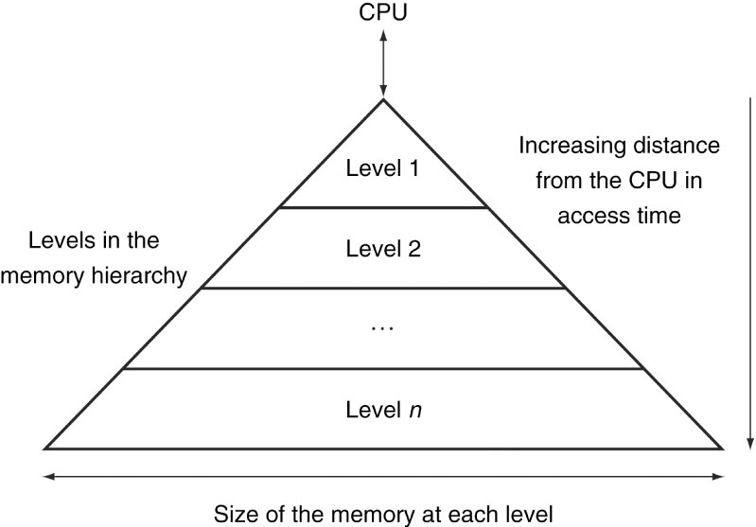
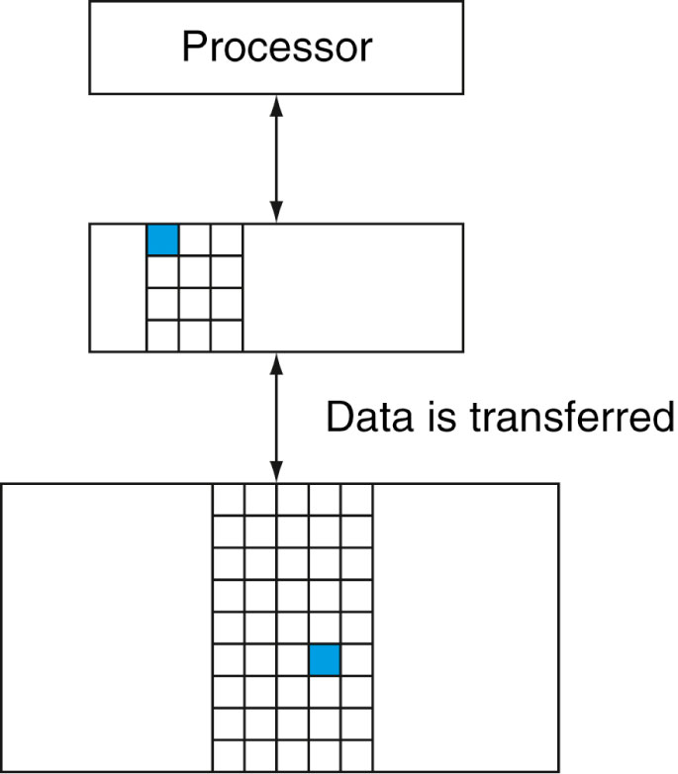
Memory hierarchy and some terminology
Data is stored in a pure hierarchy
The data stored at the level closer to the processor is a subset of the data at a level farther away
Even if the hierarchy consists of multiple levels, data is copied only between two adjacent levels
So we can concentrate on systems with just two levels to understand this
The minimum unit that can be transferred between two adjacent levels is called a block or a line

Slide 7
Memory hierarchy and some terminology
Suppose the processor requests an item in memory
The item is requested using the memory address
If that item is there in the first level of memory, then we have a hit
If the item is not present, then there is a miss and the item has to be fetched from the second level (this is possible because of the pure hierarchy nature)
Hit rate is the fraction of memory accesses which were a hit
Miss rate = 1 - Hit rate
Hit time is the time required to access an item in the first level, including the time taken to determine whether an item is present at the first level or not
Miss penalty is the time required to replace an item in the first level from the second level and to deliver that item to the processor

Slide 8
Summary of today's class
Requirement of a fast large memory
Locality principle
Spatial
Temporal
Hierarchy of memories
Terminology: Hit, miss, hit rate, miss rate, miss penalty
Reference: Hennessy and Patterson

