Slide 1

Department of Avionics,
Indian Institute of Space Science and Technology
AV224 - Computer Organization & Operating Systems
Instructor: Vineeth B. S. (vineethbs@iist.ac.in)
Lecture 22
01/03/2017
Figures in these lecture slides are taken from Hennessy and Patterson's
Computer Organization and Design
(Copyright © 2014 Elsevier Inc. All rights reserved)

Slide 2
Review
Locality principles
Spatial
Temporal
Hierarchy of memories
Terminology: Hit, miss, hit rate, miss rate, miss penalty
Processor
Large and slow
memory
holds all items
Small and fast
memory
holds items recently accessed, items near items recently accessed.

Slide 3
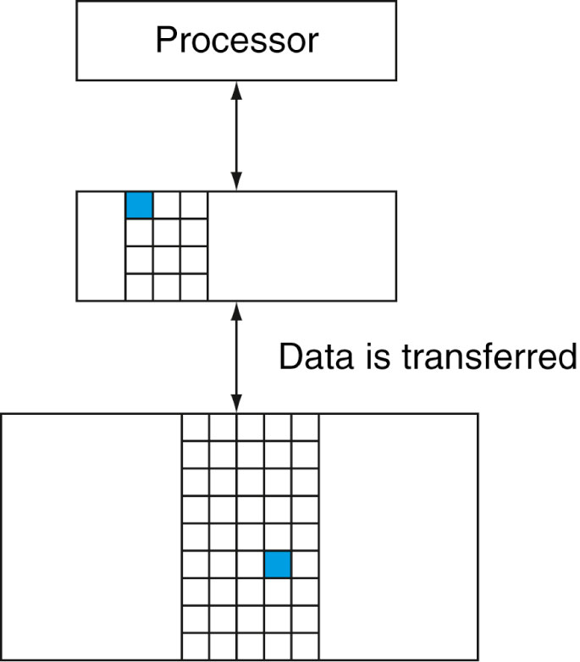
Caches
The first level of memory in between the processor and the main memory is called a cache (or cache memory)
Modern computers contain multiple caches
We will call the second level of memory as main memory
How to store items in the cache?
Assume that a block is a word for now
Direct mapped caches
Each memory location in the second level or main memory is mapped to a fixed location in the cache
Multiple main memory locations are mapped to the same fixed location
The mapping from main memory address to cache memory address is usually
Block address (modulo) Number of blocks in the cache
Cache
Main
memory

Slide 4
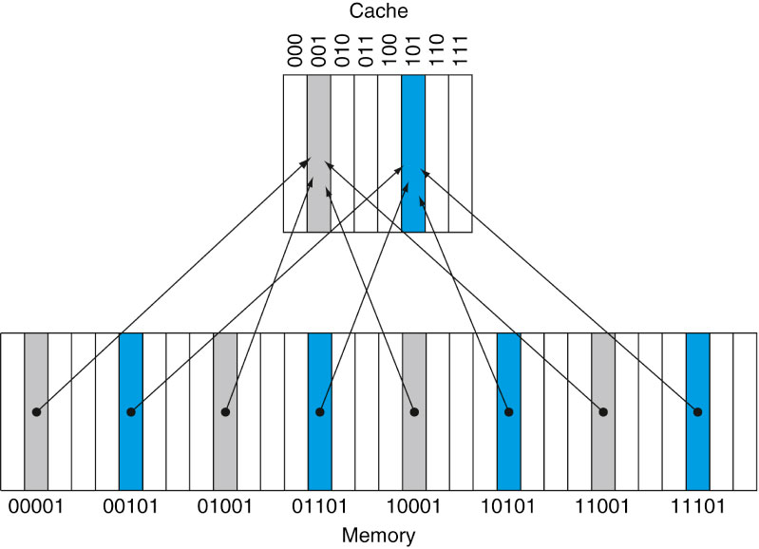
Caches
The first level of memory in between the processor and the main memory is called a cache (or cache memory)
Modern computers contain multiple caches
We will call the second level of memory as main memory
How to store items in the cache?
Direct mapped caches
Each memory location in the second level or main memory is mapped to a fixed location in the cache
Multiple main memory locations are mapped to the same fixed location
The mapping from main memory address to cache memory address is usually
Block address (modulo) Number of blocks in the cache

Slide 5
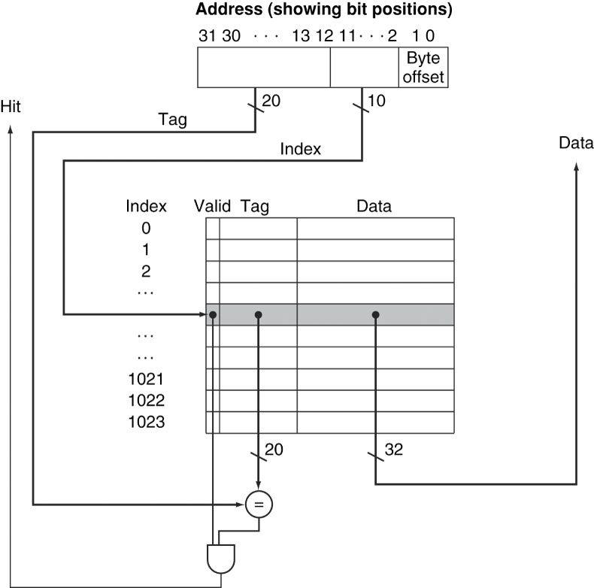
Caches
Direct mapped caches
Each memory location in the second level or main memory is mapped to a fixed location in the cache
Multiple main memory locations are mapped to the same fixed location
The mapping from main memory address to cache memory address is usually
Block address (modulo) Number of blocks in the cache
The address in the cache is given by the lower order bits of the address
Suppose the processor requests a word (=block) at a particular address
How does the cache know whether it contains that block?
Need to store tag bits along with the data in the cache
The tag bits are the higher order bits of the address
Need to also store a valid bit to indicate whether the stored data is valid or not.

Slide 6
Direct mapped caches - number of bits required
Total number of bits required is a function of cache size and the address size
Suppose a block is 2^{m} word (a word is 32 bits or 4 bytes)
Suppose the cache size is 2^{n} blocks
Suppose the byte address size is 32 bits
Number of bits in the tag field is 32 - (n + m + 2)
There are as many valid bits as there are blocks
Example
Direct mapped cache with 16 KB
1 block = 4 words = 16 bytes = 128 bits
32 bit byte address
Number of blocks = 4 K = 2¹² words = 2¹⁰ blocks
Number of tag bits/block = 32 - (10 + 2 + 2) = 18
Number of valid bits/block = 1
Number of data bits/block = 128
Total number of bits = 147 x 2¹⁰ = 18.4 KB
Usually, the cache data size is only stated (e.g. 16 KB cache)

Slide 7
Direct mapped caches - mapping an address to a multiword cache
Suppose the cache has 64 blocks
Each block has 16 bytes or 4 words (what happens if blocks are not the same as words)
Suppose the processor addresses the byte 1200
This comes in the floor( 1200 / 16 ) = 75th block
Since there are only 64 blocks, the block address in the cache is 75 modulo 64 = 11

Slide 8
Cache access example
Suppose the cache consists of 8 words (= blocks) and is direct mapped
The initial state of the cache would be
Index | V | Tag | Data
000 | N
001 | N
010 | N
011 | N
100 | N
101 | N
110 | N
111 | N

Slide 9
Cache access example
Suppose the cache consists of 8 words (= blocks) and is direct mapped
The initial state of the cache would be
Suppose the processor accesses
Word addr | Binary addr | Hit/miss | Cache block
22 | 10 110 | Miss | 110
Index | V | Tag | Data
000 | N
001 | N
010 | N
011 | N
100 | N
101 | N
110 | Y | 10 | Mem[10110]
111 | N

Slide 10
Cache access example
Suppose the cache consists of 8 words (= blocks) and is direct mapped
The initial state of the cache would be
Suppose the processor accesses
Suppose the processor accesses
Word addr | Binary addr | Hit/miss | Cache block
22 | 10 110 | Miss | 110
Index | V | Tag | Data
000 | N
001 | N
010 | Y | 11 | Mem[11010]
011 | N
100 | N
101 | N
110 | Y | 10 | Mem[10110]
111 | N
Word addr | Binary addr | Hit/miss | Cache block
26 | 11 010 | Miss | 010

Slide 11
Cache access example
Suppose the cache consists of 8 words (= blocks) and is direct mapped
The initial state of the cache would be
Suppose the processor accesses
Suppose the processor accesses
Suppose the processor accesses
Word addr | Binary addr | Hit/miss | Cache block
22 | 10 110 | Miss | 110
Index | V | Tag | Data
000 | N
001 | N
010 | Y | 11 | Mem[11010]
011 | N
100 | N
101 | N
110 | Y | 10 | Mem[10110]
111 | N
Word addr | Binary addr | Hit/miss | Cache block
26 | 11 010 | Miss | 010
Word addr | Binary addr | Hit/miss | Cache block
22 | 10 110 | Hit | 110
26 | 11 010 | Hit | 010

Slide 12
Cache access example
Suppose the cache consists of 8 words (= blocks) and is direct mapped
The initial state of the cache would be
Suppose the processor accesses
Suppose the processor accesses
Suppose the processor accesses
Word addr | Binary addr | Hit/miss | Cache block
22 | 10 110 | Miss | 110
Index | V | Tag | Data
000 | Y | 10 | Mem[10000]
001 | N
010 | Y | 11 | Mem[11010]
011 | Y | 00 | Mem[00011]
100 | N
101 | N
110 | Y | 10 | Mem[10110]
111 | N
Word addr | Binary addr | Hit/miss | Cache block
26 | 11 010 | Miss | 010
Word addr | Binary addr | Hit/miss | Cache block
22 | 10 110 | Hit | 110
26 | 11 010 | Hit | 010
16 | 10 000 | Miss | 000
3 | 00 011 | Miss | 011
16 | 10 000 | Hit | 000

Slide 13
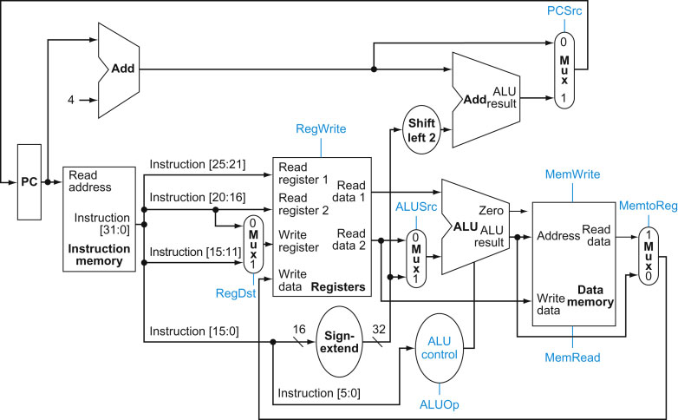
What happens in the architecture that we have studied?
Cache
Cache

Slide 14
What happens when there is a cache miss?
If there is a cache hit, then the processor proceeds normally as before
If there is a cache miss
Single cycle architecture - have to wait till the memory is accessed
Pipelined architecture
Stall the CPU pipeline
Instruction cache miss
Refetch instruction
Data cache miss
Have to complete data access

Slide 15
What happens when an address in the cache is written to?
The contents in the cache don't match with the contents in memory
The cache is said to be inconsistent
Two strategies
Write through
Whenever the cache is written to the memory is also updated
But this means that memory writes will proceed at the speed of memory accesses
Solve this partly by using a write buffer
Write back
Suppose the cache is inconsistent
But accessing the memory location which is in cache will return the most recent written value, which is correct
We need to update memory only when the memory location in cache is replaced - this is the writeback strategy

Slide 16
Summary of today's class
Requirement of a fast large memory
Locality principle
Spatial
Temporal
Hierarchy of memories
Terminology: Hit, miss, hit rate, miss rate, miss penalty
Caches
Direct mapped caches
Accessing direct mapped caches
Cache miss
Writing into caches
Reference: Hennessy and Patterson

