Slide 1

Department of Avionics,
Indian Institute of Space Science and Technology
AV224 - Computer Organization & Operating Systems
Instructor: Vineeth B. S. (vineethbs@iist.ac.in)
Lecture 10
02/02/2017

Slide 2
Review ...
The x86 instruction set architecture
Integer & Floating point representations
Assemblers and Linkers
So we have a fair idea of how to use the ISA
The ISA is a set of instructions
How does the processor implement the ISA?
Using the ISA (via assemblers, C)
Today's class ...
We will go through the design of a simple processor (which only does a single task)
We will review some digital logic design, and some higher order digital logic circuits which will be useful in implementing simple processors
The instruction set architecture (ISA)
Processor implementation
of ISA

Slide 3
A simple processor
We need to implement a processor to add together four two bit numbers
This can be done using combinational logic - Exercise: try for two two bit numbers
We will try to design this processor to do this in a sequence of steps in order to illustrate and review some aspects of digital logic design which will be useful for us
We need to design a memory device which can store four two bit numbers
We need to design an accumulator which will accumulate the sum
We will see that the following combinational digital logic circuits will be useful
Half and full adders
Decoders and Encoders
Muxes and Demuxes
Read only memory (ROM) (is this combinational or sequential?)
We will also need to look at sequential logic circuits in order to implement memory elements
You can try using a digital logic simulator such as Logisim in order to play around with these circuits and understand it better.

Slide 4
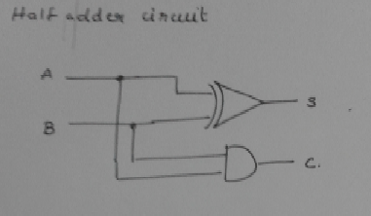
Half adder and Full adder
What is a half adder?
What is a full adder?
A | B | S | C
0 | 0 | 0 | 0
0 | 1 | 1 | 0
1 | 0 | 1 | 0
1 | 1 | 1 | 1
A | B | C_{in} | S | C_{out}
.... | .... | .... | .... | ....
0 | 0 | 1 | 1 | 0
0 | 1 | 1 | 0 | 1
1 | 0 | 1 | 0 | 1
1 | 1 | 1 | 1 | 1

Slide 5
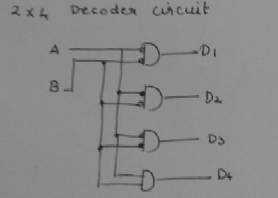
Decoders and Encoders
What is a 2x4 decoder?
What is a 4x2 encoder?
A | B | D1 | D2 | D3 | D4
0 | 0 | 1 | 0 | 0 | 0
0 | 1 | 0 | 1 | 0 | 0
1 | 0 | 0 | 0 | 1 | 0
1 | 1 | 0 | 0 | 0 | 1
A | B | C | D | E1 | E2
1 | 0 | 0 | 0 | 0 | 0
0 | 1 | 0 | 0 | 0 | 1
0 | 0 | 1 | 0 | 1 | 0
0 | 0 | 0 | 1 | 1 | 1

Slide 6
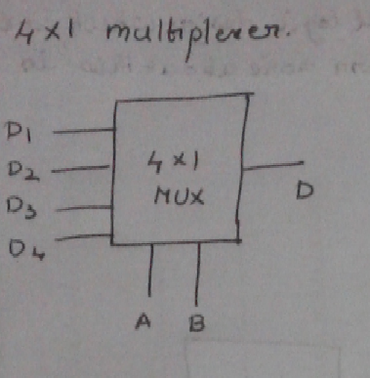
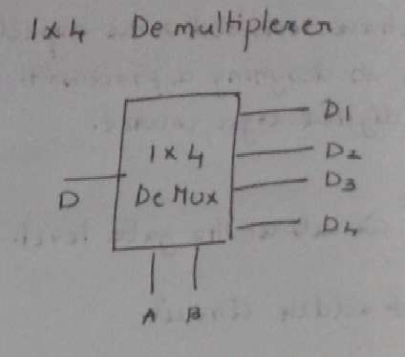
Muxes and Demuxes
What is a 4x1 mux?
What is a 1x4 demux?

Slide 7
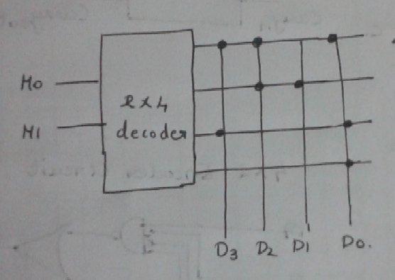
Read only memory

Slide 8
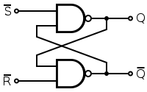
SR latch
~S | ~R | Q | ~Q
0 | 0 | ? | ?
0 | 1 | 0 | 1
1 | 0 | 1 | 0
1 | 1 | Q | ~Q

Slide 9
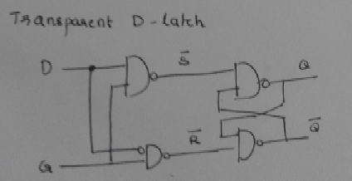
Transparent D latch
D | G | ~S | ~R | Q | ~Q
0 | 0 | 1 | 1 | Q | ~Q
1 | 0 | 1 | 1 | Q | ~Q
0 | 1 | 1 | 0 | 1 | 0
1 | 1 | 0 | 1 | 0 | 1

Slide 10
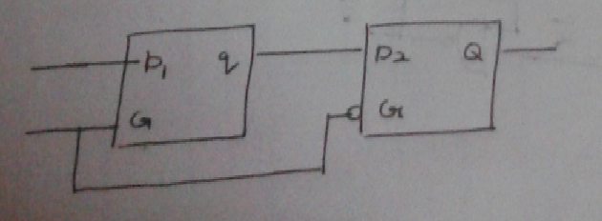
Edge triggered D flip flop

