Slide 1

Department of Avionics,
Indian Institute of Space Science and Technology
AV224 - Computer Organization & Operating Systems
Instructor: Vineeth B. S. (vineethbs@iist.ac.in)
Lecture 11
02/02/2017

Slide 2
Review ...
What should the simple processor do?
Review of digital circuits
Half and full adders
Decoders and Encoders
Muxes and Demuxes
Read only memory (ROM)
SR latch
Transparent D latch
Edge triggered D flip flop
Memory device for storing four 2 bit numbers

Slide 3
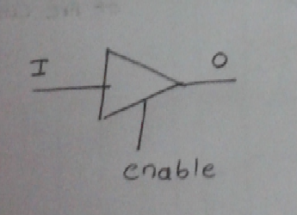
Tristate buffers

Slide 4
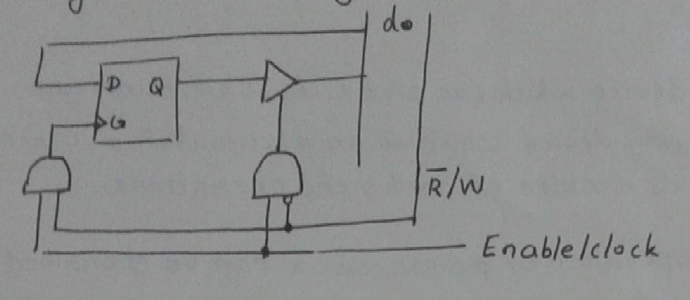
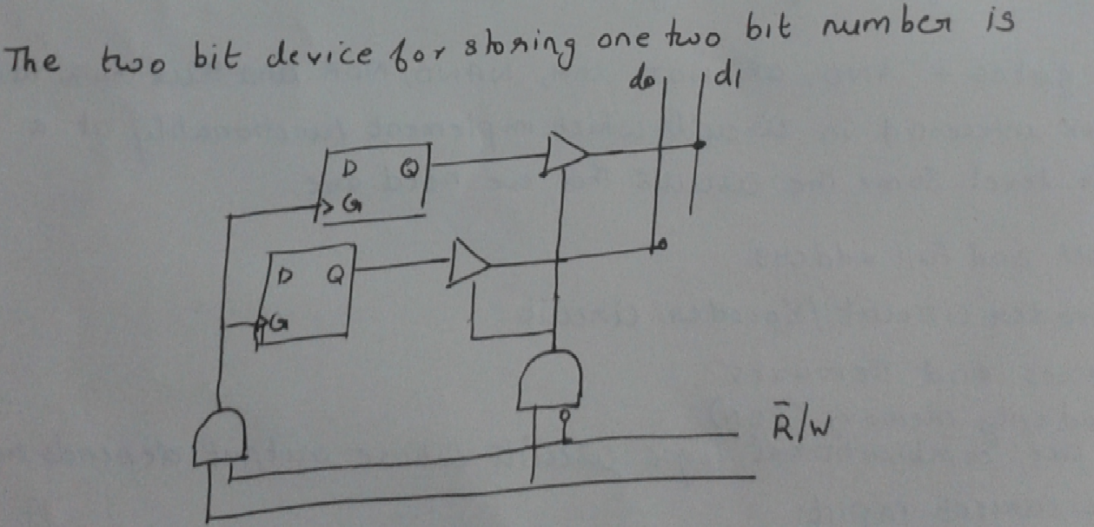
A basic memory cell
A two bit memory device

Slide 5
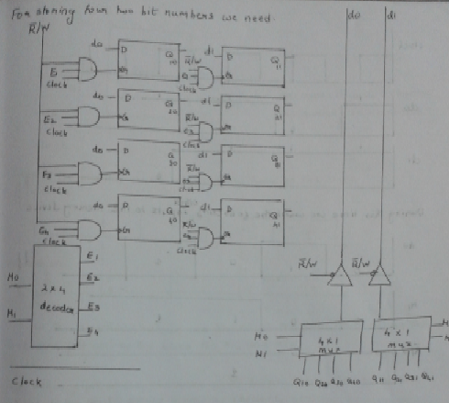
Memory device for storing four two bit numbers

Slide 6
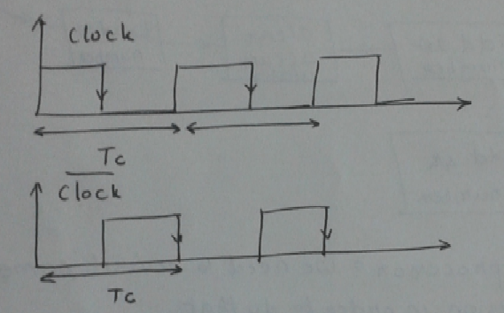
The clock

Slide 7
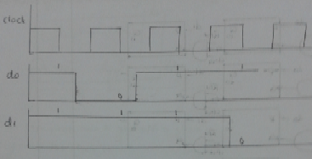
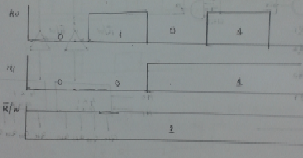
Operating the memory device for storing four two bit numbers
Clock and Data inputs (d0 and d1)
Control inputs M0, M1, and ~R/W

Slide 8
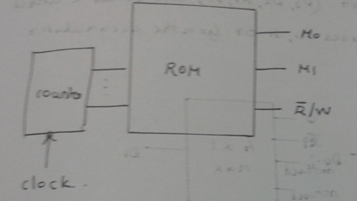
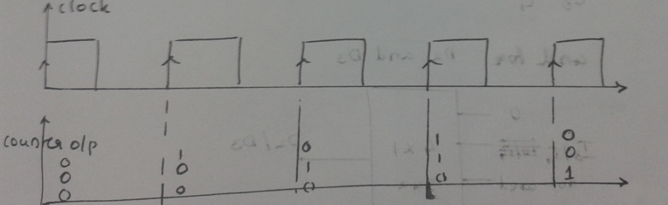
How to generate the control signals?
Use a counter (up-counter) as the memory address for a read only memory (ROM)
The ROM is hardcoded with the values of the control signals
C2 | C1 | C0 | M0 | M1 | ~R/W
0 | 0 | 0 | 0 | 0 | 1
0 | 0 | 1 | 0 | 1 | 1
0 | 1 | 0 | 1 | 0 | 1
... | ... | ... | ... | ... | ...
What is a counter?
Sequential circuits - counts clock transitions
Exercise: Find out how a counter is implemented using flip flops.

