Slide 1

Department of Avionics,
Indian Institute of Space Science and Technology
AV224 - Computer Organization & Operating Systems
Instructor: Vineeth B. S. (vineethbs@iist.ac.in)
Lecture 16
14/02/2017
Figures in these lecture slides are taken from Hennessy and Patterson's
Computer Organization and Design
(Copyright © 2014 Elsevier Inc. All rights reserved)

Slide 2
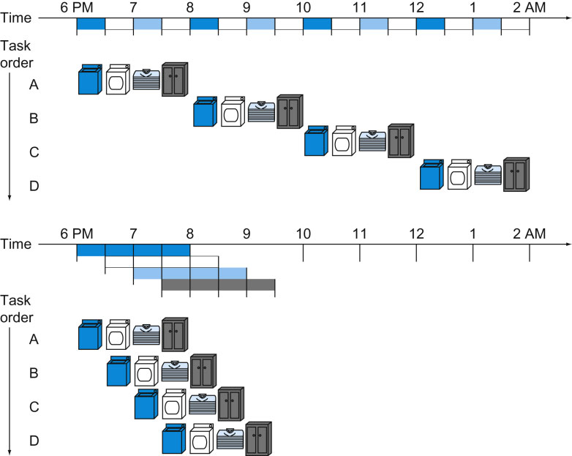
Review: Single cycle data path processors
The instructions that we have seen are implemented so that each instruction takes one clock cycle to complete - single cycle data paths
We need multiple copies of the same component - for example adders in our processor design. There is less reuse of components.
The clock period is therefore decided by the slowest instruction
The instruction that has the most propagation delays is the slowest instruction
Violates a design principle of making common cases fast
Not feasible to vary the clock period depending on the instruction - added complexity in the design
Review: Pipelining

Slide 3
An example
Instruction | Fetch (ps) | Register read (ps) | ALU operation | Data access (ps) | Register Write (ps) | Total Time (ps)
Load | 100 | 100 | 100 | 100 | 100 | 500
Store | 100 | 100 | 100 | 100 |  | 400
Add | 100 | 100 | 100 |  | 100 | 400
Branch | 100 | 100 | 100 |  |  | 300
Assume that 100 instructions are executed
25 are loads
10 are stores
45 are adds
20 are branches
Single cycle execution
Total time taken is 100 * 500 = 50000 ps
Optimal execution is
25 * 500 + 10 * 400 + 45 * 400 + 20 * 300 = 40500 ps
Multi cycle execution
Clock cycle time is 100 ps
Meets the optimal execution time!
Exercise - can you find a set of values for the step completion times for which there is no gain!

Slide 4
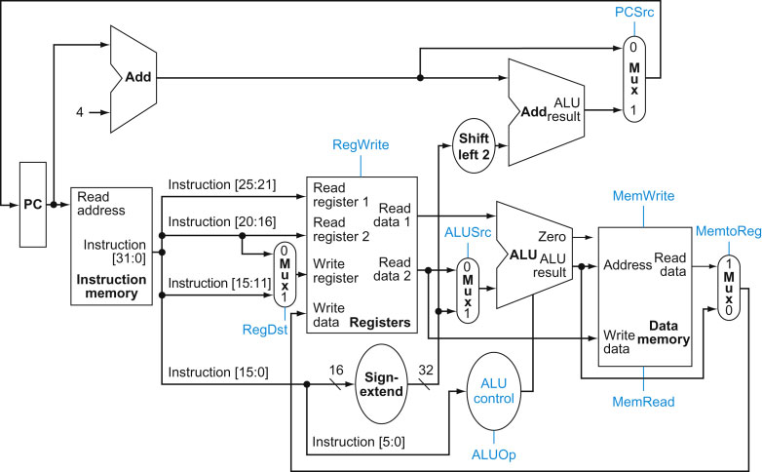
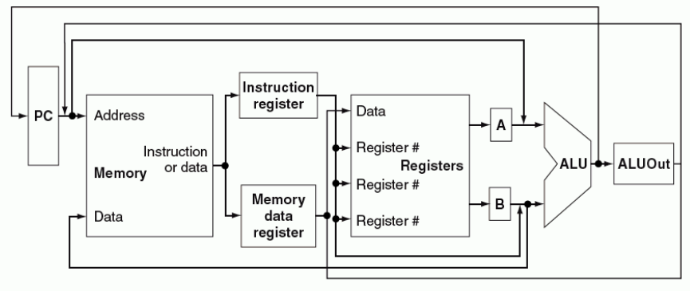
Multicycle datapaths
Single Cycle Architecture
Multiple Cycle Architecture

Slide 5
Multicycle datapaths
Each operation is broken into a series of steps
Instruction Fetch
Register read
ALU operation
Data access
Register write
Each step is executed in a clock cycle
We can reuse components
All data that is used within an instruction must be stored - so there are additional registers in the datapath.
These registers are not visible to the programmer
Note that the register positions are determined by the set of components that work together in one clock cycle (one clock cycle in the multicycle implementation) and what data is needed for later stages.
Multiple Cycle Architecture

Slide 6
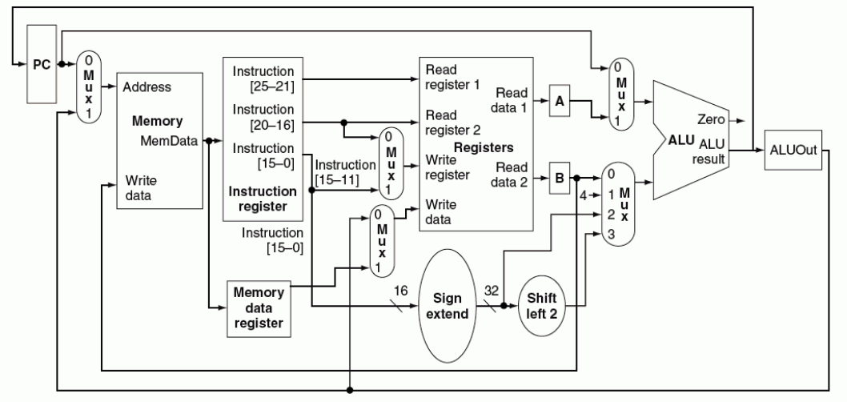
A more refined multicycle datapath architecture
Why?
Why?
Why?
Why?
Why?
Why?

Slide 7
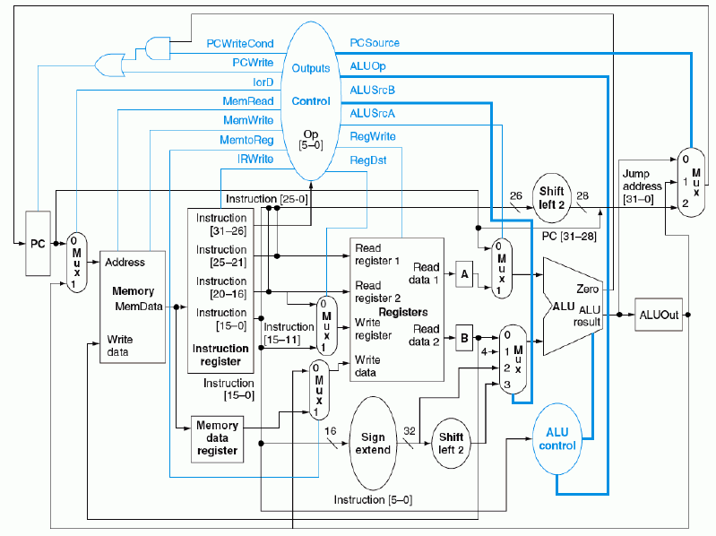
A much more refined multicycle datapath architecture
Exercise
Figure out what are the functions of all these control signals, especially PCWriteCond, PCWrite, IorD, IRWrite, PCSource, ALUSrcA/B

Slide 8
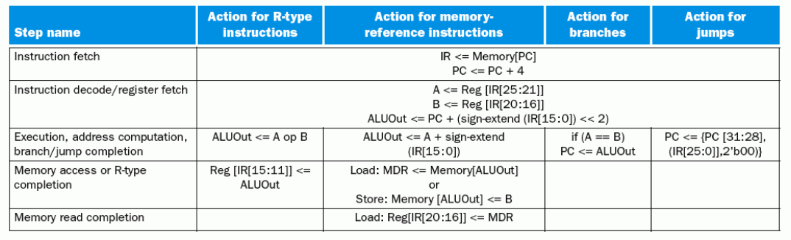
Multicycle implementation - steps for each instruction
Each instruction executed in the processor
Load r1, [r2 + offset]
4

Slide 9
Multicycle implementation - steps for each instruction
Each instruction executed in the processor
Load r1, [r2 + offset]

Slide 10
Multicycle implementation - steps for each instruction
Each instruction executed in the processor
Load r1, [r2 + offset]

Slide 11
Multicycle implementation - steps for each instruction
Each instruction executed in the processor
Load r1, [r2 + offset]

Slide 12
Multicycle implementation - steps for each instruction
Each instruction executed in the processor
Load r1, [r2 + offset]

Slide 13
Summary
Multicycle data path execution time vs Single cycle data path execution time
Multicycle data path architecture
Reuse of components
Additional registers to hold intermediate values
Multiplexers and additional control signals
Steps in executing an instruction
Instruction Fetch
Instruction Decode and Register read
ALU operations
Data access
Register write
References
For multicycle architecture refer to the 3rd edition of Hennessy and Patterson

