Slide 1

Digital Filter Design - Review
AV343 - Communication Lab
Figures are taken from the textbooks
Discrete Time Signal Processing - Oppenheim and Schafer
Digital Signal Processing - Oppenheim and Schafer

Slide 2
What is a filter?
From a communication engineer's perspective, a filter is mainly used to manipulate a signal by selective discrimination of the frequency components in the signal
Low pass, high pass, band pass, band stop filters
Hilbert transform
In this review class, we will primarily consider the design of low pass filters - the design for other forms of filters can usually be obtained using techniques which are similar to that of low pass filters or by transformation formulae.
For designing a filter, we should be given a specification.
How should a specification look like?
The specification says how we should discriminate among the frequencies, as a function of the digital frequency variable.
Passband
Stopband
ω_{c}

Slide 3
Filter specification
How should a specification look like?
The specification says how we should discriminate among the frequencies, as a function of the digital frequency variable.
But in many cases we will be implementing a digital filter to filter an analog signal. The specifications for the filter would then be given in the analog domain and needs to be converted to a specification in digital domain.
How is that done?
Recall the mapping between analog frequencies and digital frequencies
Passband
Stopband
ω_{c}

Slide 4
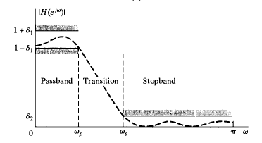
Filter specification
How should a specification look like?
The specification says how we should discriminate among the frequencies, as a function of the digital frequency variable. Note that a linear phase response is also desired in the passband.
Since such ideal filters cannot be realized, what is realizable is a specification (LPF) like:
Passband
Stopband
ω_{c}

Slide 5
Filter design techniques
Broadly classified as FIR and IIR filter design techniques
FIR
Frequency sampling
Window
Least squares design
Optimal ripple design
IIR (analog filter design mapped to digital filters)
Impulse invariance
Bilinear transform

Slide 6
Filter design - Finite Impulse Response (FIR) filters
Let h[n] be a sequence of finite extent, i.e., n ε {0,1,..., M}
If h[n] is the impulse response of a discrete time LTI or LSI (linear shift invariant) system then h[n] is a finite impulse response
Design techniques for FIR filters are based on direct approximation of
The desired impulse response
The desired frequency response
FIR filters can use FFT for their implementation (FFT with overlap and save)

Slide 7





Filter design - Finite Impulse Response (FIR) filters
The z-transform of h[n] is
For an FIR h[n], the RoC is the whole of the z-plane except at z = 0
At z = 0, note that the z-transform has M poles
The z-transform also has M zeros
The DTFT of h[n] is
In order to make the relationship between the DTFT and the z transform more explicit, we will
start using the notation instead of .
So the DTFT of h[n] is

Slide 8
FIR - Frequency sampling design
Suppose we want to build an FIR filter with linear phase response for the ideal specification shown below.
We sample this ideal response at (M + 1) uniformly spaced points - so the samples form a (M+1) point DFT
The inverse DFT gives us a finite extent signal h[n].
How good is h[n] as a filter?
Demonstration ...
Passband
Stopband
ω_{c}

Slide 9
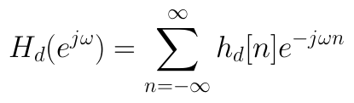
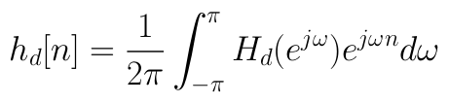
Finite Impulse Response (FIR) filters - Design using Windows (1)
Suppose H_{d}(e^{jω}) is a desired frequency response such as shown
The corresponding impulse response is h_{d}[n]
Usually for brickwall type frequency response (which is desired) h_{d}[n] would be an infinite impulse response
The relationship between H_{d}(e^{jω}) and h_{d}[n] is
In some cases we can obtain h_{d}[n] from H_{d}(e^{jω}) analytically
e.g. on board: h_{d}[n] for the low pass response shown above.
Passband
Stopband
ω_{c}

Slide 10

Finite Impulse Response (FIR) filters - Design using Windows (2)
Suppose H_{d}(e^{jω}) is a desired frequency response such as shown
The corresponding impulse response is h_{d}[n]
Usually for brickwall type frequency response (which is desired) h_{d}[n] would be an infinite impulse response
An FIR filter should have a finite extent impulse response h[n].
We define
Where w[n] is a window of extent (M + 1), i.e., {0 to M}
e.g. w[n] could be a rectangular window
on board - how is windowing done?
What is the difference in H_{d}(e^{jω}) and H(e^{jω})?
Desired and what is obtained via windowing.
Passband
Stopband
ω_{c}

Slide 11
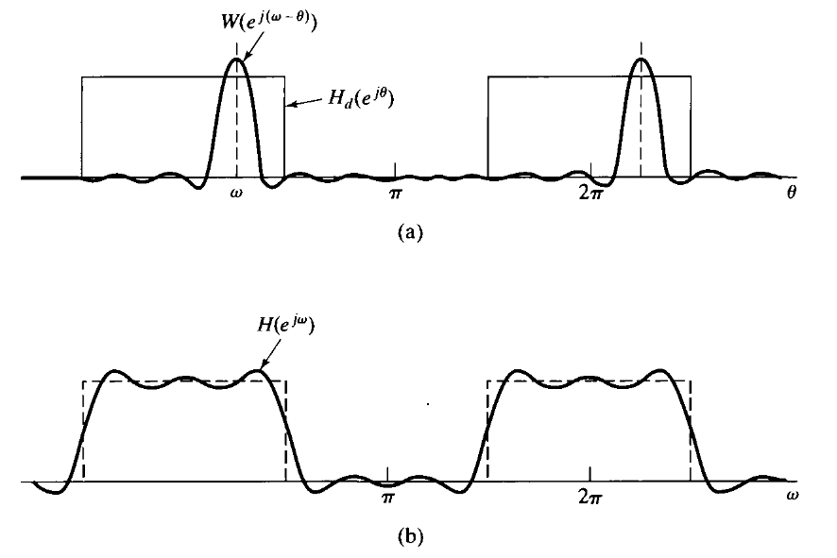
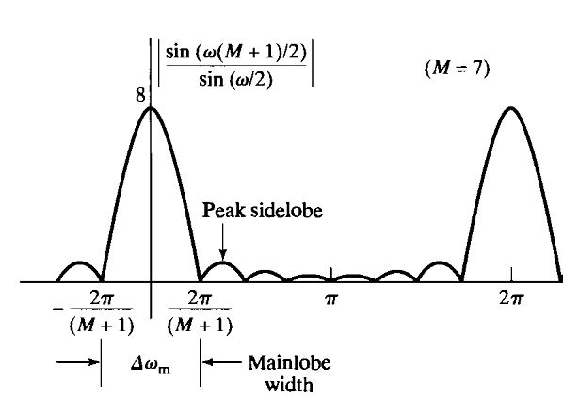
Finite Impulse Response (FIR) filters - Design using Windows (3)
We have that
From properties of the DTFT we have that
On board:
DTFT of w[n]
Main lobe width decides the transition band width!
convolved result

Slide 12
Finite Impulse Response (FIR) filters - Design using Windows (4)
We define
Where w[n] is a window of extent 0 to M
What is the difference in H_{d}(e^{jω}) and H(e^{jω})?
Desired and what is obtained via windowing.
Fourier series
representation
Truncated Fourier series
representation
Gibb's phenomenon

Slide 13

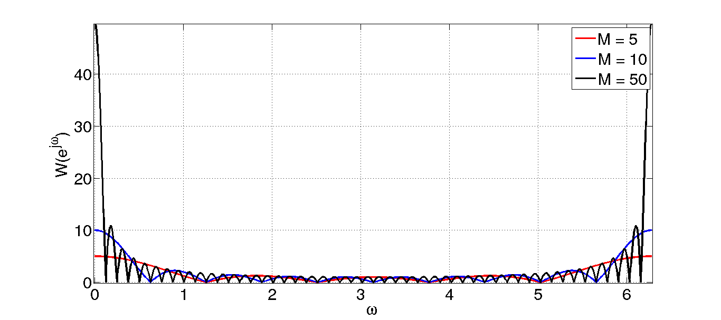
DTFT of w[n]
How does change with M?
In time domain: As the window size increases, h[n] = h_{d}[n] for more and more values of n.
In freq. domain: As the window size increases, the main lobe size decreases, and the spectrum tends to a delta function.
However, "ripples" would always be present.
Area under each side lobe would remain the same as M decreases.

Slide 14

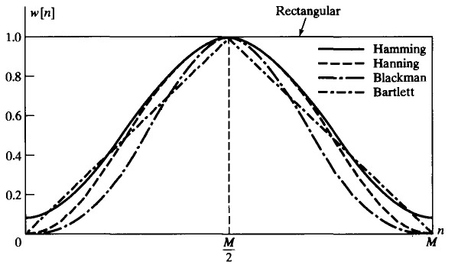
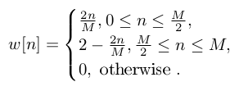

Finite Impulse Response (FIR) filters - Windows
The rectangular window is one of the possible windows that can be used.
The side lobe size can be reduced by using windows that "taper" (intuition?)
For example, Bartlett (triangular), Blackman, Hanning, Hamming windows
Other possibilities are

Slide 15
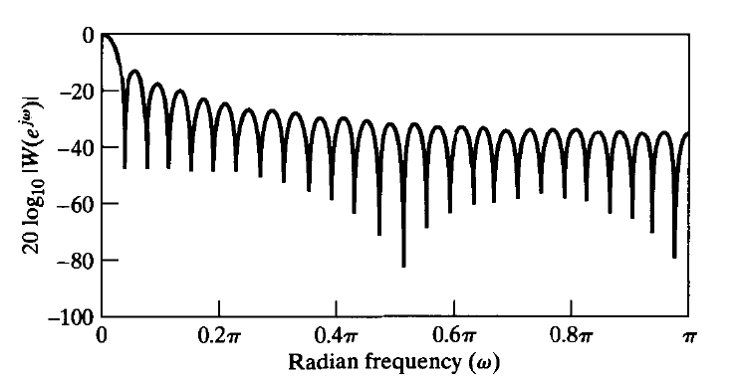
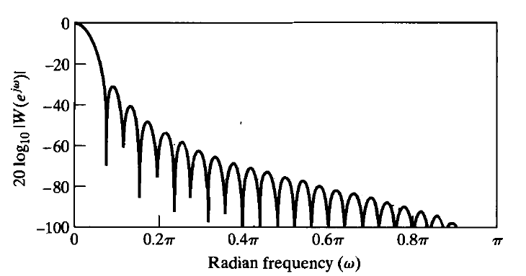
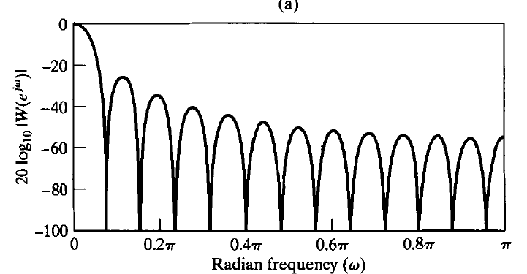
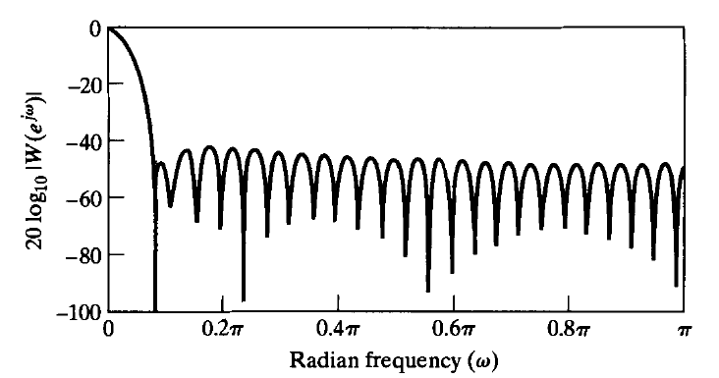
Finite Impulse Response (FIR) filters - Windows
The spectrum W(e^{jω}) of these windows (M = 50) are as follows:
Plotting in log scale is important !
Rectangular Window
Hanning Window
Bartlett Window
Hamming Window

Slide 16
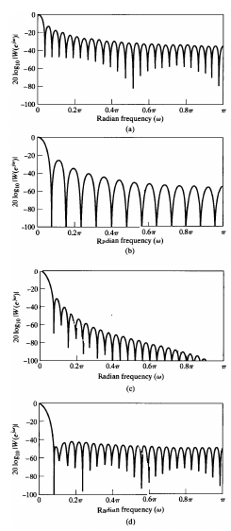
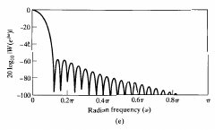
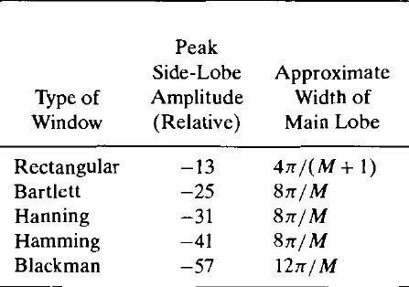

Finite Impulse Response (FIR) filters - Windows
The spectrum W(e^{jω}) of these windows (M = 50) are as follows:

Slide 17


Finite Impulse Response (FIR) filters - Phase response
Usually filtering is used to selectively pass frequency components
we try to approximate the following "brickwall" form
Within the passband we want the phase response of the filter to be linear
What this means is that
For FIR filters such a requirement can be easily met by ensuring the following symmetry condition
On board: Example for M odd and M even.
On board: Proof of linear phase for M odd and M even.
Windows are defined in such a way so that this symmetry is maintained.
Major advantages of using FIR filters
Use of FFT
Easy to obtain linear phase response
Passband
Stopband
ω_{c}

Slide 18
Finite Impulse Response (FIR) filters - Characteristic behaviour when windowing
In order to understand how H(e^{jω}) looks like we will use the following simple approximation which captures the windows DTFT W(e^{jω}) and carry out convolution of W(e^{jω}) with H_{d}(e^{jω}).
1
1
0.25
-0.125
-0.5

Slide 19
Finite Impulse Response (FIR) filters - Characteristic behaviour when windowing
1
0.25
-4
-0.125
-0.5
1

Slide 20
Finite Impulse Response (FIR) filters - Characteristic behaviour when windowing
1
0.25
-4
-0.125
-0.5
1

Slide 21


Finite Impulse Response (FIR) filters - Characteristic behaviour when windowing
1
0.25
-4
-0.125
-0.5
1

Slide 22

Finite Impulse Response (FIR) filters - Characteristic behaviour when windowing
1
0.25
-4
-0.125
-0.5
1

Slide 23

Finite Impulse Response (FIR) filters - Characteristic behaviour when windowing
1
0.25
-4
-0.125
-0.5
1

Slide 24
Finite Impulse Response (FIR) filters - Characteristic behaviour when windowing
1
0.25
-4
-0.125
-0.5
1

Slide 25

Finite Impulse Response (FIR) filters - Characteristic behaviour when windowing
1
0.25
-4
-0.125
-0.5
1

Slide 26
Finite Impulse Response (FIR) filters - Characteristic behaviour when windowing
1
0.25
-4
-0.125
-0.5
1
The transition width depends on the main lobe width
The overshoot and the undershoot are symmetric - the overshoot and undershoot are measured wrt to the constant gain that we should get (provided the cutoff frequency is more than the main lobe width)

Slide 27
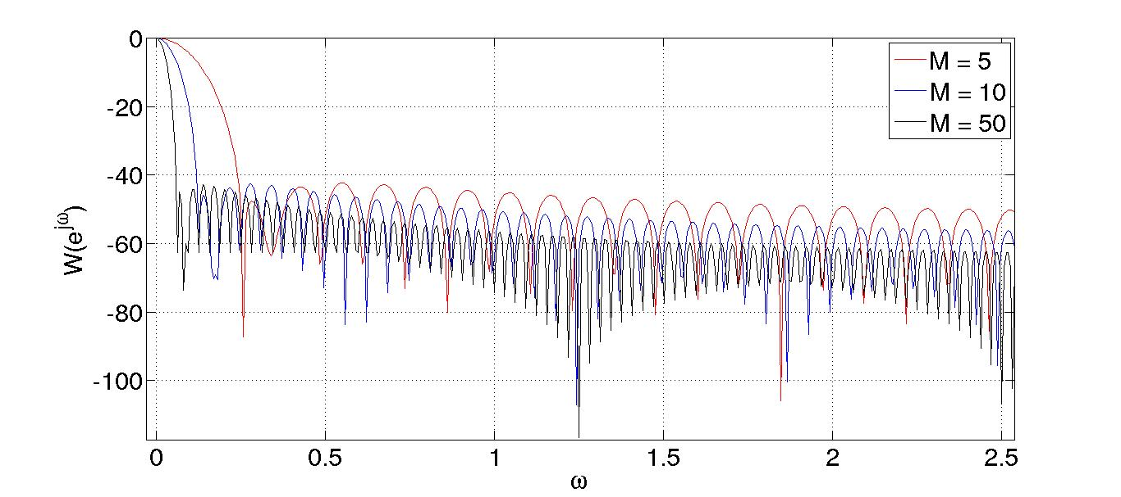
Finite Impulse Response (FIR) filters - Design based on Windows
Windows allow us to control the ripple
But they tradeoff ripple with the main lobe width
We can then reduce main lobe width by increasing the length M
The peak side lobe amplitude is approximately the same even as M is changed!

Slide 28
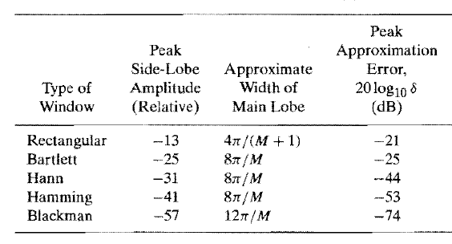
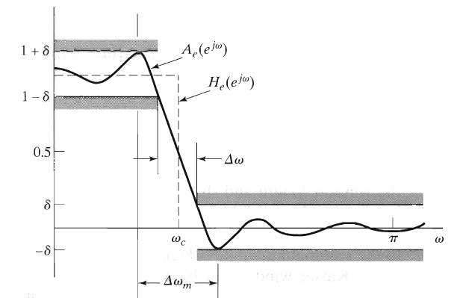
Finite Impulse Response (FIR) filters - Design based on Windows
Why are we looking at the magnitude/amplitude responses only?
We are looking at filters with linear phase.

Slide 29
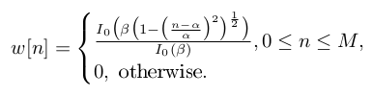
Finite Impulse Response (FIR) filters - Kaiser Window Method
We have a tradeoff between mainlobe width and sidelobe area
less mainlobe width implies more sidelobe area and more ringing
For a given mainlobe width which windows has the minimum sidelobe area?
Kaiser's window
The Kaiser window is defined as:
Here α is chosen as M/2 and I₀( ) is a special function. I₀( ) is the zeroth-order modified Bessel function of the first kind.
The Kaiser window has two parameters - the length (M + 1) and the shape parameter β.

Slide 30
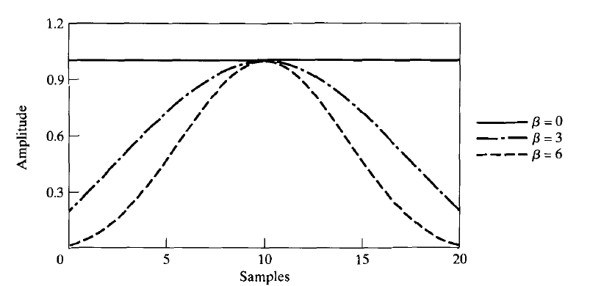
Finite Impulse Response (FIR) filters - Kaiser Window Method
The Kaiser window has two parameters - the length (M + 1) and the shape parameter β.
Example for M = 20

Slide 31
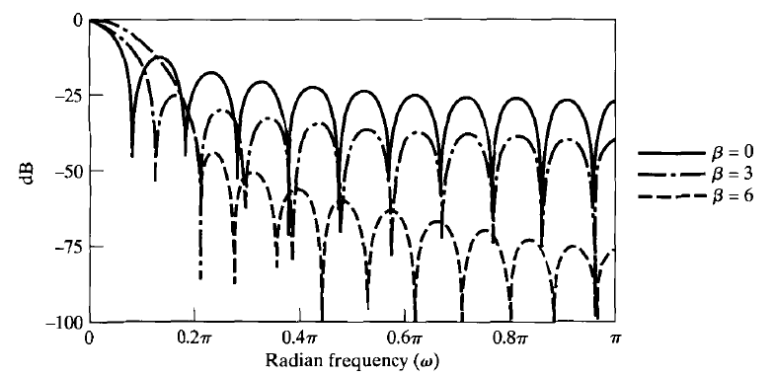
Finite Impulse Response (FIR) filters - Kaiser Window Method
The Kaiser window has two parameters - the length (M + 1) and the shape parameter β.
Example for M = 20
Parameterized
spectrum. Important for optimization.

Slide 32
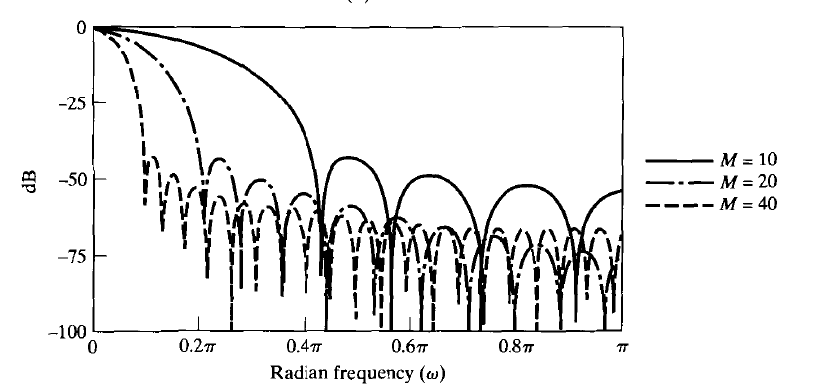
Finite Impulse Response (FIR) filters - Kaiser Window Method
The Kaiser window has two parameters - the length (M + 1) and the shape parameter β.
Example for β = 6

Slide 33
Finite Impulse Response (FIR) filters - Characteristic behaviour of Kaiser windows

Slide 34


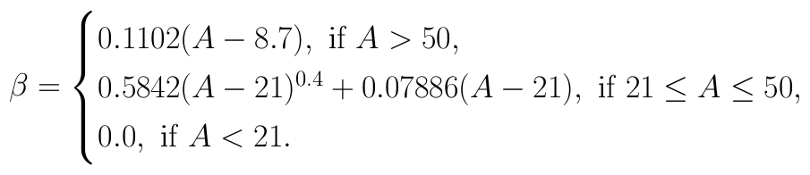

Finite Impulse Response (FIR) filters - Design formula

Slide 35



Finite Impulse Response (FIR) filters - Design example - low pass filter

Slide 36

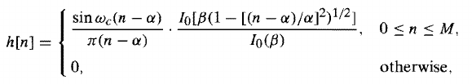
Finite Impulse Response (FIR) filters - Design example - low pass filter

Slide 37
FIR Filter design techniques
FIR
Frequency sampling
Window
Least squares design
Optimal ripple design
Use of firpm - specification of the normalized frequency
an example of a low pass filter
an example of a band pass filter

Slide 38

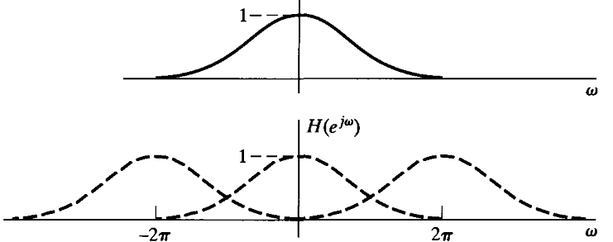
IIR Filter design techniques
IIR filters are usually designed by mapping analog filter designs to the digital domain
Mapping a stable analog filter should give a stable digital filter
Mapping of the jω axis to the unit circle.
We will look at a simple scheme for doing this mapping - called impulse invariance
Suppose we have an analog filter with impulse response h_{a}(t) and a Laplace transform H_{a}(s)
We note that
Let T denote a sampling period used for sampling h_{a}(t).
Let h[n] = h_{a}(nT)
Then we have that

Slide 39




Impulse invariance
An (practical) analog filters will not be bandlimited, so we will have some aliasing.
In designing, we will assume that
Suppose we have found a H_{a}(s) such that this mapping meets our requirements.
Then how is the system really implemented?
We write H_{a}(s) as a partial fraction expansion
The corresponding impulse response is
With h[n] being h_{a}(nT) we have that

Slide 40
Impulse invariance
So there is a mapping of the poles of the analog transform to the z-plane
This can be used to specify the digital filter

Slide 41

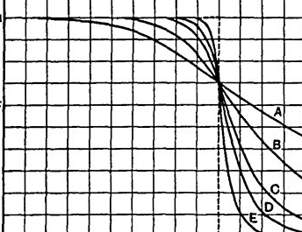

Impulse invariance - example design using analog Butterworth filters
We consider a low pass filter design example using analog Butterworth filters
For an analog Butterworth filter of order N we have that the magnitude squared response is
The N roots of H_{a}(s) are those of which are in the
LHS of the s-plane (for stability of the filter).
Suppose we are given a specification of a low pass filter
We need to find a N and a 3-dB frequency such that those requirements are satisfied.
Find out the poles and map it into the digital domain.

