Slide 1

Department of Avionics,
Indian Institute of Space Science and Technology
AV224 - Computer Organization & Operating Systems
Instructor: Vineeth B. S. (vineethbs@iist.ac.in)
Lecture 26
14/03/2017
Some of the figures in these lecture slides are taken from Silberschatz et al.'s
Operating System Concepts and the xv6 book.

Slide 2
Where are we?
Program 1
Program 2
Program n
...
Operating System
ISA
Interface to H/W
Hardware
Processor
Memory
Input, Output, & Storage

Slide 3
Textbooks and references
xv6 book and source code
https://pdos.csail.mit.edu/6.828/2016/
Operating system concepts - Silberschatz, Galvin, and Gagne
Slides
Today's class
An initial definition of an operating system
System calls and examples
System programs
Architecture of operating systems
Booting

Slide 4
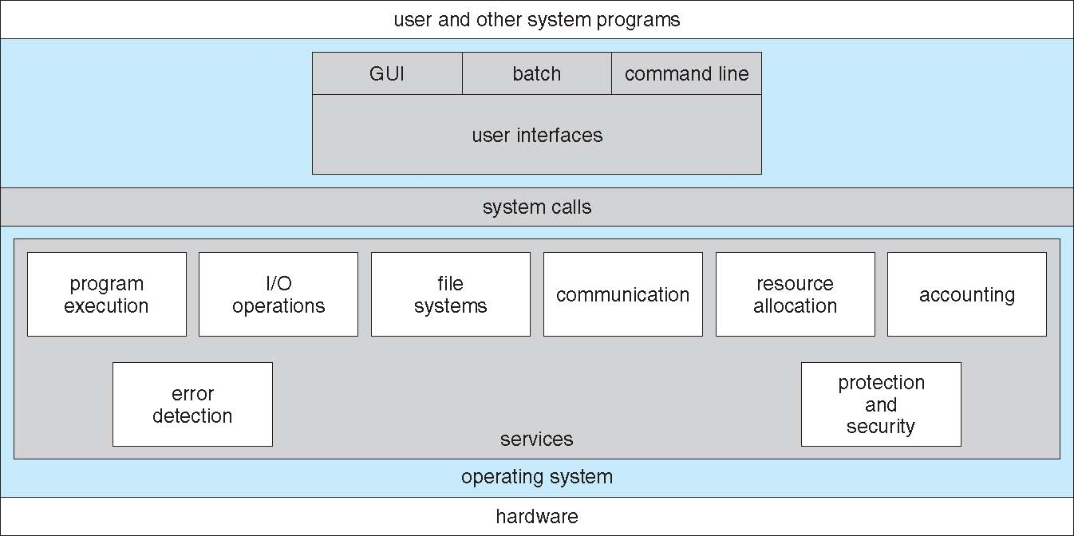
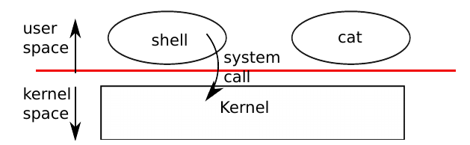
A starting defintion of an operating system
An operating system is a program
That shares computer hardware resources amongst multiple programs and users
Abstracts low level hardware so that programs can easily access hardware
That provides mechanisms for programs to run and interact with each other
The operating system exposes a set of services to programs through an interface - think of this as using a library
What makes up a good interface? How to implement the interface?

Slide 5
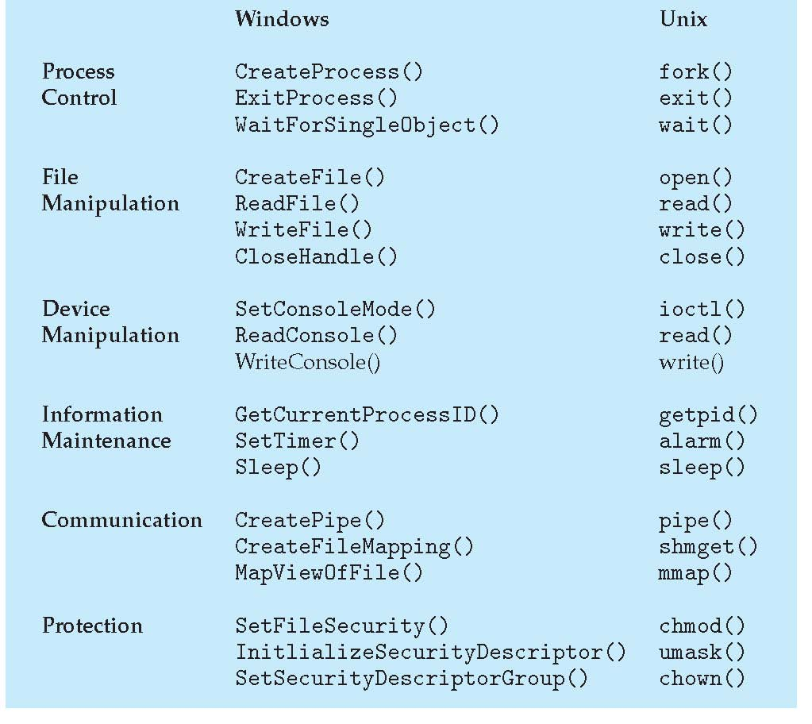
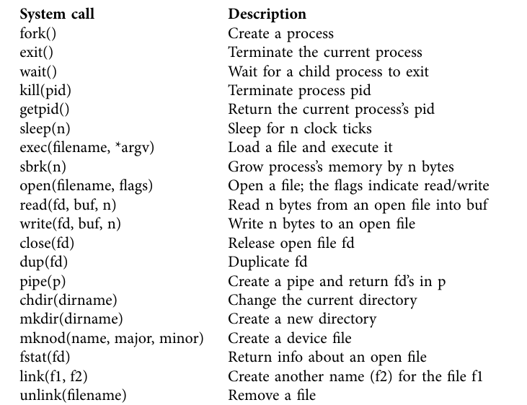
System calls
A set of functions supported by the operating system
Windows & Unix
xv6

Slide 6
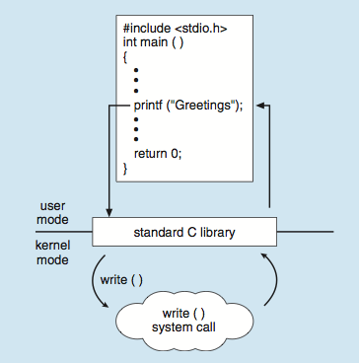
System calls
A set of functions supported by the operating system
Handled by support functions in libraries compiled along with executables (e.g. libc)
xv6

Slide 7
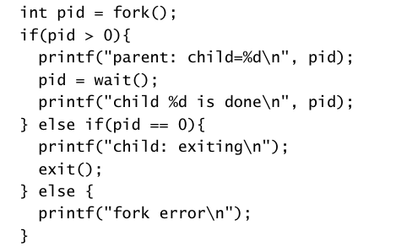
Processes and memory
A xv6 process consists of
Instructions, Data, Stack
Per process state (modifiable only by the kernel)
Kernel time shares between processes
Each process has a PID
A process can create another process using fork()
fork() creates a child process from the parent process
Memory contents of child is same as that of the parent
fork() returns in both parent and child
In parent returns PID of child, in child returns 0
wait() syscall in a parent waits for a child to exit and returns the PID
exec() replaces the calling process with another program loaded from a file
PID is the same
exit() terminates the process and releases kernel resources
sbrk() is used to grow the memory allocated to a process
The xv6 shell is an interface to the OS. It uses the above system calls to start and end programs

Slide 8
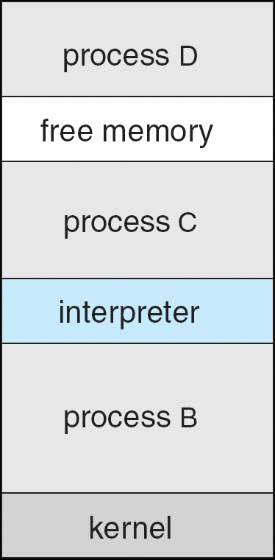
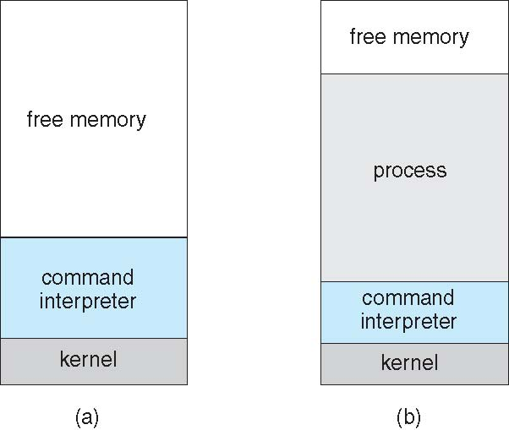
How different operating systems load programs into memory?
MSDOS
Exercise: using x86 write a simple loader
assume memory mapped IO
assume program start is at the lowest program location
Linux, xv6

Slide 9
Summary
Operating system
Resource manager
Abstraction of low level details
Interprocess communication
System calls
fork(), exec()
References
xv6 book and source code
https://pdos.csail.mit.edu/6.828/2016/
Operating system concepts - Silberschatz, Galvin, and Gagne
Slides

