Slide 1

Department of Avionics,
Indian Institute of Space Science and Technology
AV224 - Computer Organization & Operating Systems
Instructor: Vineeth B. S. (vineethbs@iist.ac.in)
Lecture 29
21/03/2017
Some of the figures in these lecture slides are taken from Silberschatz et al.'s
Operating System Concepts and the xv6 book.

Slide 2
Review ...
Processes
Today's class
Scheduling of processes
xv6 operating system
processes in the xv6 operating system

Slide 3
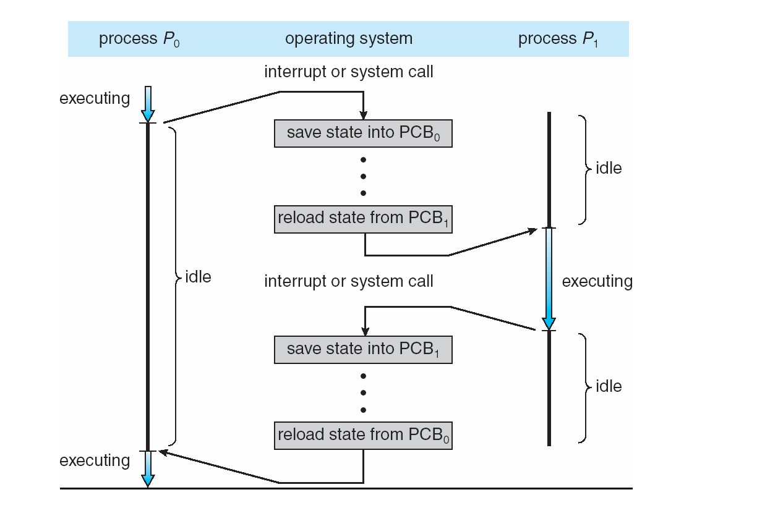
Time sharing between processes

Slide 4
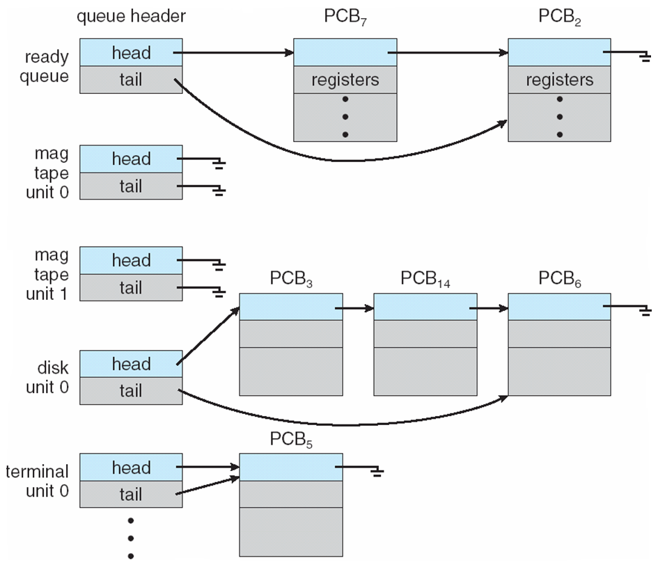
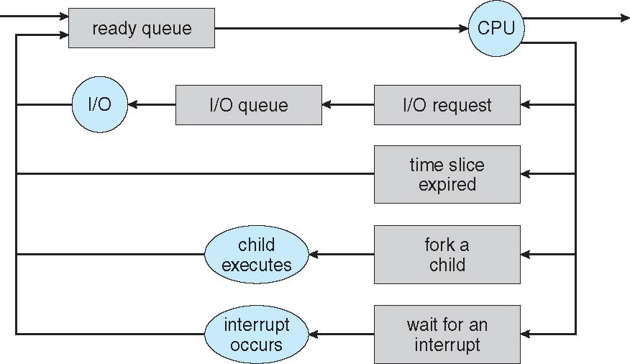
Process scheduling
Efficient use of CPU
Switch processes onto CPU for time sharing
Process scheduler does this selection among available processes for next execution
Multiple scheduling queues of processes may be present
Job queue – set of all processes in the system
Ready queue – set of all processes residing in main memory, ready and waiting to execute
Device queues – set of processes waiting for an I/O device
Processes migrate among the various queues

Slide 5
Schedulers
Short-term scheduler (or CPU scheduler) – selects which process should be executed next and allocates CPU
Sometimes the only scheduler in a system
Short-term scheduler is invoked frequently (milliseconds) ⇒ (must be fast)
Long-term scheduler (or job scheduler) – selects which processes should be brought into the ready queue
Long-term scheduler is invoked infrequently (seconds, minutes) ⇒ (may be slow)
The long-term scheduler controls the degree of multiprogramming
Processes can be described as either:
I/O-bound process – spends more time doing I/O than computations, many short CPU bursts
CPU-bound process – spends more time doing computations; few very long CPU bursts
Long-term scheduler strives for good process mix

Slide 6
The xv6 operating system
xv6 has a monolithic kernel
is designed to run on 80386 or later x86 processors
not a co-operative multiprogramming OS
interaction to hardware via OS via systemcalls
fork(), exec(), open(), read(), write(), close()
x86 supports
user mode and kernel mode
in kernel mode can execute privileged instructions
special instruction for switching from user to kernel mode - the int instruction
the control branches to a location in the kernel which handles system calls - just like exceptions and interrupts which we have studied before
return is done using iret
all of xv6 runs in kernel mode (monolithic kernel)

Slide 7
Setting up the xv6 operating system
Linux based systems
Use git to obtain the latest source files
git clone git://github.com/mit-pdos/xv6-public.git
Make sure that you have gcc installed
Make sure that you have qemu installed
sudo apt-get install qemu
or obtain from www.qemu-project.org
run make qemu to start an instance of xv6 running on a qemu virtual machine
Windows based systems
Use VMWare or Virtualbox to install Linux, enable networking
install gcc and associated tools
install qemu
Modifying the operating system source code
Example - need to make the shell prompt say "AV224 $" instead of "$"
Use your favourite code editor
Edit sh.c
Do make qemu and observe the results

Slide 8
Project - phase I
Choose whether you want to do the class project or not
Decide your group
Choose the operating system that you want to work with
Setup the operating system on a virtual machine on at least one laptop
Setup and test the development environment on your laptop
Test whether a simple modification can be made and compiled
Should be complete by 27/03/17
All groups should email a document consisting of
The list of people in the group
The operating system you have chosen
The simple modification
A screenshot of the OS running on the virtual machine
to Arnab by 27/03/17
Arnab should consolidate all the documents and email to me.

