Slide 1

Department of Avionics,
Indian Institute of Space Science and Technology
AV224 - Computer Organization & Operating Systems
Instructor: Vineeth B. S. (vineethbs@iist.ac.in)
Lecture 31
30/03/2017
Some of the figures in these lecture slides are taken from Silberschatz et al.'s
Operating System Concepts and the xv6 book.

Slide 2
Review ...
Processes
Process scheduling
Interprocess communication
Producer - Consumer paradigm
Threads
Race conditions
When several processes/threads access data concurrently and the outcome of the execution depends on the order of access
Today's class
Critical sections and critical section problem
Solution to the critical section problem
Peterson's solution
Synchronization hardware support

Slide 3
Race condition
counter++ could be implemented as register1 = counter register1 = register1 + 1 counter = register1
counter-- could be implemented as register2 = counter register2 = register2 - 1 counter = register2
Suppose counter is initially 5
Suppose the actual execution occurs like this
producer execute register1 = counter {register1 = 5}
producer execute register1 = register1 + 1 {register1 = 6}
consumer execute register2 = counter {register2 = 5}
consumer execute register2 = register2 – 1 {register2 = 4}
producer execute counter = register1 {counter = 6 }
consumer execute counter = register2 {counter = 4}
Race condition: When several processes/threads access data concurrently and the outcome of the execution depends on the order of access
Needs synchronization (using protocols) between processes so that race conditions do not occur

Slide 4
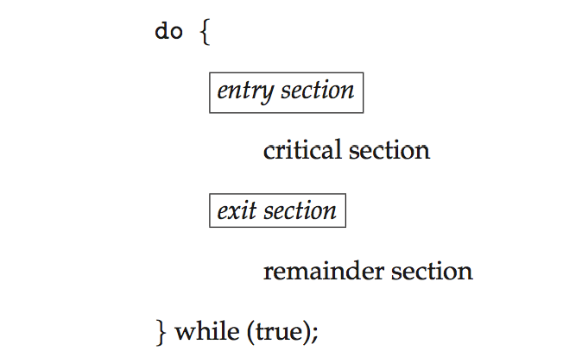
Critical sections
Suppose we have a system with n processes
The processes are co-operating processes which share data
Each process can be thought of as having at least one critical section
Inside a critical section, a process changes shared variables, which are used by other processes - within their critical section
We will also think about the other code/data in a process which can be run independently as in a remainder section

Slide 5
Critical section problem
The critical section problem is to synchronize/co-ordinate or have a protocol so that when a process is its critical section, no other process is in its critical section.
Usually this protocol will mean that processes need additional code
in an entry section to ask for permission or tell other processes that the critical section is being entered
in an exit section to indicate that the process has left the critical section (and enters the remainder section)
A simple method for a fixed set of n processes. For process i
do {
while (turn != i);
critical section
turn = i + 1;
remainder section
} while (true);

Slide 6
Required properties of the solution to the critical section problem
Mutual exclusion
Progress
Bounded waiting time
The protocol should not assume anything about relative speed of execution of the processes
do {
while (turn != i);
critical section
turn = i + 1;
remainder section
} while (true);
Does this satisfy all properties ?

Slide 7
Peterson's solution for the case of two processes
Atomic operations - operations which are executed without any interruption from other processes
Assume that load and store are atomic operations
The two processes share two variables
int turn
boolean flag[2]
flag indicates whether a process is ready to enter the critical section
flag[i] = true implies that i is ready to enter the critical section
do {
flag[1] = true;
turn = 2;
while (flag[2] && turn == 2);
critical section
flag[1] = false;
remainder section
} while (true);
do {
flag[2] = true;
turn = 1;
while (flag[1] && turn == 1);
critical section
flag[2] = false;
remainder section
} while (true);
Exercise: What if the variable turn is not used? What about n processes?

Slide 8
Hardware support for synchronization
The basic idea for synchronization is "locking"
Processor support for atomic operations which cannot be interrupted
do {
acquire lock
critical section
release lock
remainder section
} while (TRUE);

Slide 9
The test_and_set() instruction and its use in synchronization
The test_and_set() instruction
boolean test_and_set(boolean *target)
{
boolean rv = *target;
*target = TRUE;
return rv:
}
This is implemented as an atomic operation
The operation is used as follows: lock is initialized to false
do { while (test_and_set(&lock)); /* do nothing */
/* critical section */
lock = false;
/* remainder section */
} while (true);

Slide 10
The compare_and_swap() instruction and its use in synchronization
The compare_and_swap() instruction
int compare _and_swap(int *value, int expected, int new_value) {
int temp = *value;
if (*value == expected)
*value = new_value;
return temp;
}
This is implemented as an atomic operation
The operation is used as follows: lock is initialized to 0
do { while (compare_and_swap(&lock, 0, 1) != 0); /* do nothing */
/* critical section */
lock = 0;
/* remainder section */
} while (true);

Slide 11
Implementing bounded waiting with test_and_set()
do { waiting[i] = true; key = true; while (waiting[i] && key)
key = test_and_set(&lock);
waiting[i] = false;
/* critical section */
j = (i + 1) % n;
while ((j != i) && !waiting[j])
j = (j + 1) % n;
if (j == i)
lock = false;
else
waiting[j] = false;
/* remainder section */
} while (true);

Slide 12
Summary
Critical sections and critical section problem
Solution to the critical section problem
Peterson's solution
Synchronization hardware
Reference: Silberschatz et al. (Topics from Ch. 5)

