Slide 1

Department of Avionics,
Indian Institute of Space Science and Technology
AV224 - Computer Organization & Operating Systems
Instructor: Vineeth B. S. (vineethbs@iist.ac.in)
Lecture 20
23/02/2017
Figures in these lecture slides are taken from Hennessy and Patterson's
Computer Organization and Design
(Copyright © 2014 Elsevier Inc. All rights reserved)

Slide 2
Modified attendance rules
You have to sign the attendance sheet and be honest
If I find that any one of you are signing attendance for a person who is absent for a class
All the students who are present in that class will have x marks deducted from their total marks
x for each student is random and is picked uniformly between 5(n - 1) and 5(n - 1) + 4
n is the offense index
If the maximum marks drops below 60
There will be two class tests (after the final exams with appropriate hardness levels) to make up
Bonus: If you are honest for the rest of the term, all of you will get a bonus of 5 marks

Slide 3
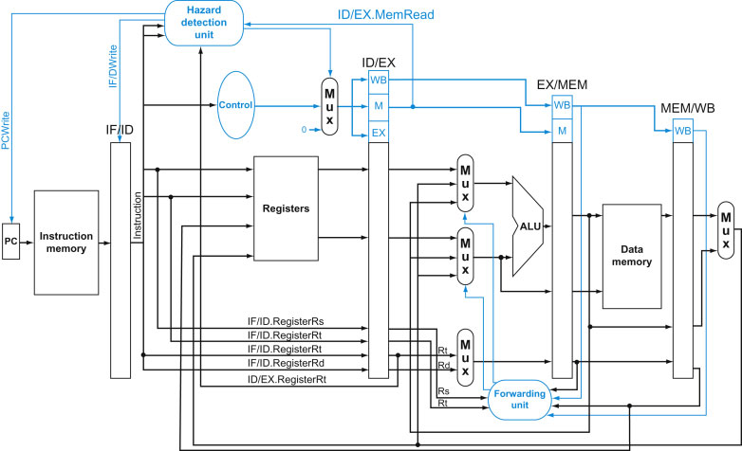
Review
Pipelined data path and control
The single cycle data path is modified to get the pipelined data path
Temporary pipeline registers to hold state of the instruction at different stages of its execution
Forwarding unit
Hazard detection unit
Control hazards

Slide 4
Branch prediction
Static branch prediction - a fixed rule for deciding what to put in the pipeline next
Dynamic branch prediction
Tradeoff - more hardware for better prediction depending upon how the program executes
A simple dynamic rule
Use the address of the branch instruction to see if the branch was taken the last time this instruction was executed. Use this to fetch instructions from the place that was used last time.
Implementation approach
Branch prediction buffer or lookup table
Addressed by the lower bits of the instruction address
The data is just a bit that says whether the branch was taken or not
The bit is modified depending upon whether the prediction is correct or not

Slide 5
1 bit branch prediction - a shortcoming
Consider a loop inside another loop
The loop runs for 10 iterations
So branches back 9 times and exits the loop on the 10th iteration
The branch is not taken once
The loop might be run again
The 1 bit predictor makes 2 prediction errors
In the first iteration of the loop, the predicion says that the branch will not be taken (since when this loop was executed last, the last prediction is wrong and the bit will be changed)
Since the branch is taken for all the iterations except the last one, the last prediction will also be wrong!
Ideally, we want the predictor to have a prediction accuracy equal to the proportion in the actual data.

Slide 6
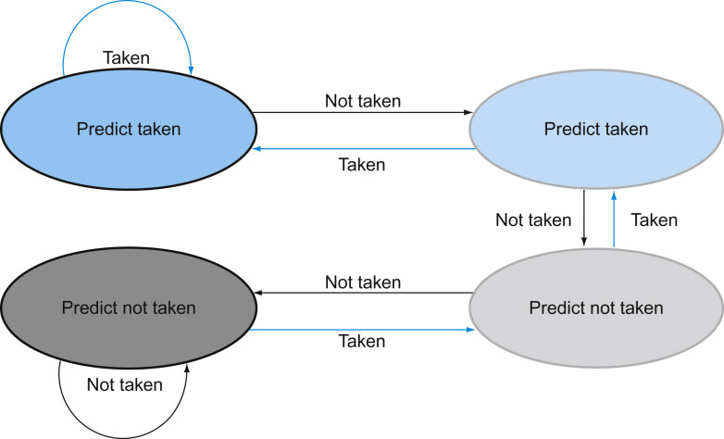
2 bit branch prediction
In order to solve this performance issue with the single bit prediction scheme, we use a two bit predictor
A two bit predictor strongly favours the history of the branches - the prediction has to be wrong twice before the prediction is changed.
The operation of the prediction changing procedure can be explained via the following state diagram
Exercise: Check whether the performance issue with the loop discussed in the previous slide is solved with this scheme for changing predictions.
Reading assignment: Find out other optimizations which can be done for branching - branch target caches, reducing the number of instructions flushed when a branch is taken.

Slide 7
Exceptions and Interrupts
These are unexpected events that change the control flow
Unlike jumps and conditional branches occur at specific times in the program
Interrupts
Caused due to some external (outside the processor) event
From an external I/O controller signalling that some input has occurred
Exceptions
Caused due to internal events
Unknown opcode - how can this happen?
Arithmetic overflow
System call
How to handle exceptions or interrupts
Logic to detect exceptions or interrupts
Save state of the program counter - might need to return to this or use for debugging
Exception Program Counter
Store what kind of exception or interrupt has occurred (Cause register)
Jump to an exception handler (usually at a fixed address!)
Inside the exception handler use the Cause register to find out what caused the exception and do an appropriate action

Slide 8
Handling Exceptions and Interrupts
How to handle exceptions or interrupts
Logic to detect exceptions or interrupts
Save state of the program counter - might need to return to this or use for debugging
Exception Program Counter
Depending upon the kind of exception or interrupt jump to different exception handlers
If the handler addresses are chosen according to the type of exception or interrupt: Vectored interrupts
Exercise: How to handle arithmetic overflow and invalid opcode exceptions in our single cycle processor?

Slide 9
Pipelined implemenation - how to handle exceptions?
Treat it as a control hazard
Suppose we do
add r1, r2, r1
and there is an arithmetic overflow.
Exception is detected by the control logic
Additional instructions which were fetched should be flushed
Jump to the handler
Actually sequence is
Exception is detected by the control unit
Prevent writing back to r1
Complete previous instructions in the pipeline
Flush current and subsequent instructions
Update Cause and EPC registers
Jump to the handler

Slide 10
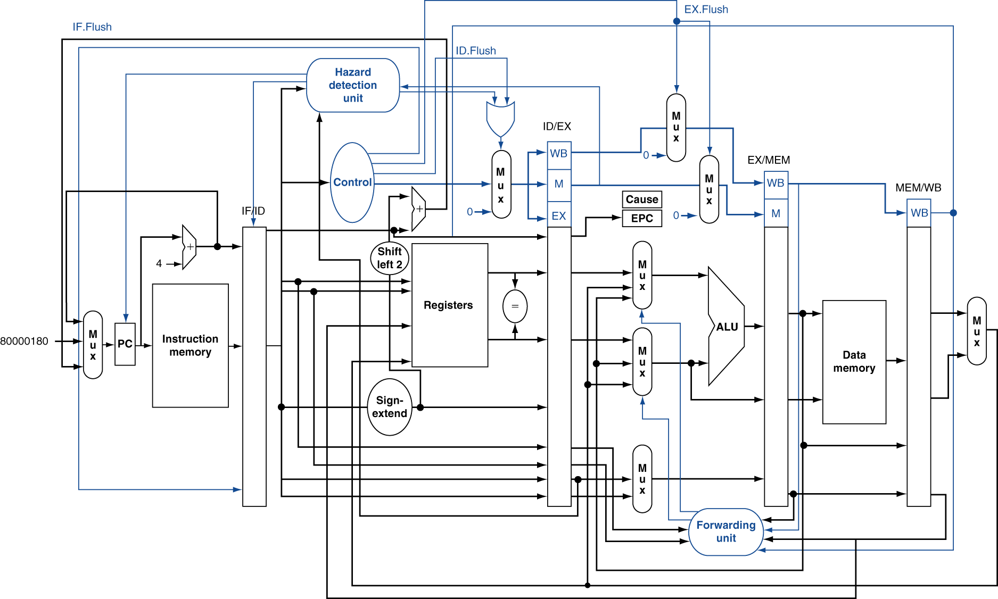
Pipelined implemenation - how to handle exceptions?

Slide 11
Multiple exceptions in the pipeline
Since there are multiple instructions in the pipeline, multiple exceptions can happen
Example?
Invalid opcode during IF, arithmetic overflow during EX
Some protocol to handle this
Usually the earliest exception (which one?) is handled

Slide 12
Summary of Chapter 4
Design of a simple processor
Finite state machines, Control signals from hardcoded bit patterns, Clocks, Instruction Parallelism
Single cycle data path design
Arithmetic instructions
Memory instructions
Conditional and Unconditional branches
Circuit components in the data path
Multi cycle data path design
Pipelined implementation
The concept of pipelining
Formula for speed up due to pipelining
Hazards in pipelining
Structural
Data
Control
Pipelining architectures - with forwarding and hazard detection
Branch prediction
Exceptions and interrupts
Read Chapter 4 of Hennessy and Patterson

