Slide 1

Department of Avionics,
Indian Institute of Space Science and Technology
AV224 - Computer Organization & Operating Systems
Instructor: Vineeth B. S. (vineethbs@iist.ac.in)
Lecture 39
12/04/2017
Some of the figures in these lecture slides are taken from Silberschatz et al.'s
Operating System Concepts and the xv6 book.

Slide 2
Review ...
The role of memory management
Programmer's view of memory
Multiprocessing
Execution time address binding
Memory protection
Logical and Physical address space
Memory management methods
Contiguous memory allocation
Segmentation
Swapping
Paging
Today's class
Segmented paging
Virtual memory

Slide 3


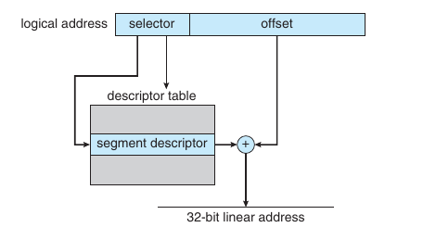
Segmentation and Paging (e.g. in IA-32)
Segments themselves can be paged
Need two address mappings!
In IA-32 each segment could be as large as 4 GB
And there could be 16K segments per process
16K segments = 8K private and 8K shared
8K private - LDT (local descriptor table)
8K shared - GDT (global descriptor table)
The logical address put out by the CPU is a (segment (actually selector), offset) from which a linear address is computed.
selector:

Slide 4
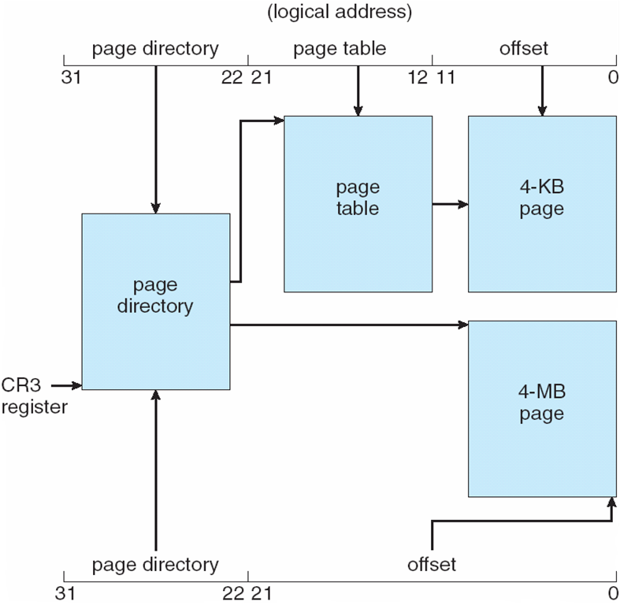

Segmentation and Paging (e.g. in IA-32)
The 32 bit linear address is mapped into a physical address using paging
The architecture allows for hierarchical paging or a simple page table - using two different page sizes
linear address:

Slide 5
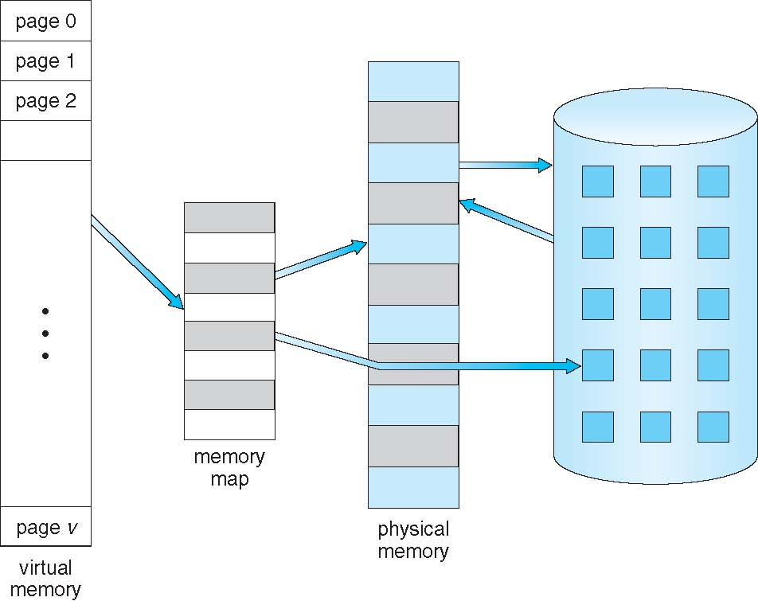
Virtual memory
Large memory to be presented to the programmer
Recall
Swapping - whole processes are swapped in and out
Paging - logical address space is divided into frames or pages
Swapping can be done on a page/frame wise basis rather than on a process-wise basis
Some parts of a program are rarely used - entire program need not be in memory at once
Error handling code
Data type conversion code
Execute partly loaded programs - with provision to load parts if needed
More processes can be run concurrently without the overhead of complete process swap in and out
Virtual memory
mapping from virtual address space (logical address space) to physical
Recall page faults and valid/invalid bits

Slide 6
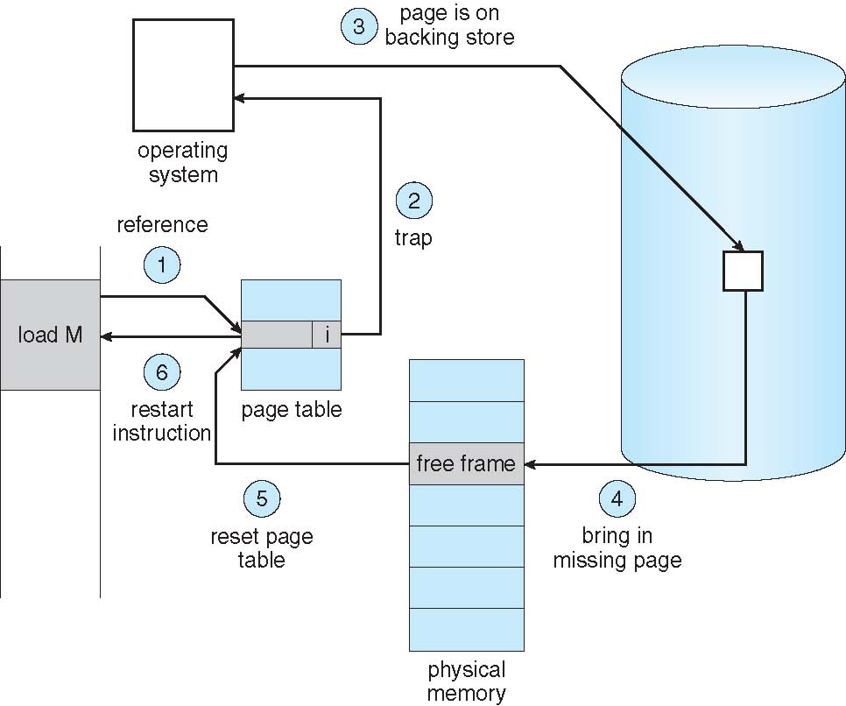
Page faults and page replacement
Page replacement: LRU

Slide 7
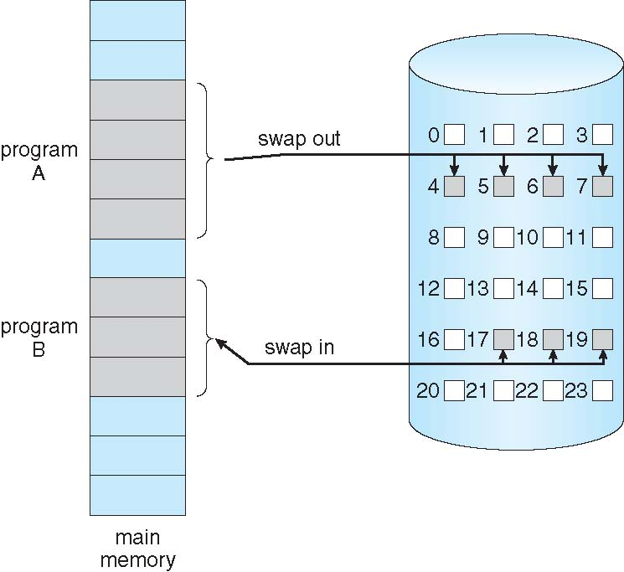
Demand paging
Bring a page to memory only when needed - done using a lazy swapper - a swapper dealing with pages is called a pager
A simple method is that a process is started with no pages in memory
Needed pages are brought into memory via page faults

Slide 8
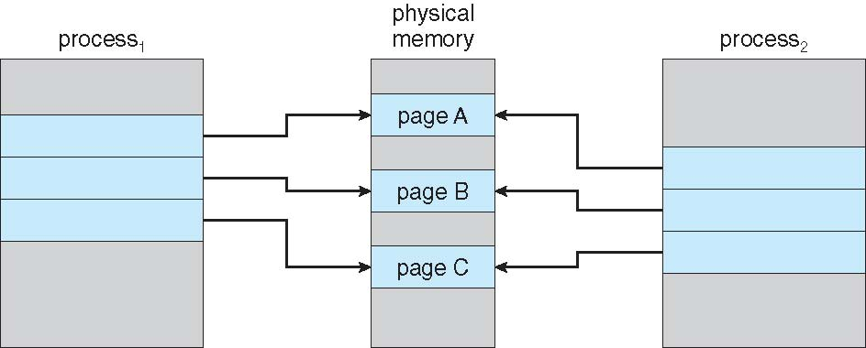
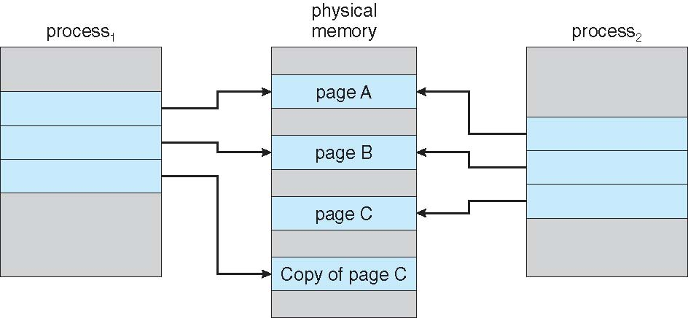
Other aspects of paging: Shared pages, Copy on write
Recall the write back scheme we studied in virtual memory
Paging allows for sharing pages between a parent and child (created using fork)
If the processes change pages, then copies of those pages which have been changed are made

Slide 9
Other aspects of paging: Page allocation to processes
Demand paging
Start with all pages being free
Bring pages in as page faults are generated
Other options are possible
Allocate a minimum number of pages to a process
Equal sharing = m pages for n processes
Proportional sharing = size of the process
Global and local page replacement

Slide 10
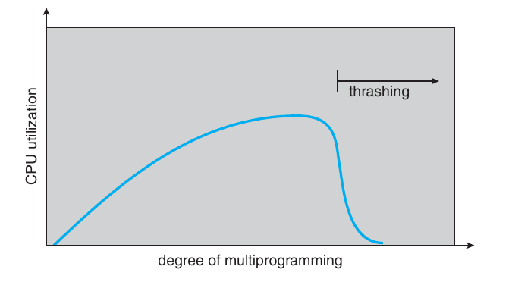
Other aspects of paging: Thrashing
A process is thrashing if it is spending a larger amount of time generating page faults compared to its execution time
A scenario in which this can happen
Suppose the CPU utilization is low
Some more processes are run (by the long term scheduler which brings in more processes)
These processes may page fault and replace pages of other processes
But the other processes also need these pages (almost all processes have the same last used count)
CPU utilization decreases since pager is working
The long term scheduler brings in more jobs ...

Slide 11
Summary
Role of memory managment
Memory management techniques
Contiguous memory allocation
Segmentation
Swapping
Paging
Segmentation and Paging (eg. IA-32)
Virtual memory
Reference: Silberschatz et al. (Topics from Ch. 8 and Ch. 9)

