Slide 1

Department of Avionics,
Indian Institute of Space Science and Technology
AV224 - Computer Organization & Operating Systems
Instructor: Vineeth B. S. (vineethbs@iist.ac.in)
Lecture 40
13/04/2017
Some of the figures in these lecture slides are taken from Silberschatz et al.'s
Operating System Concepts and the xv6 book.

Slide 2
Review ...
Processes
Multiprocessing
Interprocess communication
Synchronization
Scheduling
Memory managment
Segmentation
Paging
Virtual memory
Today's class
Storage
Scheduling of disk activities by the operating system

Slide 3

Overview
Operating System
File system
Logical blocks
Storage device drivers
Harddisk
Harddisk

Slide 4
Storage devices
Storage devices/drives are attached to computer via I/O bus
A lot of variety in the bus protocols EIDE, ATA, SATA, USB, Fibre Channel, SCSI
Recall our discussion on motherboards
A input/output or host controller uses the I/O bus to interact with the controller for the disk drive
Disk drives are addressed as one dimensional arrays of logical blocks, where the logical block is the smallest unit of transfer
Low-level formatting creates logical blocks on physical media
The 1-dimensional array of logical blocks is mapped into the sectors of the disk sequentially
Sector 0 is the first sector of the first track on the outermost cylinder
Mapping proceeds in order through that track, then the rest of the tracks in that cylinder, and then through the rest of the cylinders from outermost to innermost

Slide 5
Disk scheduling
Drive attached to computer via I/O bus
The operating system is responsible for using storage efficiently — for the disk drives, this means having a fast access time and disk bandwidth
Minimize seek time, rotational latency which are components of the access time
Seek time is proportional to seek distance
Disk bandwidth is the total number of bytes transferred, divided by the total time between the first request for service and the completion of the last transfer
There are many sources of disk I/O request: OS, System processes, Users processes
I/O request includes input or output mode, logical disk address, memory address, number of logical blocks or sectors to transfer
OS maintains queue of requests, per disk or device
Idle disk can immediately work on I/O request, busy disk means work must queue
Drive controllers have to schedule the I/O requests so as to minimize access time, increase disk bandwidth

Slide 6
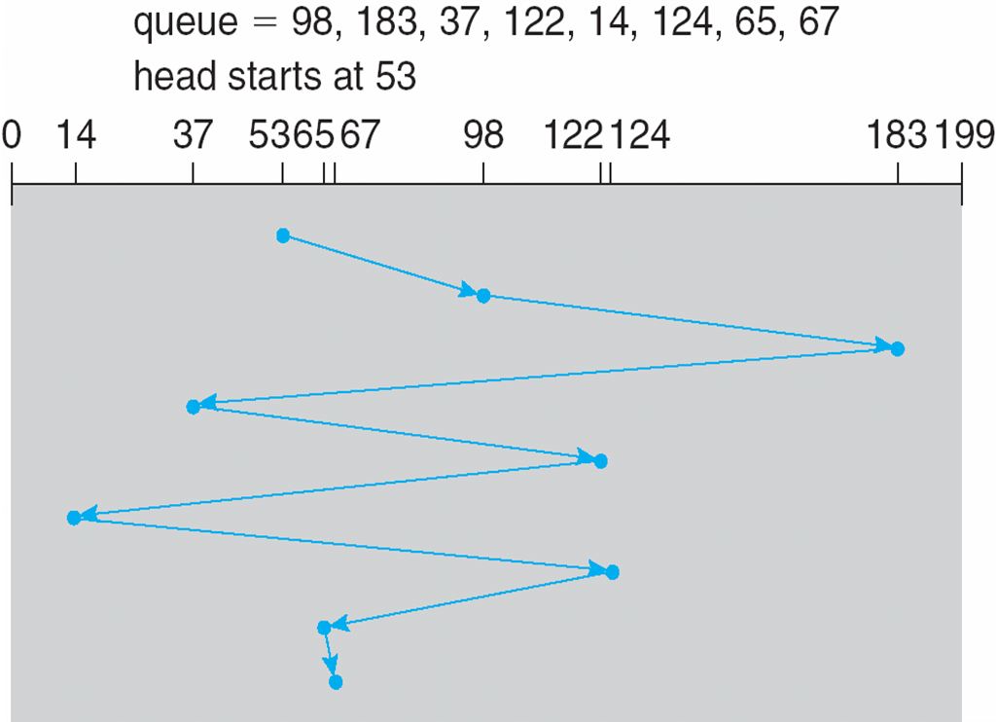
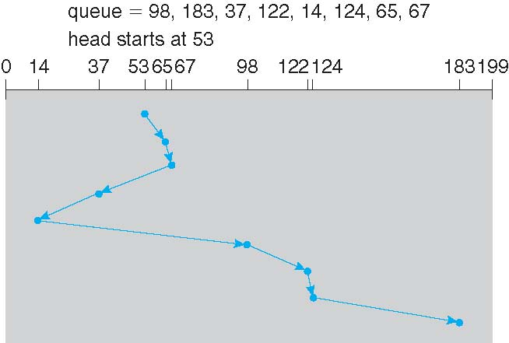
FCFS disk scheduling
We illustrate scheduling algorithms with a request queue
98, 183, 37, 122, 14, 124, 65, 67
Head pointer 53
First requests are served first
Total head movement is 640 cylinders
SSTF disk scheduling
Shortest Seek Time First selects the request with the minimum seek time from the current head position
SSTF scheduling is a form of SJF scheduling; may cause starvation of some requests
Total head movement is 236 cylinders

Slide 7
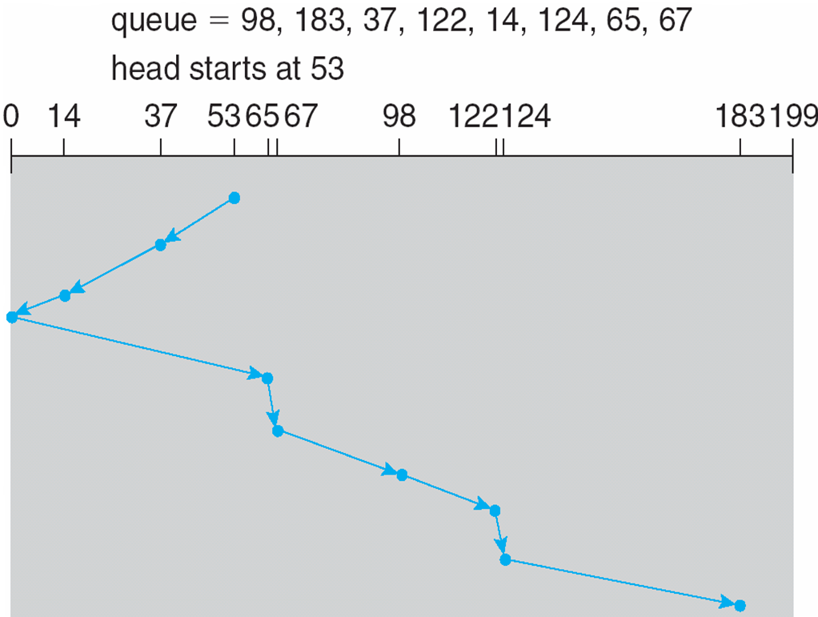
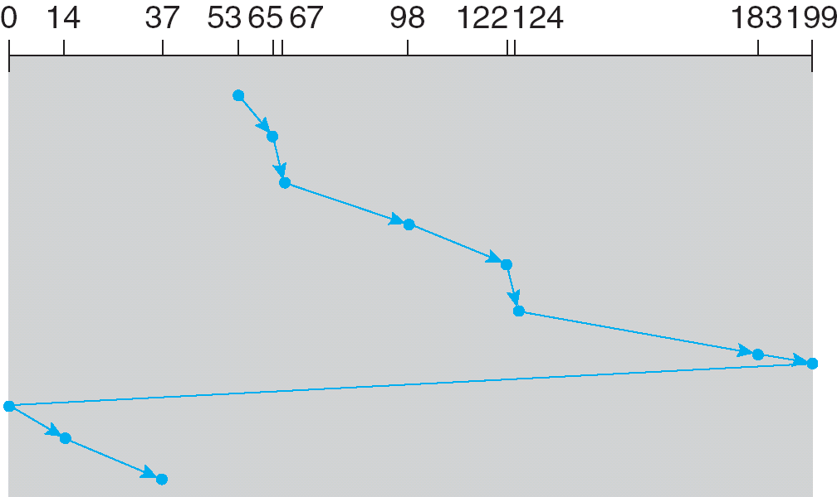
SCAN (elevator) disk scheduling
The disk arm starts at one end of the disk, and moves toward the other end, servicing requests until it gets to the other end of the disk, where the head movement is reversed and servicing continues.
SCAN algorithm (elevator algorithm)
Illustration shows total head movement of 208 cylinders
But note that if requests are uniformly dense, largest density at other end of disk and those wait the longest
C-SCAN disk scheduling
Provides a more uniform wait time than SCAN
The head moves from one end of the disk to the other, servicing requests as it goes
When it reaches the other end, however, it immediately returns to the beginning of the disk, without servicing any requests on the return trip
Treats the cylinders as a circular list that wraps around from the last cylinder to the first one

Slide 8
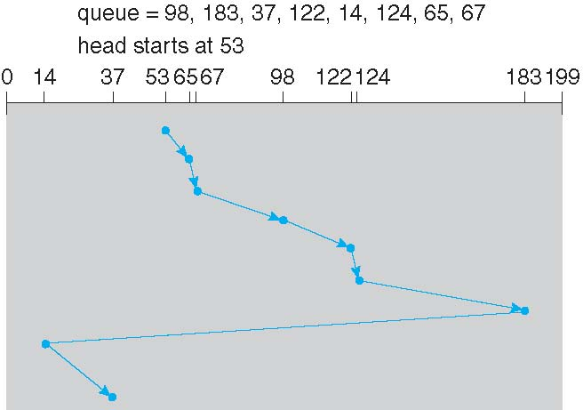
LOOK and C-LOOK disk scheduling
Arm only goes as far as the last request in each direction, then reverses direction immediately, without first going all the way to the end of the disk

Slide 9
Choice of a disk scheduling algorithm
SSTF is common
SCAN and C-SCAN perform better for systems that place a heavy load on the disk
Less starvation
Performance depends on the number and types of requests
Computation required for finding the optimal sequence means that usually a simple algorithm is used
Requests for disk service can be influenced by the file-allocation method
And metadata layout
Either SSTF or C-LOOK is a reasonable choice for the default algorithm

Slide 10
Disk management done by the operating system
Disk formatting
Low-level formatting, or physical formatting — Dividing a disk into sectors that the disk controller can read and write
Each sector can hold header information, plus data, plus error correction code (ECC). Usually 512 bytes of data but can be selectable
To use a disk to hold files, the operating system still needs to record its own data structures on the disk
Partition the disk into one or more groups of cylinders, each treated as a logical disk
Logical formatting or “making a file system”
To increase efficiency most file systems group blocks into clusters
Disk I/O done in blocks, File I/O done in clusters
Operating systems also allow raw disk access for some applications
Booting from the disk
Boot block initializes system
A small loader is stored in ROM, which loads in code from the first sector
Bootstrap loader program stored in boot blocks of boot partition (multiple levels of loading might happen)
Bad blocks
Methods such as sector sparing used to handle bad blocks

Slide 11
Summary
Storage
Disk managment
Disk schedulers
Reference: Silberschatz et al. (Topics from Ch. 10)

