Slide 1

Department of Avionics,
Indian Institute of Space Science and Technology
AV224 - Computer Organization & Operating Systems
Instructor: Vineeth B. S. (vineethbs@iist.ac.in)
Lecture 41
17/04/2017
Some of the figures in these lecture slides are taken from Silberschatz et al.'s
Operating System Concepts and the xv6 book.

Slide 2

Review
Storage
Scheduling of disk activities by the operating system
Today's class
Files and directories
Overview of requirements
File systems
Major features in all implementations
Operating System
File system
Logical blocks
Storage device drivers
Harddisk
Harddisk

Slide 3
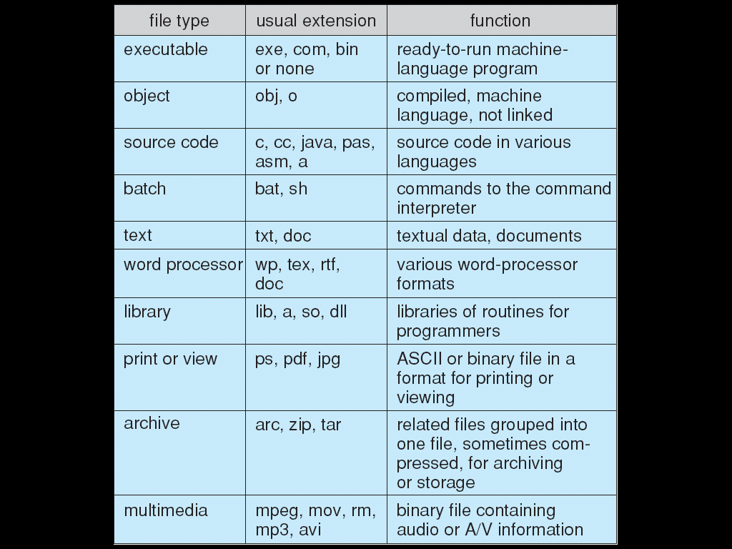
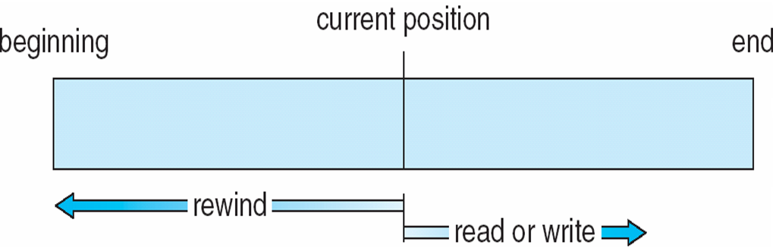
What is a file?
Sequence of bytes or words
Contiguous address space in the file
Different types
Simple record structure
Complex types
Programs can simulate the above types using the logical address space + additional control data
OS support is usually limited
Attributes
Name, Identifier, Type, Location
Size, Protection, Time, date, and user identification
Operations
Create, Write, Read, Delete
Reposition with a file
Truncate
System calls for implementing these operations
Types of file access
Sequential access - read next, write next, reset
Direct access - read n, write n, move to n
Indexed access

Slide 4
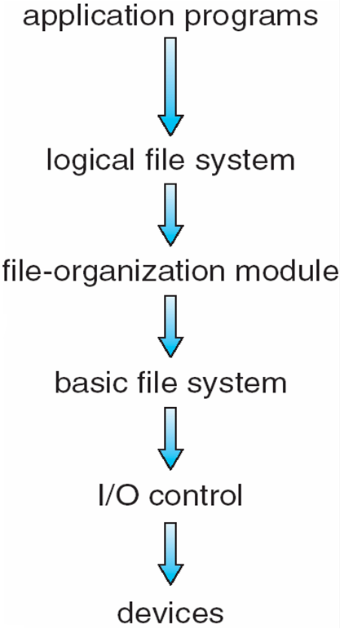
File systems
Device drivers manage I/O devices at the I/O control layer
Given commands like “read drive1, cylinder 72, track 2, sector 10, into memory location 1060” outputs low-level hardware specific commands to hardware controller
Basic file system given command like “retrieve block 123” translates to device driver
Also manages memory buffers and caches (allocation, freeing, replacement)
Buffers hold data in transit
Caches hold frequently used data
File organization module understands files, logical address, and physical blocks
Translates logical block # to physical block #
Manages free space, disk allocation
Logical file system manages metadata information
Translates file name into file number, file handle, location by maintaining file control blocks
Directory management
Protection

Slide 5
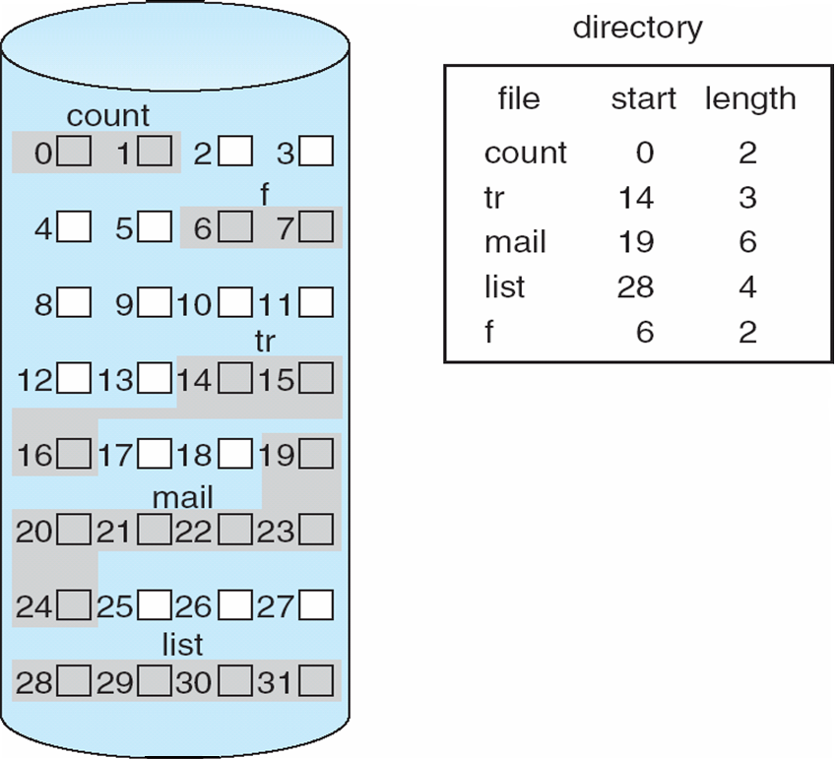
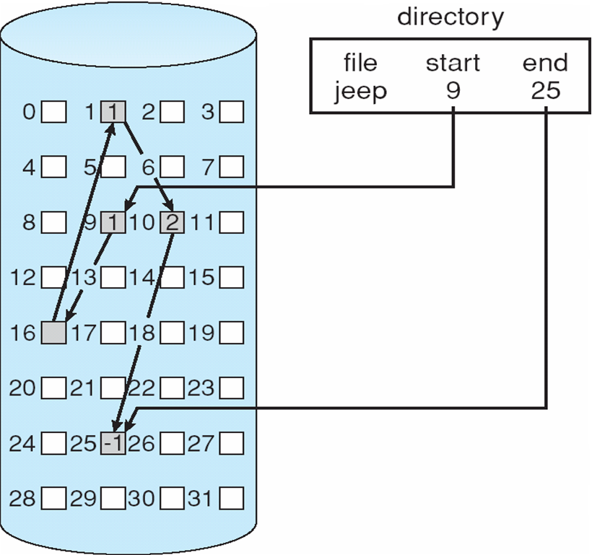
Allocation of disk blocks
Contiguous allocation
Each file is allocated a contiguous list of blocks
Starting location and length of file is needed
External fragmentation
Extent based allocation
An extent is a contiguous block of disks
Extents are allocated for file allocation
A file consists of one or more extents
Linked allocation
Linked list of blocks
File ends at nil pointer
No external fragmentation
Each block contains pointer to next block

Slide 6
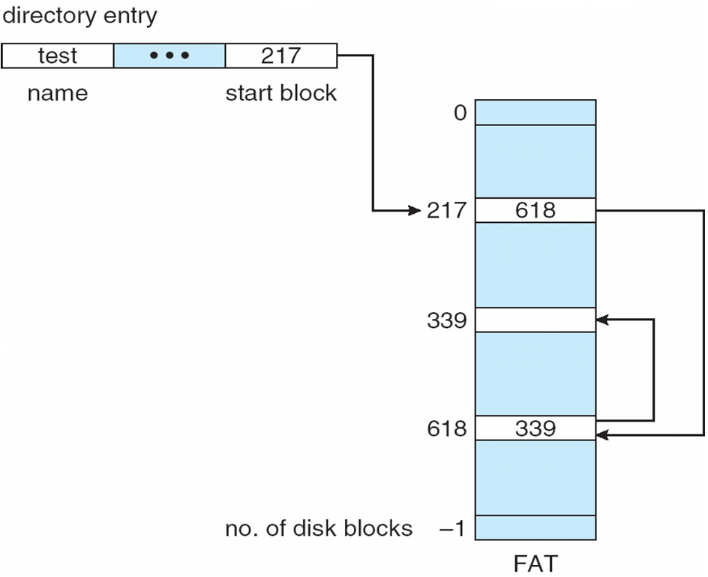
Allocation of disk blocks - Linked allocation
Linked allocation
Linked list of blocks
File ends at nil pointer
No external fragmentation
Each block contains pointer to next block
File allocation table is used to keep track of all files
Example: FAT file system

Slide 7
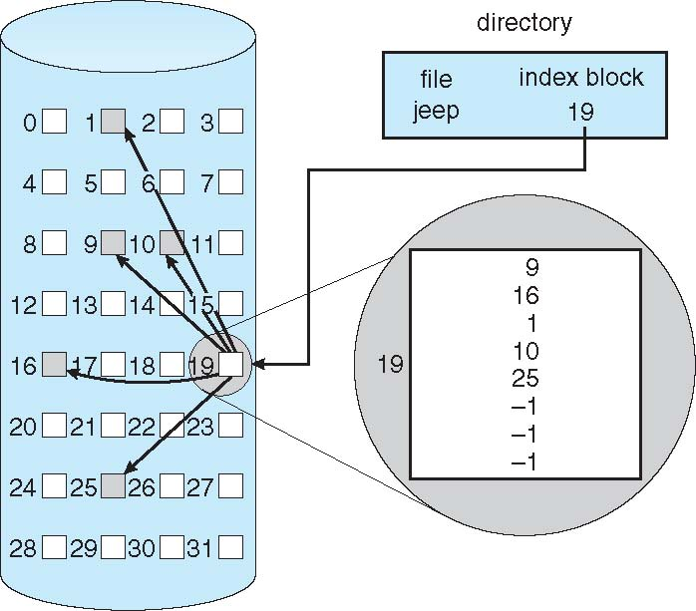
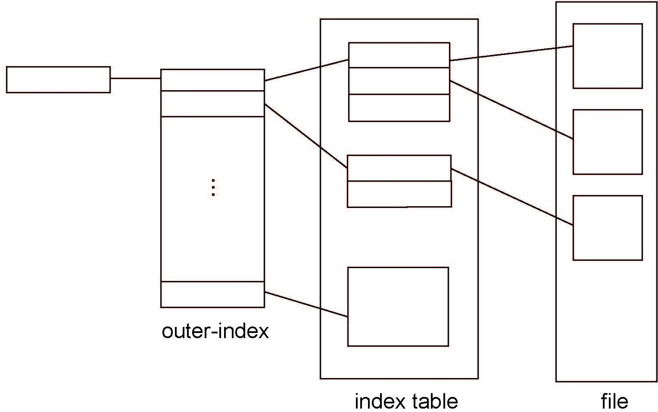
Allocation of disk blocks - indexed allocation
Indexed allocation
Each file has a list of indices to the blocks which make up that file
Random access into the file is possible
Size of the index table limits the size of the file
Hierarchical index table

Slide 8
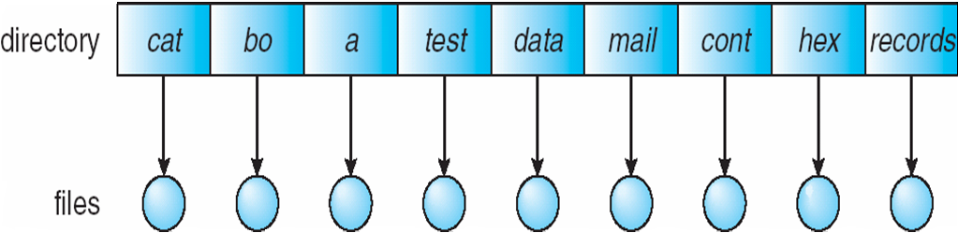
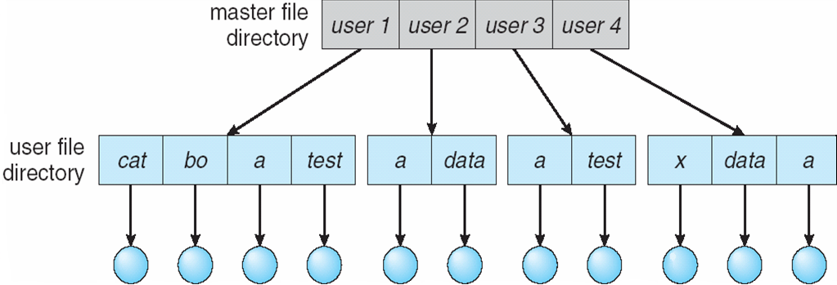
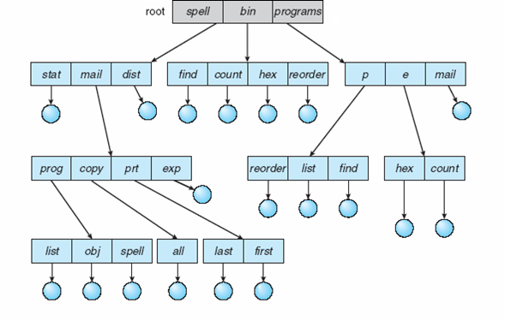
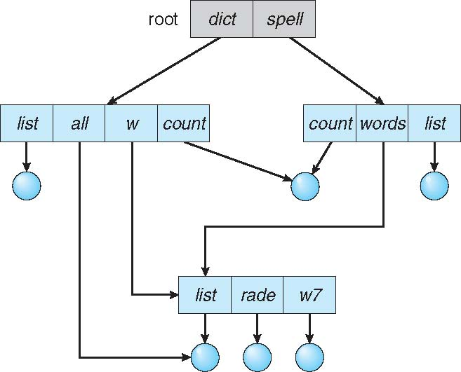
What is a directory?
Contains information about a list of files (or directories)
Operations on a directory
Search for a file
Create a file
Delete a file
List a directory
Rename a file
Traverse the file system
Directory organization
Single level - single user
Two level - multiple user
Tree
Acyclic graph
Shared directories
Links

Slide 9
Implementation of directory structure
Linear list of file names with pointer to the data blocks
Linear search time
Hash Table – linear list with hash data structure
Decreases directory search time
Collisions – situations where two file names hash to the same location

Slide 10
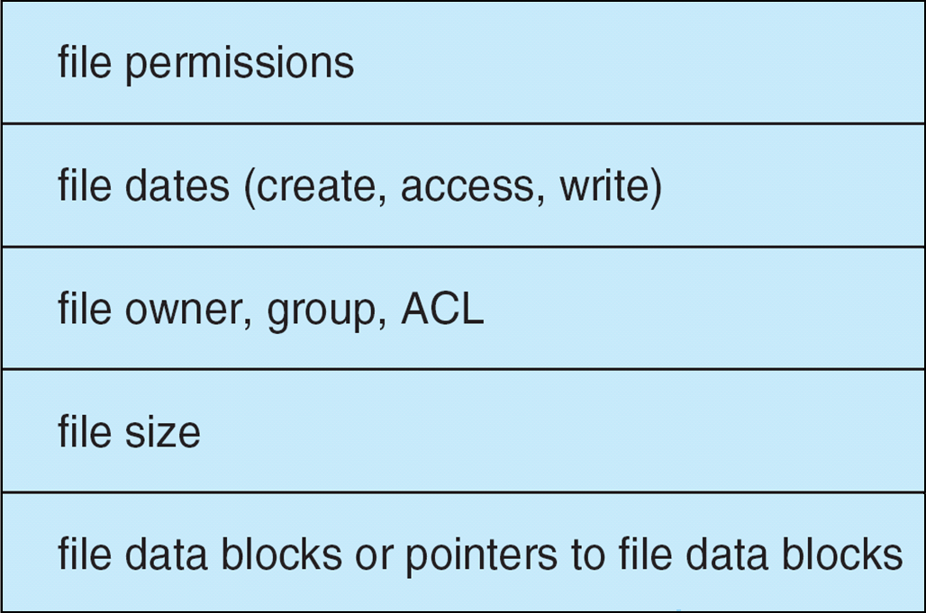
General observations about implementation of functionality
On-disk and in-memory data structures are used to implement the functionality
Disks contain
Boot control block
For booting operating systems
Super block or Master file table
Contains information like total number of blocks, block size, free block pointers
File control block - see figure
In memory structures
Example - Open file table - tracks open files
File pointer: pointer to last read/write location, per process that has the file open
File-open count: counter of number of times a file is open – to allow removal of data from open-file table when last processes closes it
Disk location of the file: cache of data access information
Access rights: per-process access mode information
Open returns a file handle for subsequent use

Slide 11
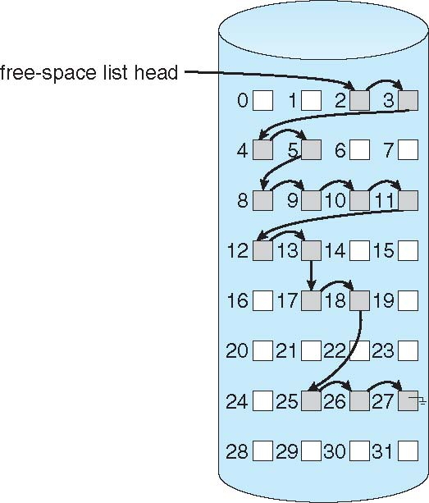
Free-space management
0
1
2
n - 1
File system maintains free-space list to track available blocks/clusters
Bit vector or bit map (n blocks)
Linked list of free blocks
Extensions ...
Grouping
Modify linked list to store address of next n-1 free blocks in first free block, plus a pointer to next block that contains free-block-pointers
Counting
Because space is frequently contiguously used and freed, with contiguous-allocation allocation, extents, or clustering
Keep address of first free block and count of following free blocks
Free space list then has entries containing addresses and counts
…
1 ⇒ block[i] free
0 ⇒block[i] occupied
bit[i] =


Slide 12
Summary
Storage
Disk managment
Disk schedulers
File Systems
Files
File blocks and allocation
Directories
Implementing directories
Free space managment
Reference: Silberschatz et al. (Topics from Ch. 11 and Ch. 12)

