Slide 1

Department of Avionics,
Indian Institute of Space Science and Technology
AV224 - Computer Organization & Operating Systems
Instructor: Vineeth B. S. (vineethbs@iist.ac.in)
Lecture 42
18/04/2017
End of Course

Slide 2

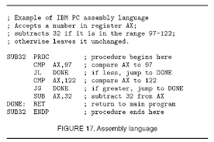


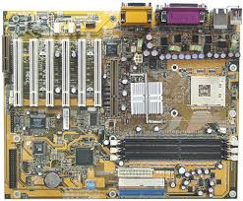
Where we started: Building abstractions for our computing needs
A standard interface to use the operating system (e.g. POSIX)
Operating Systems
A standard architecture to use the components (e.g. x86 architecture)

Slide 3

Run multiple programs, protect programs from each other, allow programs to communicate, share constrained resources
Achieved using abstractions of processes/threads, virtual memory, file systems
These abstractions are built up using layered architectures, which use the most simple functionality at the lower layers and then successively build up complexity
Interface to the hardware
Abstracts the complexity of actually execution into a set of instructions
ISA (x86)

Slide 4
Syllabus covered
CPU: Characteristics of CISC and RISC processors ‐ Performance of a processing unit
Memory: Memory hierarchy ‐ Main memory unit ‐ Internal organization of a memory chip ‐Organization of a main memory unit ‐ Error correction memories ‐ Interleaved memory units ‐Cache memory unit ‐ Concept of cache memory ‐ Mapping functions ‐ organization of a cache memory unit ‐ Fetch and Write mechanisms ‐ Memory management unit
Concept of virtual memory ‐ Address translation ‐ hardware support for memory management.
Input / Output subsystem: Access of I/O devices ‐ I/O ports. ‐ I/O control mechanisms ‐ Program controlled I/O‐ Interrupt controlled I/O ‐ DMA controlled I/O ‐ I/O interfaces ‐ System buses.
Peripherals: Terminals ‐ Video displays ‐ Magnetic storage disks ‐ magnetic tapes ‐ CD ROMs.
High‐ Performance processors: Instruction pipe lining ‐ Pipe line ‐ Hazards ‐ Super scalar processors ‐Performance considerations. Multi processor systems: Shared memory systems ‐ Interconnection networks ‐ Caches in multi processor systems.
Operating systems - layered architecture; basic concepts
Interrupt architecture, system calls
Process and threads; synchronization and protection issues;
Scheduling; memory management including virtual memory management including virtual memory and paging techniques; i/o architecture and device management; file systems;distributed file systems
Self study component
Case studies - xv6 project, written project
Assignments

Slide 5
Your Final Exam
Syllabus
Whatever that was covered during the semester
Mark distribution
20% of marks for Computer Organization
80 % of marks for Operating Systems
Please do all assignments on your own before the final exam

Slide 6
Reminder:
Written project report deadline is 30th April
xv6 project deadline is 15th May
Regularly check the course webpage for any updates.
Thanks !!
Best of luck for your final exams!
Have a good summer vacation!

