Slide 1

Department of Avionics,
Indian Institute of Space Science and Technology
AV224 - Computer Organization & Operating Systems
Instructor: Vineeth B. S. (vineethbs@iist.ac.in)
Lecture 37
10/04/2017
Some of the figures in these lecture slides are taken from Silberschatz et al.'s
Operating System Concepts and the xv6 book.

Slide 2
Review ...
Process scheduling
Short term schedulers
Performance metrics
Real time schedulers
Little's law
Today's class
The role of memory management
Address binding
Logical and Physical address space
Memory protection
Memory management methods
Continguous memory allocation
Paging
Segmentation

Slide 3
The role of memory management
Services offered by the operating system
processes (threads), multiprocessing (multithreading)
communication and synchronization between processes
Programmer's view of memory
Logical addresses
Segments/Modules of code
Binding of addresses
Our view of memory - memory is a black box that reads addresses off from an address bus and reads or writes data from memory to a data bus or from data bus to memory respectively.

Slide 4
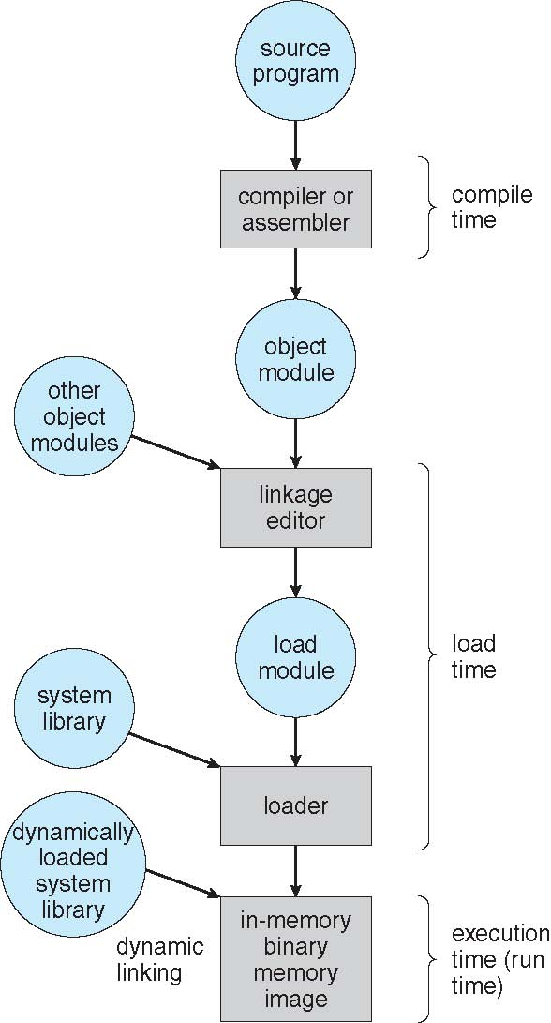
Background about address binding
At several stages during a program's lifetime there is binding of variable names
Binding is a mapping from one address space to another
Compile time - If memory location known a priori, absolute code can be generated; must recompile code if starting location changes
Load time: Must generate relocatable code if memory location is not known at compile time
Execution time: Binding delayed until run time if the process can be moved during its execution from one memory segment to another
Need hardware support for address maps (e.g., base and limit registers)

Slide 5
Logical and Physical addresses
Logical address is generated by the CPU
Physical address is the address seen by the memory unit
Logical and physical addresses are the same in compile time or load time binding
Logical and physical addresses could be different in execution time binding
Set of logical and physical addresses - the address space

Slide 6
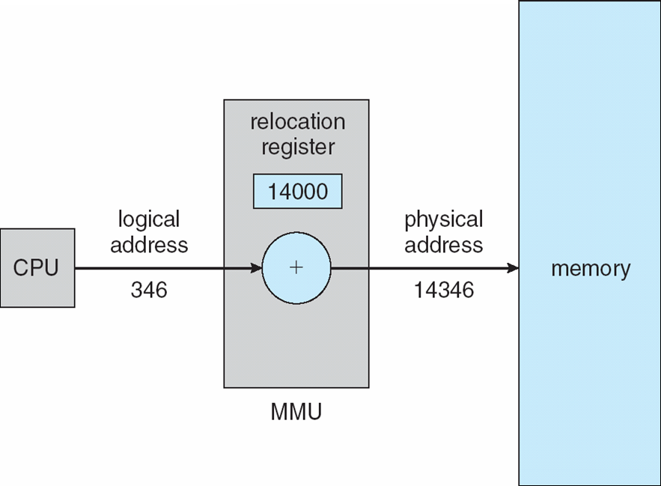
Memory management unit
Hardware unit used in logical to physical address mapping
Software control by the operating system
An example of a mapping - using relocation registers

Slide 7
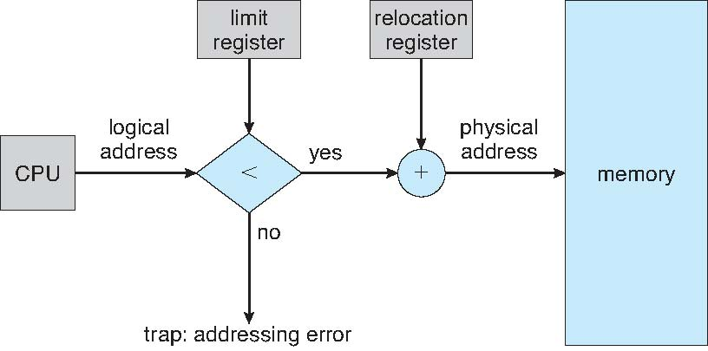
Contiguous memory allocation ...
An early memory management technique
RAM should contain operating system as well as other processes
Partition the main memory
Operating system along with ISRs in low memory area
Processes allocated contiguous memory areas
Relocation registers are used to have logical to physical addresses
Relocation registers are modified by the operating system during context switch
Memory protection done using a limit register (base and limit registers sometimes used)

Slide 8
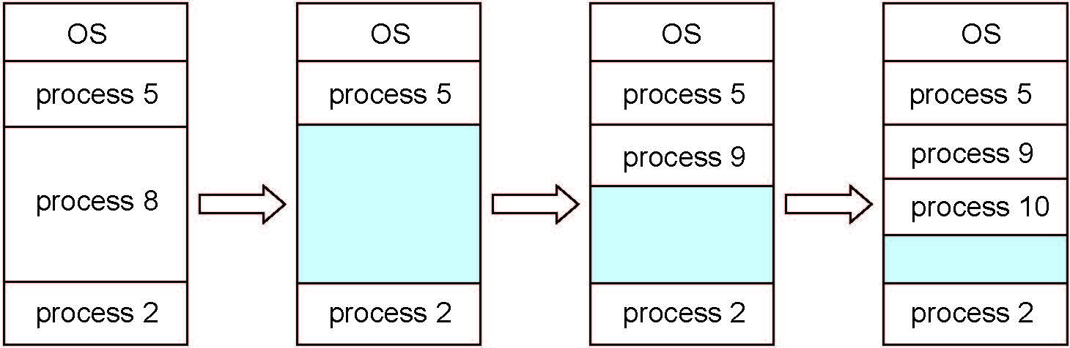
... Contiguous memory allocation
The number of concurrent processes limited by the number of partitions
Variable sized partitions used for higher efficiency
Hole is a contiguous part of memory which is free for allocation
A new process is allocated memory from a hole which is large enough to fit the process
An exiting process frees its memory leading to a hole
Adjacent holes would be combined to a larger holes
Operating system maintains information about allocated partitions and holes
Allocation methods
First fit, Best fit
An issue: Fragmentation
Total memory > size for process - but not contiguous

Slide 9
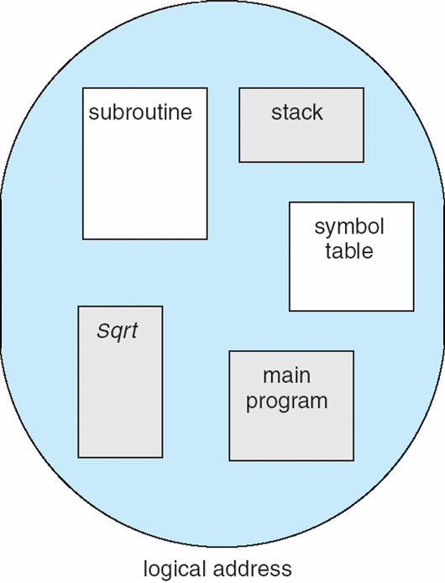
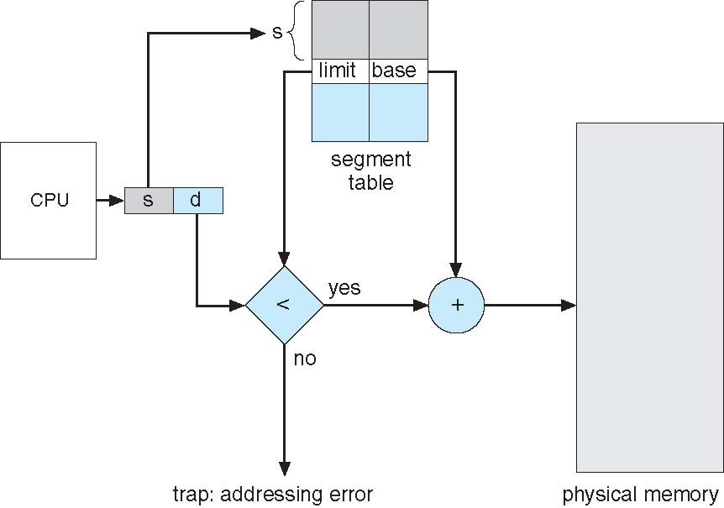
Segmentation
1
User view of memory
The logical address space is organized into segments
Logical address is <segment number, offset>
Segment table
maps <segment number, offset> to physical address
base and limit entries
Segment table base register - segment table in memory for a process
Segment table length register - number of segments for a process
Protection bits - protection at the segment level
Note that each segment is still allocated in a contiguous section of memory - fragmentation would still occur.
4
1
2
3
4
2
3
user space
physical memory space

Slide 10
Summary
Role of memory managment
Memory management techniques
Contiguous memory allocation
Paging
Segmentation
Segmentation and Paging
Reference: Silberschatz et al. (Topics from Ch. 8)

