Slide 1

Department of Avionics,
Indian Institute of Space Science and Technology
AV224 - Computer Organization & Operating Systems
Instructor: Vineeth B. S. (vineethbs@iist.ac.in)
Lecture 1
10/01/2017

Slide 2
Review ...
How "computer-geeky" are you?
Are you comfortable with C programming?
This is an important pre-requisite for this course
You have already done MA122 and MA231

Slide 3
Today's class ...
Course overview
Objectives of this course
Course content and plan
Course textbooks
Other material you can follow
Course webpage
What is required of you?
Attendance
Evaluation
Assignments
Class tests
Class participation
Exams

Slide 4
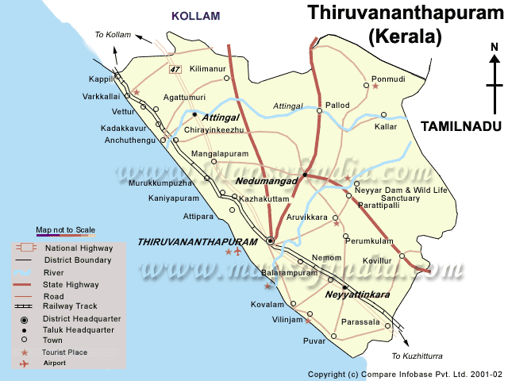

Building abstractions - OLA
Everyone knows about OLA/Uber
What do they do? How do they make money?
The usual procedure !
Get an auto/taxi
Goto the nearest junction
Ask/Argue with the driver to put the meter on
Initial bargaining about the fare
Hope/Pray to god that the driver is not taking me for a ride
Fare bargaining at the end of the trip
Try to get enough change to pay
The driver has no incentive to behave nicely (unless you are a locally known)

Slide 5
Building abstractions - OLA
Everyone knows about OLA/Uber
What do they do? How do they make money?
Users
OLA abstraction layer
Safety, SOS
Maps, Tracking
Driver Feedback
Personalization
Experience management
GPS (AGPS)
Taxis/Autos
Payment Portal
EWallet

Slide 6

What do we need?
We want to "declare" our needs
We want a genie to take our declarations and do things for us
For example
"I want coffee"
"I want to simulate this communication system for a SNR of 10 dB"
"I want to play a game of chess with my friend in Russia"
"I want to travel safetly, inexpensively, with no hassle, from Nedumangad to Kovalam"
Standard interface to the genie
Black Box (how the genie does it is not something we care about)

Slide 7
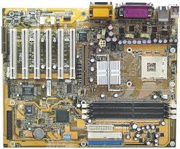

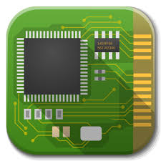
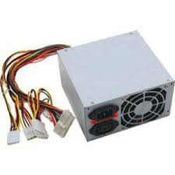
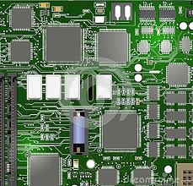
Building abstractions for our computing needs
We want to "declare" our computing needs
We want a genie ("programmer") to take our declarations and do things for us
A standard architecture to use the components (e.g. x86 architecture)
Computer Organization
The architecture should hide how the components are put together

Slide 8


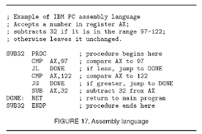

Building abstractions for our computing needs
A standard interface to use the operating system (e.g. POSIX)
Operating Systems
A standard architecture to use the components (e.g. x86 architecture)

Slide 9
Course overview
A standard interface to use the operating system (e.g. POSIX)
Operating Systems
A standard architecture to use the components (e.g. x86 architecture)
Computer Organization

Slide 10
Course syllabus
CPU: Characteristics of CISC and RISC processors ‐ Performance of a processing unit
Memory: Memory hierarchy ‐ Main memory unit ‐ Internal organization of a memory chip ‐Organization of a main memory unit ‐ Error correction memories ‐ Interleaved memory units ‐Cache memory unit ‐ Concept of cache memory ‐ Mapping functions ‐ organization of a cache memory unit ‐ Fetch and Write mechanisms ‐ Memory management unit
Concept of virtual memory ‐ Address translation ‐ hardware support for memory management.
Input / Output subsystem: Access of I/O devices ‐ I/O ports. ‐ I/O control mechanisms ‐ Program controlled I/O‐ Interrupt controlled I/O ‐ DMA controlled I/O ‐ I/O interfaces ‐ System buses.
Peripherals: Terminals ‐ Video displays ‐ Magnetic storage disks ‐ magnetic tapes ‐ CD ROMs. High‐ Performance processors: Instruction pipe lining ‐ Pipe line ‐ Hazards ‐ Super scalar processors ‐Performance considerations. Multi processor systems: Shared memory systems ‐ Interconnection networks ‐ Caches in multi processor systems.
Operating systems - layered architecture; basic concept
Interrupt architecture, system calls
Process and threads; synchronization and protection issues;
Scheduling; memory management including virtual memory management including virtual memory and paging techniques; i/o architecture and device management; file systems;distributed file systems

Slide 11
Course material
Textbooks & References
Hennessy and Patterson - Computer architecture - a quantitative approach
Hennessy and Patterson - Computer organization and design
Irv Englander - The architecture of computer hardware and system software
Tanenbaum - Operating systems: Design and implementations
Online courses
OCW 6.828 Operating Systems Engineering
IITD - S. Bansal - Operating Systems
IITD - S.R. Sarangi - Computer organization and architecture
IITM - C. Rebeiro - Operating Systems
Slides and Handouts
The Internet ...
Course webpage: http://vineethbs.github.io/2017_AV224/index.html

Slide 12
Course attendance and evaluation
Component | Marks
Mid Term I | 15
Mid Term II | 15
Final exam | 50
Class project | 20
Attendance - institute rules
Assignments - not required to submit these
Please conduct yourself in a professional manner in class
Give credit where it is due (when you do the assignments or the class project)

