Slide 1

Department of Avionics,
Indian Institute of Space Science and Technology
AV224 - Computer Organization & Operating Systems
Instructor: Vineeth B. S. (vineethbs@iist.ac.in)
Lecture 34
05/04/2017
Some of the figures in these lecture slides are taken from Silberschatz et al.'s
Operating System Concepts and the xv6 book.

Slide 2
Review ...
Race conditions
When several processes/threads access data concurrently and the outcome of the execution depends on the order of access
Critical sections and critical section problem
Solution to the critical section problem
Peterson's solution
Support for synchronization in hardware - test_and_set(), compare_and_swap()
Mutex locks
Semaphores
Deadlock examples for mutexes and semaphores
Classical problems in synchronization
Today's class
Deadlocks in more detail

Slide 3
Deadlock and starvation for semaphores
We looked at an example deadlock problem for mutexes
P1 acquires mutex A and then B, P2 acquires B and then A - deadlock!
An example with semaphores
Let S and Q be two semaphores initialized to 1
Starvation - indefinite waiting in the waiting queue for the semaphore
Priority inversion problem - a lower priority process holds a semaphore and blocks a higher priority process
P0 wait(S); wait(Q); ... signal(S); signal(Q): | P1 wait(Q); wait(S); ... signal(Q); signal(S)

Slide 4
A model for thinking about deadlocks and characterization of deadlocks
There are some resources in the system
There are m types of resources R₁, R₂, ..., R_{m}
There are W_{i} instances of the resource R_{i}
Procedure for using an instance of a resource: request → use → release
A deadlock can occur when (necessary conditions)
Only one process can hold a resource - mutual exclusion
A process holds a resource and then waits to get other resources held by other processes - hold and wait
A process has to voluntarily give up a resource - No pre-emption
P₁ wants a resource held by P₂, P₂ one by P₃, ... P_{n} one by P_{n+1}, and P_{n+1} one by P₁ - circular wait

Slide 5
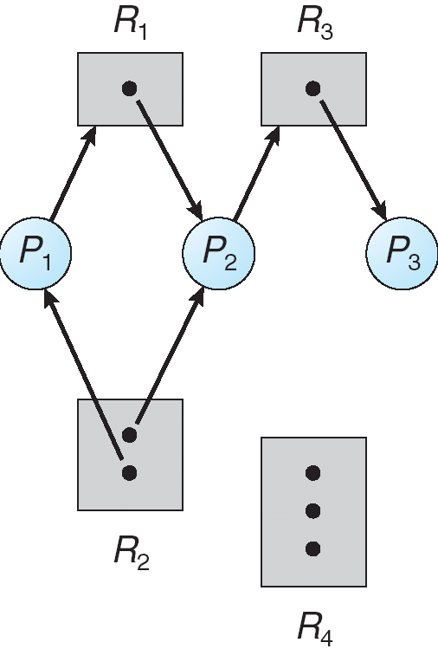
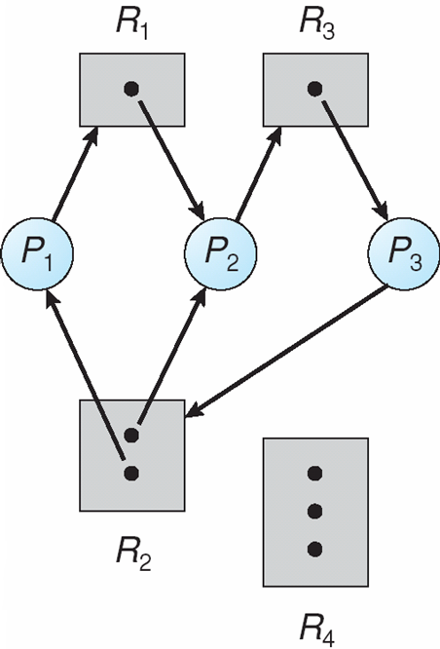
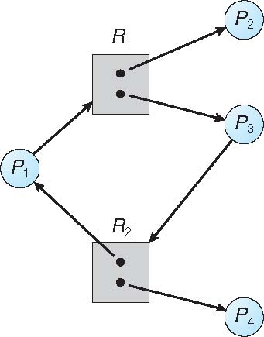
A graph representation to think about deadlocks
Resources R₁, R₂, ..., R_{m} and processes P₁, P₂, ... P_{n} are nodes in a graph
Request edge between P_{i} and R_{j} which is directed
Allocation edge between R_{j} and P_{i} which is directed
P_{i}
R_{j}
P_{i}
R_{j}
If a graph contains no cycles; then no deadlock
If cycles exist, then
If there is only one instance of a resource; then deadlock
If there are multiple instances; possible deadlock

Slide 6
How to handle deadlocks?
Prevent and avoid deadlocks - don't allow system to enter a deadlock state
Allow system to enter a deadlock - identify that system has entered deadlock and then recover
Ignore the problem - used by xv6 (and in fact other operating systems)
Deadlock prevention
Prevent ways/restrict ways in which requests can be made
Mutual exclusion
not needed for shareable resources like read only files
Hold and wait
processes should be allocated all its resources when the process starts
No Pre-emption
If a process holding some resources asks for other resources which are held by others
Release all currently holding resources - but these are put in a wait queue
Get all resources together
Circular wait
Lock order

Slide 7
How to handle deadlocks?
Deadlock avoidance
Make each process declare the maximum number of resource instances of each type that it needs
Define resource-allocation state
Number of available resource instances
Number of allocated resource instances
Maximum demands of processes
Concept of a safe state
A state in which deadlocks cannot occur
The system will be in a safe state if
There exists a set of processes P₁, P₂, ... , P_{n}
For each P_{i}, the resources that P_{i} can still request can be satisfied by currently available resources and resources being used by all P_{j}, for j < i
If P_{i} needs resources not immediately available it has to wait for P_{j}-s to release them
Once it obtains the resources then it uses all the resources and releases them
Once P_{i} has finished P_{i+1} can start

Slide 8
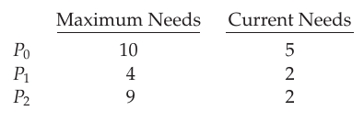
Deadlock avoidance - safe states
An example
12 harddisks, 3 processes
Their maximum needs and current needs are as shown
At current time, we are in a safe state
3 remaining
The allocation sequence P1, P0, P2 leads to a safe state
P1 can be allocated 2 and then returned (P0 and P2 waits)
4 + 1 = 5 remaining
P0 can get 5 and then returned
10 remaining
P2 can get 7 more

Slide 9
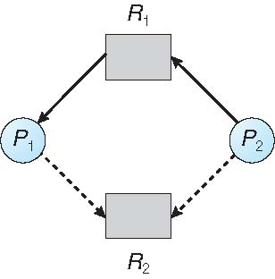
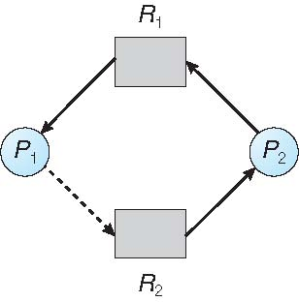
Avoidance algorithms
Single instance for every resource type - use the resource graph
Resource requests should be made apriori
A new type of edge in the resource graph - claim edge (Process may claim a resource)
The claim edge is converted to a request edge; request edge converted to an allocation/assignment edge
Once the process releases the resource the edge goes back to a claim edge
Suppose process P_{i} requests R_{j}
Request is granted only if converting request to assignment does not lead to cycles

Slide 10
Banker's algorithm
Multiple instances for every resource type
Conditions
Each process must claim maximum resource usage
A process may have to wait for a resource
When a process gets all resources it has to return it in a finite amount of time
n be the number of processes, m be the number of resources
Some variables required
Available: Vector of length m. If available[j] = k, there are k instances of resource type R_{j} available
Max: n x m matrix. If Max [i,j] = k, then process P_{i} may request at most k instances of resource type R_{j}
Allocation: n x m matrix. If Allocation[i,j] = k then P_{i} is currently allocated k instances of R_{j}
Need: n x m matrix. If Need[i,j] = k, then P_{i} may need k more instances of R_{j} to complete its task so that Need [i,j] = Max[i,j] – Allocation [i,j]
Rows of matrices are represented with the row index as subscript

Slide 11
Banker's algorithm
Safety algorithm
Let Work and Finish be vectors of length m and n, respectively. Initialize:
Work = Available
Finish [i] = false for i = 0, 1, …, n- 1
2. Find an i such that both:
(a) Finish [i] == false
(b) Need_{i} <= Work
If no such i exists, go to step 4
3. Work = Work + Allocation_{i} Finish[i] = true go to step 2
4. If Finish [i] == true for all i, then the system is in a safe state

Slide 12
Banker's algorithm
Resource request algorithm
Request_{i} = request vector for process P_{i}. If Request_{i} [j] = k then process P_{i} wants k instances of resource type R_{j}
1. If Request_{i} <= Need_{i} go to step 2. Otherwise, raise error condition, since process has exceeded its maximum claim
2. If Request_{i} <= Available, go to step 3. Otherwise P_{i} must wait, since resources are not available
3. Pretend to allocate requested resources to P_{i} by modifying the state as follows: Available = Available – Request_{i};
Allocation_{i} = Allocation_{i} + Request_{i};
Need_{i} = Need_{i} – Request_{i};
If safe the resources are allocated to P_{i}
If unsafe P_{i} must wait, and the old resource-allocation state is restored

Slide 13
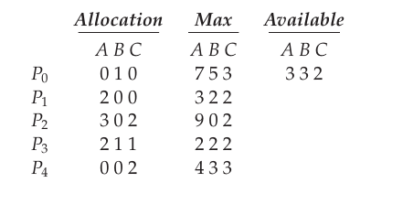
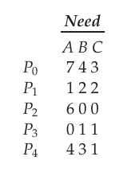
Example for Banker's algorithm
5 processes
3 resources = A (10), B (5), C (7)
At some time t0 we have the following state
The need matrix is
Do we have a safe system?
Prove that the sequence P1, P3, P4, P2, P0 leads to a safe state
P1 requests 1 A and 2 C
Assume that the allocation is done
Does the sequence P1, P3, P4, P0, P2 lead to a safe state?

Slide 14
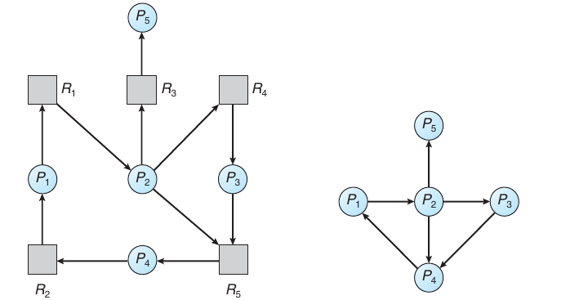
Deadlock detection
We need some algorithm that runs periodically to detect deadlocks
If there is a single instance of each resource then we make a wait-for graph from the resource graph and check for cycles
If a deadlock has been detected then
Abort processes (either all or sequentially until cycles are not there)

Slide 15
Summary
Deadlocks
Necessary conditions
Graph representation
Deadlock prevention
Deadlock avoidance
Banker's algorithm
Deadlock detection
Reference: Silberschatz et al. (Topics from Ch. 7)

